Slide 1

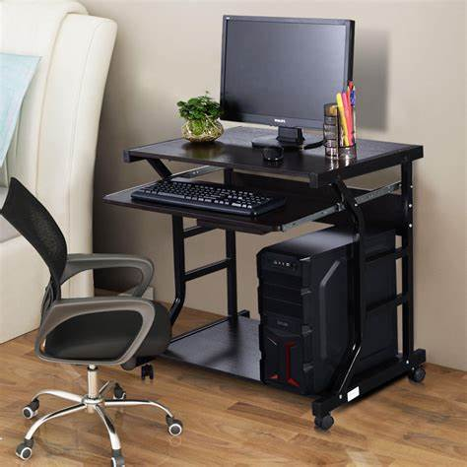
Why this product?
Generated from Quotation

Slide 2
Customer Need
• Seeking a high-performance computing solution tailored to intensive workloads.
• Require reliable hardware with scalable memory and storage options.
• Need assurance of robust after-sales support and warranty coverage.
• Looking for timely delivery to meet project deadlines.
• Desire cost-effective pricing without compromising quality.

Slide 3
Our Solution
• Offering the latest model tailored to meet your performance requirements.
• Equipped with top-tier CPU and ample RAM for multitasking efficiency.
• Includes generous storage capacity with fast read/write speeds.
• Comes with comprehensive warranty and dedicated support.
• Competitive pricing aligned with your budget and timeline.

Slide 4
Product Overview
• CPU: Intel Core i7-12700K 12-Core Processor for superior speed.
• RAM: 32GB DDR4 ensuring smooth multitasking and application performance.
• Storage: 1TB NVMe SSD delivering fast data access and ample space.
• Graphics: NVIDIA RTX 3060 for enhanced graphics and rendering.
• Connectivity: Multiple USB 3.1 ports and Wi-Fi 6 support.

Slide 5
Pricing Breakdown
• Base Price: $1,800 per unit reflecting premium hardware components.
• Volume Discount: 5% off for orders exceeding 10 units.
• Includes all software licenses and pre-installed drivers.
• No hidden fees; transparent pricing with detailed invoice.
• Flexible payment terms available upon request.

Slide 6
Warranty & Support
• 3-year comprehensive warranty covering parts and labor.
• 24/7 technical support with dedicated account manager.
• On-site repair service within 48 hours of issue reporting.
• Regular firmware and driver updates included.
• Optional extended warranty and premium support packages.

Slide 7
Product Comparison
• Compare three variants of our flagship product tailored to your needs.
• Each variant offers the same high-performance specifications.
• Pricing varies slightly to accommodate additional features and services.
• Warranty and support remain consistent across all variants.
• Enables you to choose the best option fitting your budget and requirements.

Slide 8
Delivery Timeline
• Standard delivery within 3 weeks of order confirmation.
• Expedited shipping options available for urgent needs.
• Real-time tracking provided from dispatch to delivery.
• Pre-installation and testing completed before shipment.
• Dedicated logistics coordinator assigned to your order.

Slide 9
Call to Action
• Contact us today to finalize your order and secure pricing.
• Benefit from our expert consultation to customize your solution.
• Take advantage of our limited-time volume discounts.
• Ensure your project success with our reliable hardware and support.
• Let’s partner for your technology needs and future growth.

Slide 10
Product Comparison
Product Name | Price | CPU | RAM | Storage | Warranty | Support
Product Name Variant 1 | $1,800 | Intel Core i7-12700K 12-Core | 32GB DDR4 | 1TB NVMe SSD | 3 years | 24/7 technical support
Product Name Variant 2 | $1,850 | Intel Core i7-12700K 12-Core | 32GB DDR4 | 1TB NVMe SSD | 3 years | 24/7 technical support
Product Name Variant 3 | $1,900 | Intel Core i7-12700K 12-Core | 32GB DDR4 | 1TB NVMe SSD | 3 years | 24/7 technical support

