Slide 1
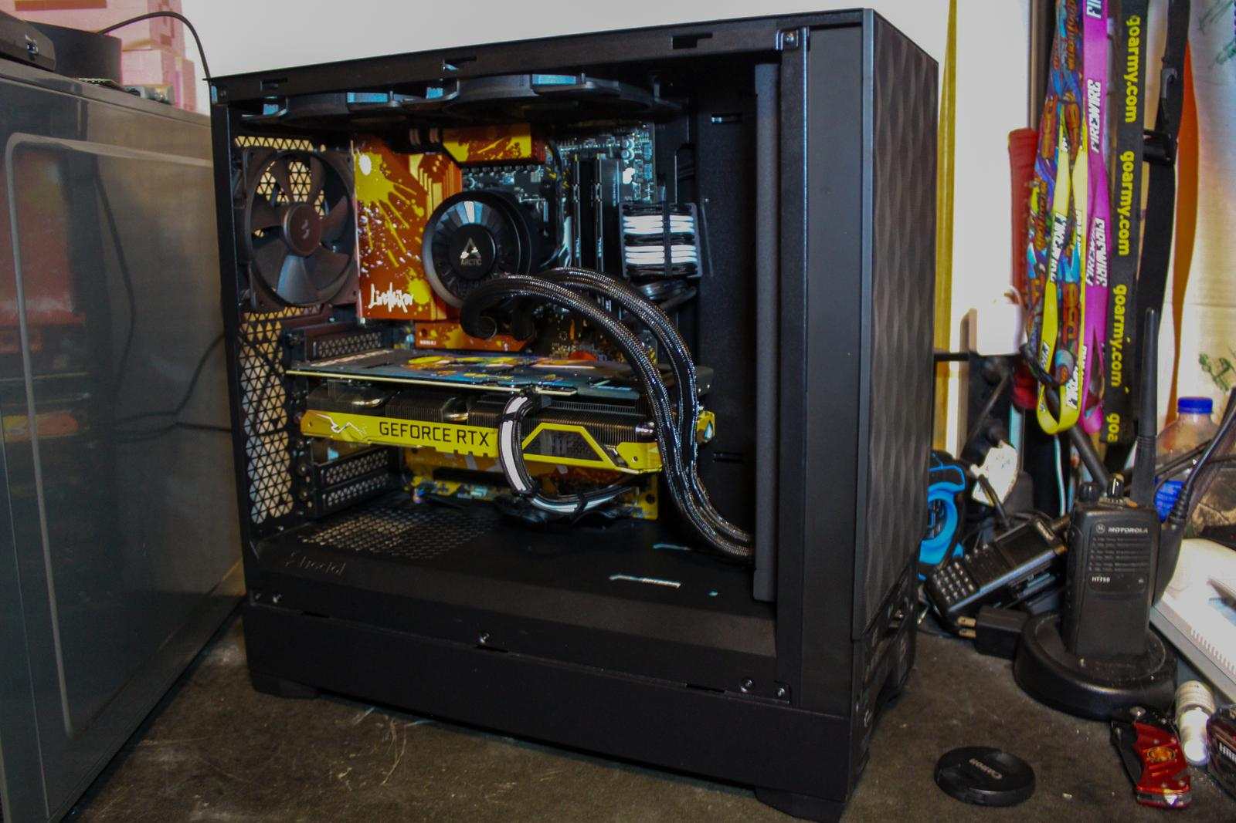

Sales Pitch Deck
Quotation for general products from Otsuka Co.

Slide 2
Customer Need
• Otsuka Corporation requires high-performance workstations for engineering and AI workloads.
• Reliable, scalable systems to support business growth.
• Advanced graphics and compute for design and simulation.
• Comprehensive warranty and support required.
• Efficient delivery and installation.
2

Slide 3
Our Solution
• Dell Precision 7960 Tower Workstation with Intel Xeon and NVIDIA RTX A6000.
• 128GB DDR5 ECC RAM and 2TB NVMe SSD for fast performance.
• Dell UltraSharp 32 4K Monitor for superior display quality.
• 5 years onsite warranty and 24/7 premium support.
• Onsite installation and staff training included.
3

Slide 4
Product Overview
• Dell Precision 7960: Intel Xeon W9-3495X, 128GB RAM, 2TB SSD, RTX A6000 GPU.
• Dell UltraSharp 32 4K Monitor: 3840x2160, IPS Black, USB-C connectivity.
• Windows 11 Pro for Workstations pre-installed.
• All products covered by manufacturer warranty.
• Energy-efficient and reliable components.
4

Slide 5
Pricing Breakdown
• 2x Dell Precision 7960: $12,500 each.
• 2x Dell UltraSharp 32 4K Monitor: $1,100 each.
• Total: $27,200 USD (includes installation and training).
• No hidden fees. Transparent pricing.
• Quotation valid for 30 days.
5

Slide 6
Warranty & Support
• 5 years onsite warranty for workstations.
• 3 years advanced exchange for monitors.
• 24/7 premium support for workstations.
• Onsite installation and staff training included.
• Remote diagnostics and proactive monitoring.
6

Slide 7
Delivery Timeline
• Estimated delivery: 3-4 weeks from order confirmation.
• Onsite installation scheduled upon delivery.
• Minimal disruption to daily operations.
• Flexible scheduling to suit your needs.
• Dedicated project manager for smooth implementation.
7

Slide 8
Product Comparison
Product Name | Key Features | Price | Vendor
Dell Precision 7960 Tower | Intel Xeon, 128GB RAM, RTX A6000 | $12,500 | Dell
HP Z8 G4 Workstation | Intel Xeon, 128GB RAM, RTX A6000 | $12,200 | HP
Lenovo ThinkStation P920 | Intel Xeon, 128GB RAM, RTX A6000 | $12,300 | Lenovo

