Slide 1
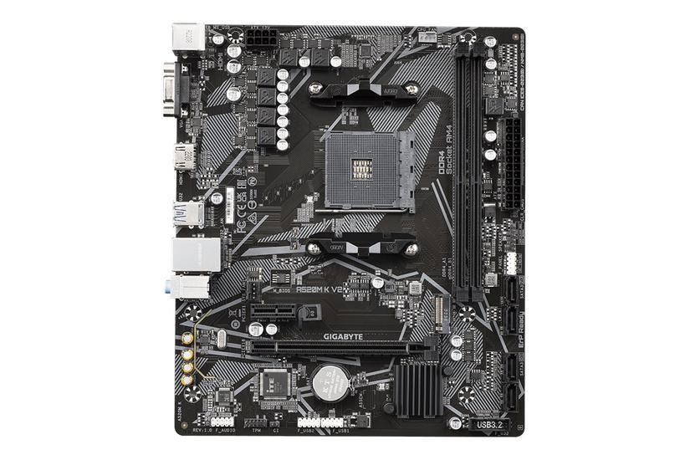

Quotation for motherboard from Otsuka Co.

Slide 2
Customer Need
• Otsuka Corporation requires high-performance CPUs for their new engineering workstations.
• Reliable and scalable processing power to support business growth.
• Advanced compute for design, simulation, and AI workloads.
• Comprehensive warranty and support required.
• Efficient delivery and installation.
2

Slide 3
Our Solution
• Intel Core i9-13900K: 24 cores, 32 threads, up to 5.8GHz turbo.
• Latest 13th Gen Intel architecture for top-tier performance.
• Compatible with DDR5 memory and PCIe 5.0 for future-proofing.
• 3 years warranty and standard support included.
• Onsite installation and basic testing included.
3

Slide 4
Product Overview
• Intel Core i9-13900K: 24 cores, 32 threads, 3.0GHz base, 5.8GHz turbo.
• Supports advanced workloads: engineering, AI, and simulation.
• Energy-efficient design with high reliability.
• Compatible with ASUS ROG STRIX Z790-E Gaming motherboard.
• All products covered by manufacturer warranty.
4

Slide 5
Pricing Breakdown
• Intel Core i9-13900K: $600 each.
• ASUS ROG STRIX Z790-E Gaming: $400.
• Total: $1,000 USD (includes installation and testing).
• No hidden fees. Transparent pricing.
• Quotation valid for 30 days.
5

Slide 6
Warranty & Support
• 3 years warranty for CPU.
• 2 years warranty for motherboard.
• Standard support for all components.
• Onsite installation and basic testing included.
• Remote diagnostics and proactive monitoring.
6

Slide 7
Delivery Timeline
• Estimated delivery: 2-3 weeks from order confirmation.
• Onsite installation scheduled upon delivery.
• Minimal disruption to daily operations.
• Flexible scheduling to suit your needs.
• Dedicated project manager for smooth implementation.
7

Slide 8
Product Comparison
Product Name | Key Features | Price | Vendor
Intel Core i9-13900K | 24 cores, 32 threads, 5.8GHz turbo | $600 | Intel
AMD Ryzen 9 7950X | 16 cores, 32 threads, 5.7GHz turbo | $580 | AMD
Intel Core i7-13700K | 16 cores, 24 threads, 5.4GHz turbo | $420 | Intel

