Slide 1

Exploratory Data Analysis
Cardiovascular heart disease

Slide 2
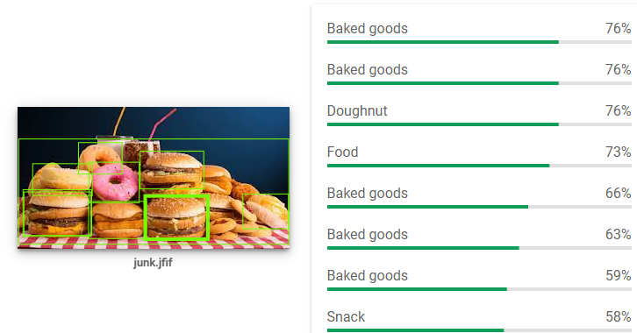

Unstructured Data

Slide 3
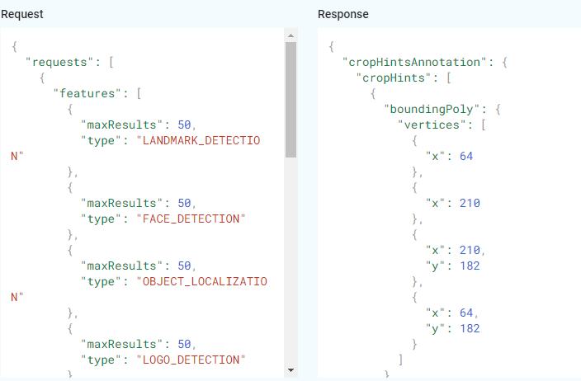
API Request and Response

Slide 4
Structured Data
id | unique identity
age | age in days
gender | 1 - women, 2 - men
height | in cm
weight | in kg
ap_hi | Systolic blood pressure
ap_lo | Diastolic blood pressure
cholesterol | 1: normal, 2: above normal, 3: well above normal
gluc | 1: normal, 2: above normal, 3: well above normal
smoke | whether patient smokes or not
alco | whether patient drinks or not
active | whether patient is active or not
cardio | 1 - disease and 0 - No disease

Slide 5
EDA REPORT
Hosted healthcare EDA Report
https://tejasjay.com/Blogs/healthcare/report.html

Slide 6
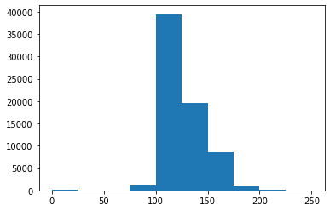
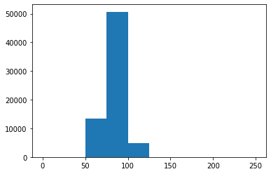
AP_hi vs AP_lo
Ap_hi
Systolic blood pressure
Measures the force your heart exerts on the walls of your arteries each time it beats.
Ap_lo
Diastolic blood pressure
the pressure in the arteries when the heart rests between beats.

Slide 7
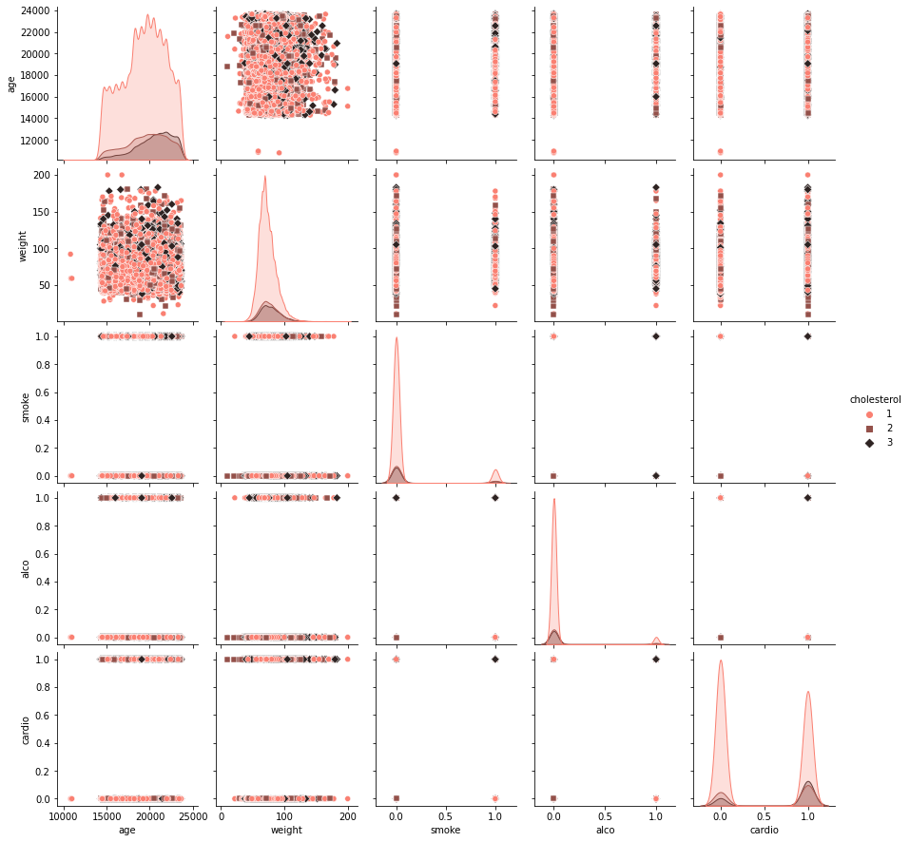

Slide 8
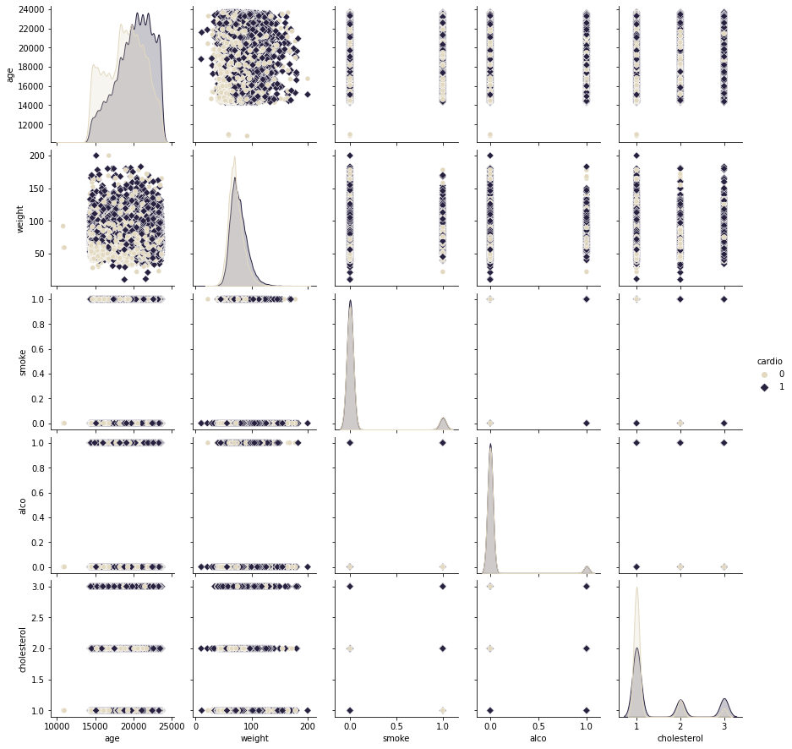

Slide 9

Thank You!

