Slide 1
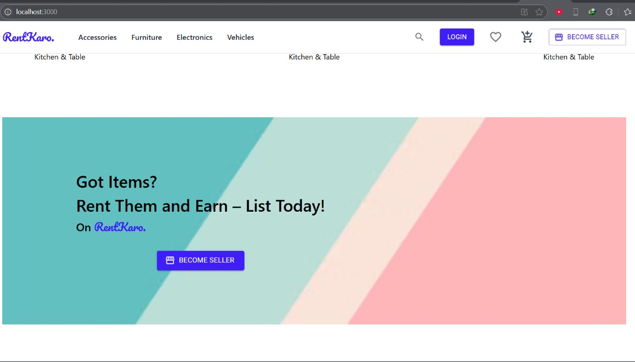
RENTKARO
NAME OF STUDENT :​
​Prashant Kumar - 240840120117
Saurabh Shirbhate - 240840120158
Prathmesh Joshi - 240840120121
Siddhesh Darade -240840120189
Tejas Koshti - 240840120206
Guide : Mr. P.M.SOLANKI Sir
Guide : Mr. P.M.SOLANKI Sir
Guide : Abhilash Bande Sir

Slide 2
INTRODUCTION
RentKaro - Full Stack Application
Everything on Rent is a full-stack web application designed to facilitate a seamless renting experience for users. The platform allows individuals to rent various items, including cars, furniture, and gadgets, from sellers, negotiate prices, and complete transactions securely. The system consists of three primary roles: Buyer, Seller, and Admin.
This project follows a Microservices Architecture and adheres to design patterns to ensure scalability and maintainability. With features like real-time price negotiation, a secure booking system, and an admin dashboard for managing users and listings, Everything on Rent provides an intuitive and efficient rental marketplace

Slide 3
INTRODUCTION
Features :
User Authentication & Role-based Access (Buyer, Seller, Admin)
Listing of Rental Items (Cars, Furniture, Gadgets, etc.)
Booking System for Renting Items
Secure Payments (UPI, PayPal, Credit/Debit Card)
Ratings & Reviews for Sellers and Rental Items
Admin Dashboard for Managing Users and Listings

Slide 4
PROBLEM STATEMENT
🔹 Challenges Without RentKaro:
Finding rental items is time-consuming.
No structured platform for owners to list items.
Lack of security in rental transactions.
🔹 How RentKaro Solves It:
A centralized platform to list and rent products.
Secure payments and user authentication.
Location-based search and rental management.

Slide 5
OBJECTIVE OF PROJECT
To develop an online rental platform for easy renting and lending of products
To provide a secure and scalable system for managing rental transactions.
To integrate multiple backend technologies for efficient API management.
To ensure user authentication and secure payments using JWT and .NET API.
To optimize the platform using cloud deployment (AWS, Docker).

Slide 6
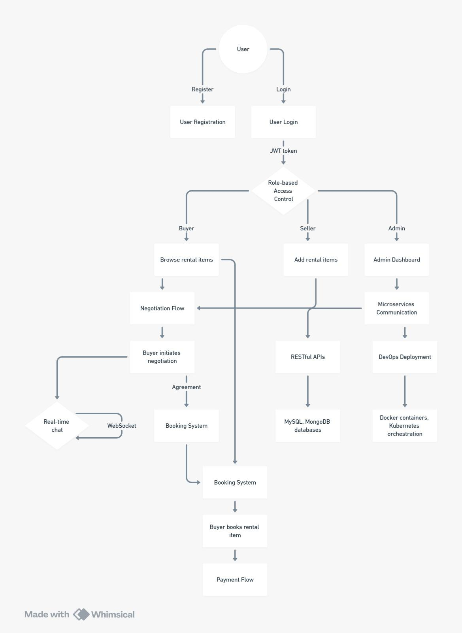
Step 1: Requirement gathering and system analysis.
Step 2: Designing UI and Database schema.
Step 3: Developing frontend using React.js + Tailwind CSS.
Step 4: Implementing backend using Express.js, Spring Boot.
Step 5: Securing authentication and payment integration.
Step 6: Testing for performance, security, and user experience.
Step 7: Deploying on AWS using Docker for scalability.
METHODOLOGY

Slide 7
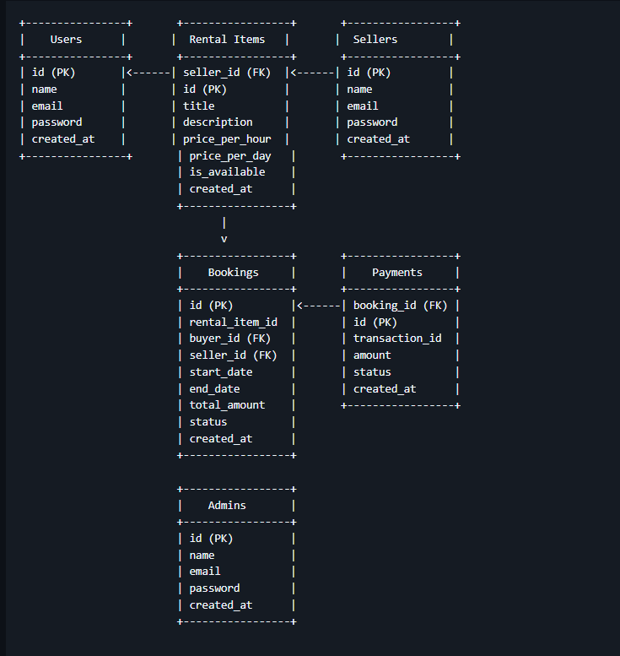
METHODOLOGY
Relationships
1.Users → Bookings → A buyer can make multiple bookings.
2. Sellers → Rental Items → A seller can list multiple rental items.
3.Bookings → Payments → Each booking has one payment.
ER Diagram Representation

Slide 8
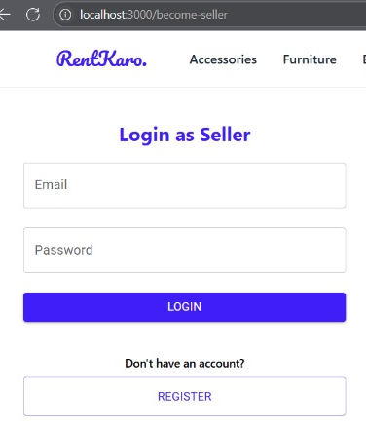
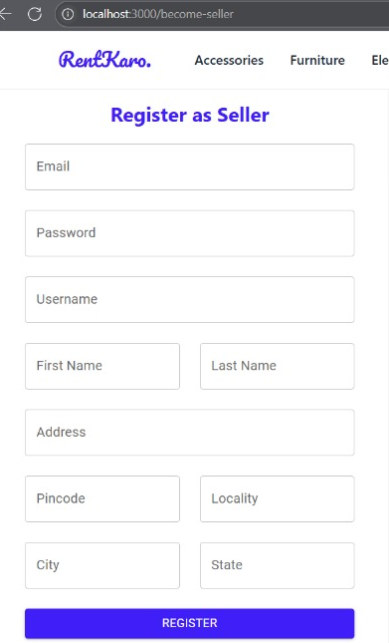
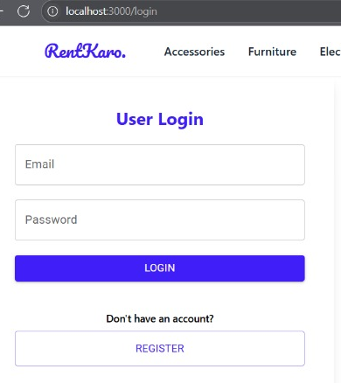
METHODOLOGY
📂 Folder Structure
📦 everything-on-rent
┣ 📂 backend
┃ ┣ 📂 user-service
┃ ┣ 📂 rental-service
┃ ┣ 📂 negotiation-service
┃ ┣ 📂 payment-service
┃ ┗ 📂 review-service
┣ 📂 frontend
┃ ┣ 📂 src
┃ ┣ 📂 components
┃ ┣ 📂 pages
┃ ┣ 📂 redux
┃ ┗ 📂 assets
┣ 📜 docker-compose.yml
┣ 📜 README.md
┣ 📜 .gitignore
┗ 📜 package.json
Folder Structure

Slide 9
LITERATURE SURVEY
Existing Systems:
Traditional rental services are offline and lack automation.
Some online platforms exist but have limited functionality.
Gap Analysis:
Lack of integrated systems supporting multiple categories.
Security concerns in existing platforms.
Limited backend scalability.
Proposed Solution:
A multi-technology platform integrating Express.js, Spring Boot, and .NET.
Secure transactions and authentication with JWT.
Scalable cloud deployment using AWS and Docker.

Slide 10
EXPECTED KEY OUTCOMES
A fully functional Online Rental Platform for users.
Secure user authentication using JWT and encrypted passwords.
Optimized API performance using a combination of Express.js, Spring Boot.
Seamless user experience with responsive UI and dynamic filtering.
Scalable cloud-based deployment for high availability.
Automated rental management system for easy transactions.

Slide 11
APPLICATIONS
E-commerce & Rental Marketplaces – Renting electronics, appliances, etc.
Real Estate & Vehicles – Online renting of homes, bikes, and cars.
Event Management – Renting event supplies like chairs, tents, and decorations.
Educational Sector – Renting books, project kits, and lab equipment.
Tool & Equipment Rentals – Construction tools, cameras, and heavy machinery rentals.

Slide 12
CONCLUSION
RentKaro provides a secure, efficient, and scalable rental management system.
Combines multiple backend technologies to improve API efficiency.
Ensures user security through authentication and safe transactions.
Cloud deployment using AWS enhances availability and performance.
Future enhancements include AI-based rental suggestions and mobile app development.

Slide 13

THANK YOU

