Slide 1

M.Tech Program
Advanced Industry Integrated Programs
Jointly offered by University and LTIMindTree
Review III
Multilingual RAG for Government
Scheme and Eligibility Guidance
Tejas Manindra
VIT Chennai (25MML1006)
T10000
Knowledge partner | Implementation partner

Slide 2
Multilingual Rag for Government Scheme and Eligibility Guidance
Introduction
Government information is distributed across numerous official portals, documents, schemes, policies, and notifications, making it difficult for citizens to quickly find relevant and reliable information.
This project proposes a Multilingual Retrieval-Augmented Generation (RAG) system that combines information retrieval with Large Language Models (LLMs) to provide responses grounded in official government sources.
The system focuses on Telugu and English, with an initial coverage of Telangana, Andhra Pradesh, and Central Government information, enabling users to access and understand government services and schemes through a reliable, user-friendly, and multilingual AI interface.

Slide 3
Multilingual Rag for Government Scheme and Eligibility Guidance
Objective
To develop a Multilingual Retrieval-Augmented Generation (RAG) system that enables citizens to efficiently access and understand accurate, contextual, and source-grounded government information in Telugu and English.
Primary Use Case
The system acts as an intelligent interface for discovering and understanding government schemes and services. Users can query information related to:
Scheme benefits and purpose
Eligibility criteria, Required documents
Application procedure
Deadlines and relevant conditions, Government services and policies

Slide 4
Multilingual Rag for Government Scheme and Eligibility Guidance
Modules to cover
Module 1: Government Scheme Data Collection & Knowledge Base
Collects and organizes verified government scheme information.
Module 2: Document Ingestion & Preprocessing
Extracts, cleans, OCR-processes, and chunks government documents.
Module 3: Multilingual Query Understanding
Understands user queries in English/Telugu and identifies intent.
Module 4: Hybrid RAG Retrieval & Reranking
Retrieves and ranks the most relevant scheme information.

Slide 5
Multilingual Rag for Government Scheme and Eligibility Guidance
Modules to cover
Module 5: Eligibility Assessment & Rule Engine
Matches user details against scheme-specific eligibility rules.
Module 6: LLM-Based Response Generation
Generates grounded, multilingual responses using retrieved context.
Module 7: Source Verification & Update Management
Tracks official sources, scheme changes, deadlines, and versions.
Module 8: Multilingual User Interface
Provides scheme search, eligibility checking, and personalized guidance.

Slide 6
Multilingual Rag for Government Scheme and Eligibility Guidance
Problem Statement
Fragmented information: Government scheme information is scattered across multiple portals and documents, making it difficult for citizens to find relevant schemes in one place.
Complex eligibility: Eligibility criteria are often lengthy and difficult to understand, especially when users need to compare their personal details with multiple scheme requirements.
Language barrier: Most government information is primarily available in English, creating accessibility challenges for Telugu-speaking citizens.

Slide 7
Multilingual Rag for Government Scheme and Eligibility Guidance
Methodology/Modeling Plan
Data → Processing → Retrieval → Eligibility → Response
Data: Official Central, Telangana & Andhra Pradesh scheme sources
Processing: OCR, text cleaning, chunking & metadata extraction
Retrieval: BGE-M3 embeddings + Hybrid Search + Qdrant
Eligibility: Rule-based deterministic eligibility engine
Response: Gemma 3 12B / LLM + Streamlit, with grounded citations
Key Design Principle: The eligibility is determined by the rule-based engine.

Slide 8
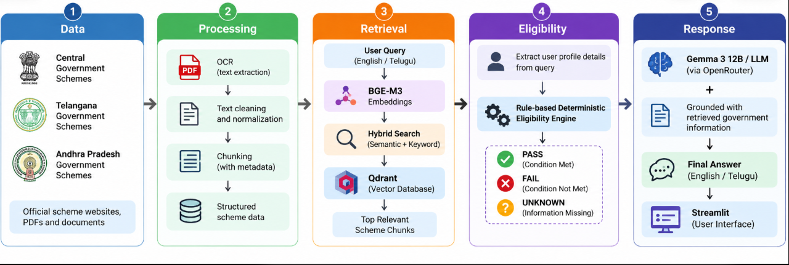
Multilingual Rag for Government Scheme and Eligibility Guidance
Approach/Algorithms/Tools
RAG: Hybrid semantic + keyword retrieval
Embedding: BGE-M3
Search: Qdrant Vector Database + Reranking
Eligibility: Rule-based decision engine
LLM: Gemma 3 12B
Frontend: Streamlit
Data: Python, OCR & PostgreSQL

Slide 9
Multilingual Rag for Government Scheme and Eligibility Guidance
Findings and Results
1,351 scheme records successfully processed from Central, Telangana & Andhra Pradesh sources.
45 unique government schemes indexed for multilingual retrieval.
BGE-M3 + Hybrid Search + Qdrant retrieves relevant schemes from user queries in English and Telugu.
Rule-based eligibility engine classifies conditions as PASS, FAIL, or UNKNOWN, avoiding unsupported eligibility claims.

Slide 10
Multilingual Rag for Government Scheme and Eligibility Guidance
Conclusion
MultiRAG provides a unified platform to discover relevant government schemes from Central, Telangana and Andhra Pradesh sources.
The combination of multilingual RAG and deterministic eligibility evaluation provides relevant and reliable scheme guidance.
English and Telugu support improves accessibility and helps citizens understand schemes and eligibility requirements more easily.
The system delivers grounded, source-backed responses, reducing misinformation and simplifying access to government welfare information.

Slide 11
M.Tech Program
Advanced Industry Integrated Programs
Jointly offered by University and LTIMindTree
Review III
Agentic AI for Business Intelligence,
Insights and Strategic Recommendations
Tejas Manindra
VIT Chennai (25MML1006)
T10000
Knowledge partner | Implementation partner

Slide 12
Agentic AI for Business Intelligence, Insights and Strategic Recommendations
Introduction
E-commerce businesses generate large volumes of business data from orders, customers, products, marketing, inventory, and returns.
Business leaders need quick and accurate insights to make strategic decisions.
Traditional BI systems mainly provide dashboards and reports, requiring manual analysis.
Our system uses Agentic AI to automatically analyze data, identify insights, and find root causes.
It provides KPIs, visualizations, business insights, and strategic recommendations to support faster decision-making.

Slide 13
Agentic AI for Business Intelligence, Insights and Strategic Recommendations
Objective
Develop an Agentic AI-powered BI system for e-commerce business analysis.
Automate data analysis from orders, customers, products, marketing, inventory, and other business data.
Generate meaningful business insights and identify the root causes behind KPI changes.
Provide strategic, actionable recommendations to support business decisions.
Enable faster decision-making through KPIs, visualizations, AI insights, and automated reports.

Slide 14
Agentic AI for Business Intelligence, Insights and Strategic Recommendations
Modules to cover
Natural Language Query & Understanding
  Understand business questions asked in natural language.
AI-Based SQL Generation & Data Retrieval
  Convert questions into SQL queries and retrieve relevant data from PostgreSQL.
Data Analysis & Visualization
  Generate KPIs, trends, charts, and executive dashboards.
AI Insights & Root Cause Analysis
  Identify business problems, explain why they occurred, and analyze their impact.

Slide 15
Agentic AI for Business Intelligence, Insights and Strategic Recommendations
Modules to cover
Strategic Recommendations
  Provide actionable recommendations based on insights and business performance.
Automated Reporting & CI/CD
  Generate PDF/email reports and support automated CI/CD deployment of the application.

Slide 16
Agentic AI for Business Intelligence, Insights and Strategic Recommendations
Problem Statement
E-commerce businesses generate large volumes of data across sales, customers, inventory, returns, and marketing.
Traditional BI dashboards require manual analysis to understand business performance.
Identifying the root causes of declining profits and poor marketing performance is challenging.
Manual analysis delays decision-making and limits the identification of growth opportunities.
Proposed Solution: An Agentic AI-powered BI system that delivers visual insights, root-cause analysis, and actionable strategic recommendations for faster, data-driven decisions.

Slide 17
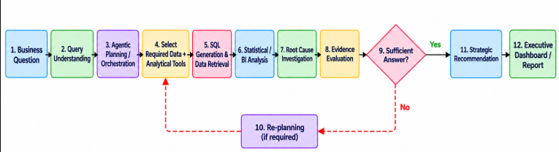
Agentic AI for Business Intelligence, Insights and Strategic Recommendations
Methodology/Modeling Plan

Slide 18
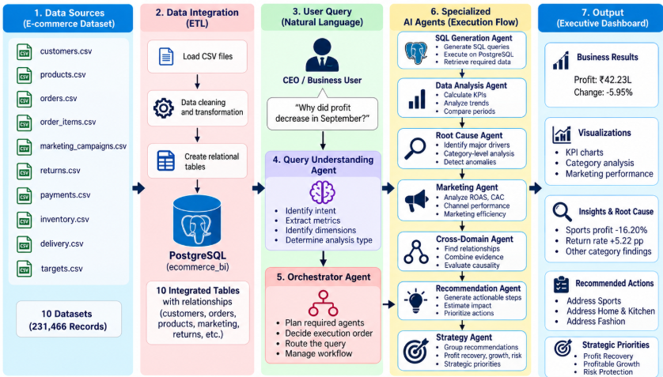
Agentic AI for Business Intelligence, Insights and Strategic Recommendations
Approach/Algorithms/Tools

Slide 19
Agentic AI for Business Intelligence, Insights and Strategic Recommendations
Findings and Results
Integrated multiple e-commerce datasets covering sales, customers, products, marketing, inventory, returns, payments, and delivery.
Developed a PostgreSQL-based data management system for efficient data storage, retrieval, and business analysis.
Implemented AI agents to understand natural-language queries, retrieve relevant data, and analyze business performance.
Developed an executive dashboard displaying KPIs, visualizations, business insights, root-cause analysis, and prioritized strategic recommendations.
Integrated PDF report generation to present and share business insights, analytical findings, and actionable recommendations.

Slide 20
Agentic AI for Business Intelligence, Insights and Strategic Recommendations
Conclusion
The project demonstrates the use of Agentic AI to transform e-commerce data into meaningful business insights and strategic recommendations.
Integration of PostgreSQL and multiple specialized AI agents enables natural-language querying, data analysis, and root-cause investigation.
The executive dashboard presents key performance indicators, visualizations, and actionable insights to support data-driven decision-making.
Overall, the proposed system aims to help business owners make faster, smarter, and more informed strategic decisions through AI-powered business intelligence.

