Slide 1
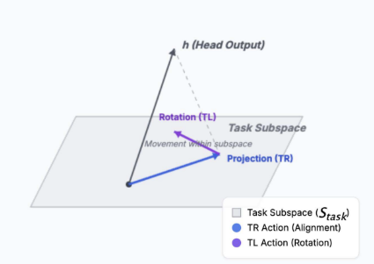
Localizing Task Recognition and Task Learning
in In-Context Learning via Attention Head Analysis
IE 663 Course Project
Scaled reproduction of TSLA on SST-2
Team name
Team members
<>
Tejas (23B0932)
Question: can in-context learning be decomposed into
Task Recognition and Task Learning at the head level?
Notes:
[Sources] - User-uploaded report.pdf - User-uploaded tl-tr-heads.png (adapted paper figure)

Slide 2
Outline
From transformer-circuit intuition to our scaled reproduction results
Problem statement and workflow
What changed after prep review
Background: residual stream, task subspace, induction heads
Proposed approach: TR, TL and IH scoring
Dataset, prompts and experimental setup
Results: head identification and specialization
Results: ablation, depth, and attention patterns
Main takeaways and limitations
End-term proposal: multi-position TSLA
References
Notes:
[Sources] - User-uploaded report.pdf

Slide 3
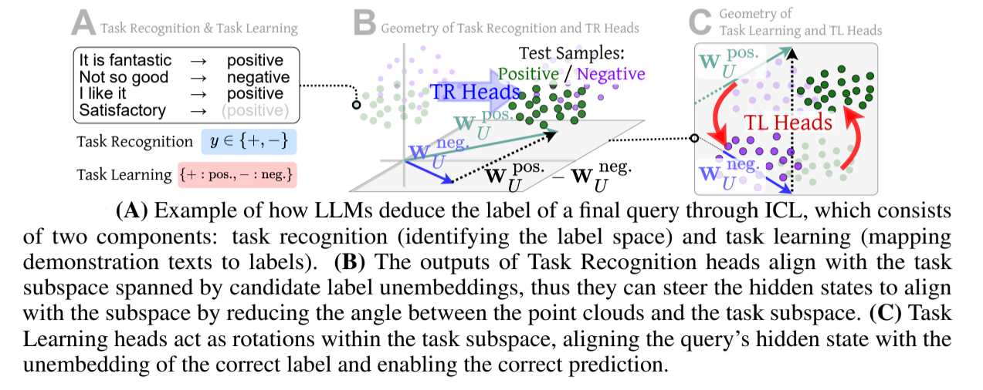
Problem statement
The paper asks whether in-context learning decomposes into two separable computations
Core question
Task Recognition (TR): infer the label space from demonstrations
Task Learning (TL): map the query to the correct label inside that space
Induction Heads (IH): copy-like heads that may support ICL structurally
Goal of our project: test whether the paper’s qualitative findings survive in a small, quantized setup
TR
TL
IH
recognize label space
pick correct label
copy label-like patterns
Notes:
[Sources] - User-uploaded report.pdf - User-uploaded tl-tr-heads.png

Slide 4
Workflow
How the project progressed from reading to implementation
1
2
3
4
5
Read papers
Define scope
Build codebase
Run experiments
Analyze + report
Primary paper + foundational reading: transformer circuits and induction heads
Feasible setup under Kaggle limits: SST-2, 8-shot ICL, 4-bit Llama 3.2 3B
Implemented prompt bookkeeping, head extraction, TR/TL/IH scoring, ablation, plotting
Reproduced five experiments and compared trends against the paper
Notes:
[Sources] - User-uploaded report.pdf

Slide 5
What changed after prep presentation review
Main corrections and extensions added before the final report/deck
Tightened the TR/TL math to match the paper: general label subspace, correct projector, TR as projected norm
Added two new analyses: layer-wise depth distribution and attention allocation (demo labels vs. query tokens)
Strengthened the interpretation of overlap metrics: top-set overlap + full-ranking correlations
Refined the end-term plan into a concrete research idea: extend TSLA beyond single-position localization
Improved report rigor, references, and explicit workflow / limitations sections
Notes:
[Sources] - User-uploaded report.pdf

Slide 6
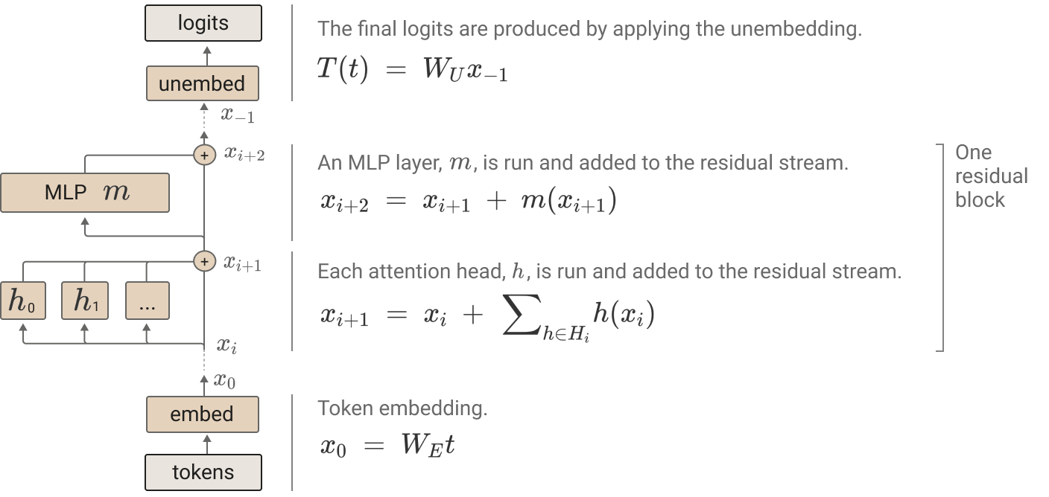
Background: the residual stream view
Why attention heads can be studied as separable contributors?
Each attention head writes a vector into the residual stream
The final logits are read out by the unembedding matrix
So each head has a direct, measurable effect on candidate-label logits
This makes per-head attribution possible in principle
Intuition
Think of the residual stream as a shared communication bus.
Heads can write in different subspaces; some subspaces matter for sentiment labels, others do not.
Notes:
[Sources] - User-uploaded report.pdf - User-uploaded transformer-model.png

Slide 7
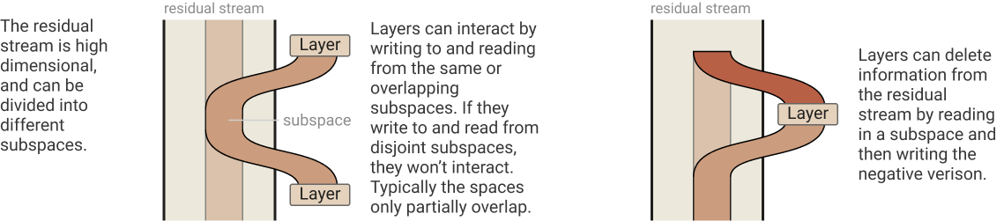
Background: task subspace, TR and TL
Geometric intuition behind the paper’s decomposition
Key idea
Candidate-label unembedding vectors span a low-dimensional task subspace inside the residual stream.
TR
TL
How much of a head output lies in the label subspace
Within that subspace, how much it favors the correct label
Notes:
[Sources] - User-uploaded report.pdf - User-uploaded residual-stream.png - User-uploaded tl-tr-heads.png

Slide 8
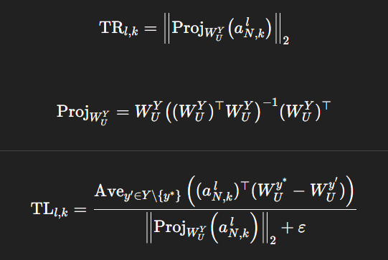

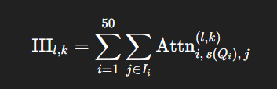
Proposed approach in the paper
Score heads, select the top sets, then test them causally
Scoring
Selection
Tests
50 scoring prompts
672 total query heads
Top 3% = 20 heads per set
Matched-size random control set
Overlap + rank correlations
Ablation on 200 eval prompts
Layer-depth analysis
Attention allocation analysis
Main question
Do these independently selected heads behave like distinct mechanisms?
Notes:
[Sources] - User-uploaded report.pdf

Slide 9
Dataset and prompt design
A single-task but carefully controlled SST-2 setup
Dataset: SST-2 sentiment classification
Labels: negative / positive
Demonstrations: 8 shots (4 positive, 4 negative)
Scoring queries: 50
Eval queries: 200
Prompt template
"It is fantastic" Sentiment: positive
"Not so good" Sentiment: negative
...
"An ambitious and moving film" Sentiment:
Why this task?
8-shot
50
ICL context
score prompts
Simple binary labels make the TR/TL geometry easy to visualize while still exercising genuine in-context classification.
Notes:
[Sources] - User-uploaded report.pdf

Slide 10
Experimental setup and implementation details
A scaled qualitative reproduction under Kaggle constraints
Model: unsloth/Llama-3.2-3B-Instruct-bnb-4bit
28 layers × 24 query heads = 672 heads
Hidden size 3072, head dimension 128
Attention extraction in eager mode
Per-head output reconstruction from quantized weights
Reproduction philosophy
Not an exact replication of the paper’s model/dataset sweep
Target: recover the paper’s qualitative trends
Single dataset + single model lets us go deeper on interpretation
Every result should be read as “consistent with” rather than “identical to” the paper
P100
4-bit
200
Code + artifacts
16 GB VRAM
NF4 checkpoint
eval prompts
https://github.com/TejasNC/task-subspace-logit-attribution
Notes:
[Sources] - User-uploaded report.pdf

Slide 11
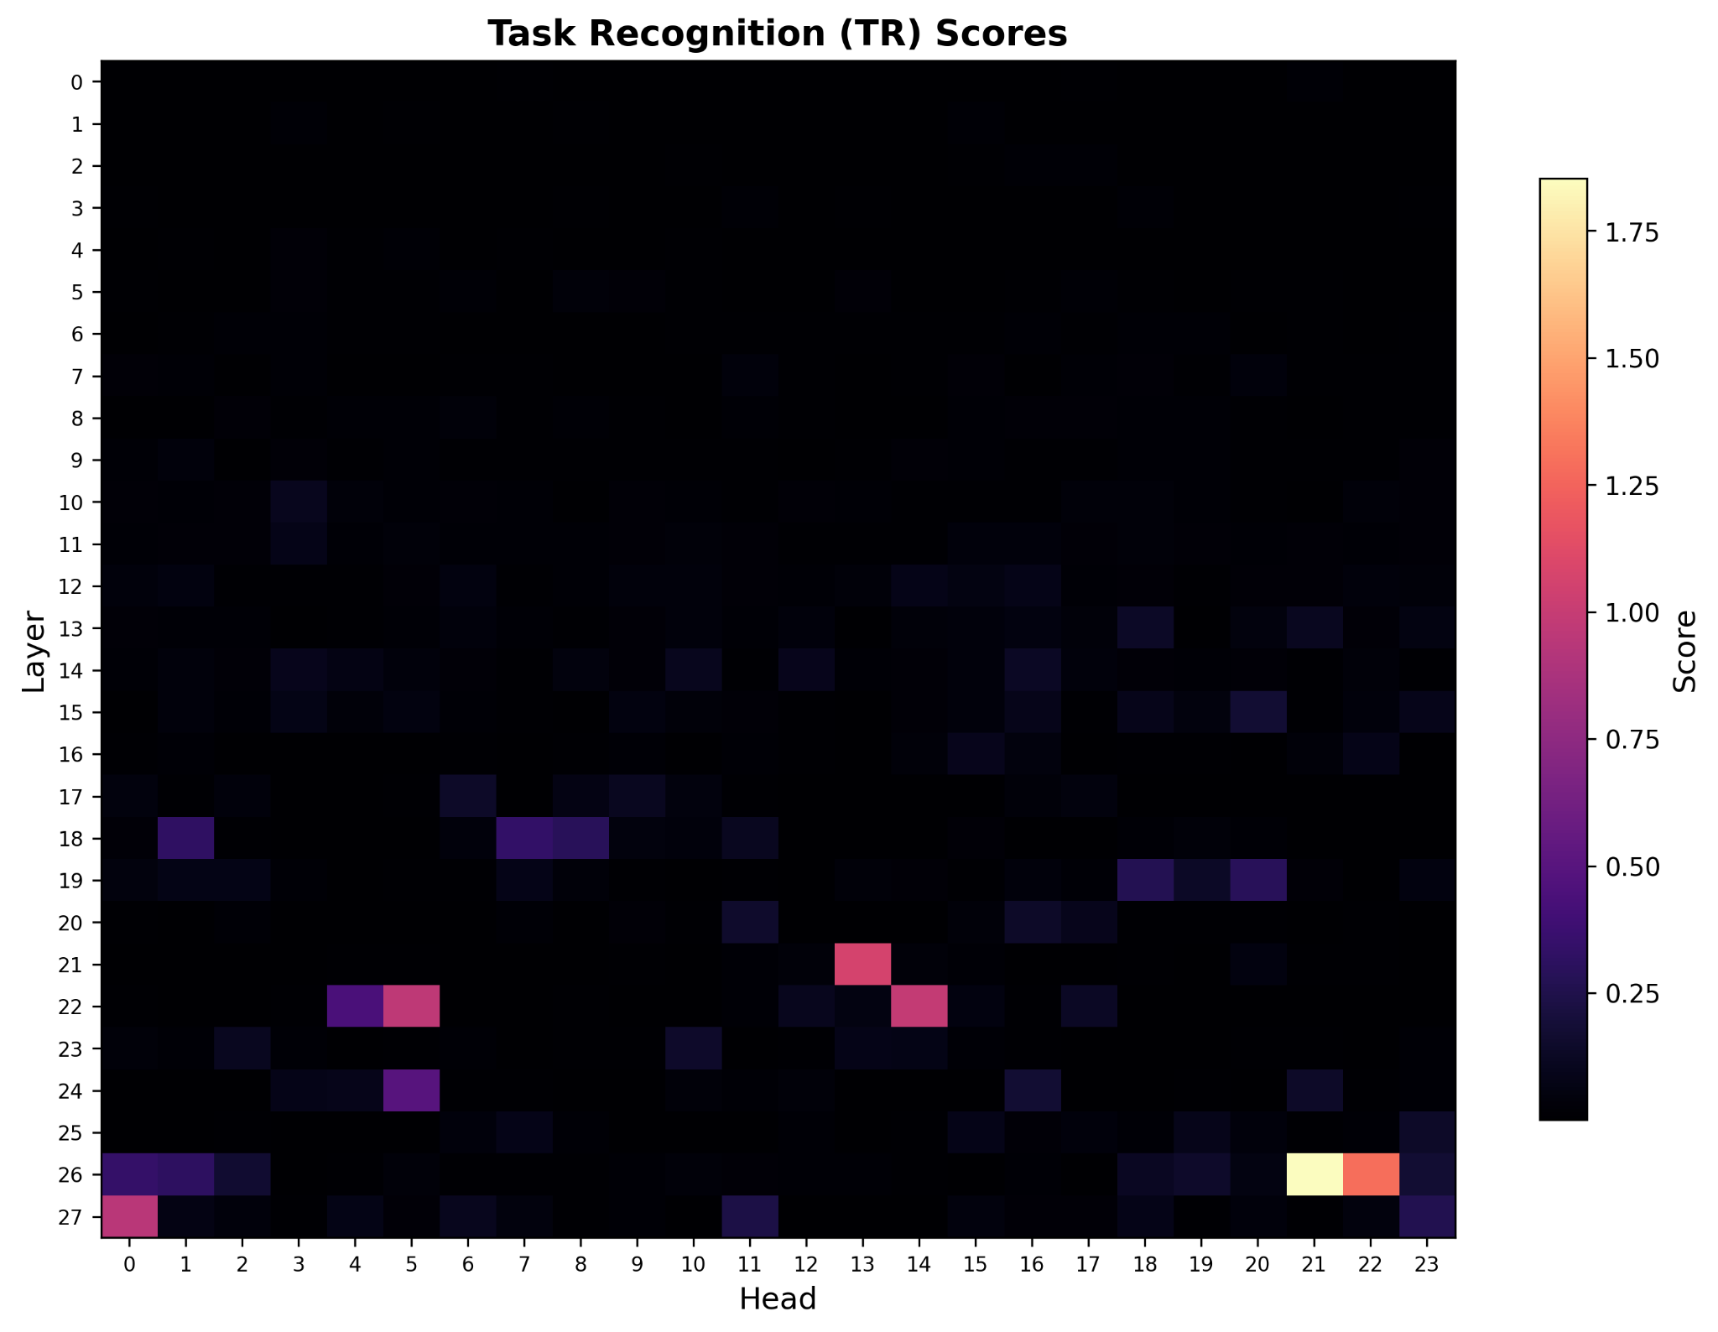
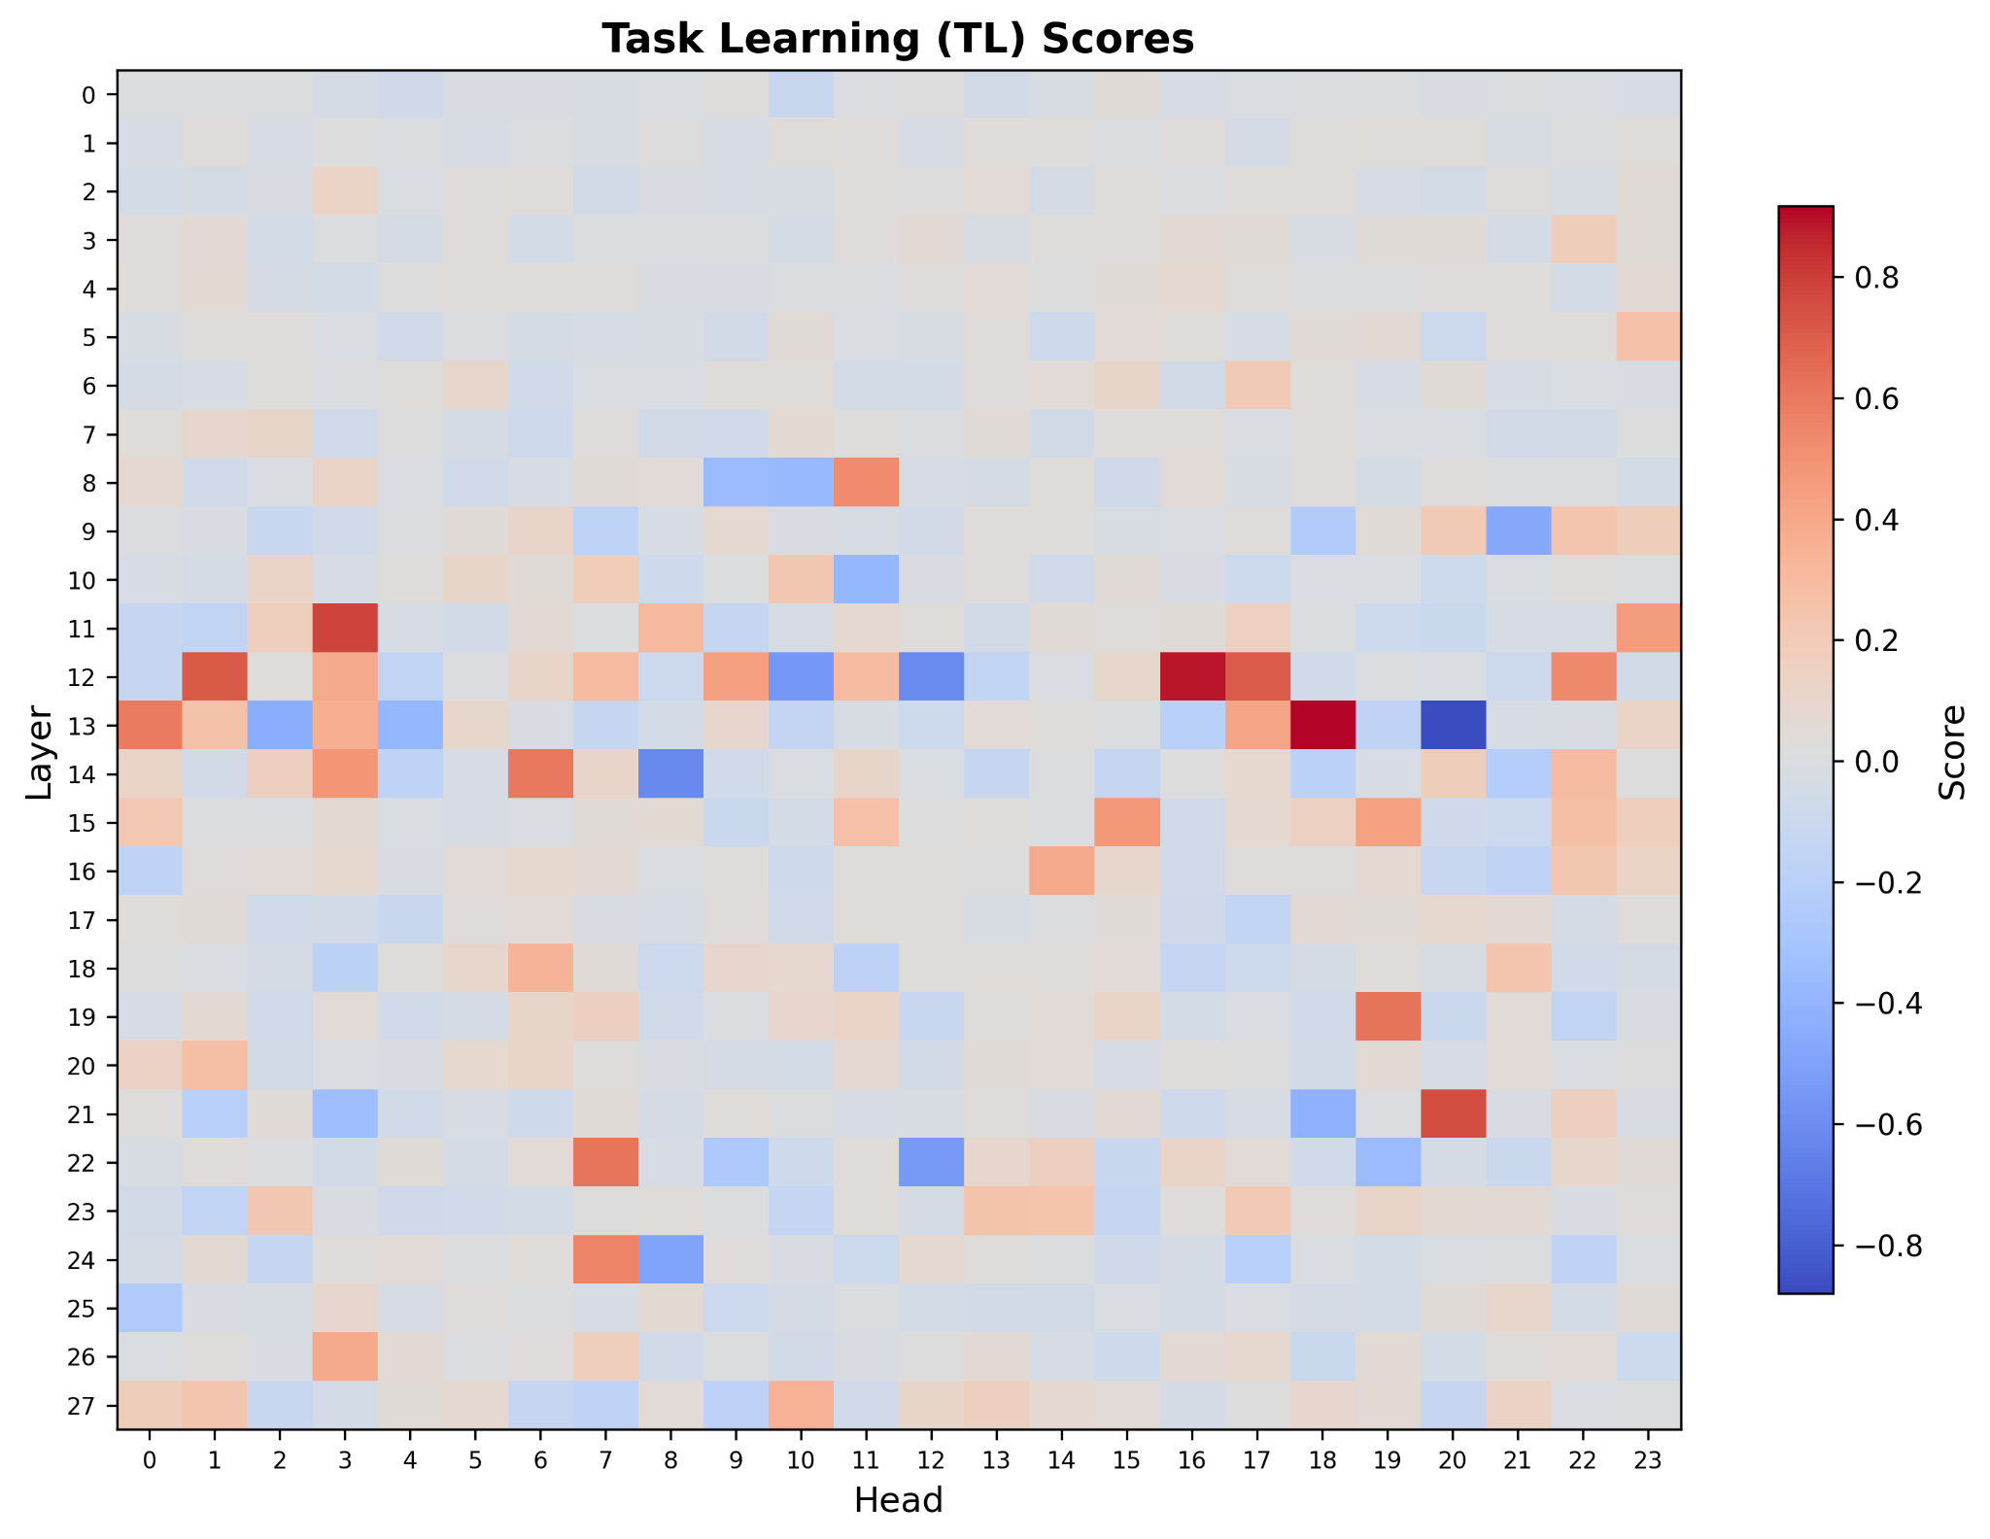
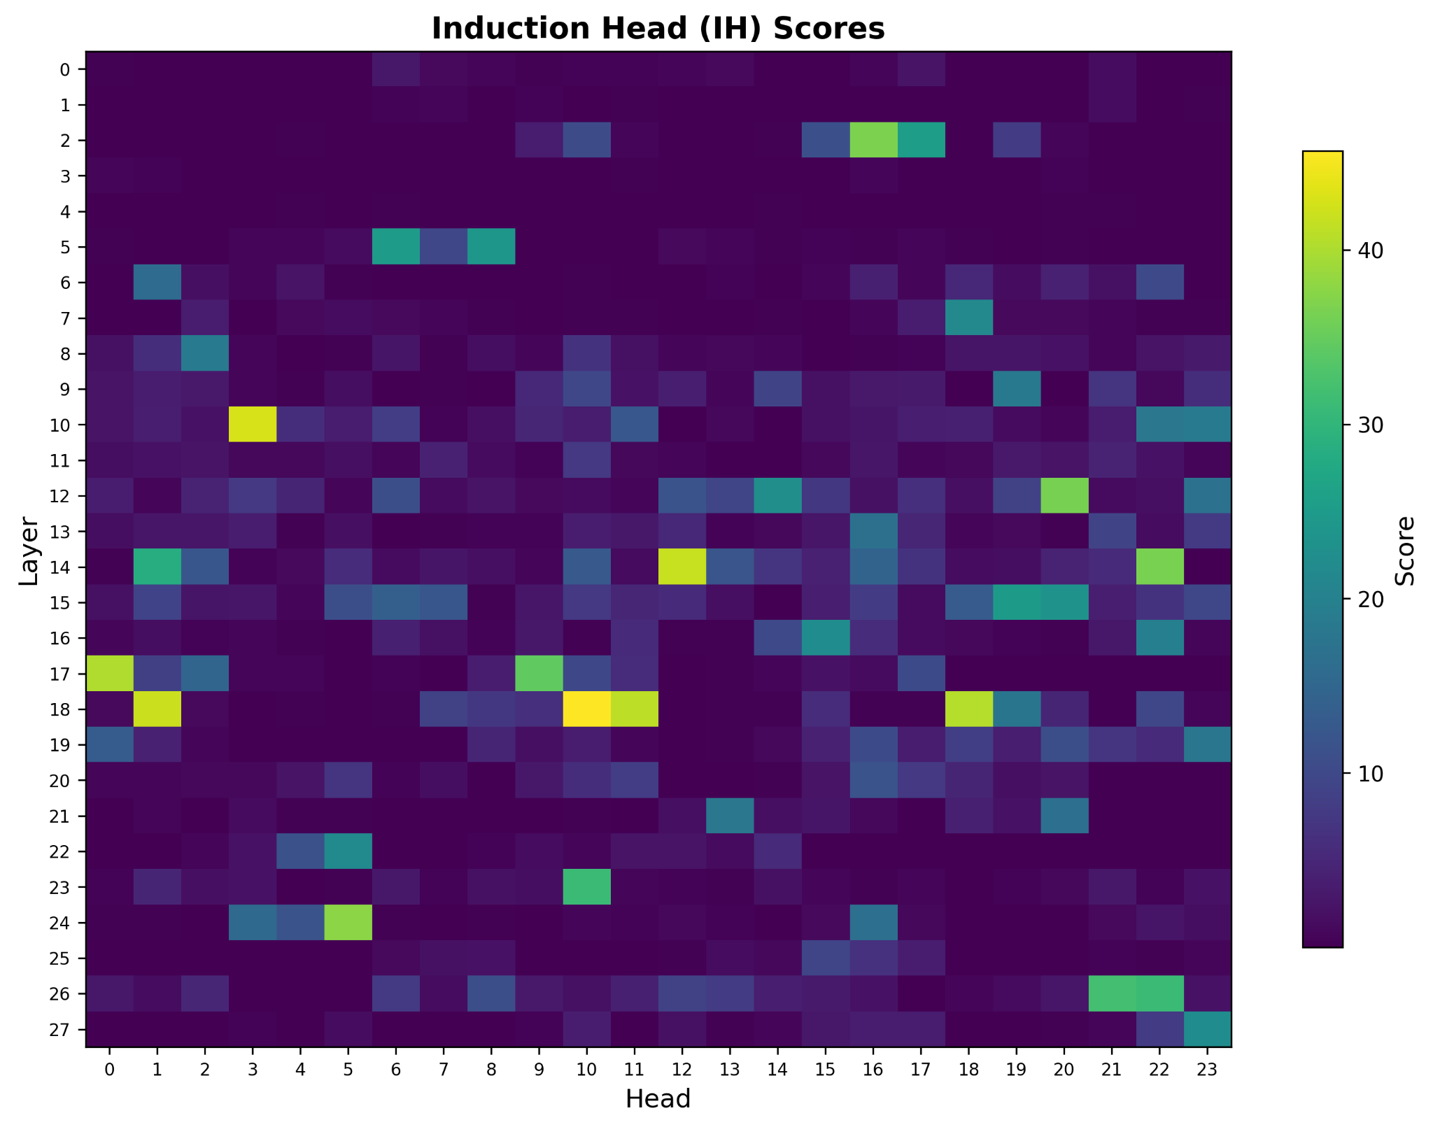
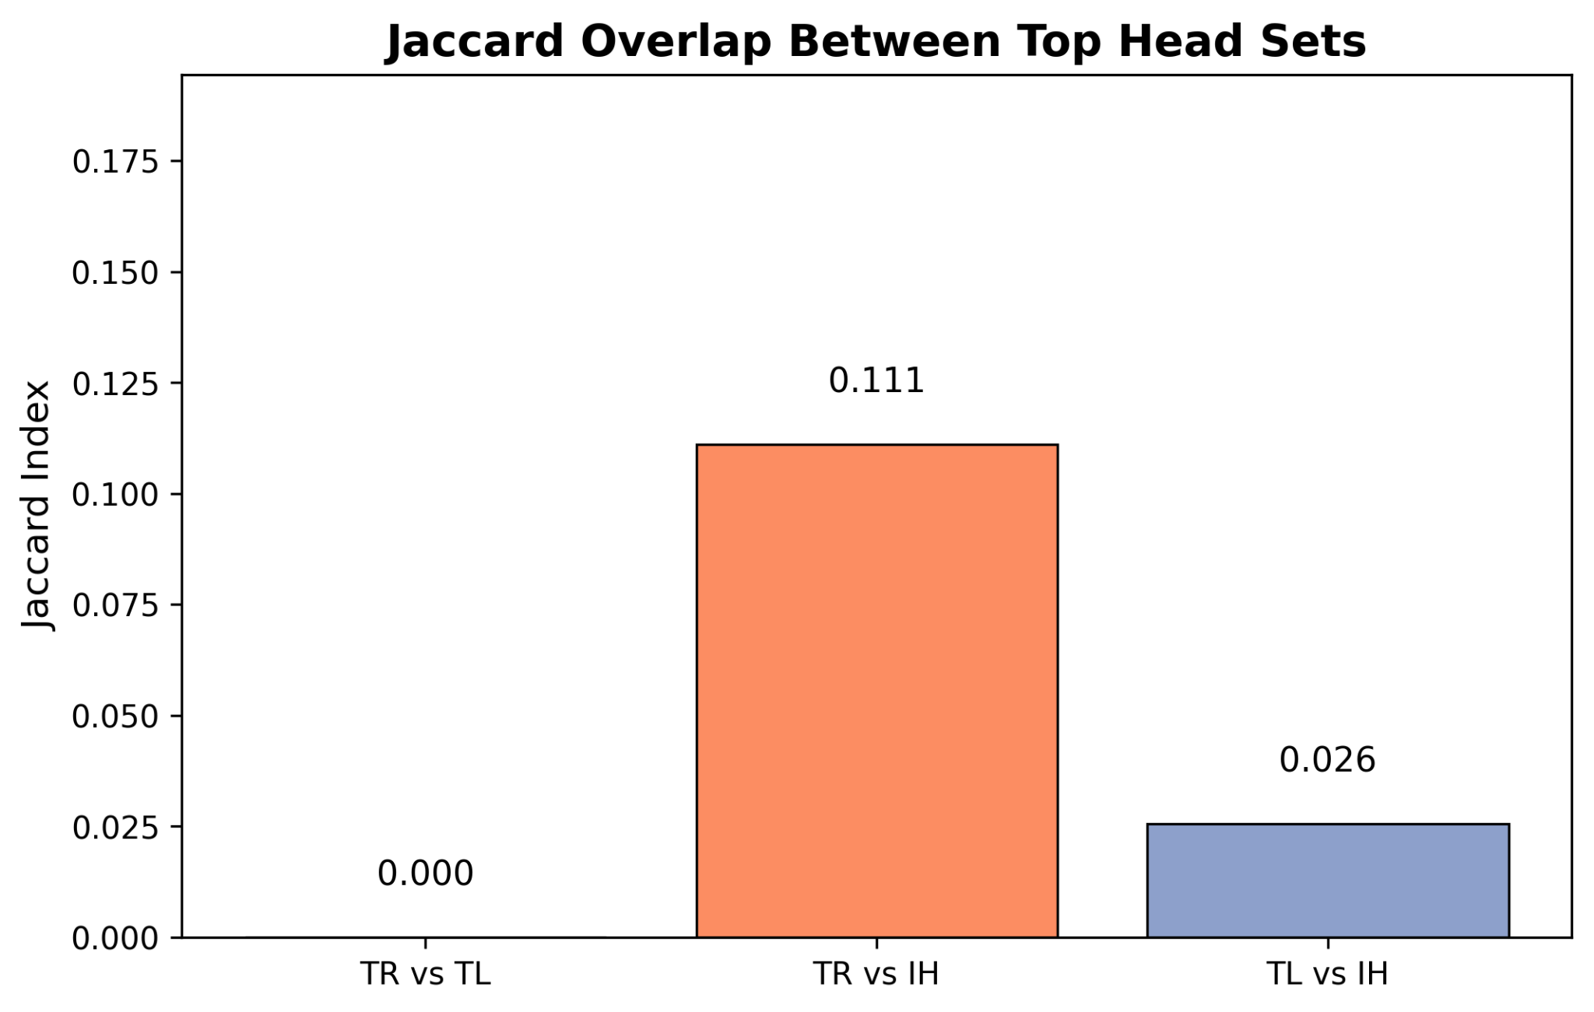
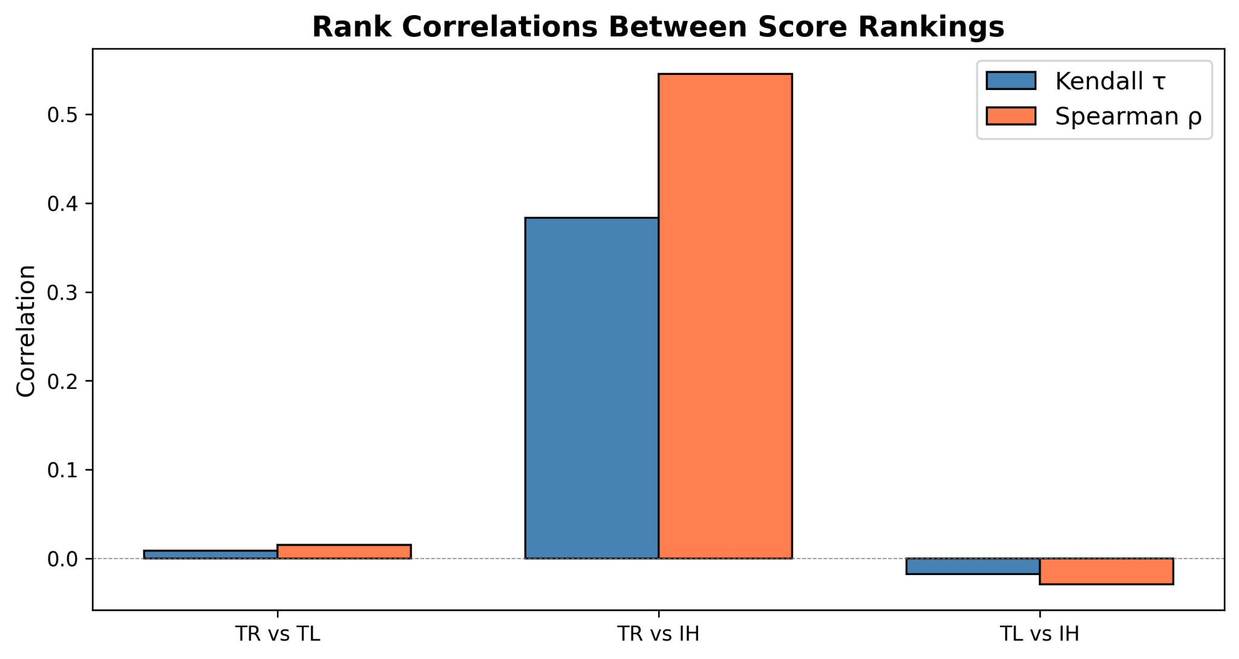
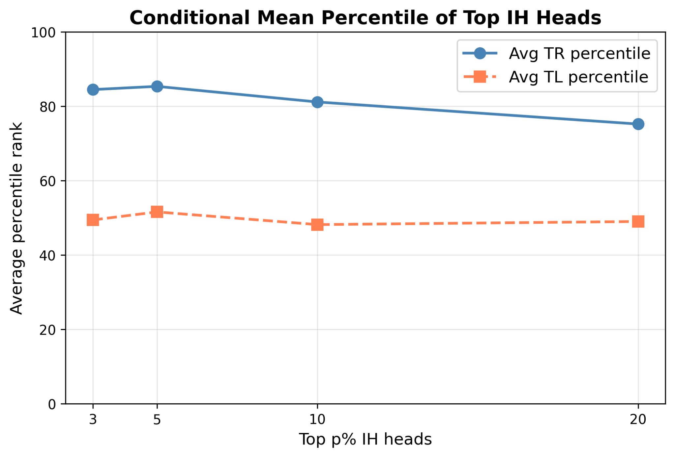
Results I: head identification and specialization
TR looks much closer to IH than TL does
Key numbers: TR-IH overlap = 4/20; TL-IH overlap = 1/20; Jaccard(TR,IH)=0.111; Spearman(TR,IH)=0.545.
Notes:
[Sources] - User-uploaded report.pdf - User-uploaded experiment-1-tr-heatmap.png - User-uploaded experiment-1-tl-heatmap.png - User-uploaded experiment-1-ih-heatmap.png - User-uploaded experiment-2-jacard-similarity.png - User-uploaded experiment-2-rank-correlation.png - User-uploaded experiment-2-conditional-mean-percentile.png

Slide 12
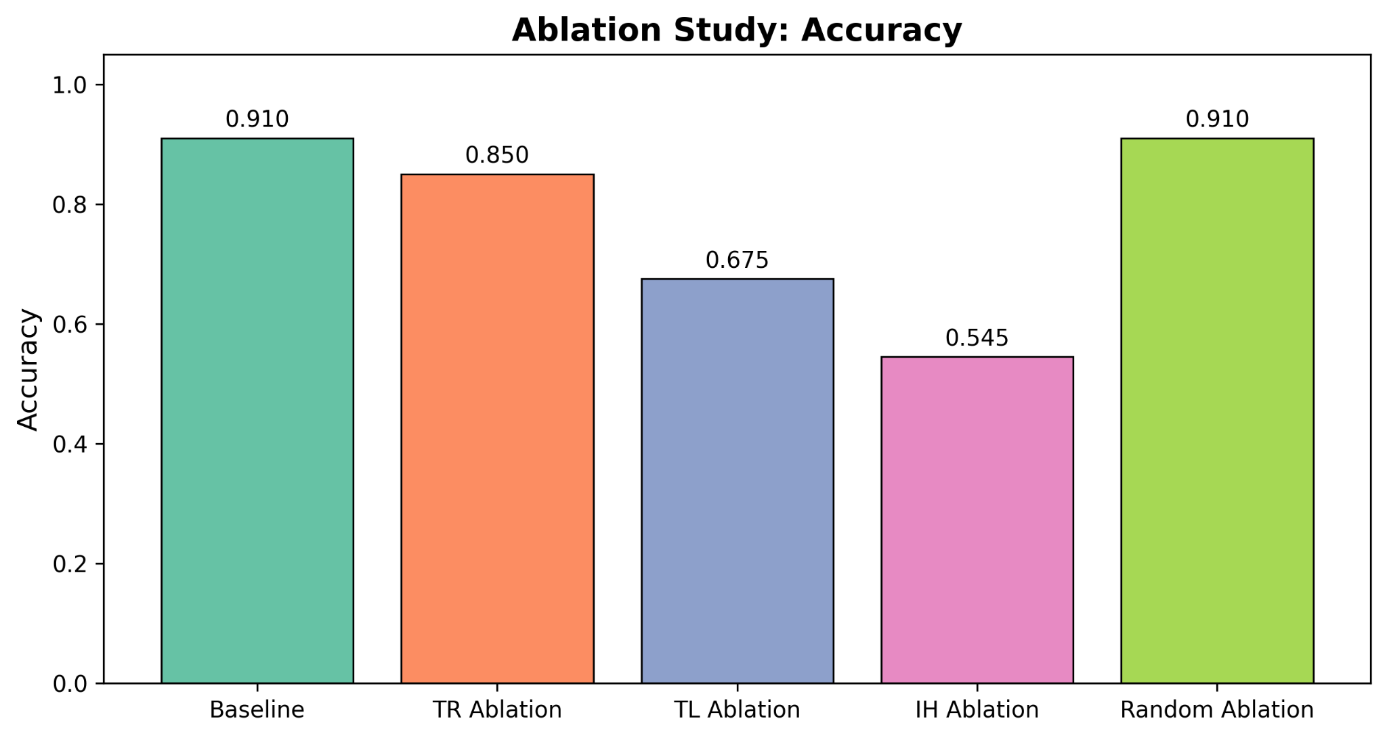
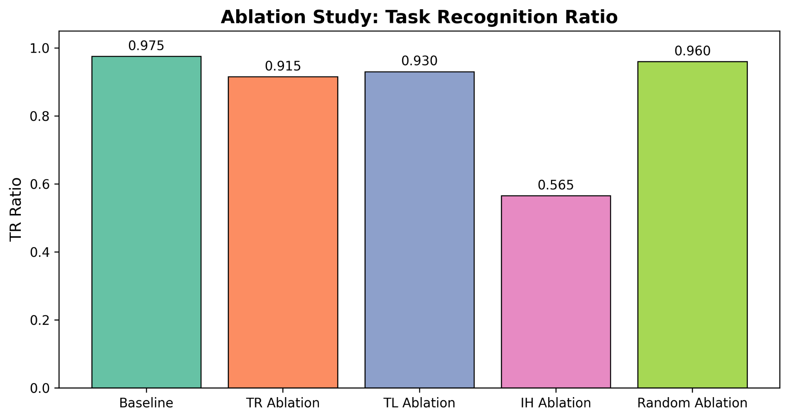
Results II: ablation
Different head sets break the model in different ways
TR ablation drops both accuracy and TR ratio → the model is less likely to stay in the label space
TL ablation hurts accuracy more than TR ratio → the model still “knows the task” but often picks the wrong label
IH ablation is most destructive → induction-like machinery is a shared substrate for ICL here
Random ablation is basically harmless → effects are functional, not just due to removing 20 heads
Notes:
[Sources] - User-uploaded report.pdf - User-uploaded experiment-3-abalation-accuracy.png - User-uploaded experiment-3-tr-ration.png

Slide 13
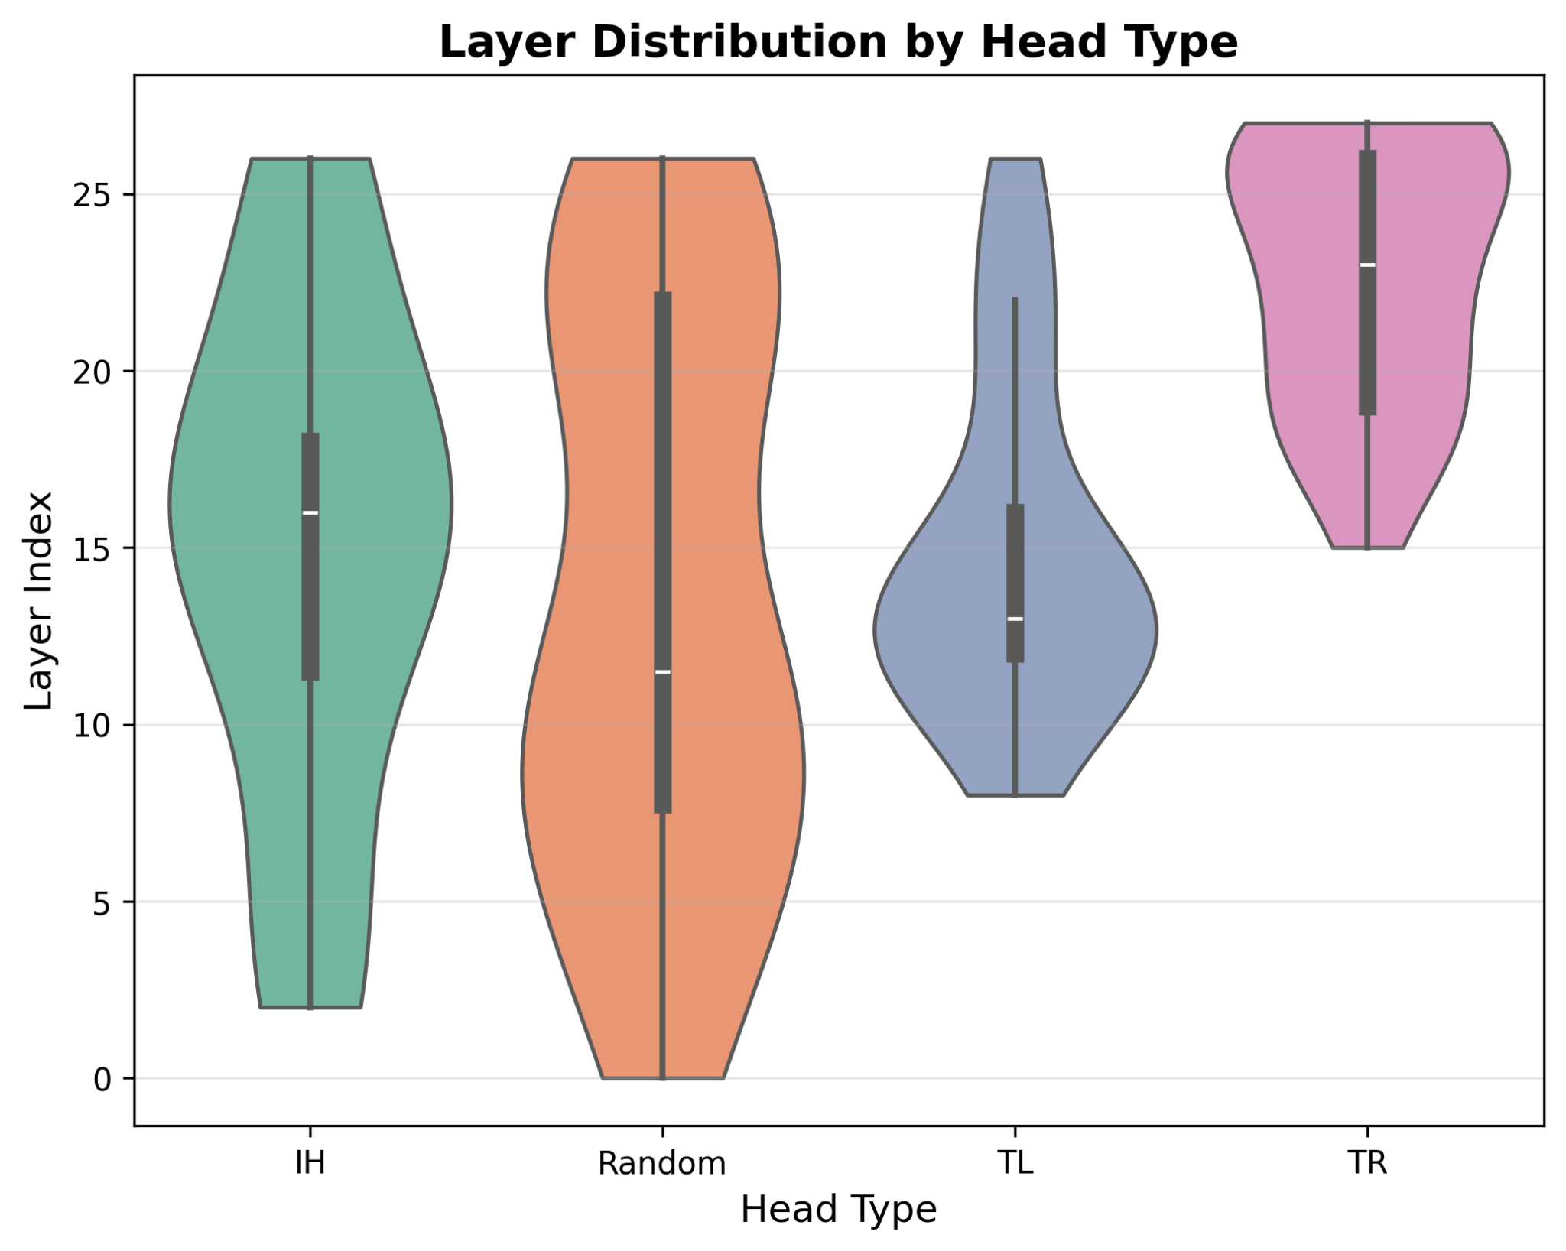
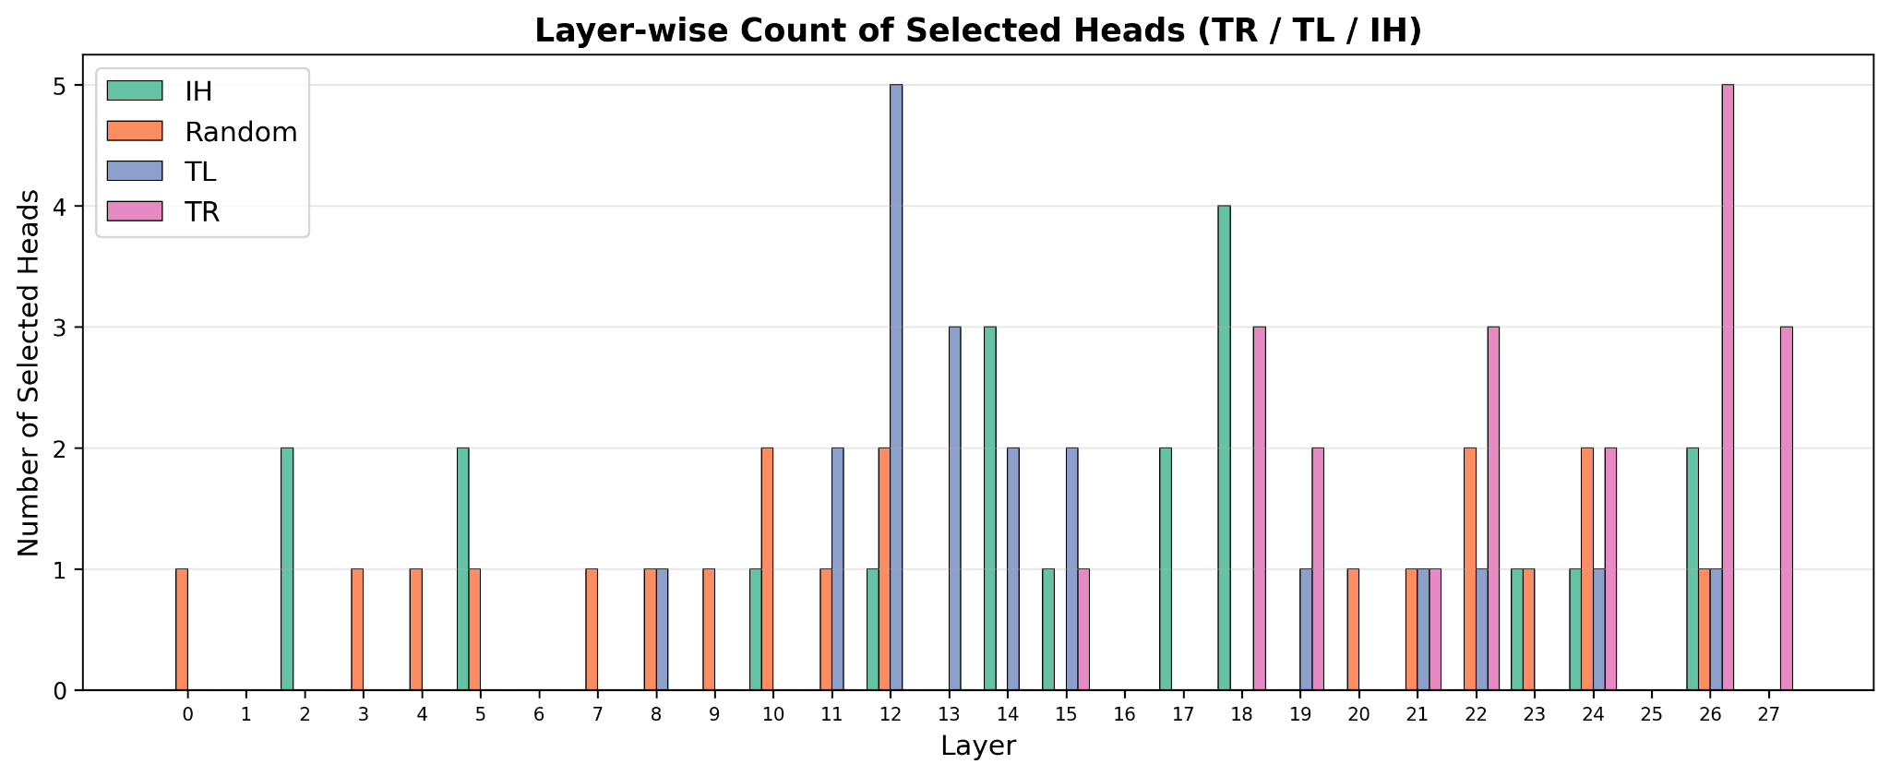
Results III: layer-wise distribution
TR heads emerge much deeper than TL and IH heads
Mean layer indices: TR 22.65, TL 14.95, IH 14.90
TL vs TR and IH vs TR are significant; TL vs IH is not
Interpretation: middle layers retrieve and structure evidence; late layers project into the task-label subspace
Notes:
[Sources] - User-uploaded report.pdf - User-uploaded experiment-4-violin -plot.png - User-uploaded experiment-4-layer-count.png

Slide 14
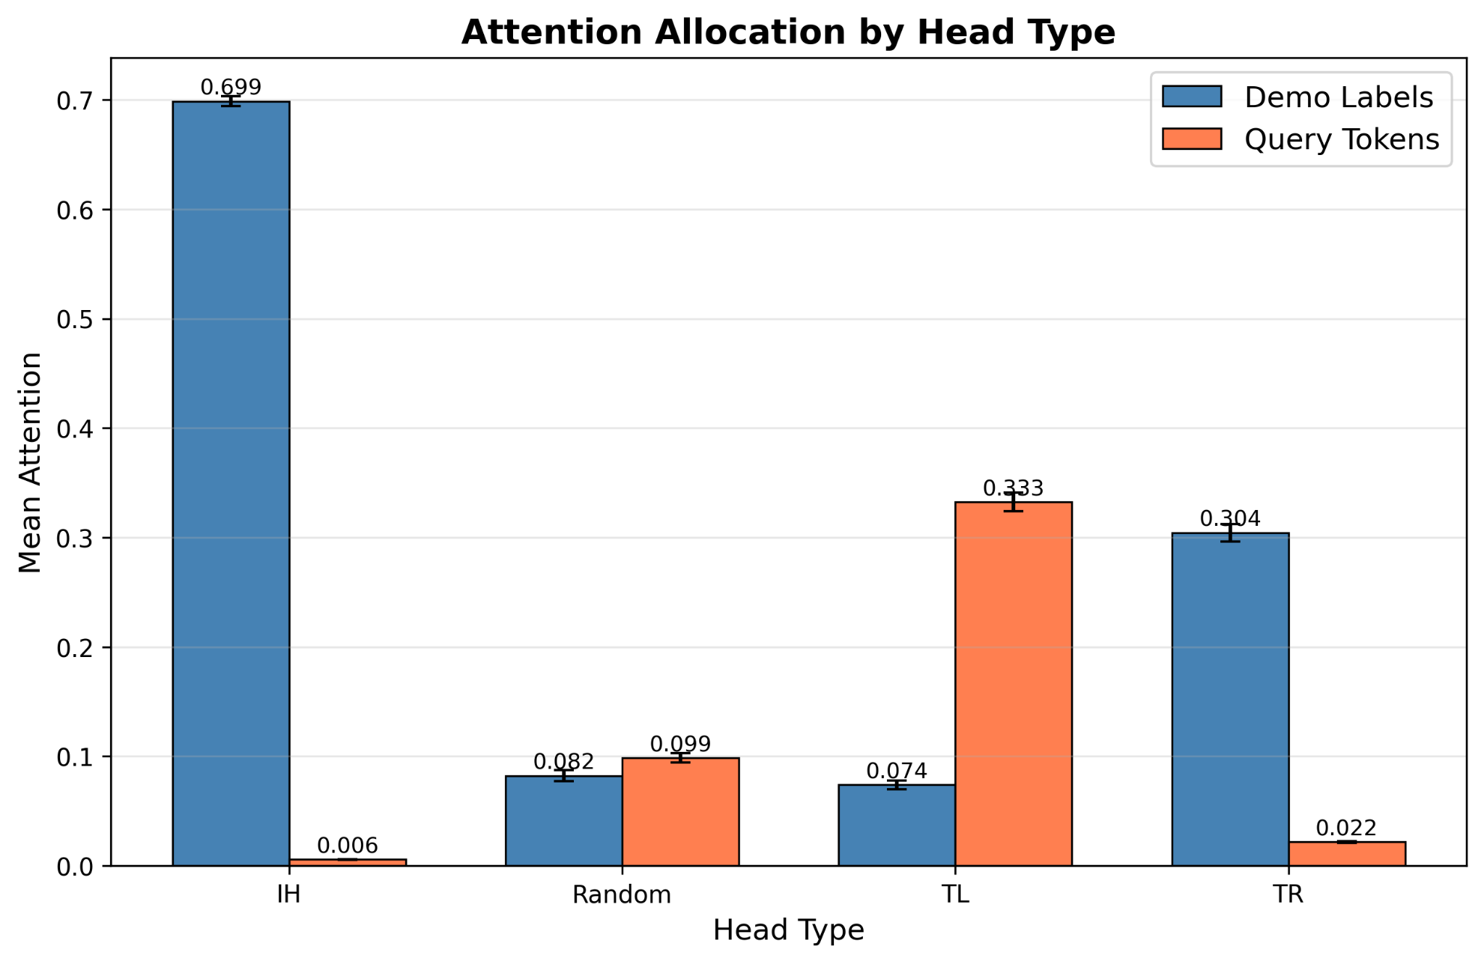
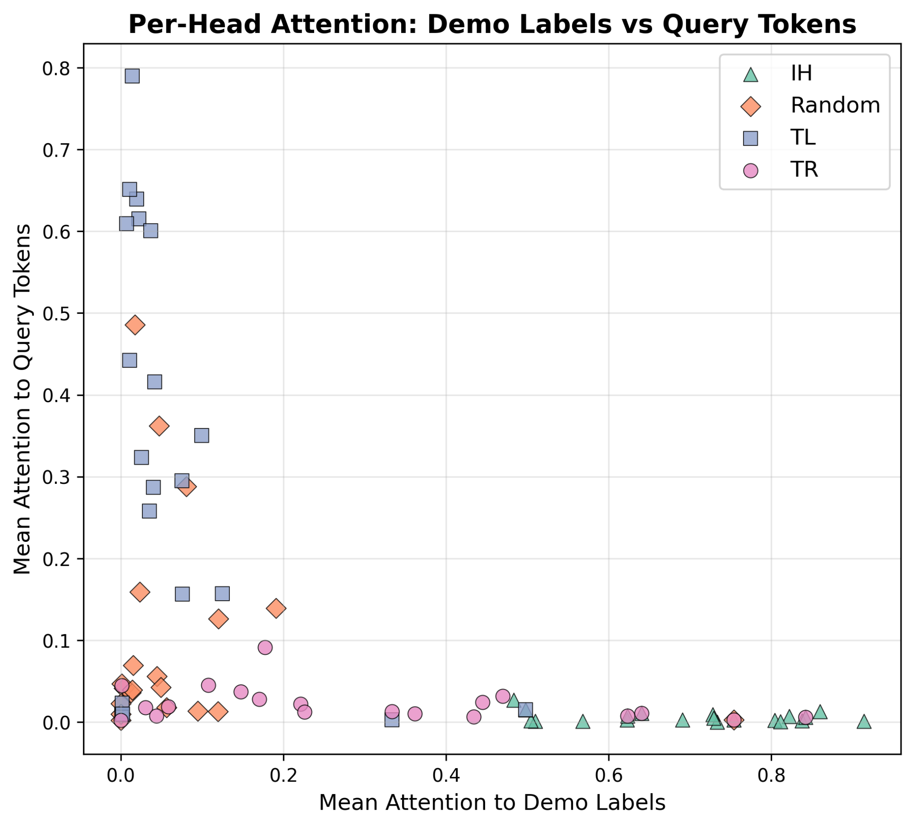
Results IV: attention allocation
TR looks label-focused; TL looks query-focused
IH: ~0.70 attention to demo labels, almost none to query
TR: elevated demo-label attention (~0.30)
TL: strongest query attention (~0.33)
Random heads show no structured pattern
Notes:
[Sources] - User-uploaded report.pdf - User-uploaded experiment-5-attention-allocation.png - User-uploaded experiment-5-scatter.png

Slide 15
Conclusions
What survived the scaled reproduction?
We recovered the paper’s main qualitative story on SST-2 with a smaller 4-bit model
TR and TL heads are separable by overlap, depth, attention patterns, and ablation signatures
TR is mechanistically closer to induction heads than TL is
The decomposition is useful because it explains not just which heads matter, but how they matter
4/20
0/20
TR ∩ IH
TR ∩ TL
22.65
0.333
TR mean layer
TL query attention
Takeaway
In-context learning is not monolithic.
Recognizing the task and solving the query look like different head-level computations.
Notes:
[Sources] - User-uploaded report.pdf

Slide 16
Plan for end-term assessment
One concrete extension: move from single-position TSLA to multi-position TSLA
Motivation
Expected deliverables
Current TSLA scores heads at one prediction position
But task information in ICL may be distributed across multiple output positions
Composite prompts stress this weakness most clearly
Head-set stability: does multi-position TR become more robust?
Composite-task experiments: does TR transfer across subtasks more than TL?
Multi-position intervention: does it explain more causally than final-position-only ablation?
Broader test of a key criticism: are task representations localized or distributed?
Proposed idea
Define multi-position TR/TL scores that aggregate head contributions over several task-relevant positions (demo outputs + query outputs), then compare them against single-position TSLA.
Why this is a good extension
It builds directly on our existing code and targets a real limitation of the paper, rather than merely adding more datasets.
Notes:
[Sources] - User-uploaded report.pdf - OpenReview paper PDF: Localizing Task Recognition and Task Learning in In-Context Learning via Attention Head Analysis - OpenReview workshop paper: Single-Position Intervention Fails: Distributed Output Templates Drive In-Context Learning

Slide 17
References
Papers, websites, and code resources used in the project
Yang, H., Cho, H., & Inoue, N. (2026). Localizing Task Recognition and Task Learning in In-Context Learning via Attention Head Analysis. ICLR 2026. OpenReview.
Elhage, N. et al. (2021). A Mathematical Framework for Transformer Circuits. Transformer Circuits Thread, Anthropic.
Olsson, C. et al. (2022). In-context Learning and Induction Heads. Transformer Circuits Thread, Anthropic.
Wolf, T. et al. (2020). Transformers: State-of-the-Art Natural Language Processing. EMNLP System Demonstrations.
Dettmers, T. et al. (2023). QLoRA: Efficient Finetuning of Quantized Language Models. NeurIPS 2023.
Unsloth. (March, 2026 accessed). unsloth/Llama-3.2-3B-Instruct-bnb-4bit. Hugging Face model repository.
Notes:
[Sources] - User-uploaded report.pdf

