Slide 1

Sanjivani College of Engineering, Kopargaon
(An Autonomous Institute, Affiliated to SPPU, Pune)
Department of Computer Engineering, NBA Tier-1 Accredited
IoT(MDCO321) Project Presentation
T.Y. B. Tech – Computer Engineering | AY [ 2026–2027 ] | Div-A
AI-Based Non-Communicable Disease Prediction and Smart Medicine Reminder System using IoT
Submitted By
Wakchaure Shruti | Shinde Chanchal
| Nere Tejas | Gidhad Arti
Under the Guidance of
Prof. N.Y. Siddiqui
www.sanjivanicoe.org.in

Slide 2
Index
CONTENT
SLIDE
CONTENT
SLIDE
01
Introduction
3
11
Pin Configuration & Slot Mapping
13
02
Literature Survey
4
12
Prototype & Sensor Placement
14
03
Problem Definition
5
13
Project Structure
15
04
Aim & Objectives
6
14
IoT Communication & Dashboard
16
05
Methodology
7
15
Implementation Status
17
06
System Architecture
8
16
Testing & Observations
18
07
System Working Flow
9
17
Applications
19
08
Hardware Components
10
18
Advantages & Limitations
20
09
Software Requirements
11
19
Future Scope
21
10
Project Specifications
12
20
Conclusion & References
22–23
Sanjivani COE | Department of Computer Engineering | IoT (MDCO321) Project | T.Y. B.Tech
2

Slide 3
Introduction
01 · OVERVIEW
UNDERSTANDING NON-COMMUNICABLE DISEASES
OUR SOLUTION
Non-communicable diseases such as diabetes, hypertension, heart disease and kidney disease require regular medication and continuous monitoring over a long period of time.
Smart Medicine Dispenser
Medical Report OCR
THE CHALLENGE WITH CURRENT PRACTICE
AI Disease Prediction
Patients may forget medicines, family members cannot tell whether a dose was taken, and doctors lack continuous visibility into adherence and recovery. Medical reports are also hard for patients to understand and are analysed manually.
Adherence & Recovery Monitoring
Role-Based Dashboard
DUAL-LAYER APPROACH
Layer 1 — IoT / Hardware
ESP32 · Servos · IR Sensor · LED · Buzzer · LCD
Layer 2 — Software / Cloud
Dashboard · Database · OCR · AI/ML · Alerts
Sanjivani COE | Department of Computer Engineering | IoT (MDCO321) Project | T.Y. B.Tech
3

Slide 4
Literature Survey
Sr. | Author(s) & Year | Title | Technology / Method | Key Findings | Gap vs. Our Work
1 | Zainalabidin et al., 2026 | Pill Dispensing and Monitoring System with Biometric Access (PDMS-BA) | ESP32, fingerprint sensor, RTC module, servo-based dispensing, Wi-Fi logging to Google Sheets | Audio-visual alerts, fingerprint check before dispensing, real-time cloud logging; missed doses recorded automatically | Adds a biometric layer; focuses on authentication and logging, not report analysis or disease-risk prediction
2 | Radika et al., 2026 | Prototype Kotak Obat Otomatis Berbasis IoT (IoT-based automatic medicine box prototype) | ESP32, Firebase Realtime Database, Next.js web interface, stepper motor, I2C LCD, buzzer | Reminders, automatic dispensing and history logging verified by black-box testing | Reminder and logging focus; no medical-report OCR or AI-based risk prediction
3 | Charunetraa et al., 2025 | A Mobile IoT-Based Smart Pill Dispenser with Biometric Authentication | ESP32, AS608 fingerprint module, stepper motor, DS3231 RTC, Wi-Fi and mobile app | Scheduling, voice-guided reminders and caregiver notifications with fail-safe dispensing controls | Dispensing and caregiver alerts only; no report analysis or role-based clinical dashboard
Common observation: existing dispensers concentrate on reminders, dispensing and logging; combining them with report analysis, risk prediction and role-based monitoring is the gap this project addresses.
Sanjivani COE | Department of Computer Engineering | IoT (MDCO321) Project | T.Y. B.Tech
4

Slide 5
Problem Definition
THE PROBLEM
PROBLEM STATEMENT
Missed medicine doses
01
Patients with non-communicable diseases need regular medication and continuous health monitoring. Missed doses, no adherence tracking and manual analysis of medical reports make healthcare management difficult.
Family members and healthcare professionals often lack real-time information about a patient's medication intake and health status.
No reliable reminder or controlled dispensing at the prescribed time.
No adherence visibility
02
Family and doctors cannot see what was dispensed or collected.
Manual report analysis
03
Reports are hard to interpret and are analysed by hand.
THE NEED An integrated system that automates medicine reminders and dispensing, analyses medical reports using OCR, predicts disease risk using AI/ML, and provides centralised patient monitoring through a role-based dashboard.
Sanjivani COE | Department of Computer Engineering | IoT (MDCO321) Project | T.Y. B.Tech
5

Slide 6
Aim & Objectives
THE MISSION
PROJECT AIM
KEY OBJECTIVES
To develop an IoT, AI and OCR-enabled healthcare monitoring system that automates medicine reminders and dispensing, monitors medicine pickup and adherence, analyses medical reports, predicts disease risk and provides role-based health monitoring.
01
To Automate scheduled medicine dispensing and reminders using IoT technology.
02
To Monitor medication adherence and generate alerts for missed doses.
03
To Extract medical parameters from reports using OCR technology.
04
To Predict the risk of non-communicable diseases using AI/ML models.
05
To Enable centralised health monitoring through role-based dashboards for patients and healthcare professionals.
Sanjivani COE | Department of Computer Engineering | IoT (MDCO321) Project | T.Y. B.Tech
6

Slide 7
Methodology
EIGHT-STEP APPROACH
1
Patient & Prescription Setup
2
IoT Hardware Initialisation
3
Scheduled Dispensing
4
Pickup Detection & Alerts
Register the patient and store prescribed medicines, dosage schedules and relevant medical information.
Configure ESP32, servos, IR sensor, LCD, LED and buzzer; map medicines to the six carousel slots.
ESP32 compares NTP-synced time with the schedule; carousel and gate release the selected medicine.
IR sensor detects a hand at the outlet; dose status is recorded; missed-dose alerts to family or nurse.
5
Medical Report Processing
6
AI Risk Prediction
7
Database & Dashboard
8
Monitoring & Follow-Up
Uploaded reports are processed with OCR (Tesseract) to extract key medical parameters.
Trained AI/ML models estimate risk of diabetes, hypertension, heart and kidney disease, and stroke.
Prescriptions, reports, dose records and predictions are stored and shown on role-based dashboards.
Track adherence, health data and risk trends to support follow-up care.
Layer 1 — IoT / Hardware
Layer 2 — Software / Cloud
Sanjivani COE | Department of Computer Engineering | IoT (MDCO321) Project | T.Y. B.Tech
7

Slide 8
System Architecture
NTP Time Server
Internet time source
ESP32
Carousel Servo · GPIO 23
Wi-Fi / NTP
Central controller
Gate Servo 1 · GPIO 18
Wi-Fi + HTTP web server
NTP time synchronisation
Stores six-slot schedules
Schedule vs. time check
Drives servos, LED, buzzer, LCD
Reads IR sensor
Reports status to dashboard
Gate Servo 2 · GPIO 19
Web Dashboard
Schedules · status · history
HTTP over Wi-Fi
LED · GPIO 26
Passive Buzzer · GPIO 25
IR Sensor · GPIO 34
I2C LCD · SDA 32 / SCL 33
Telegram alerts
Blue: motion · Amber: alerts · Green: sensing and display
Sanjivani COE | Department of Computer Engineering | IoT (MDCO321) Project | T.Y. B.Tech
8

Slide 9
System Working Flow
SETUP
SCHEDULE MATCH
DISPENSE
UPDATE
1
ESP32 powers ON and connects to Wi-Fi
6
ESP32 keeps comparing current time with scheduled times
9
IR sensor monitors the dispensing area
12
ESP32 updates the dispensing status
2
Current date and time obtained via NTP
7
On a match, carousel servo moves to the matching slot
10
Hand detected: the matching gate servo opens
3
User enters medicine names and times on the dashboard
13
Dashboard shows the updated status and history
4
Dashboard sends the schedule to the ESP32
8
LED and buzzer alert the user
11
Gate stays open for the set duration, then closes
5
ESP32 stores schedules for the six slots
Technical note: IR detection only shows that a hand was detected near the dispensing area (pickup detected). It does not independently prove the medicine was swallowed or consumed.
Sanjivani COE | Department of Computer Engineering | IoT (MDCO321) Project | T.Y. B.Tech
9

Slide 10
Hardware Components
SYSTEM REQUIREMENTS
ESP32 Board
Servo Motors (×3)
IR Sensor
16×2 LCD (I2C)
Main controller with built-in Wi-Fi; runs the HTTP server, schedule logic and device control.
Carousel Servo positions the slot; Gate Servo 1 and Gate Servo 2 open the dispensing gates.
Detects the user's hand near the medicine dispensing area.
Displays system information and status in the base unit.
GPIO 23 · 18 · 19
OUT: GPIO 34
SDA 32 · SCL 33
LED
Passive Buzzer
Medicine Carousel
Power Supply
Visual medicine reminder at the scheduled time.
Audio medicine reminder at the scheduled time.
Physical storage with six medicine slots, split across two dispensing gates.
External supply / battery powers the ESP32 and servos through suitable voltage regulation.
GPIO 26
GPIO 25
6 slots · 2 gates
Sanjivani COE | Department of Computer Engineering | IoT (MDCO321) Project | T.Y. B.Tech
10

Slide 11
Software Requirements
SOFTWARE STACK
ESP32 FIRMWARE
WEB DASHBOARD
PROPOSED SOFTWARE LAYER
Wi-Fi connectivity
HTTP web server
NTP date and time synchronisation
Six-slot schedule management
Carousel and gate servo control
LED, buzzer, LCD and IR handling
Status reporting to the dashboard
Medicine slot configuration
Medicine name entry
Schedule / time selection
ESP32 connection test
Time synchronisation
Live status monitoring (periodic polling)
Dispensing history
OCR (Tesseract) for medical reports
AI/ML disease-risk models
Backend and database for prescriptions, reports and dose records
Role-based views: Patient, Doctor, Nurse/Family, CHO
Missed-dose notifications (Telegram planned)
Status Firmware and dashboard are implemented; the proposed layer is the next development stage.
Sanjivani COE | Department of Computer Engineering | IoT (MDCO321) Project | T.Y. B.Tech
11

Slide 12
Project Specifications
Parameter | Specification
Project Name | AI-Based NCD Prediction and Smart Medicine Reminder System using IoT
Controller | ESP32 Development Board with Wi-Fi
Actuators | 3 servo motors: Carousel Servo, Gate Servo 1, Gate Servo 2
Sensor | IR sensor for hand detection at the dispensing area
Display | 16×2 LCD with I2C interface
Alert Output | LED (visual) and passive buzzer (audio)
Medicine Slots | 6 slots; Gate 1 serves slots 1–3, Gate 2 serves slots 4–6
Time Source | ESP32 Wi-Fi NTP synchronisation (DS3231 RTC planned)
Communication | HTTP endpoints over Wi-Fi between dashboard and ESP32
Dashboard | Web dashboard: slot configuration, status monitoring, history
Power Supply | External supply / battery with suitable voltage regulation
Main Functions | Scheduled reminders, carousel positioning, gated dispensing, pickup detection, status monitoring
Sanjivani COE | Department of Computer Engineering | IoT (MDCO321) Project | T.Y. B.Tech
12

Slide 13
Pin Configuration & Slot Mapping
ESP32 PIN CONFIGURATION
MEDICINE SLOT MAPPING
Component | ESP32 GPIO
Gate Servo 1 | GPIO 18
Gate Servo 2 | GPIO 19
Carousel Servo | GPIO 23
IR Sensor OUT | GPIO 34
LED | GPIO 26
Passive Buzzer | GPIO 25
LCD SDA | GPIO 32
LCD SCL | GPIO 33
Medicine Slot | Carousel Angle | Gate
Slot 1 | 0° | Gate 1
Slot 2 | 60° | Gate 1
Slot 3 | 120° | Gate 1
Slot 4 | 0° | Gate 2
Slot 5 | 60° | Gate 2
Slot 6 | 120° | Gate 2
How it works: the carousel servo rotates to the slot angle, and the gate servo of that slot's group (Gate 1 or Gate 2) opens to dispense.
Pin map of the current standalone implementation.
Sanjivani COE | Department of Computer Engineering | IoT (MDCO321) Project | T.Y. B.Tech
13

Slide 14
Prototype & Sensor Placement
PROTOTYPE DIMENSIONS
1
Upper Housing
2
Dual-Gate Mechanism
Base Enclosure
14 in L × 12 in W × 4 in H (35.6 × 30.5 × 10.2 cm)
Upper Medicine Housing
8 in L × 8 in W × 13 in H (20.3 × 20.3 × 33 cm)
Dispensing Opening
5 in W × 8 in H (12.7 × 20.3 cm)
Overall Height
Approx. 17 in (13 in housing + 4 in base)
Six-slot rotating medicine carousel; the Carousel Servo sits below/behind it and rotates it to the selected slot.
Gate Servo 1 operates slots 1–3 and Gate Servo 2 operates slots 4–6 for controlled dispensing.
3
Detection Zone
4
Base Enclosure
IR sensor near the dispensing outlet detects a hand / medicine pickup (distance: 5 in).
ESP32, 16×2 LCD, LED and passive buzzer are housed in the base control section.
Sanjivani COE | Department of Computer Engineering | IoT (MDCO321) Project | T.Y. B.Tech
14

Slide 15
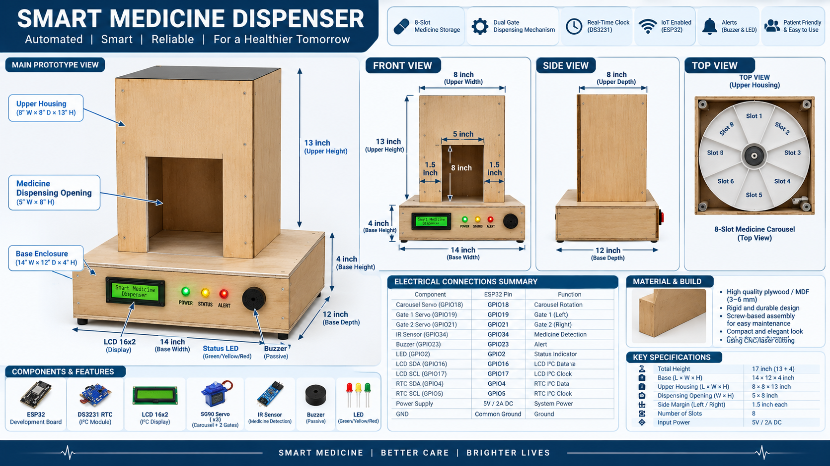
Project Structure
Smart Medicine Dispenser: front, side and top views with component list
Sanjivani COE | Department of Computer Engineering | IoT (MDCO321) Project | T.Y. B.Tech
15

Slide 16
IoT Communication & Dashboard
DASHBOARD ⇄ ESP32 OVER HTTP
Method | Endpoint | Purpose
GET | /api/status | Returns current system status; dashboard polls it periodically
POST | /api/schedule | Sends the schedule of one medicine slot to the ESP32
POST | /api/schedule/all | Sends the schedules of all slots in one request
POST | /api/time | Synchronises time between dashboard and ESP32
DASHBOARD FEATURES
1
Six-slot management
2
Medicine name entry
3
Schedule / time selection
4
ESP32 connection test
5
Time synchronisation
Data flow: the dashboard sends schedules to the ESP32; the ESP32 compares them with NTP-synchronised time, dispenses on a match, and returns status that the dashboard displays with history.
6
Status monitoring
7
Dispensing history
Sanjivani COE | Department of Computer Engineering | IoT (MDCO321) Project | T.Y. B.Tech
16

Slide 17
Implementation Status
CURRENTLY IMPLEMENTED / WORKING
FUTURE ENHANCEMENTS
ESP32 Wi-Fi connectivity
HTTP server communication
Six-slot dashboard configuration
Medicine schedule transmission
ESP32-based NTP time synchronisation
Three-servo control
Carousel positioning and two-gate control
IR-based hand detection
LED and buzzer alerts
LCD status display
Dashboard status communication
DS3231 RTC for reliable timekeeping
Telegram notifications
Battery-powered portable operation
Improved enclosure and mechanical design
Further reliability and usability work
PROPOSED SOFTWARE LAYER
Report OCR, AI/ML risk prediction and role-based dashboards form the next software layer.
Sanjivani COE | Department of Computer Engineering | IoT (MDCO321) Project | T.Y. B.Tech
17

Slide 18
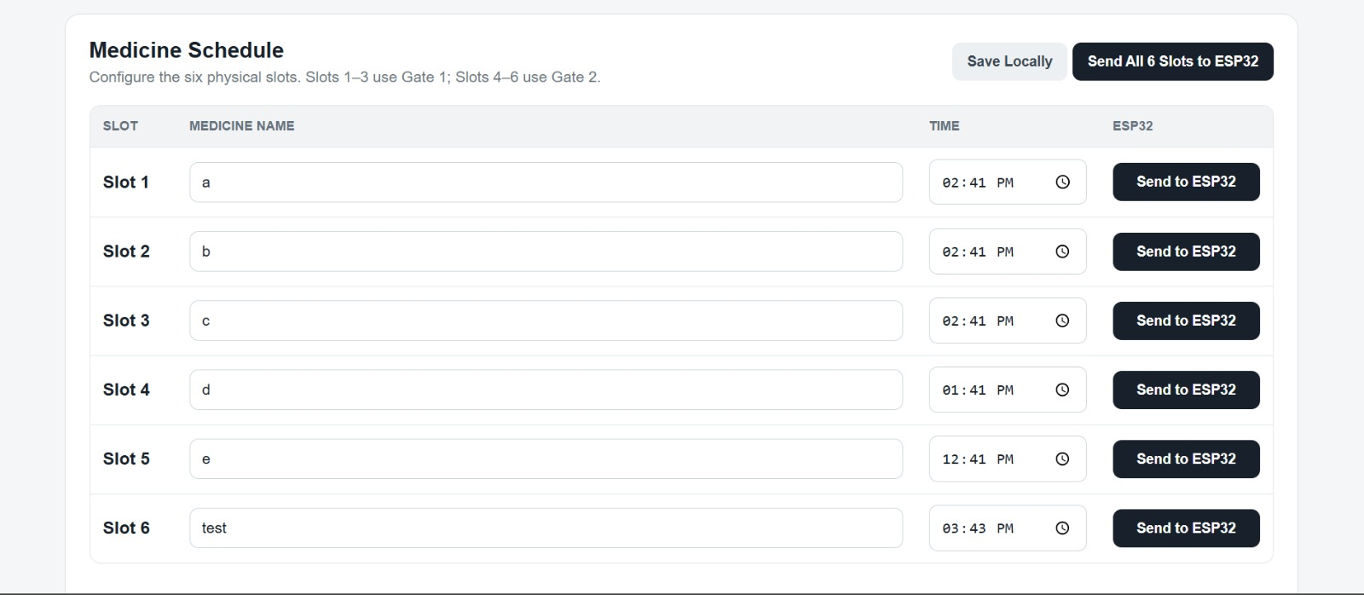
Testing & Observations
Function Tested | Observed Behaviour | Outcome
Wi-Fi and NTP time | ESP32 connects and obtains current date and time | Working
Schedule transmission | Dashboard sends six-slot schedules over HTTP | Working
Carousel positioning | Carousel servo moves to the scheduled slot angle | Working
Gate control | Gate servo for the slot's group opens and closes | Working
Hand detection | IR sensor detects a hand at the dispensing area | Working
Reminders | LED and passive buzzer activate at schedule time | Working
LCD status | LCD shows system information and status | Working
Dashboard status | Dashboard polls /api/status and shows updates | Working
Dashboard screenshot
Insert image here
Functional verification only. Hand detection is not proof of medicine ingestion, and no accuracy figures are claimed.
Sanjivani COE | Department of Computer Engineering | IoT (MDCO321) Project | T.Y. B.Tech
18

Slide 19
Applications
WHERE IT HELPS
01
Home Healthcare
02
Hospitals & Clinics
03
Family & Nursing Care
Smart reminders and automatic dispensing for chronic disease patients.
Helps doctors monitor prescriptions, reports, adherence and recovery.
Family and nurses can remotely track medicine intake and missed doses.
04
Community Healthcare
05
Preventive Healthcare
06
Population Health
Helps CHOs monitor patients, disease prevalence and health statistics across villages.
OCR and AI analysis of reports to spot potential disease risks early.
Centralised data on high-risk patients, adherence trends and common diseases at district level.
Sanjivani COE | Department of Computer Engineering | IoT (MDCO321) Project | T.Y. B.Tech
19

Slide 20
Advantages & Limitations
ADVANTAGES
LIMITATIONS
All-in-One Healthcare: Dispensing, OCR, AI prediction and monitoring in one system.
Requires Wi-Fi: Needed for NTP time, dashboard and alerts.
Time Dependency: Timekeeping relies on NTP until the RTC is added.
Automated Medication: Scheduled dispensing with visual and audio reminders.
Pickup, Not Ingestion: IR detects a hand only; it cannot confirm the medicine was swallowed.
Smart Monitoring: Tracks pickup, adherence, reports and risk status.
OCR / AI Dependency: Accuracy depends on report quality and training data.
Role-Based Access: Separate views for patients, doctors, nurses/family and CHOs.
Power Requirement: Needs continuous power or battery backup.
Early Risk Detection: OCR and AI flag potential disease risks from reports.
Prototype Scope: Six slots and selected diseases only.
Sanjivani COE | Department of Computer Engineering | IoT (MDCO321) Project | T.Y. B.Tech
20

Slide 21
Future Scope
PLANNED IMPROVEMENTS
01
DS3231 RTC Integration
02
Telegram Notifications
03
Battery-Powered Operation
More reliable timekeeping during Wi-Fi or power interruptions.
Missed-dose and status alerts sent to family members or nurses.
Further work towards portable, battery-backed use.
04
Enclosure & Mechanical Design
05
Reliability & Usability
06
Integrated Healthcare Platform
Improved enclosure and refined dispensing mechanism.
Additional robustness and ease-of-use improvements.
Link dispenser data with OCR, AI risk prediction and role-based dashboards.
Sanjivani COE | Department of Computer Engineering | IoT (MDCO321) Project | T.Y. B.Tech
21

Slide 22
Conclusion
IN SUMMARY
CONCLUSION
Automated
Scheduled reminders and gated dispensing
The proposed system integrates IoT, AI, OCR and a web dashboard into one healthcare management solution.
The IoT prototype automates reminders and scheduled dispensing using an ESP32, a servo-driven six-slot carousel with two gates, NTP-based timing, IR hand detection and a web dashboard.
RTC and Telegram alerts, together with the OCR/AI layer, will connect patients, doctors, family, nurses and CHOs for timely intervention.
Connected
ESP32 and dashboard over HTTP / Wi-Fi
Monitored
Pickup detection and status history
Extensible
RTC, Telegram, OCR and AI next
OVERALL IMPACT
“From Medicine Reminder to Intelligent Disease Monitoring — One Integrated IoT Healthcare Platform.”
Sanjivani COE | Department of Computer Engineering | IoT (MDCO321) Project | T.Y. B.Tech
22

Slide 23
References
1
World Health Organization, “Noncommunicable diseases,” WHO Fact Sheet.
2
World Health Organization, Adherence to Long-Term Therapies: Evidence for Action. Geneva: WHO, 2003.
D. Z. I. Zainalabidin, F. Mohd Atan, Z. I. Abd Latiff, N. A. M. Zin and N. A. Ismail, “Pill Dispensing and Monitoring System with Biometric Access: An IoT-Based Approach for Medication Adherence,” J. Telecommun. Electron. Comput. Eng. (JTEC), vol. 18, no. 2, pp. 23–29, 2026, doi: 10.54554/jtec.2026.18.02.004.
3
P. D. K. Radika, M. A. P. Putra and P. T. H. Permana, “Pengembangan Prototype Kotak Obat Otomatis Berbasis IoT untuk Pemantauan dan Pengingat Konsumsi Obat,” Jurnal Komtika, vol. 10, no. 1, 2026, doi: 10.31603/komtika.v10i1.16096.
4
P. L. Charunetraa, S. Ganadharani, A. P. Malaharshana, T. Joshitha, M. Deepa and R. Rajaraja, “A Mobile IoT-Based Smart Pill Dispenser with Biometric Authentication,” 2025 Int. Conf. on Intelligent Innovations in Engineering and Technology (ICIIET), 2025, pp. 1–7.
5
6
Espressif Systems, “ESP32 Series Datasheet.”
Sanjivani COE | Department of Computer Engineering | IoT (MDCO321) Project | T.Y. B.Tech
23

Slide 24
Sanjivani College of Engineering, Kopargaon
(An Autonomous Institute, Affiliated to SPPU, Pune)
Department of Computer Engineering, NBA Tier-1 Accredited
Thank You
Questions are welcome
Guided by Prof. N.Y. Siddiqui · Department of Computer Engineering
www.sanjivanicoe.org.in

