Slide 1

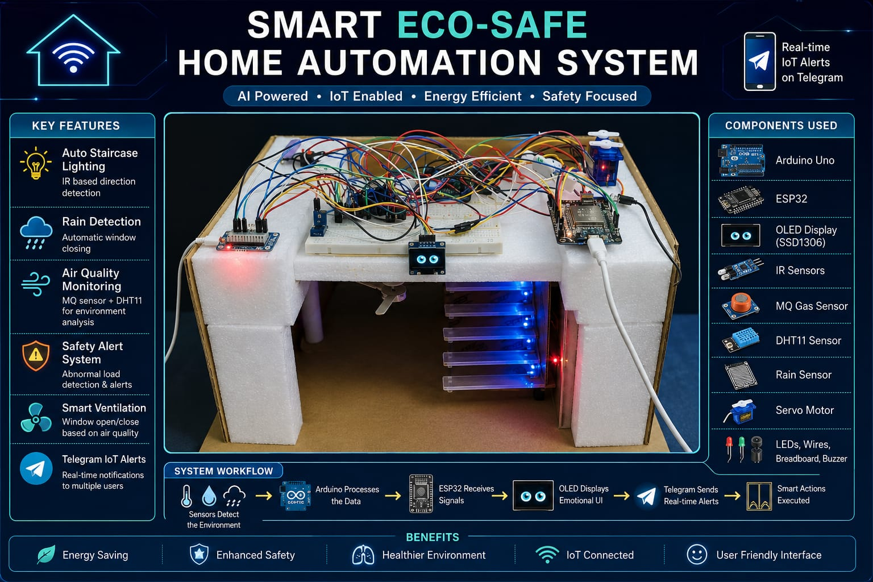
Smart Eco-Safe Home Automation System With Emotional OLED Interface
Presented by
Group ID : 14

Slide 2

Redefining Home Automation through Intelligence and Emotion
Core Project Goals
Innovation & Interaction
• Energy efficiency enhancement
• Human-like emotional interface
• Safety monitoring & protection
• Intuitive OLED visual feedback
• Environmental awareness
• Engaging machine interaction
• Real-time user interaction
• Continuous safety tracking

Slide 3

Comprehensive Hardware Integration
Sensors
Microcontrollers
Output & Display
• MQ Gas Sensor
• Arduino Uno (Logic)
• DHT11 Temp/Humidity
• SSD1306 OLED Display
• ESP32 Dev Board (IoT)
• Rain Detection Sensor
• Servo Motor (Window)
• Jumper Wires & Resistors
• Dual IR Motion Sensors
• Piezo Buzzer (Alerts)
• Sequential LED Array

Slide 4

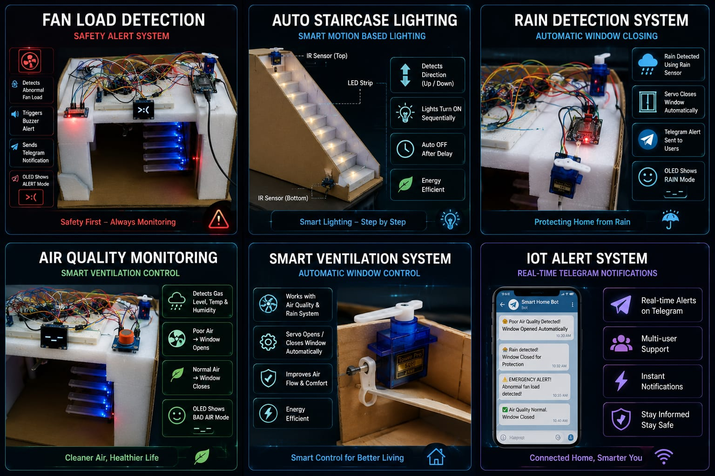
Feature 1: Intelligent Staircase Lighting
Motion-Based Logic
• Dual IR sensors detect user presence and direction
• Intelligent identification of UP or DOWN movement
• Sequential LED activation following the user's path
• Automatic turn-off delay for optimized usage
Core Benefits
• Significant energy efficiency
• Enhanced user safety at night
• Modern, automated home feel
• Hands-free operation

Slide 5

Feature 2: Fan Load Detection & Safety
Abnormal Load Monitoring
• Detects dangerous electrical conditions in fan systems
• Real-time monitoring of current and load stability
• Prevents potential fire hazards or motor damage
• Integrated with Arduino logic for instant detection
Immediate Actions
• Local Buzzer Alert (Audible)
• Telegram Notification (Remote)
• OLED "ALERT" Mode
😡

Slide 6

Feature 3: Rain & Air Quality Automation
Rain Protection System
• Sensor: High-sensitivity rain detection
• Action: Automatic window closure via Servo
• Feedback: Instant Telegram alert
• UI: OLED switches to RAIN mode
Ensures home safety during sudden weather changes.
Air Quality Monitoring
• Sensors: MQ Gas + DHT11 (Temp/Hum)
• Smart Control: Opens window for ventilation
• Advanced Logic: Hysteresis & noise filtering
• UI: OLED shows BAD AIR mode (😴)
Maintains a healthy indoor environment automatically.

Slide 7

IoT Connectivity & Telegram Integration
The ESP32 Communication Hub
• Seamless Connectivity: Built-in Wi-Fi for direct cloud access.
• Global Monitoring: Stay informed about your home from anywhere in the world.
• Multi-User Support: Capable of alerting multiple family members simultaneously.
• Reliable Delivery: Instant notification routing via the Telegram Bot API.
Real-Time Alerts
• Air Quality Changes
• Rain Detection
• Fan Load Anomalies
• System Status Updates

Slide 8

Innovation: The Emotional OLED Interface
Alert Mode
Robot Personality
Normal Mode
• Full-screen UI takeover
• Interactive home assistant
• Alternating text & emoji
• Eyes Mode: Animated robotic eyes with blinking
• Human-like engagement
• High-contrast visibility
• Dynamic visual feedback
• Message Mode: System status updates
• Intuitive user experience
😡
🌧
😴
• Flow: Eyes ↔ Message

Slide 9

System Flow: From Sensor to User
01
02
Data Acquisition
03
Sensors (MQ, DHT11, Rain, IR) continuously monitor environmental and safety parameters, feeding raw data to the controller.
Logic Processing
04
Arduino Uno evaluates sensor conditions against predefined thresholds and sends digital HIGH/LOW signals to the ESP32.
Action Execution
ESP32 receives signals, manages the Emotional OLED UI, triggers actuators (Servo/Buzzer), and initiates IoT cloud alerts.
User Feedback
The user receives immediate visual feedback via the OLED display and remote notifications through the Telegram multi-user system.

Slide 10

Future Roadmap: Scaling the Smart Assistant
Intelligence
Connectivity
Infrastructure
• AI-Based Predictions
• Dedicated Mobile App
• Behavioral Learning
• Cloud Data Storage
• Voice Assistant Support
• Predictive Maintenance
• Historical Trend Analysis
• MQTT Protocol Integration
• Enhanced Emotional UI
• Energy Usage Insights
• Multi-Device Sync
• Remote Firmware Updates

