Slide 1


Slide 2


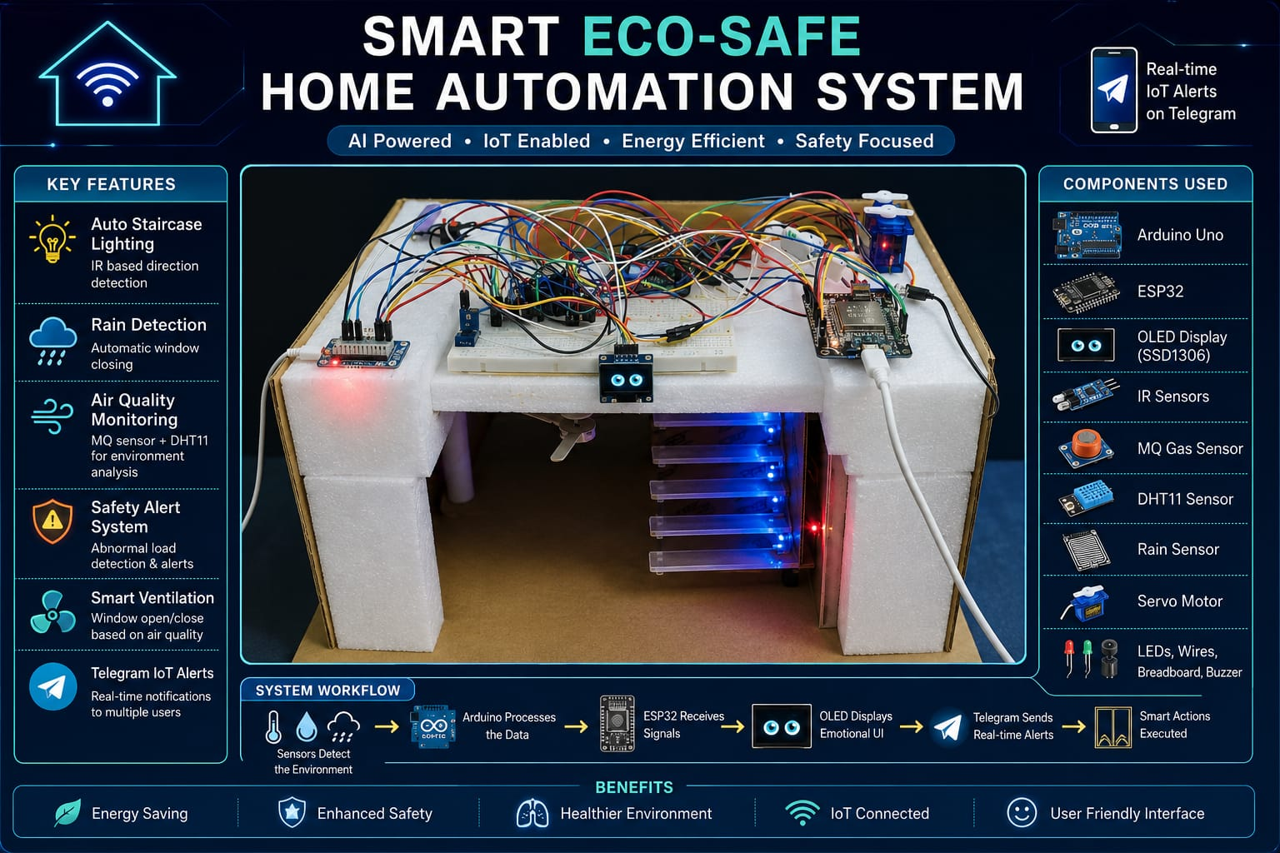
Smart Eco-Safe Home Automation System
A Sustainable Approach to Modern Living
Presented by :
66 : Sai Deokar
67 : Tejas Nere
68 : Siddharth Palande
69 : Arti Gidhad
70 : Sanket Rashinkar

Slide 3






Objective: Advancing Sustainable Smart Living
Environmental Protection
Energy Conservation
Lowering residential carbon footprints through smart automation and efficient resource management.
Ensuring appliances run only when needed to cut electricity waste and reduce overall consumption.
Pollution Monitoring
Eco-Awareness
Real-time indoor air quality tracking to maintain a healthy and eco-friendly living environment.
Providing intuitive visual feedback to raise residents' awareness of their environmental impact.
Safety First
Continuous monitoring for a secure household, balancing technology with sustainable safety standards.

Slide 4





Comprehensive Hardware for Sustainability
Controllers
Eco-Sensors
Output & Feedback
Arduino Uno
: Efficient logic hub for precise sensor management.
MQ & DHT11
: Monitoring pollutants, temperature, and humidity.
SSD1306 OLED
: High-efficiency display for eco-interface feedback.
ESP32 Board
: Low-power IoT hub for global environmental monitoring.
Rain Detection
: High-sensitivity sensor for weather protection.
Servo Motor
: Smart mechanical control for natural ventilation.
Dual IR Sensors
: Motion detection for energy-efficient lighting.
Buzzer & LEDs
: Low-energy indicators for safety alerts.
Voltage Divider
: Protects components, reducing electronic waste.
*Components integrated to balance technological advancement with environmental responsibility.

Slide 5
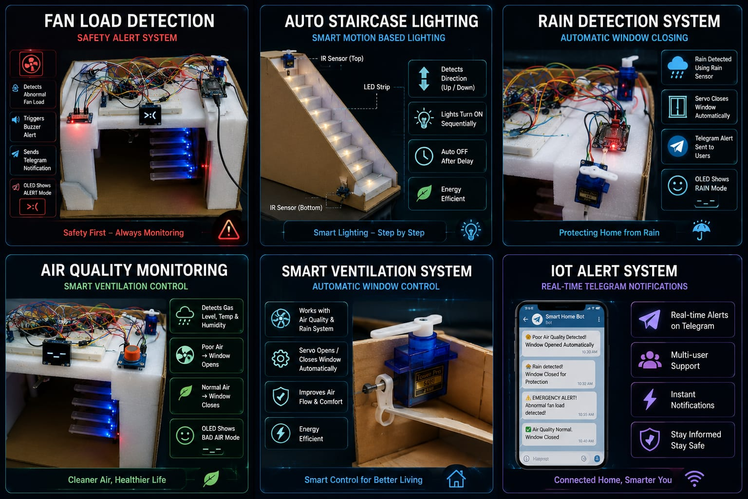





Energy Conservation: Smart Lighting
Intelligent Mechanism
Reducing Wastage
: Automated staircase lights run only when the space is occupied.
Motion Detection
: Dual IR sensors detect direction, activating lights in sequence.
Eco-Logic
: Timed delays ensure lights are turned off automatically when empty.
Environmental Impact
Lower Consumption
: Significantly reduces daily electricity usage compared to manual systems.
Sustainable Habits
: Encourages a lifestyle of conscious resource use via automation.
Carbon Reduction
: Lowers household carbon footprint through optimized efficiency.
Goal: Zero-waste residential illumination.

Slide 6




Smart Environmental Response
Rainwater Awareness
Natural Ventilation
Automatic Protection
: Immediate window closure via Servo prevents interior damage and resource loss.
Pollution Mitigation
: Opens windows automatically when indoor air quality drops.
Smart Monitoring
: High-sensitivity detection ensures home safety during sudden weather shifts.
Energy Reduction
: Uses natural air circulation to minimize reliance on mechanical cooling.
Remote Alerts
: Keeps residents informed of weather-related automated actions.
Smart Logic
: Filters environmental noise to ensure precise ventilation control.
Reduces property damage and maintenance resources.
Promotes a healthy indoor environment sustainably.

Slide 7






IoT for Global Environmental Awareness
Eco-Connectivity Hub
Global Monitoring
: Leverages IoT to track home sustainability and energy patterns from anywhere in the world.
Instant Eco-Alerts
Real-Time Data
: Instant sharing of environmental events like air quality changes or rainfall detection.
Air Quality Fluctuations
Precipitation Events
Multi-User Responsibility
: Engages all household members in environmental monitoring and safety alerts.
Energy Load Anomalies
System Efficiency Status
Sustainable Foundation
: Provides the data necessary for long-term energy and resource management.
Empowering Sustainable Choices

Slide 8






Safety and Resource Management
Preventing Resource Wastage
Fan Load Monitoring
: Detects abnormal electrical loads to prevent energy loss and motor overheating.
Eco-Safety Alert System
Hazard Prevention
: Identifies potential electrical faults that could lead to resource damage or fire hazards.
Audible Buzzer Alert
Remote Awareness
: IoT notifications keep users informed of their home's safety and efficiency status in real-time.
Telegram IoT Notification
Efficiency Impact
: Reduces long-term maintenance costs and electronic waste by protecting hardware.
OLED Visual "ALERT" Mode

Slide 9






Innovation: The Emotional Eco-Interface
Fostering Connection
Visual Sustainability
Engagement Modes
Relatable Status
: Makes environmental data engaging via an emotional OLED.
Intuitive Icons
: Uses "expressions" for air quality and safety status.
Animated Eyes
: Creates a friendly "living" system that users care to monitor.
Instant Feedback
: High-contrast UI for immediate awareness.
Human-Centric
: Bridges technology and environmental empathy.
Status Messages
: Clear updates on the home's ecological health.
😡
🌧
😴
*Designed to transform passive monitoring into active environmental engagement.

Slide 10




System Flow: A Sustainable Data Journey
Environmental Input
Intelligent Analysis
Eco-Action
User Insight
Sensors capture real-time ecological data, including air quality, rain, and motion.
The system processes data for the most energy-efficient response, preventing waste.
Automated adjustments to lighting and ventilation are executed to optimize resources.
Delivering environmental awareness directly to the resident via OLED and IoT.

Slide 11
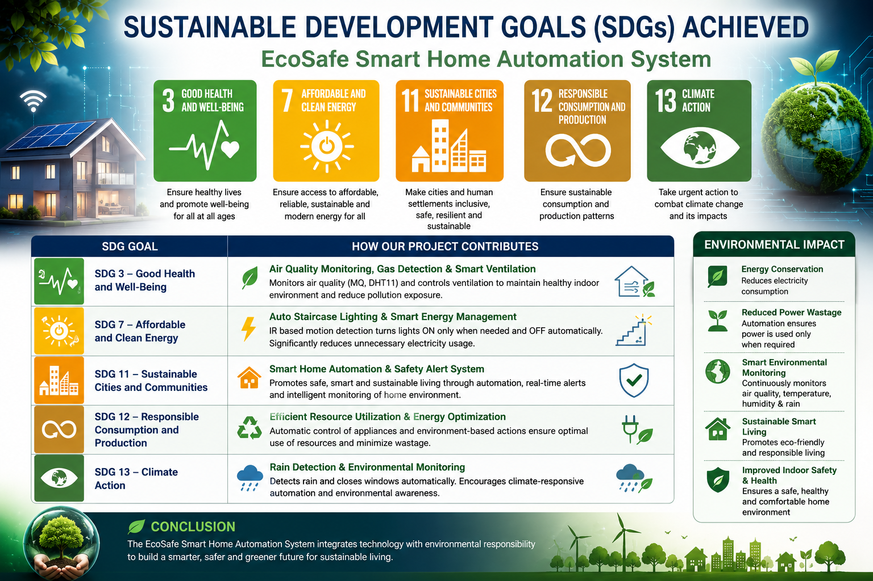

Slide 12




Future Roadmap: Towards a Greener Future
Renewable Integration
AI for Sustainability
Expanded Monitoring
Solar Management
: Direct integration with rooftop solar panels for energy tracking.
Predictive Patterns
: Using AI to anticipate and optimize home energy needs.
Water Management
: Adding soil moisture and water usage tracking for total care.
Behavioral Learning
: Adapting to resident habits to further reduce resource waste.
Storage Optimization
: Smart battery management to maximize renewable usage.
Cloud Analytics
: Long-term trend analysis for household sustainability goals.
Predictive Maintenance
: Identifying inefficiencies before they cause waste.
Community Impact
: Scaling data to support broader neighborhood green initiatives.
Grid Feedback
: Contributing excess clean energy back to the community.
Vision: Creating a fully autonomous, zero-waste residential ecosystem.

