Slide 1
British Airways
Customer ratings analysis and insights

Slide 2
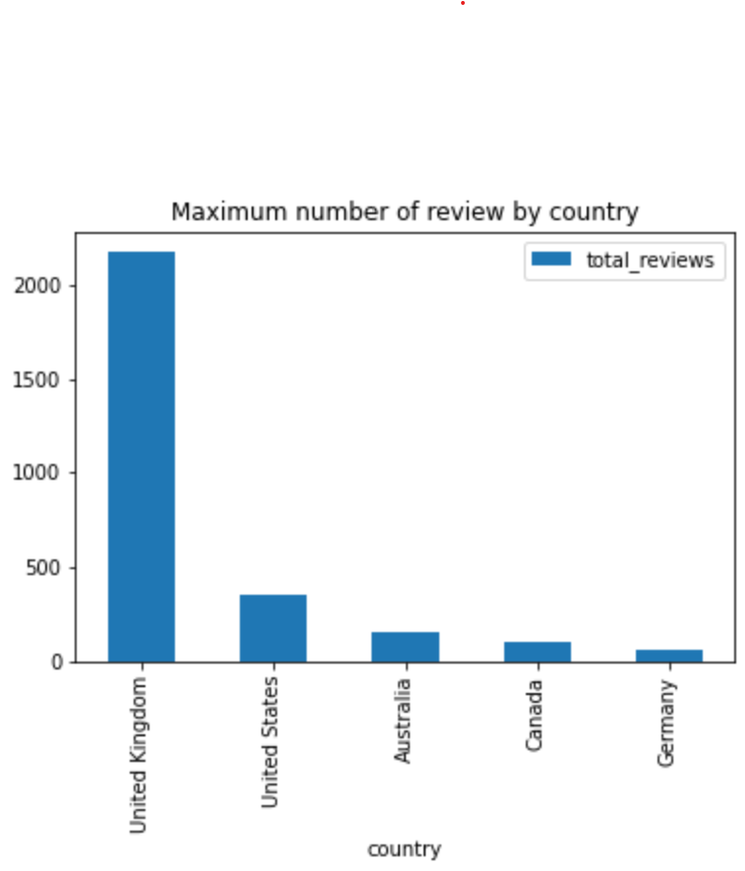
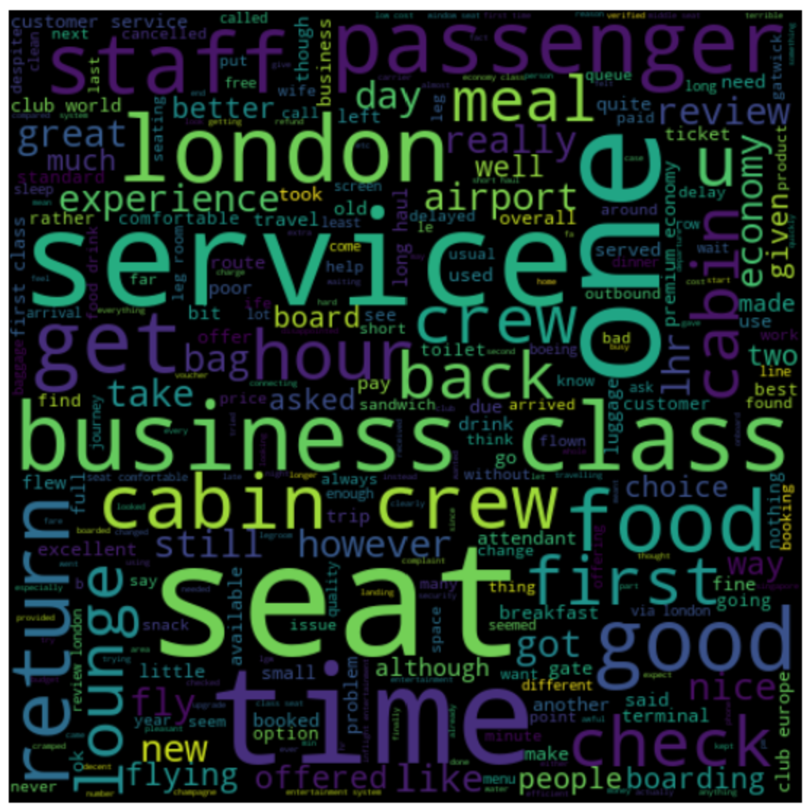
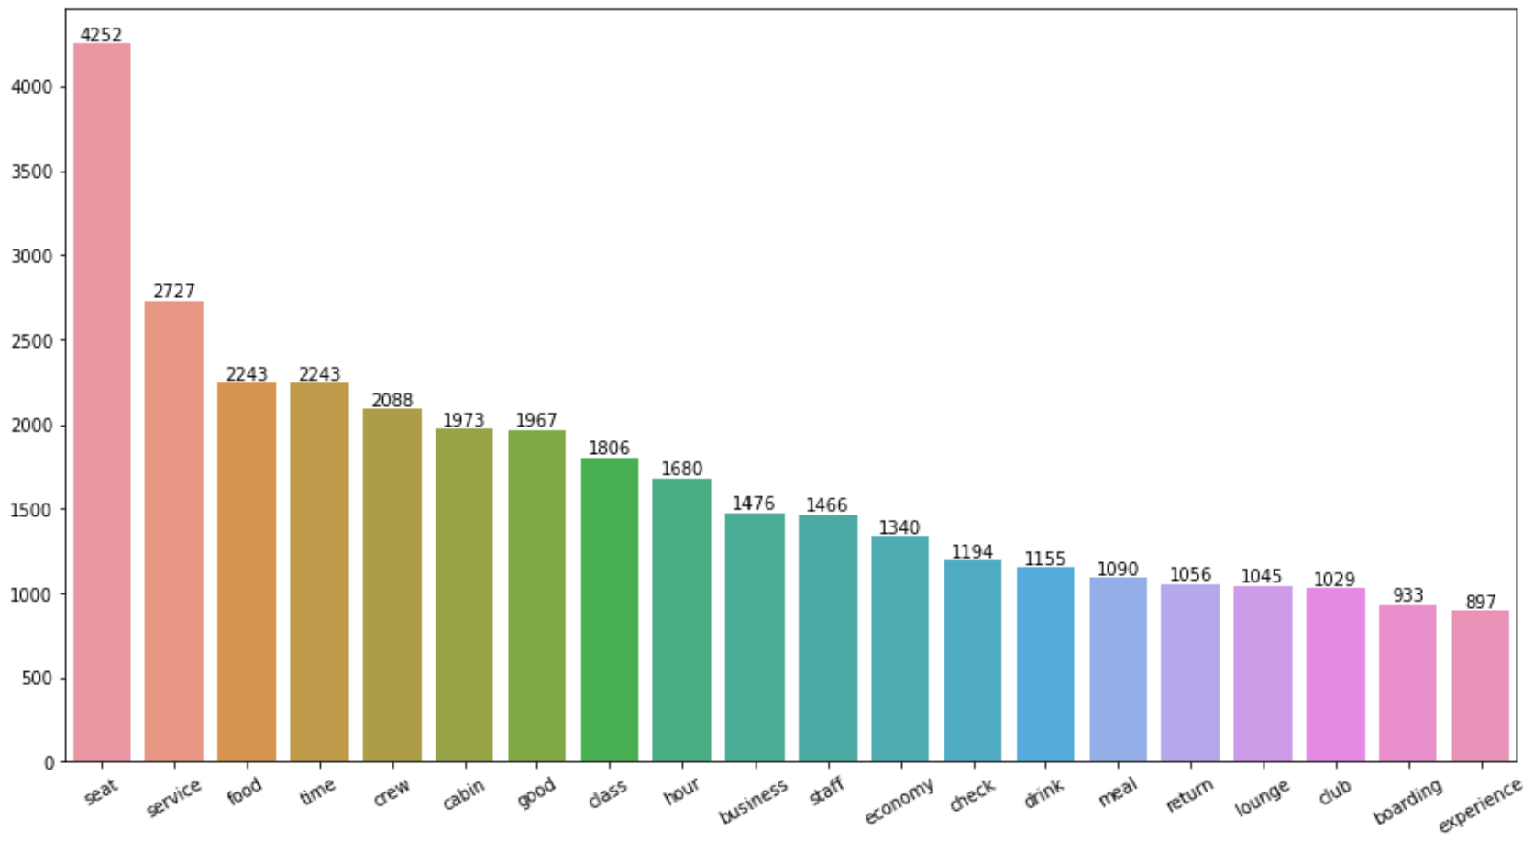
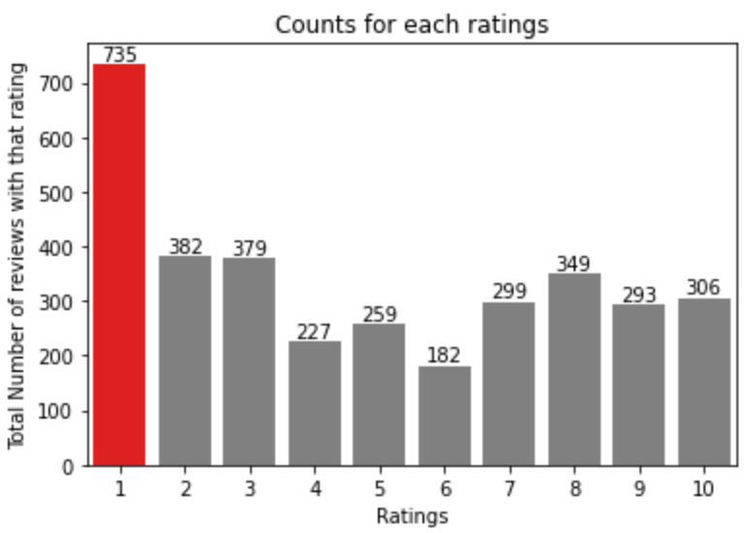
British Airways Key metrics
Reviews from 69 Countries
3411 Total reviews
collected
Average Overall Rating
4.84 /10
What customers are happy and unsatisfied about for different ratings class:
7-10 ratings wrote about comfortable seats, good inflight entertainment, descent food quality.
4-6 ratings faced problem with small entertainment screen, long passport check queue, bad business class experience.
1-3 ratings wrote dissatisfaction on congested middle seat and small screen while they liked the seats and the food.
All passengers praised the general economy seats, staff, and service of the cabin crew. Many people took business class flights.
Focus on – Economy class service, seats, enhance inflight entertainment experience and importantly Delays. Enhance the experience of business class, it seems customers want value for money. Improve Customer service on refund requests and process.

