Slide 1
Pipelining
Dr. Javier Navaridas
javier.navaridas@manchester.ac.uk
COMP25212 System Architecture

Slide 2
Overview and Learning Outcomes
Deepen the understanding on how modern processors work
Learn how pipelining can improve processors performance and efficiency
Being aware of the problems arising from using pipelined processors
Understanding instruction dependencies

Slide 3
The Fetch-Execute Cycle
As explained in COMP15111 Instruction execution is a simple repetitive cycle:
Memory
CPU
_{PC}
_{LDR R0, x}
_{LDR R0, x}
_{LDR R1, y}
_{LDR R1, y}
    _{Fetch Instruction}
    _{Execute Instruction}
_{ADD R2, R1, R0}
_{STR R2, Z}
…

Slide 4
Fetch-Execute Detail
The two parts of the cycle can be further subdivided
Fetch
  Get instruction from memory (IF)
  Decode instruction & select registers (ID)
Execute
  Perform operation or calculate address (EX)
  Access an operand in data memory (MEM)
  Write result to a register (WB)
We have designed the ‘worst case’ data path
  It works for all instructions

Slide 5
Processor Detail
IF ID EX MEM WB
Instruction Instruction Execute Access Write
Fetch Decode Instruction Memory Back
Data
Cache
Instr.
Cache
Register
Bank
MUX
PC
ALU
Cycle i
LDR R0, x | Select register (PC) | Compute address x | Get value from [x] | Write in R0
ADD R2,R1,R0 | Select registers (R0, R1) | Add R0 & R1 | Do nothing | Write in R2
Cycle i+1

Slide 6
Cycles of Operation
Most logic circuits are driven by a clock
In its simplest form one instruction would take one clock cycle (single-cycle processor)
This is assuming that getting the instruction and accessing data memory can each be done in a 1/5th of a cycle (i.e. a cache hit)
For this part we will assume a perfect cache replacement strategy

Slide 7
Logic to do this
Inst Cache
Data Cache
Fetch Logic
Decode Logic
Exec Logic
Mem Logic
Write Logic
Each stage will do its work and pass to the next
Each block is only doing useful work once every 1/5th of a cycle

Slide 8
Application Execution
 | Clock Cycle
 | 1 |  |  |  |  | 2 |  |  |  |  | 3
LDR | IF | ID | EX | MEM | WB
LDR |  |  |  |  |  | IF | ID | EX | MEM | WB
ADD |  |  |  |  |  |  |  |  |  |  | IF | ID | EX | MEM | WB
Can we do it any better?
  Increase utilization
  Accelerate execution

Slide 9
Insert Buffers Between Stages
Inst Cache
Data Cache
clock
Fetch Logic
Decode Logic
Exec Logic
Mem Logic
Write Logic
Instruction Reg.
Instead of direct connection between stages – use extra buffers to hold state
Clock buffers once per cycle

Slide 10
In a pipeline processor
Just like a car production line
We still can execute one instruction every cycle
But now clock frequency is increased by 5x
5x faster execution!
 | Clock Cycle
 | 1 | 2 | 3 | 4 | 5 | 6 | 7
LDR | IF | ID | EX | MEM | WB
LDR |  | IF | ID | EX | MEM | WB
ADD |  |  | IF | ID | EX | MEM | WB

Slide 11
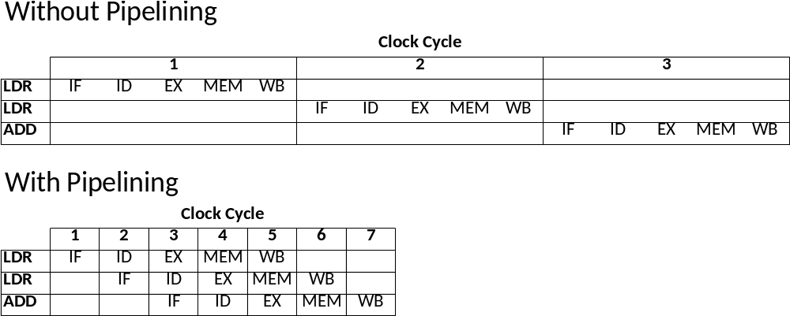
Benefits of Pipelining

Slide 12
Why 5 Stages ?
Simply because early pipelined processors determined that dividing into these 5 stages of roughly equal complexity was appropriate
Some recent processors have used more than 30 pipeline stages
We will consider 5 for simplicity at the moment

Slide 13
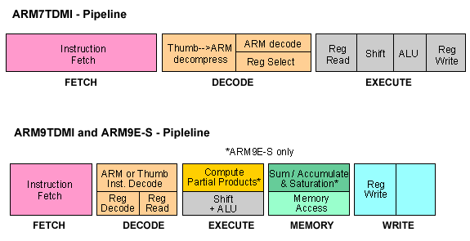
Real-world Pipelines
_{ARM7TDMI – 3-stage pipeline}
ARM9TDMI and ARM9E-S – 5-stage pipeline

Slide 14
Imagine we have a non-pipelined processor running at 10MHz and want to run a program with 1000 instructions.
a) How much time would it take to execute the program?
Assuming ideal conditions (perfect pipelining and no hazards), how much time would it take to execute the same program in:
b) A 10-stage pipeline?
c) A 100-stage pipeline?
Looking at those results, it seems clear that increasing pipeline should increase the execution speed of a processor. Why do you think that processor designers (see Intel, below) have not only stopped increasing pipeline length but, in fact, reduced it?
Pentium III – Coppermine (1999) 10-stage pipeline
Pentium IV – NetBurst (2000) 20-stage pipeline
Pentium Prescott (2004) 31-stage pipeline
Core i7 9xx – Bloomfield (2008) 24-stage pipeline
Core i7 5Yxx – Broadwell (2014) 19-stage pipeline
Core i7 77XX – Kaby Lake (2017) ~20-stage pipeline
Notes:
Why not longer pipelines?
Higher freq. => more power
More stages => more extra hardware
=> more complex design (forwarding?)
=> more difficult to split into uniform size chunks
=> loading time of the registers limits cycle period
There are some Issues that prevent from this kind of scaling

Slide 15
Limits to Pipeline Scalability
Higher frequency => higher power
More stages
  more extra hardware
  more complex design (control logic, forwarding?)
  more difficult to split into uniform size chunks
  loading time of the registers limits cycle period
Hazards (control and data)
  A longer datapath means higher probability of hazards occurring and worse penalties when they happen

Slide 16
Control Hazards

Slide 17
The Control Transfer Problem
Instructions are normally fetched sequentially (i.e. just incrementing the PC)
What if we fetch a branch?
  We only know it is a branch when we decode it in the second stage of the pipeline
  By that time we are already fetching the next instruction in serial order
  We have a ‘Bubble’ in the pipeline

Slide 18
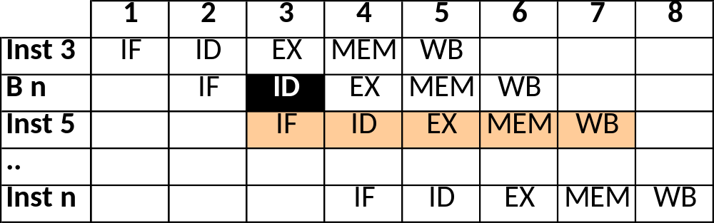
A Pipeline ‘Bubble’
Inst 1
Inst 2
Inst 3
B n
Inst 5
Inst 6
…
Inst n
We know it is a branch here.
Inst 5 is already fetched
We must mark Inst 5 as unwanted and
ignore it as it goes down the pipeline.
But we have wasted a cycle
Notes:
I don’t like this. Should improve for next year.

Slide 19
Conditional Branches
It gets worse!
Suppose we have a conditional branch
We are not be able to determine the branch outcome until the execute (3rd) stage
We would then have 2 ‘bubbles’
We can often avoid this by reading registers during the decode stage.

Slide 20
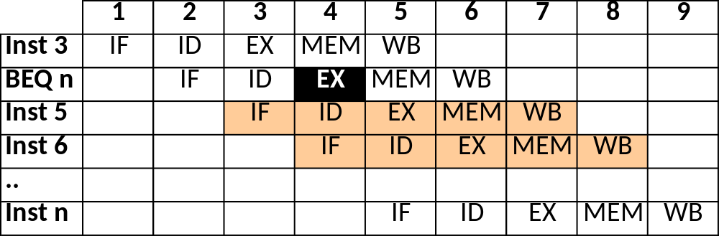
Conditional Branches
Inst 1
Inst 2
Inst 3
BEQ n
Inst 5
Inst 6
…
Inst n
We do not know whether we have to branch
until EX. Inst 5 & 6 are already fetched
If condition is true, we must mark Inst 5 & 6 as
unwanted and ignore them as they go down the
pipeline. 2 wasted cycles now

Slide 21
Deeper Pipelines
‘Bubbles’ due to branches are called Control Hazards
They occur because it takes one or more pipeline stages to detect the branch
  The more stages, the less each does
  More likely to take multiple stages
  Longer pipelines suffer more degradation from control hazards
Is there any way around?

Slide 22
Branch Prediction
In most programs many branch instructions are executed many times
  E.g. loops, functions
What if, when a branch is executed
  We take note of its address
  We take note of the target address
  We use this info the next time the branch is fetched

Slide 23
Branch Target Buffer
We could do this with some sort of (small) cache
As we fetch the branch we check the BTB
If a valid entry in BTB, we use its target to fetch next instruction (rather than the PC)
Address Data
Branch Address Target Address

Slide 24
Branch Target Buffer
For unconditional branches we always get it right
For conditional branches it depends on the probability of repeating the target
  E.g. a ‘for’ loop which jumps back many times we will get it right most of the time (only first and last time will mispredict)
But it is only a prediction, if we get it wrong we pay a penalty (bubbles)

Slide 25
Outline Implementation
valid
Inst
Cache
Branch
Target
Buffer
inc
Fetch
Stage
PC

Slide 26
Other Branch Prediction
BTB is simple to understand
  But expensive to implement
  And it just uses the last branch to predict
In practice, prediction accuracy depends on
  More history (several previous branches)
  Context (how did we get to this branch)
Real-world branch predictors are more complex and vital to performance for deep pipelines

Slide 27
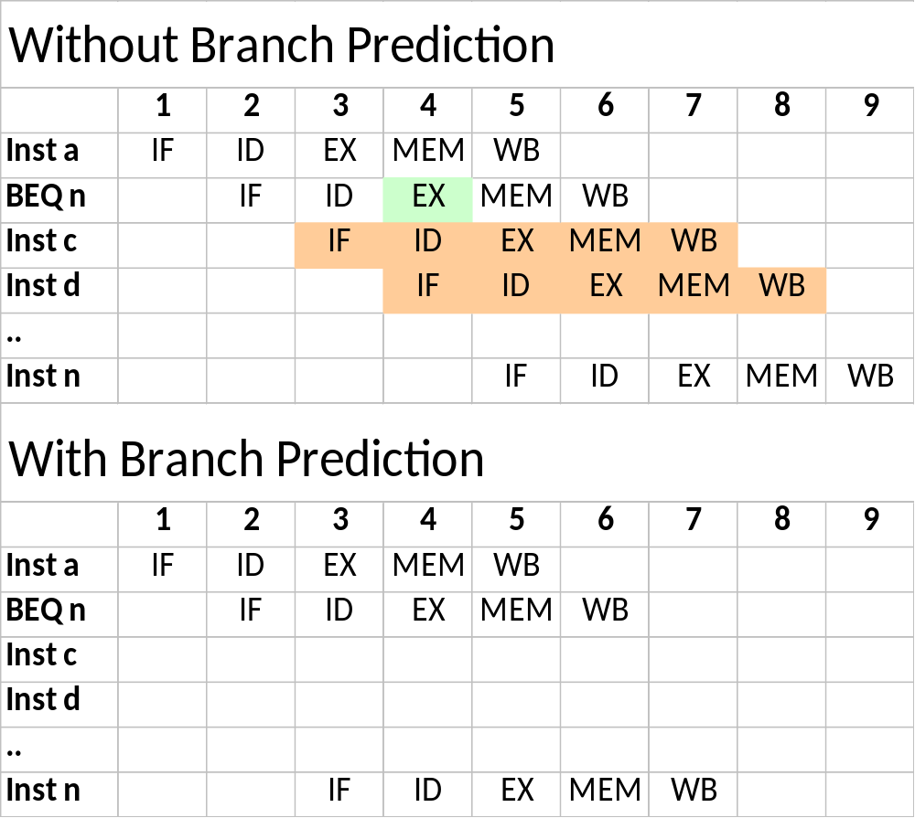
Benefits of Branch Prediction
The comparison is not done until 3rd stage, so
2 instructions have been issued and need to be eliminated from the pipeline and we have wasted 2 cycles
If we predict that next instruction will be ‘n’ then we pay no penalty

Slide 28
Consider a simple program with two nested loops as the following:
    while (true) {
    for (i=0; i<x; i++) {
    do_stuff
    }
    }
With the following assumptions:
  do_stuff has 20 instructions that can be executed ideally in the pipeline.
  The overhead for control hazards is 3-cycles, regardless of the branch
  being static or conditional.
  Each of the two loops can be translated into a single branch instruction.
Calculate the instructions-per-cycle that can be achieved for different values of x (2, 4, 10, 100):
  Without branch prediction.
  b) With a simple branch prediction policy - do the same as the last time.

Slide 29
Guest Lectures Next Week
Wed, 14-March 9am
Prof. John Goodacre (UoM, ARM, Kaleao)
“Scalable processing for cloud computing”
Fri, 16-Mar 2pm
Dr. Mark Mawson (Hartree HPC Centre, STFC)
“High Performance Computing: Use Cases and Architectures”

