Slide 1
Advanced Pipelining
Out of Order Processors
COMP25212

Slide 2
From Wednesday…
What is a Functional Unit?
  Is a hardware component of a processor which can perform a specific operation (or set thereof).
    Integer arithmetic, floating point multiplication, access memory
What is a structural hazard?
  When an instruction can not be issued because there all suitable functional units are busy
What data dependencies exists in out-of-order processors?
  True dependency (Read-after-write): instruction A depends on the output of a previous instruction B.
  Anti-dependency (Write-after-read): instruction A writes in the input of a previous instruction B. We need to ensure B reads the correct value instead of that generated by A.
  Output dependency (Write-after-write): instructions A and B write in the same register. We need to ensure that the register keeps the value of the later instruction.

Slide 3
From Wednesday…
Out-of-Order Execution with Scoreboard
Centralized data structure
  Tracks the status of registers, FUs and instructions
  Creates dynamically in HW the dependency graph
  Limited scalability
The centralized nature limits scalability:
  Small number of FUs and small window of instructions
Dealing with dependencies
  RAW – stall conflicted instruction
  WAW – stall the pipeline
  WAR – stall WB

Slide 4
Out of Order Execution with Tomasulo

Slide 5
Tomasulo’s Algorithm
Control logic for out-of-order execution is decentralized
  Reservation Stations (RS) in the functional units keep instruction information
  In addition RS seamlessly rename registers
A Common Data Bus (CDB) broadcasts data and results to the different devices
  A single instruction can finish each cycle
Distributed control allows for a larger window of instructions – more flexible dynamic scheduling

Slide 6
Tomasulo’s Algorithm
Structural hazards stall the pipeline
RS tracks operands and buffers them as soon as they are available
  Reduce pressure on the register bank
  Impact of RAW dependencies is reduced
Execute an instruction when all operands are available
WAW and WAR dependencies are avoided
  Register renaming

Slide 7
Register Renaming (Example)
Eliminates WAR and WAW hazards by renaming all destination registers.
Can be done by compiler, but Tomasulo does it transparently in hardware (reservation stations)
True dependences
DIV.D F0, F2, F4
ADD.D F6, F0, F8
ST.D F6, 0(R1)
SUB.D F8, F10, F14
MUL.D F6, F10, F8
R
R
Antidependence
S
S
Output dependence

Slide 8
Tomasulo Organization
Intr.
Queue
FP Registers
From Mem
Load Buffers
Load1
Load2
Load3
Load4
Load5
Load6
Store
Buffers
Add1
Add2
Add3
Mult1
Mult2
Reservation
Stations
To Mem
FP adders
FP multipliers
Common Data Bus (CDB)
Notes:
Resolve RAW memory conflict? (address in memory buffers)
Integer unit executes in parallel

Slide 9
Common Data Bus
Normal data bus: data + destination (“go to” bus)
Common data bus: data + source (“come from” bus)
  64 bits of data + 4 bits of Functional Unit address
  Functional units broadcast their result
  Reservation stations take the operand if it matches any input Functional Unit
  Register bank takes the operand if it matches the Functional Unit writing the result

Slide 10
Stages of Tomasulo Algorithm
1. Issue (I) — get instruction from FP Op Queue
  If reservation station free (no structural hazard), issue instruction and read operands (or RS producing them)
  Otherwise, stall the pipeline
2. Execute (EX) — operate on operands
  When both source operands are ready then execute;
  if not ready, watch Common Data Bus for results
3. Write result (WB) — finish execution
  Write on Common Data Bus to all awaiting units; free reservation station

Slide 11
Stages of a Tomasulo Pipeline
Execute
Mem
Write
Back
Retire
Execute
FP Multiplication
Write
Back
Retire
Execute
FP Multiplication
Fetch
Issue
Write
Back
Retire
Execute
FP Add
Execute
FP Division
Write
Back
Retire
Write
Back
Retire

Slide 12
Reservation Station Components
No information about instructions needed
Information in the Reservation Station
  Op: Operation to perform in the unit (e.g., + or –)
  Vj, Vk: Value of Source operands
  Qj, Qk: Reservation stations producing source registers (value to be written) Note: Qj, Qk=0 means ready
  Busy: Indicates reservation station or FU is busy
Register result status — Indicates which functional unit will write each register, if one exists. Blank when no pending instructions will write into that register
Notes:
What you might have thought
1. 4 stages of instruction executino
2.Status of FU: Normal things to keep track of (RAW & structura for busyl):
Fi from instruction format of the mahine (Fi is dest)
Add unit can Add or Sub
Rj, Rk - status of registers (Yes means ready)
Qj,Qk - If a no in Rj, Rk, means waiting for a FU to write result; Qj, Qk means wihch FU waiting for it
3.Status of register result (WAW &WAR)s:
which FU is going to write into registers
Scoreboard on 6600 = size of FU
6.7, 6.8, 6.9, 6.12, 6.13, 6.16, 6.17
FU latencies: Add 2, Mult 10, Div 40 clocks

Slide 13
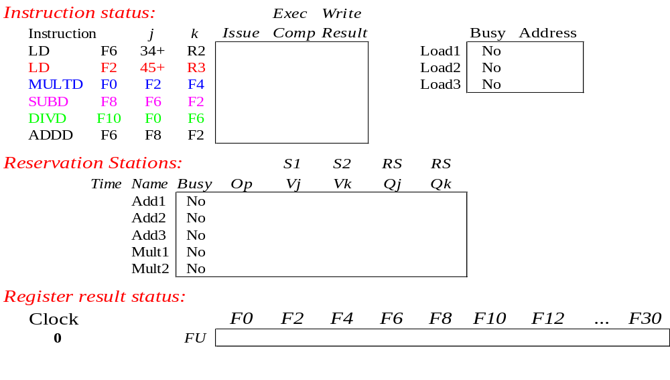
Instruction status
Instruction stream
Instruction status:
Tomasulo does not
need this info
We will show the
times for each stage,
for convenience

Slide 14
Reservation Station Components
No information about instructions needed
Information in the Reservation Station
  Op: Operation to perform in the unit (e.g., + or –)
  Vj, Vk: Value of Source operands
  Qj, Qk: Reservation stations producing source registers (value to be written) Note: Qj, Qk=0 means ready
  Busy: Indicates reservation station or FU is busy
Register result status — Indicates which functional unit will write each register, if one exists. Blank when no pending instructions will write into that register
Notes:
What you might have thought
1. 4 stages of instruction executino
2.Status of FU: Normal things to keep track of (RAW & structura for busyl):
Fi from instruction format of the mahine (Fi is dest)
Add unit can Add or Sub
Rj, Rk - status of registers (Yes means ready)
Qj,Qk - If a no in Rj, Rk, means waiting for a FU to write result; Qj, Qk means wihch FU waiting for it
3.Status of register result (WAW &WAR)s:
which FU is going to write into registers
Scoreboard on 6600 = size of FU
6.7, 6.8, 6.9, 6.12, 6.13, 6.16, 6.17
FU latencies: Add 2, Mult 10, Div 40 clocks

Slide 15
Functional Unit status
Reservation Stations:
3 Load Buffers
Input
Operands
FU count
down
Input
Operands
Which FU
will produce
operands
Reservation Stations:
3 Adder
2 Multiplication

Slide 16
Reservation Station Components
No information about instructions needed
Information in the Reservation Station
  Op: Operation to perform in the unit (e.g., + or –)
  Vj, Vk: Value of Source operands
  Qj, Qk: Reservation stations producing source registers (value to be written) Note: Qj, Qk=0 means ready
  Busy: Indicates reservation station or FU is busy
Register result status — Indicates which functional unit will write each register, if one exists. Blank when no pending instructions will write into that register
Notes:
What you might have thought
1. 4 stages of instruction executino
2.Status of FU: Normal things to keep track of (RAW & structura for busyl):
Fi from instruction format of the mahine (Fi is dest)
Add unit can Add or Sub
Rj, Rk - status of registers (Yes means ready)
Qj,Qk - If a no in Rj, Rk, means waiting for a FU to write result; Qj, Qk means wihch FU waiting for it
3.Status of register result (WAW &WAR)s:
which FU is going to write into registers
Scoreboard on 6600 = size of FU
6.7, 6.8, 6.9, 6.12, 6.13, 6.16, 6.17
FU latencies: Add 2, Mult 10, Div 40 clocks

Slide 17
Register Status
Clock cycle
counter
Which RS will write in each register?

Slide 18
A Tomasulo Example
The following code is run on a Tomasulo pipeline with:
L.D F6, 34(R2)
L.D F2, 45(R3)
MUL.D F0, F2, F4
SUB.D F8, F6, F2
DIV.D F10, F0, F6
ADD.D F6, F8, F2
Functional Unit (FU) # of FUs EX cycles
FP Multiply/Division 2 10/40
FP Addition/Substraction 3 2
Mem Load 3 2

Slide 19
Dependency Graph For Example
1
Example Code
L.D F6, 34 (R2)
1
2
3
4
5
6
L.D F6, 34(R2)
L.D F2, 45(R3)
MUL.D F0, F2, F4
SUB.D F8, F6, F2
DIV.D F10, F0, F6
ADD.D F6, F8, F2
2
L.D F2, 45 (R3)
3
MUL.D F0, F2, F4
Data Dependence:
(1, 4) (1, 5) (2, 3) (2, 4)
(2, 6) (3, 5) (4, 6)
Output Dependence:
(1, 6)
Anti-dependence:
(5, 6)
4
SUB.D F8, F6, F2
5
DIV.D F10, F0, F6
Real Data Dependence (RAW)
Anti-dependence (WAR)
Output Dependence (WAW)
6
ADD.D F6, F8, F2

Slide 20
Tomasulo Example

Slide 21
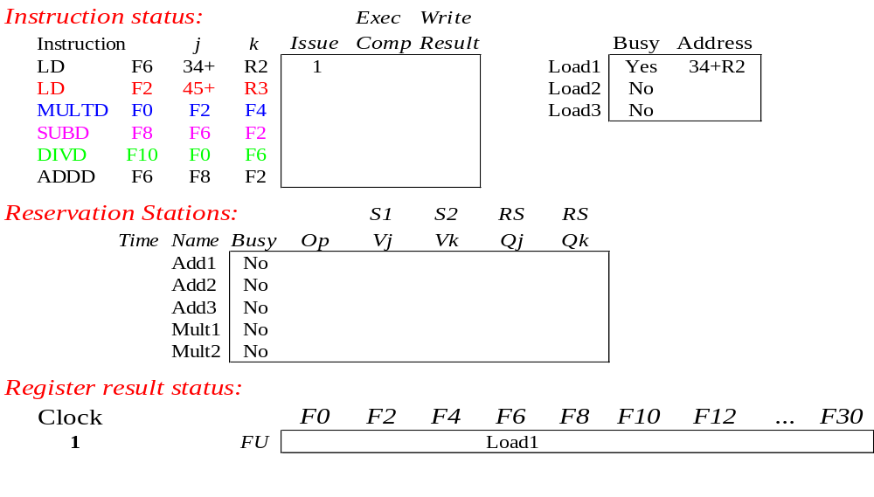
Tomasulo Example Cycle 1
LD#1 issued

Slide 22
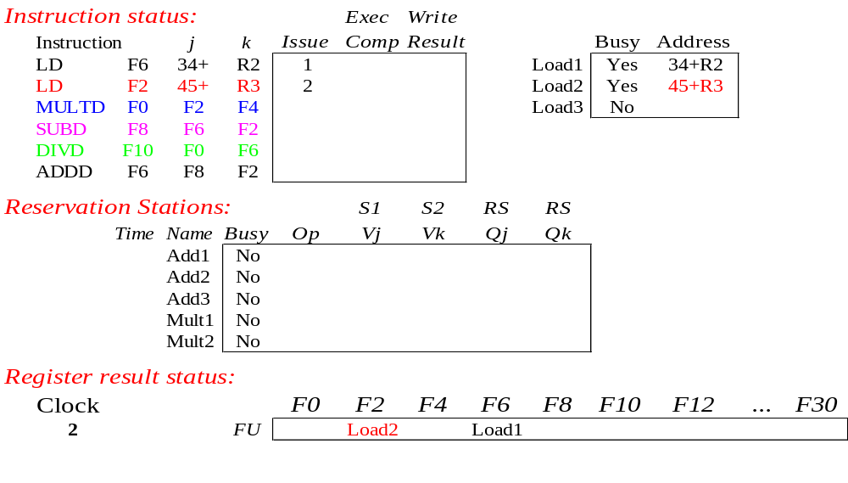
Tomasulo Example Cycle 2
LD#2 issued

Slide 23
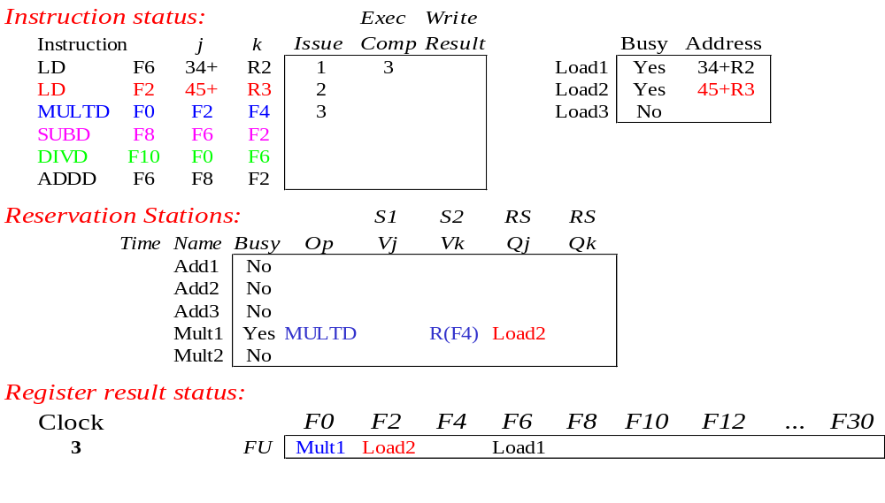
Tomasulo Example Cycle 3
MULTD is issued
LD#1 completes and broadcasts its result

Slide 24
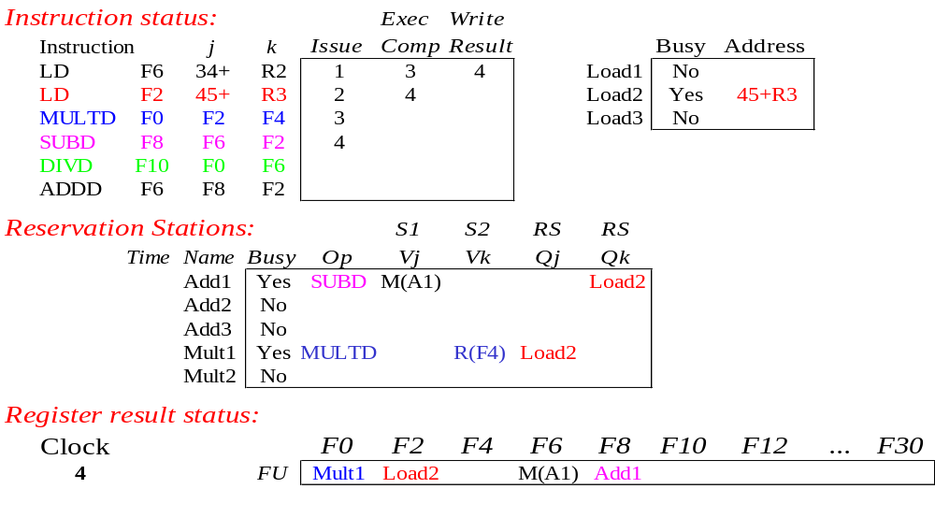
Tomasulo Example Cycle 4
LD#1 result updates the register bank and frees the RS
SUBD is issued
LD#2 completes, broadcasting its result

Slide 25
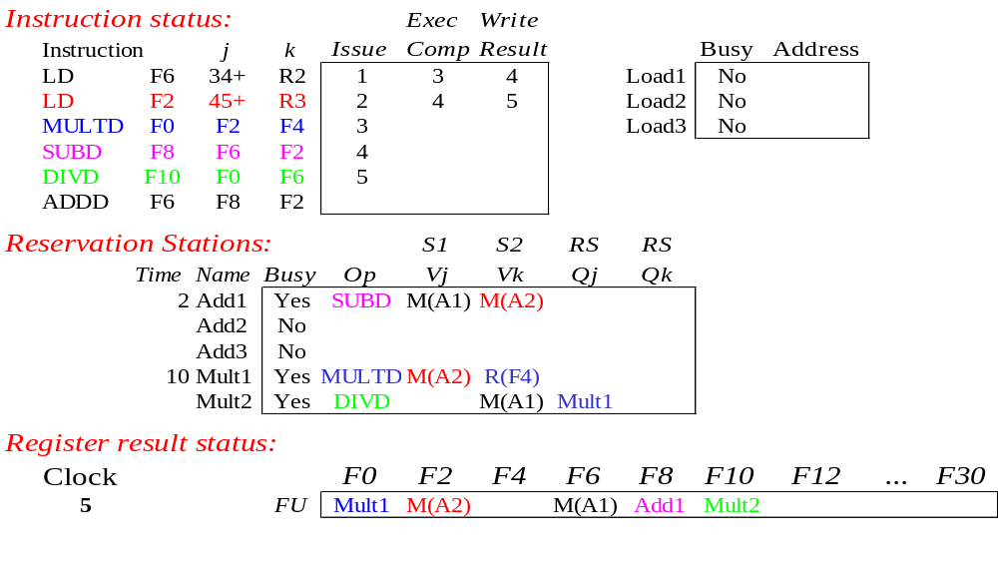
Tomasulo Example Cycle 5
LD#2 result updates the register bank and frees RS
Add1, Mult1 start execution
DIVD is issued

Slide 26
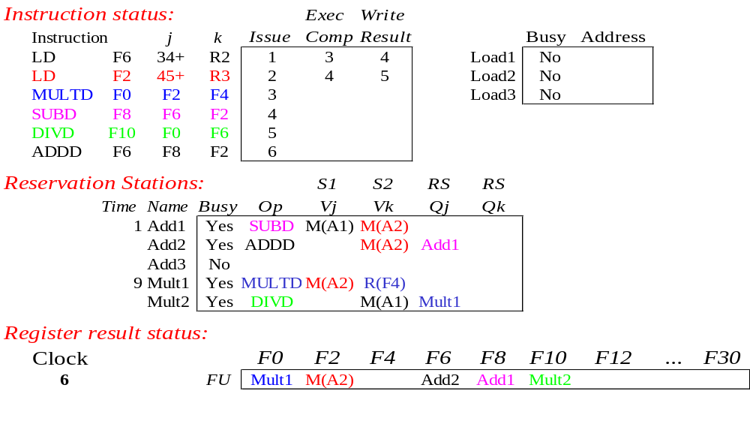
Tomasulo Example Cycle 6
ADDD issued

Slide 27

Tomasulo Example Cycle 7
Add1 (SUBD) completes and broadcasts result

Slide 28
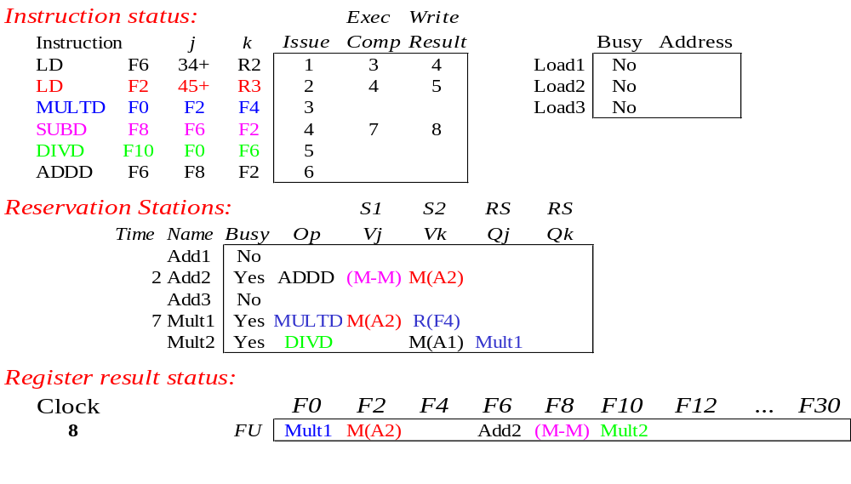
Tomasulo Example Cycle 8
Add1 (SUBD) result updates the register bank and frees RS
Add2 (ADDD) start execution

Slide 29

Tomasulo Example Cycle 9
ADDD and MULTD continue execution

Slide 30

Tomasulo Example Cycle 10
Add2 (ADDD) completes and broadcasts result

Slide 31
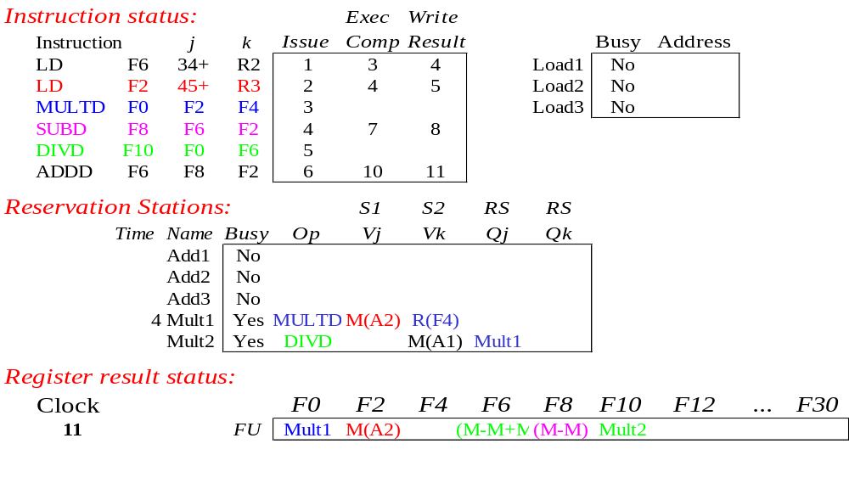
Tomasulo Example Cycle 11
ADDD updates the register bank and frees RS

Slide 32

Tomasulo Example Cycle 12
MULTD continues execution

Slide 33

Tomasulo Example Cycle 13
MULTD continues execution

Slide 34

Tomasulo Example Cycle 14
MULTD continues execution

Slide 35
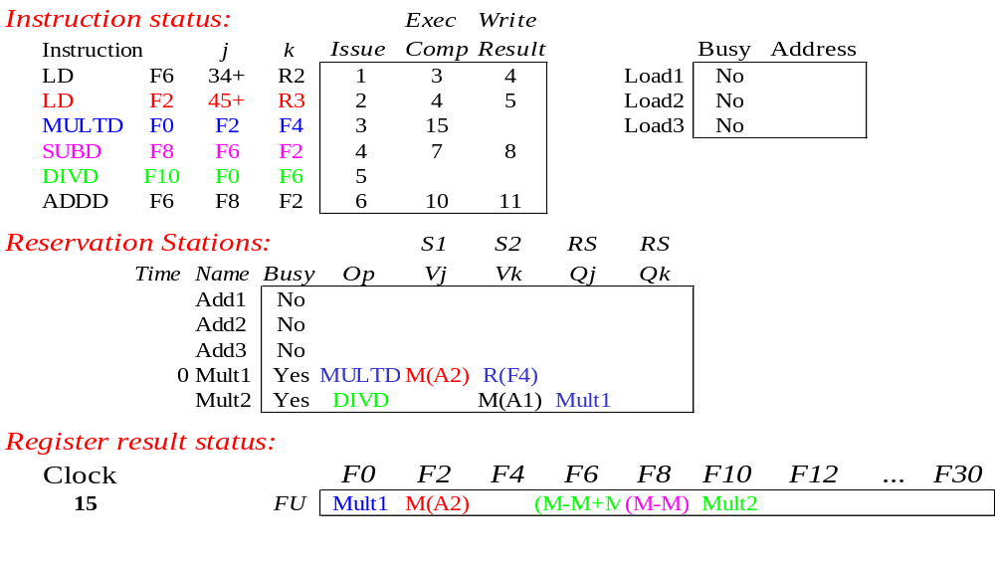
Tomasulo Example Cycle 15
MULTD completes and broadcasts result

Slide 36
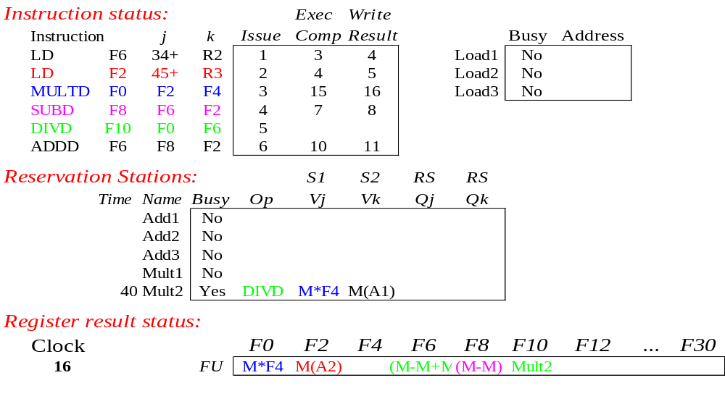
Tomasulo Example Cycle 16
MULTD updates the register bank and frees RS
DIVD starts execution

Slide 37
39 cycles later…

Slide 38
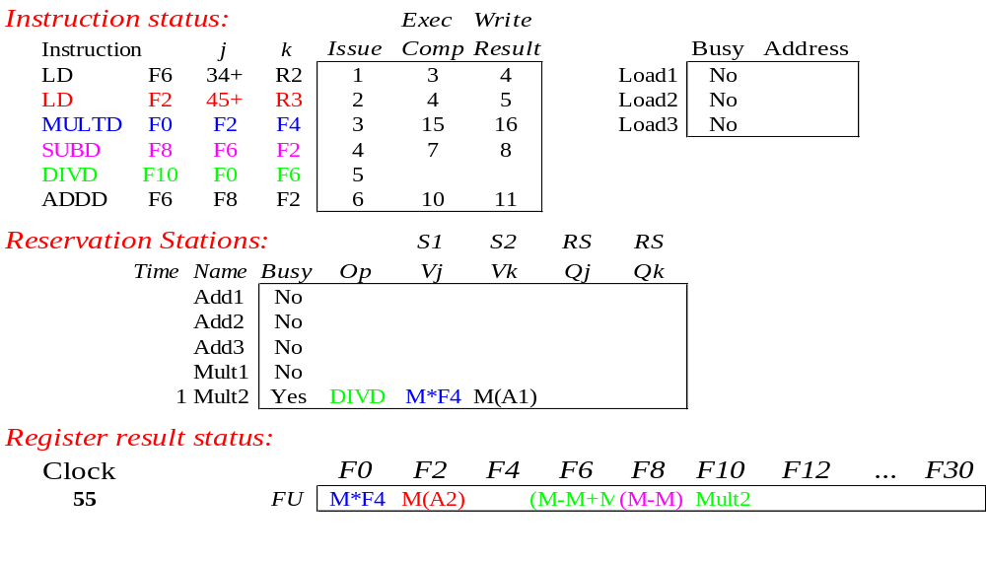
Tomasulo Example Cycle 55
DIVD is about to complete

Slide 39
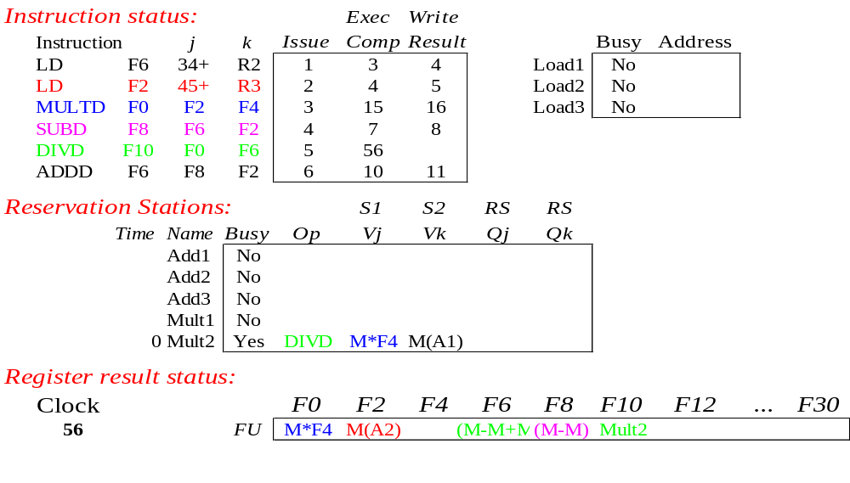
Tomasulo Example Cycle 56
DIVD completes and broadcasts result

Slide 40
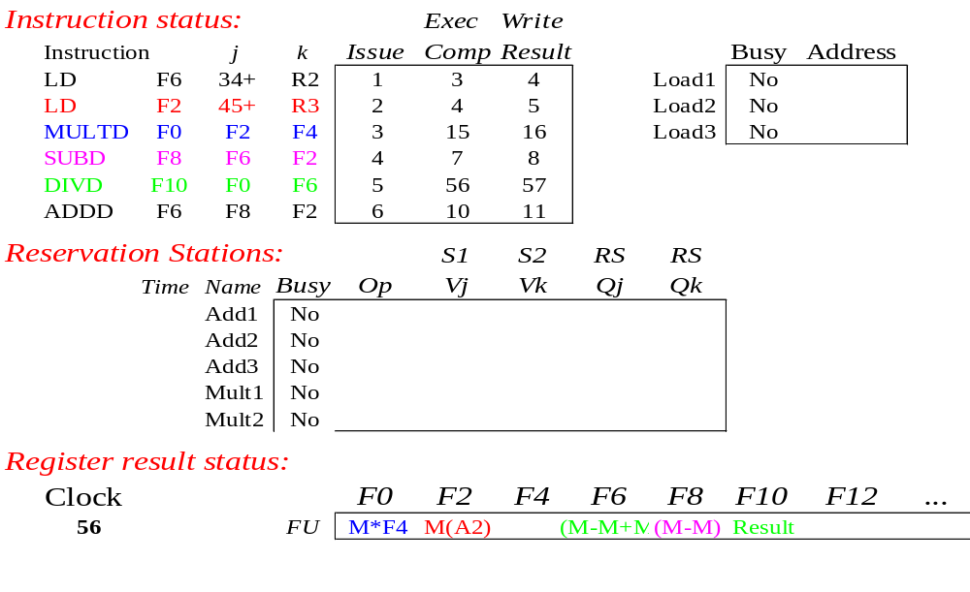
Tomasulo Example Cycle 57
DIVD updates the register bank and frees RS

Slide 41
Tomasulo Example Cycle 57
In-order issue
Out-of-order execution
Out-of-order completion
Execution Complete

Slide 42
Tomasulo’s advantages
Distributed hazard detection logic
  distributed reservation stations and the CDB
  If multiple instructions waiting on a single result, & each instruction has other operand, then instructions can be issued simultaneously by broadcasting on CDB
  If a centralized register file were used, the units would have to read their results from the registers when register buses are available.
(2) Avoids stalling due to WAW or WAR hazards

Slide 43
Tomasulo Drawbacks
Complexity of hardware
Performance limited by Common Data Bus
  Each CDB must go to all functional units
  ⇒ high capacitance, high wiring density
  Number of functional units that can complete per cycle limited to one!
    Multiple CDBs ⇒ more FU logic for parallel stores

Slide 44
Summary
Reservations stations: implicit register renaming by buffering source operands
  Prevents registers from being the bottleneck
  Avoids the WAR and WAW hazards of Scoreboard
Lasting Contributions
  Dynamic scheduling
  Register renaming
  Others (not covered here)
    Load/store disambiguation through re-ordering buffer
    Speculative execution

Slide 45
Summary of Out-of-Order Processors

Slide 46
Out of Order Processors
BENEFITS:
Accelerates the execution of programs
More efficient design
  Increases the utilisation of processor resources
LIMITATIONS:
More complex design
Expensive in terms of area and power
Non-precise interrupts
  Interrupting exactly after an instruction becomes more difficult (but can be solved with reordering buffers)

Slide 47
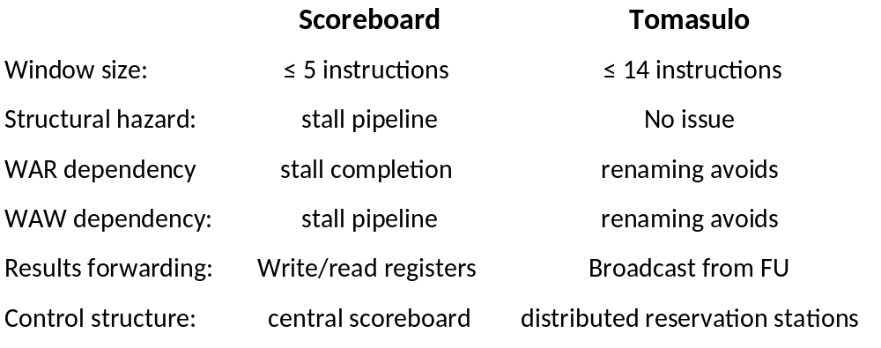
Scoreboard vs Tomasulo (originals)

Slide 48
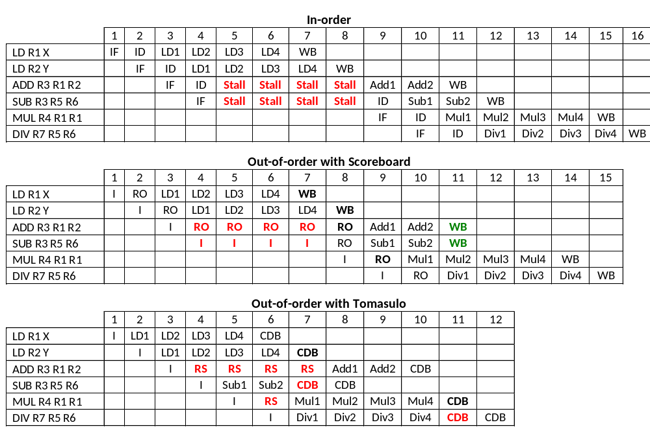
Example
LD – 4 cycles
Add/Sub – 2 cycles
Mul/Div – 2 cycles
Assuming no structural Hazards

Slide 49
Example
RAW
RAW – Stall the pipeline
WAW
RAW – ADD stalled, SUB could be issued
RAW – ADD stalled, SUB can be issued
LD – 4 cycles
Add/Sub – 2 cycles
Mul/Div – 2 cycles
Assuming no structural Hazards

Slide 50

Example
WAW
WAW – SUB cannot be issued
Stall the pipeline
WAW – Allowed by register renaming in RS
LD – 4 cycles
Add/Sub – 2 cycles
Mul/Div – 2 cycles
Assuming no structural Hazards
Notes:
ADD will change the register status so that R3 will be written by the ADD
Then, the SUB will overwrite it, so that any instruction after this that wants to read R3 will get the data from the CDB.
When the ADD finishes, the register bank will not have marked that its result is for R3, so nothing will be written to the Reg Bank.

Slide 51
Example
2 instrs. can finish at
the same time
CDB limits finishing
instrs. to one/cycle
LD – 4 cycles
Add/Sub – 2 cycles
Mul/Div – 2 cycles
Assuming no structural Hazards

Slide 52
Consider the following program which implements R = A^2 + B^2 + C^2 + D^2
  LD r1, A
  MUL r2, r1, r1 -- A^2
  LD r3, B
  MUL r4, r3, r3 -- B^2
  ADD r11, r2, r4 -- A^2 + B^2
  LD r5, C
  MUL r6, r5, r5 -- C^2
  LD r7, D
  MUL r8, r7, r7 -- D^2
  ADD r12, r6, r8 -- C^2 + D^2
  ADD r21, r11, r12 -- A^2 + B^2 + C^2 + D^2
  ST r21, R
The current code is not really suitable for a superscalar pipeline because of its
low instruction-level parallelism
Reorder the instructions to exploit superscalar execution. Assume all kinds of forwarding are implemented.

