Slide 1
From before the Break
Classic 5-stage pipeline
  Control Hazards
  Data Hazards
Instruction Level Parallelism
  Superscalar
Out of order execution
  Scoreboard
  Tomasulo

Slide 2
Pipeline
Inst Cache
Data Cache
clock
Fetch Logic
Decode Logic
Exec Logic
Mem Logic
Write Logic
Simply by adding a register between stages we can increase clock frequency up to 5x
We can have an instruction in each stage

Slide 3
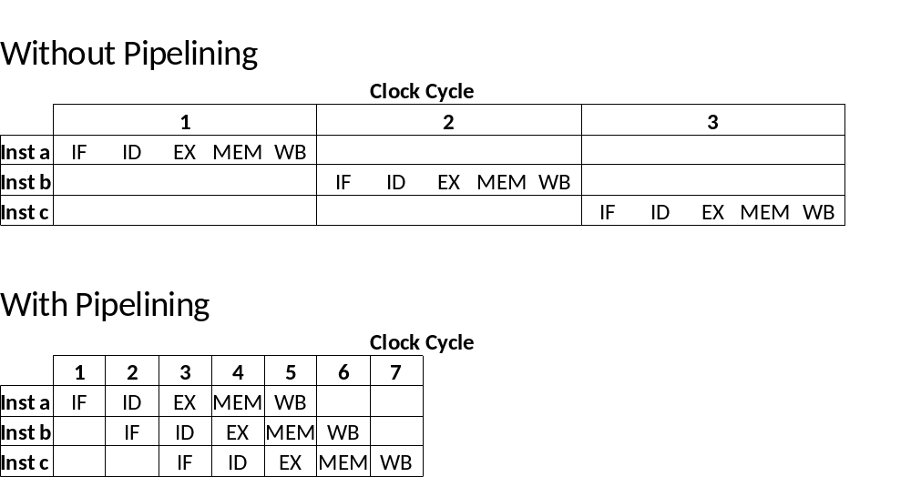
Benefits of Pipelining

Slide 4
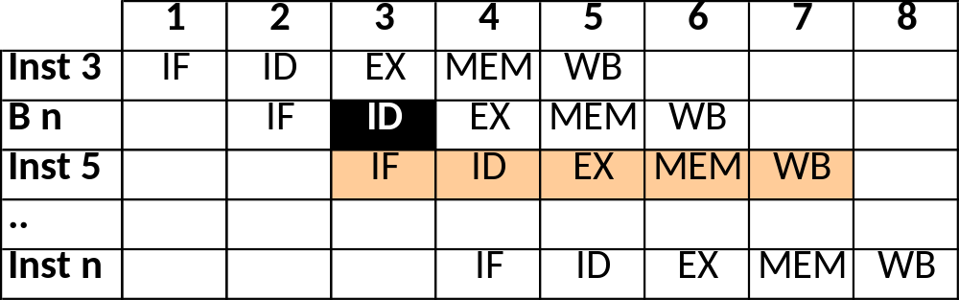
Control Hazard
Inst 1
Inst 2
Inst 3
B n
Inst 5
Inst 6
…
Inst n
We know it is a branch here.
Inst 5 is already fetched
We must mark Inst 5 as unwanted and
ignore it as it goes down the pipeline.
We have wasted a cycle
Notes:
I don’t like this. Should improve for next year.

Slide 5
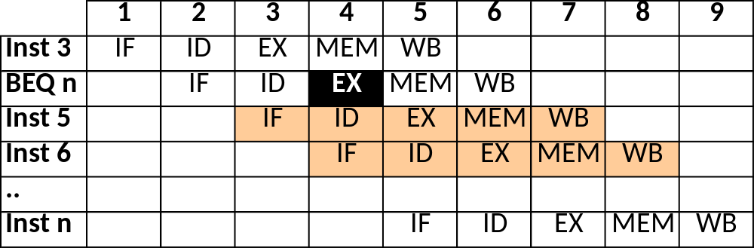
Conditional Branches
Inst 1
Inst 2
Inst 3
BEQ n
Inst 5
Inst 6
…
Inst n
We do not know whether we have to branch
until EX. Inst 5 & 6 are already fetched
If condition is true, we must mark Inst 5 & 6 as
unwanted and ignore them as they go down the
pipeline. 2 wasted cycles

Slide 6
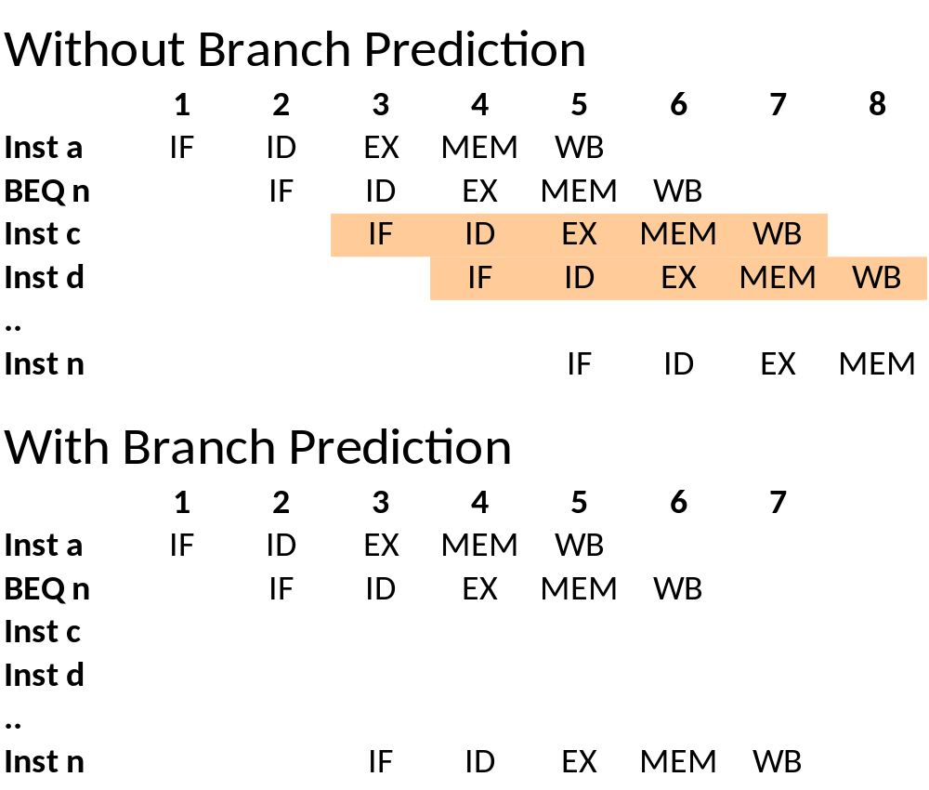
Benefits of Branch Prediction
The comparison is not done until 3rd stage
These two instructions need to be removed from the pipeline
If we predict that next instruction will be ‘n’

Slide 7
Data Hazards
Data is ready before the end of the pipeline
Forwarding helps to reduce adverse effects
Reordering instructions can minimise penalties
Register Bank
Data
Cache
PC
Instruction
Cache
ALU
MUX

Slide 8
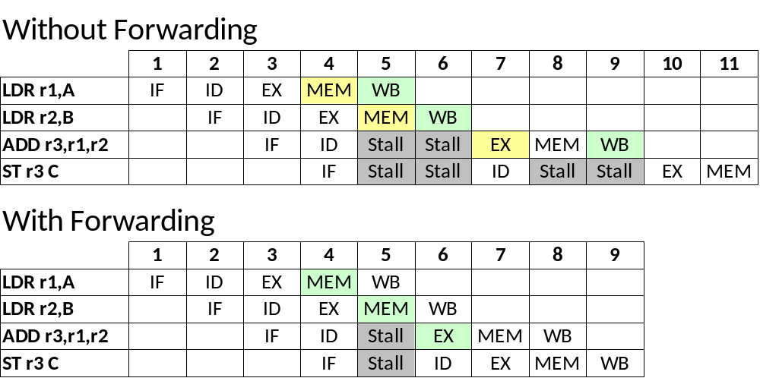
Benefits of Forwarding

Slide 9
Superscalar Architecture
Instruction
Cache
I1 I2
Register Bank
ALU
MUX
Data
Cache
PC
MUX
ALU
Several instructions (two, in the example) can be issued (and executed) per cycle

Slide 10
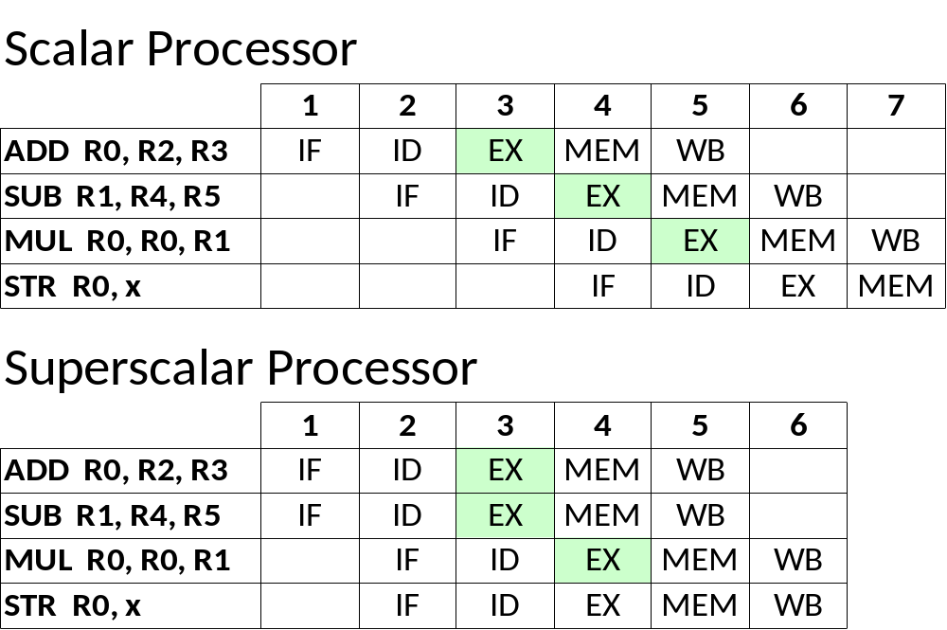
Benefits of Superscalar

Slide 11
Out of Order Execution
The original order in a program is disregarded
  Processors execute instructions as input data becomes available, allowing instructions behind stall to proceed
  Overall instructions per cycle (IPC) increases
New types of dependencies arise
  True dependency (Read-after-Write RAW)
  Anti-dependency (Write-after-Read WAR)
  Output dependency (Write-after-Write WAW)
Two main implementations
  Scoreboard
  Tomasulo

Slide 12
Scoreboard
Centralized data structure which tracks the status of registers, functional units and instructions
  This information is used to execute instructions out of order but keeping program semantics
In a scoreboard pipeline instructions are issued in-order, but executed and completed out-of-order
Dealing with dependencies is not efficient
  WAW stalls the pipeline
  WAR stalls instruction completion

Slide 13
Tomasulo
Distributed reservation stations track the status of operands and instructions
  This information is used to execute instructions out of order but keeping program semantics
In a Tomasulo pipeline instructions are issued in-order, but executed and completed out-of-order
Reservation stations transparently perform register renaming
  WAW and WAR dependencies are completely avoided

Slide 14
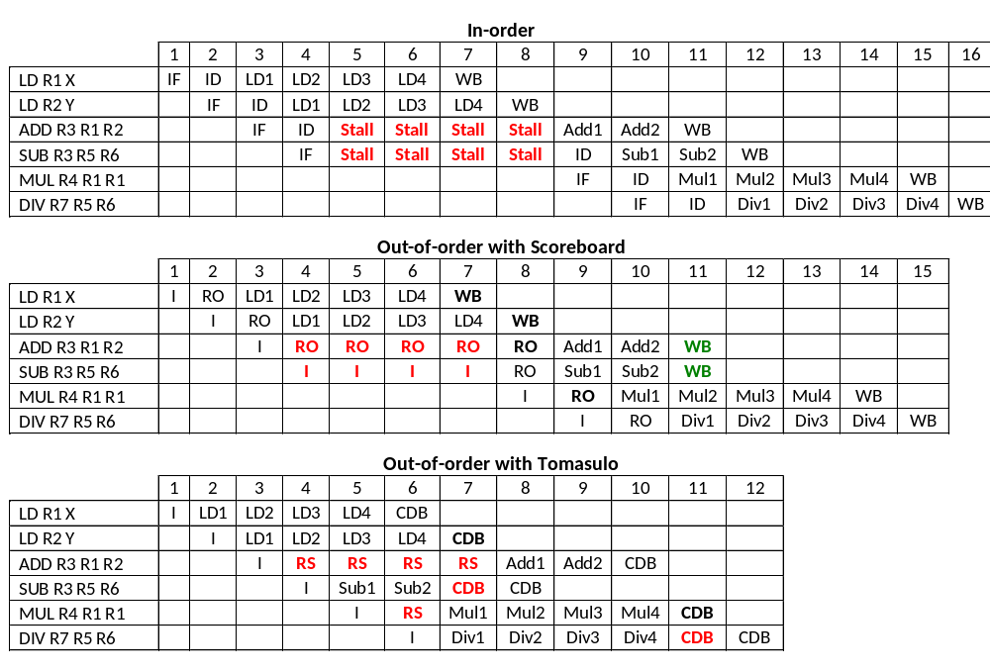
In-order vs Out-of-order

Slide 15
Hardware Multithreading
COMP25212

Slide 16
Learning Outcomes
To be able to:
  To describe the motivation for hardware multithreading
  To distinguish hardware and software multithreading
  To understand multithreading implementations and their benefits/limitations
  To be able to estimate performance of these implementations
  To explain when multithreading is inappropriate

Slide 17
Increasing Processor Performance
Minimizing memory access impact – caches
By increasing clock frequency – pipelining
  Maximizing pipeline utilization – branch prediction
  Maximizing pipeline utilization – forwarding
By running Instructions in parallel – superscalar
Maxing instruction issue – dynamic scheduling,
out-of-order execution

Slide 18
Increasing Parallelism
Amount of parallelism that we can exploit is limited by the programs
  Some areas exhibit great parallelism
    Many independent instructions
  Some others are essentially sequential
    Lots of data-dependencies
In the later case, where can we find additional independent instructions?
  In a different process!
Hardware Multithreading allows several threads to share a single processor
  Essentially distinct from Software Multithreading

Slide 19
Software Multithreading
Support from the Operating Systems
to handle multiple processes/threads
aka. Multitasking

Slide 20
Software Multithreading - Revision
Modern Operating Systems support several processes/threads to be run concurrently
Transparent to the user – all of them appear to be running at the same time
BUT, actually, they are scheduled (and interleaved) by the OS

Slide 21

Example
Notes:
Desktop
Terminal
Pdf reader – script
Editor
Browser
Music player
… OS

Slide 22
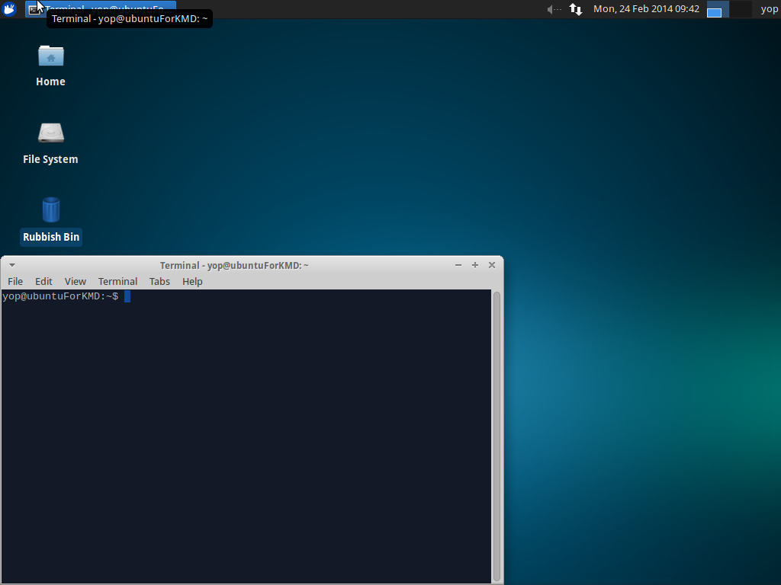
Example
Notes:
Desktop
Terminal
Pdf reader – script
Editor
Browser
Music player
… OS

Slide 23
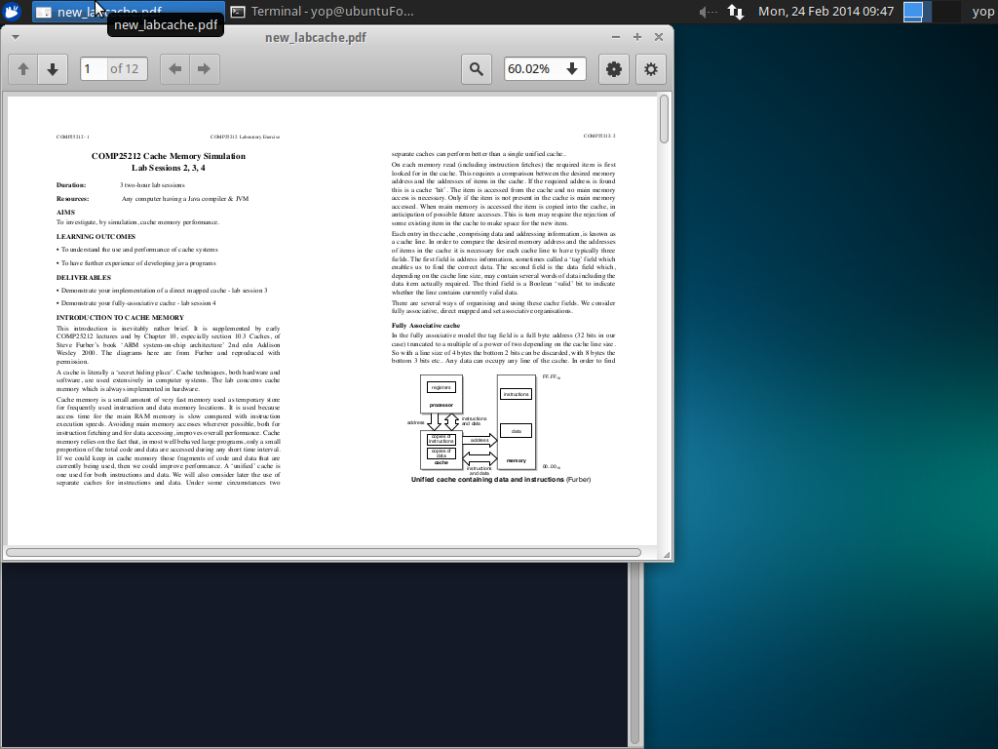
Example
Notes:
Desktop
Terminal
Pdf reader – script
Editor
Browser
Music player
… OS

Slide 24
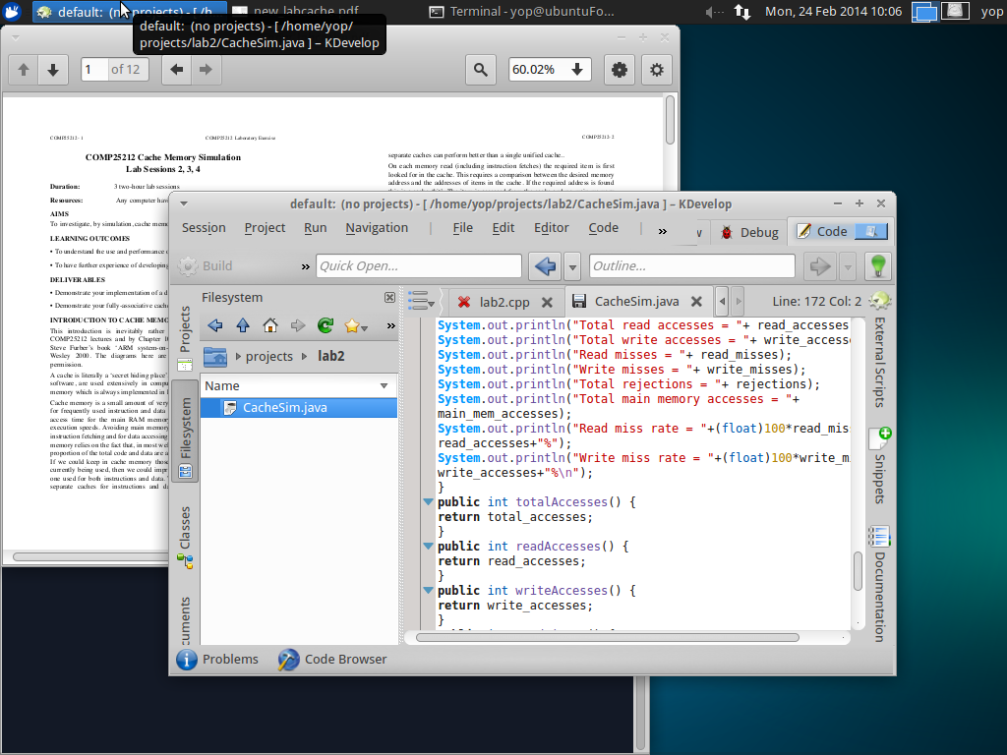
Example
Notes:
Desktop
Terminal
Pdf reader – script
Editor
Browser
Music player
… OS

Slide 25
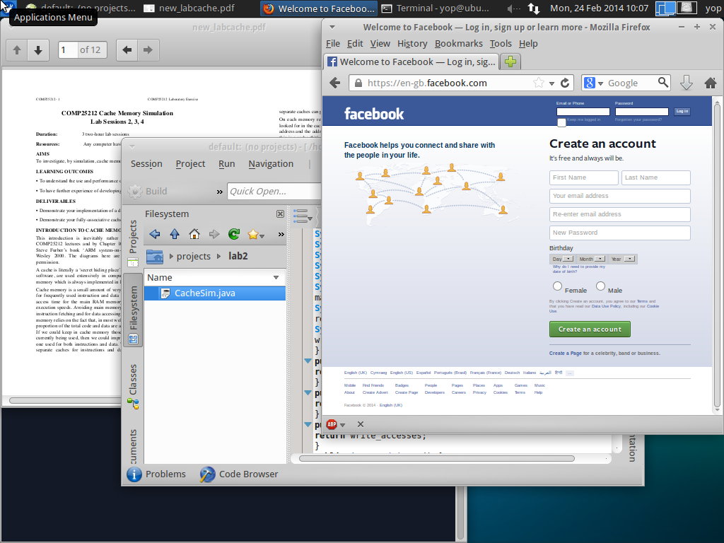
Example
+ Lots of OS Processes
Notes:
Desktop
Terminal
Pdf reader – script
Editor
Browser
Music player
… OS

Slide 26
OS Thread Switching - Revision
Operating System
Thread T₀
Thread T₁
Exec
Save state into PCB₀
Context
Switching
Wait
Load state fromPCB₁
Wait
Exec
Save state into PCB₁
Context
Switching
Load state fromPCB₀
Wait
Exec
Context switching between available threads is done so often (typically
every few ms) that, to the user, applications seem to run in parallel
COMP25111 – Lect. 5

Slide 27
Process Control Block (PCB) - Revision
PCBs store information about the state of ‘alive’ processes handled by the OS
Process ID
Process State
PC
Stack Pointer
General Registers
Memory Management Info
Open File List, with positions
Network Connections
CPU time used
Parent Process ID
Lots of information!
Context switching at this level has a huge overload

Slide 28
OS Process States - Revision
Wait (e.g. I/O)
Terminated
Running on a CPU
Blocked waiting for event
Pre-empted
Ready waiting for a CPU
Event
occurs
Dispatched
New
COMP25111 – Lect. 5

Slide 29
Hardware Multithreading
Processor architectural support
to exploit instruction level parallelism

Slide 30
Hardware Multithreading
Allow multiple threads to share a single processor
Requires replicating the independent state of each thread
  Registers
  TLB
Virtual memory can be used to share memory among threads
  Beware of synchronization issues

Slide 31
CPU Support for Multithreading
VA Mapping_{A}
Address
Translation
VA Mapping_{B}
Inst Cache
Data Cache
PC_{A}
PC
PC_{B}
Fetch Logic
Fetch Logic
Decode Logic
Fetch Logic
Exec Logic
Fetch Logic
Mem Logic
Write Logic
Register_{A}
Register Bank
Register_{B}

Slide 32
Hardware Multithreading Issues
How HW MT is presented to the OS
  Normally present each hardware thread as a virtual processor (Linux, UNIX, Windows)
  Requires multiprocessor support from the OS
Needs to share or replicate resources
  Registers – normally replicated
  Caches – normally shared
    Each thread will use a fraction of the cache
    Cache trashing issues – severely harm performance

Slide 33
Example of Trashing - Revision
Memory Accesses
Thread A |  | Thread B
: |  | :
0x075A13D0 | MISS | :
 |  | 0X018313D4 | MISS
0x075A13D4 | MISS
 |  | 0X018313D8 | MISS
0x075A13D8 | MISS
: |  | 0X018313DC | MISS

Slide 34
Example of Trashing - Revision
Memory Accesses
Thread A |  | Thread B
: |  | :
0x075A13D0 | MISS | :
 |  | 0x018313D4 | MISS
0x075A13D4 | MISS
 |  | 0x018313D8 | MISS
0x075A13D8 | MISS
: |  | 0x018313DC | MISS

Slide 35
Example of Trashing - Revision
Memory Accesses
Thread A |  | Thread B
: |  | :
0x075A13D0 | MISS | :
 |  | 0x018313D4 | MISS
0x075A13D4 | MISS
 |  | 0x018313D8 | MISS
0x075A13D8 | MISS
: |  | 0x018313DC | MISS
Same index

Slide 36
Example of Trashing - Revision
Direct Mapped cache
Memory Accesses |  |  |  |  |  |  | Line 13D
Thread A |  | Thread B |  |  | Action taken |  | Tag
: |  | : |  |  |  |  | Invalid
0x075A13D0 | MISS | :
 |  | 0x018313D4 | MISS
0x075A13D4 | MISS
 |  | 0x018313D8 | MISS
0x075A13D8 | MISS
: |  | 0x018313DC | MISS

Slide 37
Example of Trashing - Revision
Direct Mapped cache
Memory Accesses |  |  |  |  |  | Line 13D
Thread A |  | Thread B |  | Action taken |  | Tag
: |  | : |  |  |  | Invalid
0x075A13D0 | MISS | : |  | Load 0x075A |  | 0x075A

Slide 38
Example of Trashing - Revision
Direct Mapped cache
Memory Accesses |  |  |  |  |  | Line 13D
Thread A |  | Thread B |  | Action taken |  | Tag
: |  | : |  |  |  | Invalid
0x075A13D0 | MISS | : |  | Load 0x075A |  | 0x075A

Slide 39
Example of Trashing - Revision
Direct Mapped cache
Memory Accesses |  |  |  |  |  |  | Line 13D
Thread A |  | Thread B |  |  | Action taken |  | Tag
: |  | : |  |  |  |  | Invalid
0x075A13D0 | MISS | : |  |  | Load 0x075A |  | 0x075A
 |  | 0x018313D4 | MISS |  | Load 0X0183 |  | 0X0183

Slide 40
Example of Trashing - Revision
Direct Mapped cache
Memory Accesses |  |  |  |  |  |  | Line 13D
Thread A |  | Thread B |  |  | Action taken |  | Tag
: |  | : |  |  |  |  | Invalid
0x075A13D0 | MISS | : |  |  | Load 0x075A |  | 0x075A
 |  | 0x018313D4 | MISS |  | Load 0x0183 |  | 0x0183

Slide 41
Example of Trashing - Revision
Direct Mapped cache
Memory Accesses |  |  |  |  |  |  | Line 13D
Thread A |  | Thread B |  |  | Action taken |  | Tag
: |  | : |  |  |  |  | Invalid
0x075A13D0 | MISS | : |  |  | Load 0x075A |  | 0x075A
 |  | 0x018313D4 | MISS |  | Load 0x0183 |  | 0x0183
0x075A13D4 | MISS |  |  |  | Load 0x075A |  | 0x075A

Slide 42
Example of Trashing - Revision
Direct Mapped cache
Memory Accesses |  |  |  |  |  |  | Line 13D
Thread A |  | Thread B |  |  | Action taken |  | Tag
: |  | : |  |  |  |  | Invalid
0x075A13D0 | MISS | : |  |  | Load 0x075A |  | 0x075A
 |  | 0x018313D4 | MISS |  | Load 0x0183 |  | 0x0183
0x075A13D4 | MISS |  |  |  | Load 0x075A |  | 0x075A

Slide 43
Example of Trashing - Revision
Direct Mapped cache
Memory Accesses |  |  |  |  |  |  | Line 13D
Thread A |  | Thread B |  |  | Action taken |  | Tag
: |  | : |  |  |  |  | Invalid
0x075A13D0 | MISS | : |  |  | Load 0x075A |  | 0x075A
 |  | 0x018313D4 | MISS |  | Load 0x0183 |  | 0x0183
0x075A13D4 | MISS |  |  |  | Load 0x075A |  | 0x075A
 |  | 0x018313D8 | MISS |  | Load 0x0183 |  | 0x0183
0x075A13D8 | MISS |  |  |  | Load 0x075A |  | 0x075A
: |  | 0x018313DC | MISS |  | Load 0x0183 |  | 0x0183

Slide 44
Hardware Multithreading
Different ways to exploit this new source of parallelism
When & how to switch threads?
  Coarse-grain Multithreading
  Fine-grain Multithreading
  Simultaneous Multithreading

Slide 45
Coarse-Grain Multithreading

Slide 46
Coarse-Grain Multithreading
Issue instructions from a single thread
Operate like a simple pipeline
Switch Thread on “expensive” operation:
  E.g. I-cache miss
  E.g. D-cache miss

Slide 47
Switch Threads on Icache miss
 | 1 | 2 | 3 | 4 | 5 | 6 | 7
Inst a | IF | ID | EX | MEM | WB
Inst b |  | IF | ID | EX | MEM | WB
Inst c |  |  | IF MISS | ID | EX | MEM | WB
Inst d |  |  |  | IF | ID | EX | MEM
Inst e |  |  |  |  | IF | ID | EX
Inst f |  |  |  |  |  | IF | ID
- | - | - | -
Inst X
Inst Y
Inst Z
Remove Inst c and switch to other thread
The next thread will continue its execution until it encounters another “expensive” operation

Slide 48
Switch Threads on Dcache miss
 | 1 | 2 | 3 | 4 | 5 | 6 | 7
Inst a | IF | ID | EX | M-Miss | WB
Inst b |  | IF | ID | EX | MEM | WB
Inst c |  |  | IF | ID | EX | MEM | WB
Inst d |  |  |  | IF | ID | EX | MEM
Inst e |  |  |  |  | IF | ID | EX
Inst f |  |  |  |  |  | IF | ID
MISS | MISS | MISS
- | - | -
Abort these
- | - | -
- | - | -
Inst X
Inst Y
Remove Inst a and switch to other thread
  Remove the rest of instructions from ‘blue’ thread
  Roll back ‘blue’ PC to point to Inst a

Slide 49
Coarse Grain Multithreading
Good to compensate for infrequent, but expensive pipeline disruption
Minimal pipeline changes
  Need to abort all the instructions in “shadow” of Dcache miss ⇨ overhead
  Resume instruction stream to recover
Short stalls (data/control hazards) are not solved
Requires a fast thread switching mechanism
  Thread switching needs to be faster than getting the cache line

Slide 50

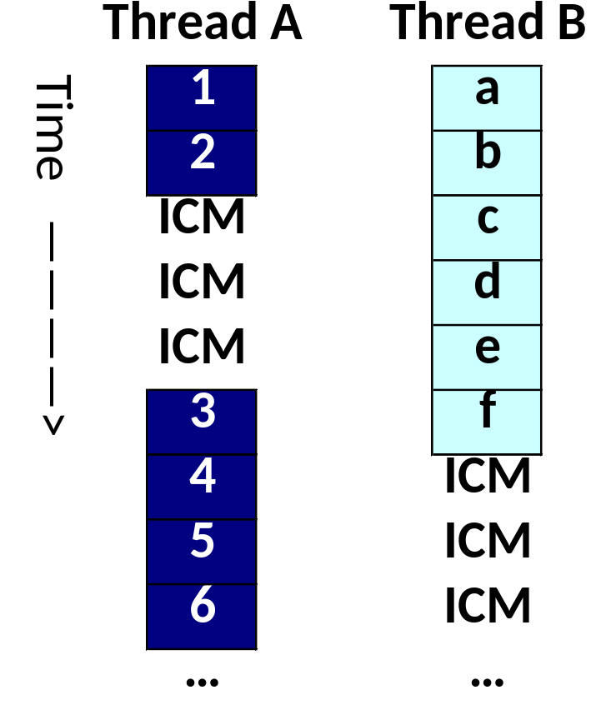
Coarse-grain Multithreading
We want to run these
two Threads
Run Thread A,
when it finishes
run Thread B

Slide 51
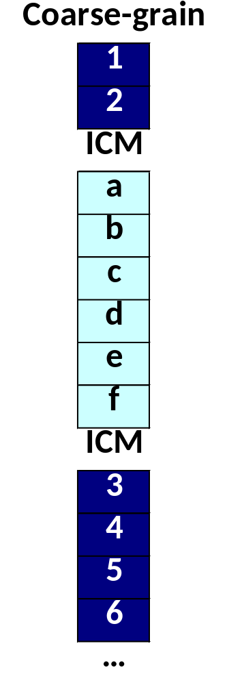
Coarse-grain Multithreading
We want to run these
two Threads
Start Thread A,
swap threads
upon ICMs

Slide 52
Fine-Grain Multithreading

Slide 53
Fine-Grain Multithreading
Overlap in time the execution of several threads
  Fetch instructions from a different thread each cycle
Typically using Round Robin among all the ‘ready’ hardware threads
  Others policies possible
Requires instantaneous thread switching
  Complex hardware

Slide 54
Fine-Grain Multithreading
Multithreading helps alleviate fine-grain dependencies (e.g. forwarding?)
 | 1 | 2 | 3 | 4 | 5 | 6 | 7
Inst a | IF | ID | EX | MEM | WB
Inst M |  | IF | ID | EX | MEM | WB
Inst b |  |  | IF | ID | EX | MEM | WB
Inst N |  |  |  | IF | ID | EX | MEM
Inst c |  |  |  |  | IF | ID | EX
Inst P |  |  |  |  |  | IF | ID
Notes:
Separation means that forwarding no longer needs a no op

Slide 55
I-cache misses in Fine Grain Multithreading
An I-cache miss is overcome transparently
 | 1 | 2 | 3 | 4 | 5 | 6 | 7
Inst a | IF | ID | EX | MEM | WB
Inst M |  | IF | ID | EX | MEM | WB
Inst b |  |  | IF-MISS | - | - | - | -
Inst N |  |  |  | IF | ID | EX | MEM
Inst P |  |  |  |  | IF | ID | EX
Inst Q |  |  |  |  |  | IF | ID
Inst b is removed and the thread is marked as not ‘ready’
‘Blue’ thread is not ready so ‘orange’ is executed
Notes:
What is the problem with this? Two Ex stages at the same time! Worth it for cases where the miss is longer....

Slide 56
D-cache misses in Fine Grain Multithreading
Mark the thread as not ‘ready’ and issue only from the other thread
 | 1 | 2 | 3 | 4 | 5 | 6 | 7
Inst a | IF | ID | EX | M-MISS | Miss | Miss | WB
Inst M |  | IF | ID | EX | MEM | WB
Inst b |  |  | IF | ID | - | - | -
Inst N |  |  |  | IF | ID | EX | MEM
Inst P |  |  |  |  | IF | ID | EX
Inst Q |  |  |  |  |  | IF | ID
Thread marked as not ‘ready’. Remove Inst b. Update PC.
‘Blue’ thread is not ready so ‘orange’ is executed
Notes:
What is the problem with this? Two Ex stages at the same time! Worth it for cases where the miss is longer....

Slide 57
Fine Grain Multithreading in out-of-order-processors
In an out of order processor we may continue issuing instructions from both threads
  Unless O-o-O algorithm stalls one of the threads
 | 1 | 2 | 3 | 4 | 5 | 6 | 7
Inst a | IF | RO | EX | MEM | WB
Inst M |  | IF | RO | EX | MEM | WB
Inst b |  |  | IF | ID | EX | MEM | WB
Inst N |  |  |  | IF | ID | EX | MEM
Inst c |  |  |  |  | IF | ID | EX
Inst P |  |  |  |  |  | IF | ID
4 | 5 | 6 | 7
M MISS
EX | MEM | WB
ID
IF | ID | EX | MEM
 |  | IF | ID
4 | 5 | 6 | 7
M MISS | Miss | Miss | WB
EX | MEM | WB
RO | (RO) | (RO) | EX
IF | RO | EX | MEM
 | IF | (RO) | (RO)
 |  | IF | RO
Notes:
CHECK THIS IN ANIMATION

Slide 58
Fine Grain Multithreading
Utilization of pipeline resources increased, i.e. better overall performance
  Impact of short stalls is alleviated by executing instructions from other threads
Each thread perceives it is being executed slower, but overall performance is better
Requires an instantaneous thread switching mechanism
  Expensive in terms of hardware

Slide 59
Fine-grain Multithreading
We want to run these
two Threads

Slide 60
Fine-grain Multithreading
We want to run these
two Threads

Slide 61
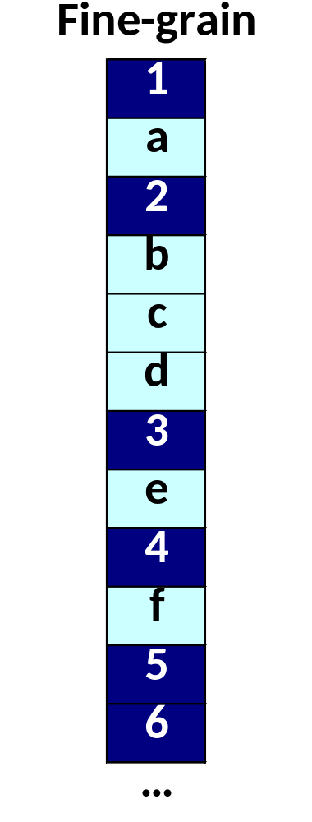
Fine-grain Multithreading
We want to run these
two Threads
Thread A not
ready, issue
from B only
Thread B not
ready, issue
from A only

Slide 62
Questions

