Slide 1
Hardware Multithreading
COMP25212

Slide 2
…from Wednesday
What are the differences between software multithreading and hardware multithreading?
  Software: OS support for several concurrent threads
  Large number of threads (effectively unlimited)
  ‘Heavy’ context switching
  Hardware: CPU support for several instructions flows
  Limited number of threads (typically 2 or 4)
  ‘Light’/’Immediate’ context switching

Slide 3
…from Wednesday
Describe Trashing in the context of Multithreading
  Two threads are accessing independent regions of memory which occupy the same cache lines and keep retiring each other’s data
Why is it a problem?
  Both threads will have a high cache miss rate, which will slow their execution down a lot
Describe Coarse-grain multithreading
  Threads are switched upon ‘expensive’ operations
Describe fine-grain multithreading
  Threads are switched every single cycle among the ‘ready’ threads

Slide 4
Simultaneous Multi-Threading

Slide 5
Simultaneous Multi-Threading
The main idea is to exploit instructions level parallelism and thread level parallelism at the same time
In a superscalar processor issue instructions from different threads in the same cycle
  Schedule as many ‘ready’ instructions as possible
  Operand reading and result saving becomes much more complex
Note that coarse-grain and fine-grain MT can also be implemented in superscalar processors

Slide 6
Simultaneous MultiThreading
Let’s look simply at instruction issue:
 | 1 | 2 | 3 | 4 | 5 | 6 | 7 | 8 | 9 | 10
Inst a | IF | ID | EX | MEM | WB
Inst b | IF | ID | EX | MEM | WB
Inst M |  | IF | ID | EX | MEM | WB
Inst N |  | IF | ID | EX | MEM | WB
Inst c |  |  | IF | ID | EX | MEM | WB
Inst P |  |  | IF | ID | EX | MEM | WB
Inst Q |  |  |  | IF | ID | EX | MEM | WB
Inst d |  |  |  | IF | ID | EX | MEM | WB
Inst e |  |  |  |  | IF | ID | EX | MEM | WB
Inst R |  |  |  |  | IF | ID | EX | MEM | WB

Slide 7
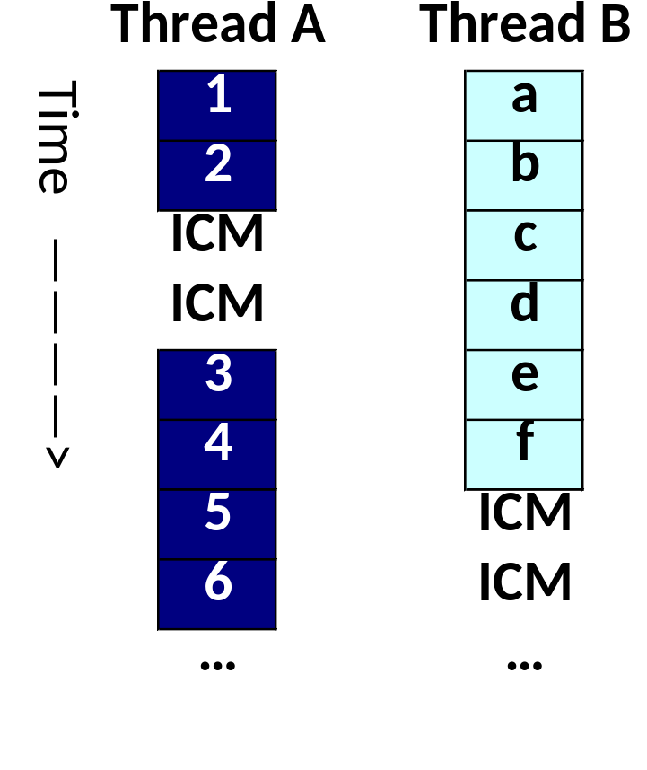
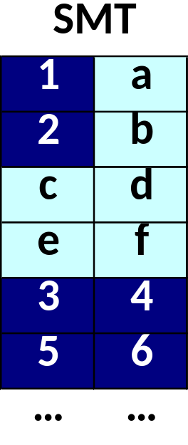
Simultaneous Multithreading
We want to run these
two Threads
Issue as many
Ready instrs.
as possible

Slide 8
SMT issues with in-order processors
Asymmetric pipeline stall
  One part of pipeline stalls – we want other pipeline to continue
Overtaking – non-stalled threads should progress
  What happens if a ready thread
Cache misses – Abort instruction (and instructions in the shadow if Dcache miss) upon cache miss
Most existing implementations are for O-o-O, register-renamed architectures (akin to tomasulo)
  e.g. PowerPC, Intel Hyperthreading

Slide 9
Simultaneous Multi Threading
Extracts the most parallelism from instructions and threads
Implemented mostly in out-of-order processors because they are the only able to exploit that much parallelism
Has a significant hardware overhead
  Replicate (and MUX) thread state (registers, TLBs, etc)
  Operand reading and result saving increases datapath complexity
  Per-thread instruction handling/scheduling engine in out-of-order implementations

Slide 10
Hardware Multithreading
Summary

Slide 11
Benefits of HW MT
Multithreading techniques improve the utilisation of processor resources and, hence, the overall performance
If the different threads are accessing the same input data they may be using the same regions of memory
  Cache efficiency improves in these cases

Slide 12
Disadvantages of HW MT
Single-thread performance may be degraded when compared to a single-thread CPU
  Multiple threads interfere with each other
Shared caches mean that, effectively, threads would use a fraction of the whole cache
  Trashing may exacerbate this issue
Thread scheduling at hardware level adds high complexity to processor design
  Thread state, managing priorities, OS-level information, …

Slide 13
Multithreading Summary
A cost-effective way of finding additional parallelism for the CPU pipeline
Available in x86, Itanium, Power and SPARC
  Intel Hyperthreading (SMT)
  PowerPC uses SMT
  UltraSparc T1/T2 used fine-grain, later models used SMT
  Sparc64 VI used coarse-grain, later models moved to SMT
Present additional hardware thread as an additional virtual CPU to Operating System
  Multiprocessor OS is required

Slide 14
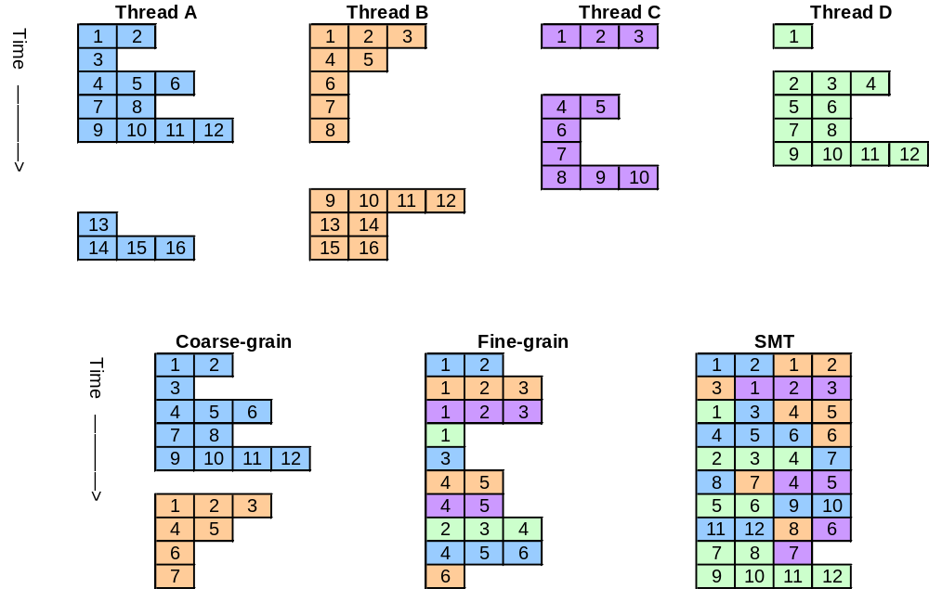
Multithreading in 4-way superscalar

Slide 15
Some Advanced Uses of Multithreading

Slide 16
Speculative Execution
When reaching a conditional branch we could spawn 2 threads
  One runs the true path
  Another runs the false
Once we know which one is correct
kill the other thread
  Effects of Control Hazards alleviated
Supported by current OoO cpus
  But not as a full-fledged thread
  Can reach several levels of nested conditions
  Requires memory support (e.g. reordering buffers)
Branch
Kill
Thread

Slide 17
Memory Prefetching
Compile applications into two threads
  One runs the whole application
  The other thread (scout thread) only has the memory accesses
The scout thread runs ahead and fetches memory in advance
  Ensures data will be in the cache when the original thread needs it
    cache hit rate increases
Synchronization is needed
  Scout has to run ahead enough so that memory delay is hidden …
  But not too much so that it does not replace useful data from the cache
  Beware trashing!!!
Single
threaded
Original
thread
Scout
thread
Data in
cache
^{x}CM
^{x}CM
^{x}CH
^{x}CM
^{x}CM
^{x}CH
^{x}CM
^{x}CH
^{x}CM

Slide 18
Slipstreaming
Compile sequential applications into two threads
  One runs the application itself
  The slipstream thread only has a critical path of the application
The slipstream thread runs ahead and passes results
  Delay of slow operations (e.g. float point division) is improved
  Synchronization and communication among the threads is needed
  Requires extra hardware to deal with this ‘special’ behaviour
  Could be used in multicore as well
Single
threaded
Original
thread
Slipstream
thread
Non-critical
Results
Critical

Slide 19
Questions

Slide 20
Multithreading Example
We want to execute 2 programs with 100 instructions each. The first program suffers an i-cache miss at instruction #31, and the second program another at instruction #71. Assume that:
+ There is parallelism enough to execute all instructions independently
(no hazards, apart from the two cache misses highlighted)
+ Switching threads can be done instantaneously
+ A cache miss requires 20 cycles to get the instruction to the cache.
+ The two programs would not interfere with each other’s caches lines
Calculate the execution time observed by each of the programs (cycles elapsed between the execution of the first and the last instruction of that application) and the total time to execute the workload
a) Sequentially (no multithreading)
b) With coarse-grain multithreading
c) With fine-grain multithreading
d) With 2-way simultaneous multithreading

Slide 21
Superscalar Example (from pipeline-2)
Consider the following program which implements R = A^2 + B^2 + C^2 + D^2
  LD r1, A
  MUL r2, r1, r1 -- A^2
  LD r3, B
  MUL r4, r3, r3 -- B^2
  ADD r11, r2, r4 -- A^2 + B^2
  LD r5, C
  MUL r6, r5, r5 -- C^2
  LD r7, D
  MUL r8, r7, r7 -- D^2
  ADD r12, r6, r8 -- C^2 + D^2
  ADD r21, r11, r12 -- A^2 + B^2 + C^2 + D^2
  ST r21, R
The current code is not really suitable for a superscalar pipeline because of its
low instruction-level parallelism
Draw the dependency graph of the application
Based on the graph above, discuss the suitability of the code to be run in a 2-way superscalar
Simulate the execution of the original and the reordered code in a 5-stage 2-way superscalar pipeline

Slide 22
Questions

