Slide 1

CHECKING WITH PROGRAM
Department Of Computer Engineering
PYTHON
MEMBER NAMES: - TEJAS SHETH.
AKSHEN DHAMI.
PARAG PATIL.

Slide 2


PROBLEM STATEMENT
Write a Python program to print all Prime Nos. between given range.
Write a Python program to find whether a given number (accepted from the user) is Even or Odd, print out an appropriate message to the user.
Write a Python program to find whether a given number (accepted from the user) is Prime or Composite, print out an appropriate message to the user.
Write a Python program to test whether a passed letter is a Vowel or Consonant.
Write a Python Game to Guess the correct number.

Slide 3
ABSTRACT
The approach we are using here is a Menu-Driven Methods where we will give a Menu on the initial page with multiple choices –
0. Exit.
Print all Prime Numbers between certain Range.
Find if Number is Odd or Even.
Find if Number is Prime or Composite.
Find if Letter is Vowel or Consonant.
Write a Python Game to Guess the correct Number.

Slide 4
PROJECT WORKFLOW
1. Print all Prime Numbers.
2. Find if Number is Odd or Even.
3. Find if Number is Prime or Composite.
4. Find if Letter is Vowel or Not.
5. Guessing the Number Game.
MENU-DRIVEN
0. EXIT

Slide 5
FUNCTIONS₁
MENU-DRIVEN.
The approach we are using here is a Menu-Driven Methods where -
We will give a menu on the initial page with multiple choices –
1. Print all Prime Numbers between 1 to 1000.
2. Find if Number is Odd or Even.
3. Find if Number is Prime or Composite.
4. Find if Letter is Vowel or Consonant.
5. Write a Python Game to Guess the correct number.
PRINT ALL PRIME NUMBERS BETWEEN RANGE.
Print all Prime Numbers between desired Range.
a. 2 Inputs Expected – Start and End.
b. This Program will appropriately print out all of the prime numbers in the range of Start to End.
FIND IF NUMBER IS ODD OR EVEN.
a. This program will print out appropriate message when the user will input any value.
b. For every Negative number except -1, the code will output ‘Neither Odd nor Even’ and for every Positive number, the code will output either ‘Odd’ or ‘Even’.
c. It will also prompt the user to enter only Integers if he enters anything else.
d. The User can Enter ‘-1’ to Return to the Main Menu.
c. The User can Enter ‘-1’ to Return to the Main Menu.

Slide 6
FUNCTIONS₂
Find if Number is Prime or Composite.
a. This program will print out appropriate message when the user will input any value.
b. For every Negative number except -1, the code will output ‘Neither Prime nor Composite’ and for every Positive number, the code will output either ‘Prime or ‘Composite’.
c. It will also prompt the user to enter only Integers if (s)he enters anything else.
d. The User can Enter ‘-1’ to Return to the Main Menu.
Find if Letter is Vowel or Consonant.
a. This program will print out appropriate message when the user will input any value.
b. For Input with more than 1 alphabet or anything other than letters, the code will output ‘1 alphabet expected’, otherwise the code will output either ‘Vowel’ or ‘Consonant’ depending on the Input.
c. The User can Enter ‘-1’ to Return to the Main Menu.
Guessing the Number Game.
a. This program will print out an appropriate message when the user will input any value.
b. For every value entered, the code will output ‘appropriate message’ and Hints.
d. The User can Enter ‘-1’ to Return to the Main Menu.
c. It will also prompt the User to enter only Integers if (s)he enters anything else.

Slide 7
OUTPUT₁
MENU-DRIVEN
MENU-DRIVEN

Slide 8
OUTPUT₂
PRIME NUMBERS
PRIME NUMBERS

Slide 9
OUTPUT₃
ODD / EVEN
ODD / EVEN

Slide 10
OUTPUT₄
PRIME / COMPOSITE
PRIME / COMPOSITE

Slide 11
OUTPUT₅
VOWEL / CONSONANT
VOWEL / CONSONANT

Slide 12
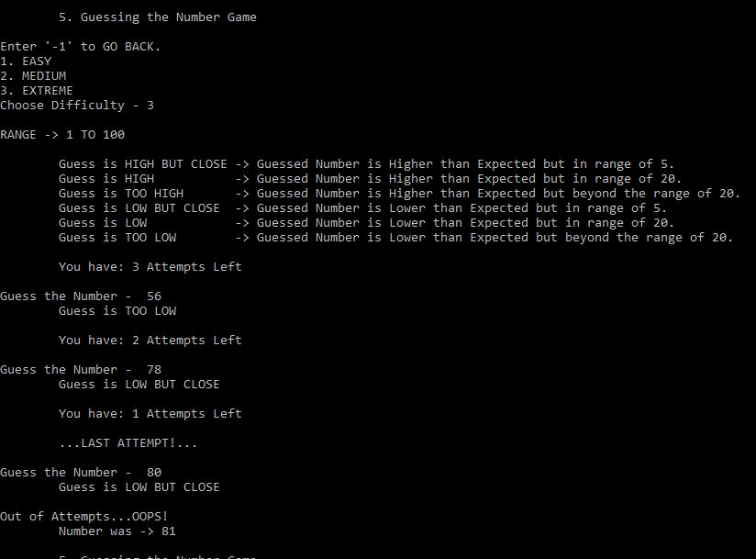
OUTPUT₆
GUESS THE NUMBER

Slide 13
ACKNOWLEDGEMENT
I, On Behalf of Group 3 would like to take this opportunity and deliver the Vote of Thanks.
APSIT Skills – gave us a worthwhile experience of learning so much at such an early stage of our college life.
Prof. Mayuri Jain & Project Mentor Miss Nimali Keny – Helped us executed our Project effortlessly and successfully.
Student Mentors Mr. Yash Chavan, Miss Amruta Deshpande & Miss Nimali Keny - They ensured that we picked the right courses and learnt consistently.
Mr. Akshen Dhami and Mr. Parag Patil - wonderful teammates, always at hand to help me out.
Once again, we THANK all the people who have helped us in the successful conclusion of our project.

Slide 14
REFERENCES
https://www.coursera.org/learn/python-crash-course - Crash Course on Python.
https://www.coursera.org/specializations/introduction-scripting-in-python – Introduction to Scripting in Python.
https://docs.python.org/3/ - Python Documentation.
https://stackoverflow.com/
https://www.learnpython.org/
https://www.programiz.com/python-programming
https://www.quora.com/
THANK YOU!

