Slide 1
Business
Journey Initiatives

Slide 2
Journey So Far
2004-2007 Started as Informal Channel Partner for Becker GmbH and hhs GmbH
2007 We form joint venture company with hhs
2008 Baumer Group takes over the joint venture company and appoints our key staff as the top managers
2008 Becker appoints Upbringing as exclusive distributor for the Indian subcontinent
2010 Upbringing starts sale of Fipa GmbH products
2021 We form a joint venture company with Optrel AG in Switzerland by name Optrel India Private Limied with separate management team

Slide 3
What we bring to the Business
Leadership
Entreprenuership
Market Brand Build up
Introduction of Premium European products

Slide 4
Our Unique Strengths
Quick Launch and Introduction
Experienced Team of Technical and Management Personnel having exposure to European way of Working
Promoters with deep knowledge of Indian Customer and Markets
More than 3 decades of working closely with the Swiss and German Companies
Ready Sales, Technical Support and Warehousing Infrastructure

Slide 5
Industry-Technoloies-Markets Exposure
Industries
Power
Paper
Packaging
Raiway
Steel
Wood working
Shipping
Pharmaceuticals
Chemicals
Dairy and Food
Steel and Metal
Technologies
Nuclear
Pneumatic Transfer
Pick and Place
Material Handliing
Process Industries
Drying
Effluent Treatment
Markets
Government
Consumer
Defense
Private Industries
Healthcare

Slide 6
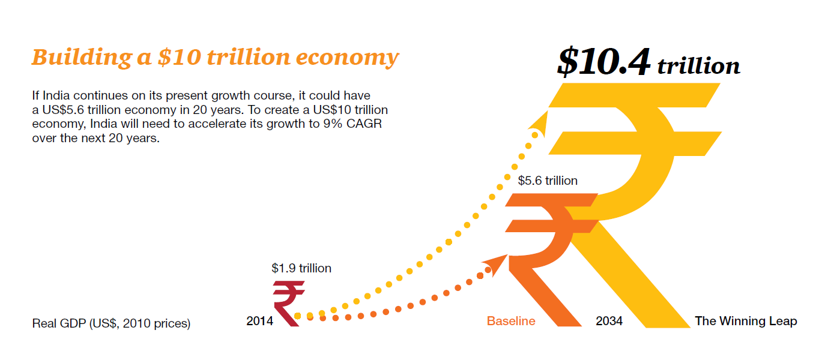
National Economic Targets of India

Slide 7
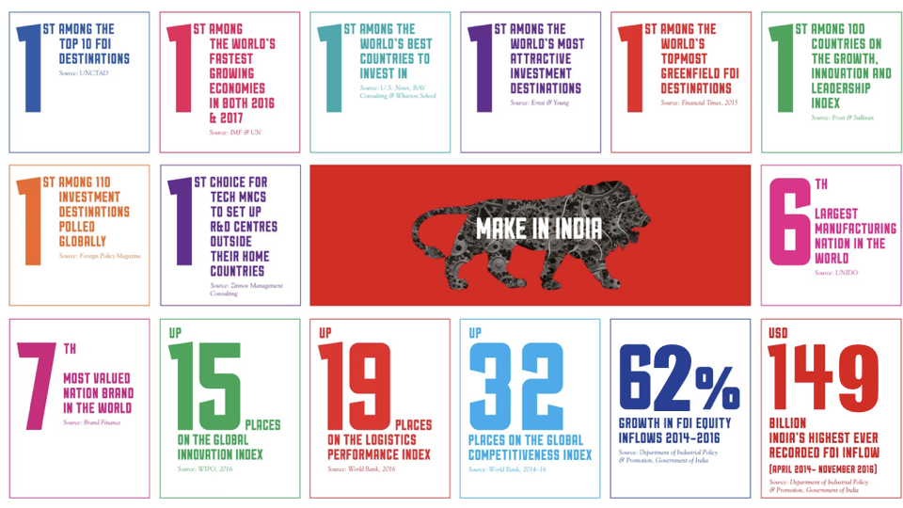
India Marching Ahead

Slide 8
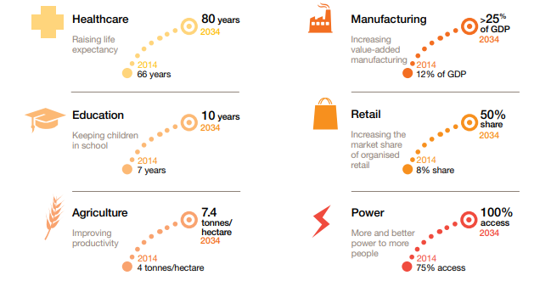
India : Major Social Indices

Slide 9
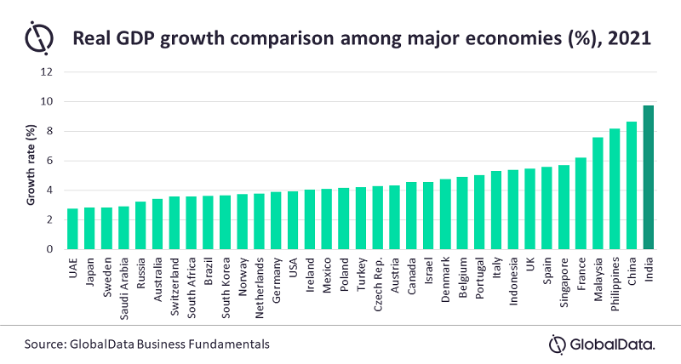
India in Comparison to the World

Slide 10
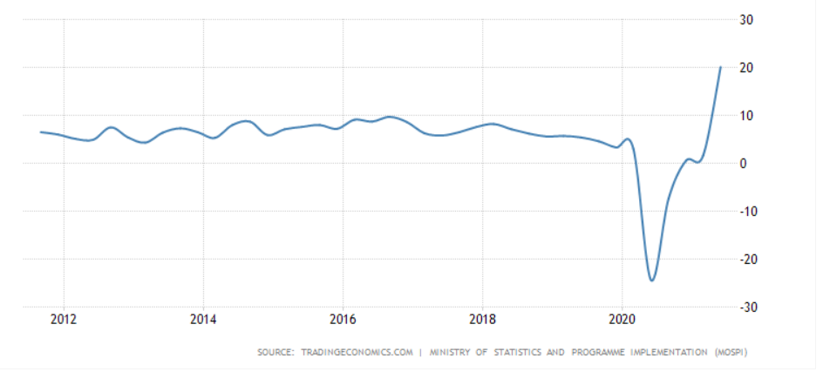
India GDP Growth

Slide 11
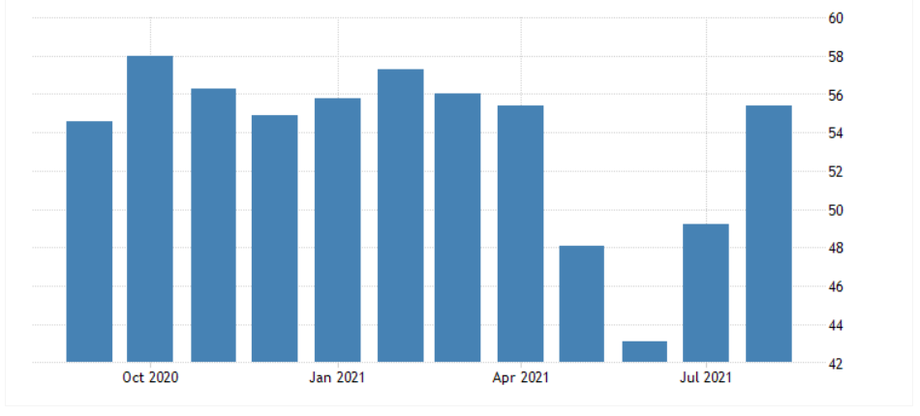
India Composite PMI

Slide 12

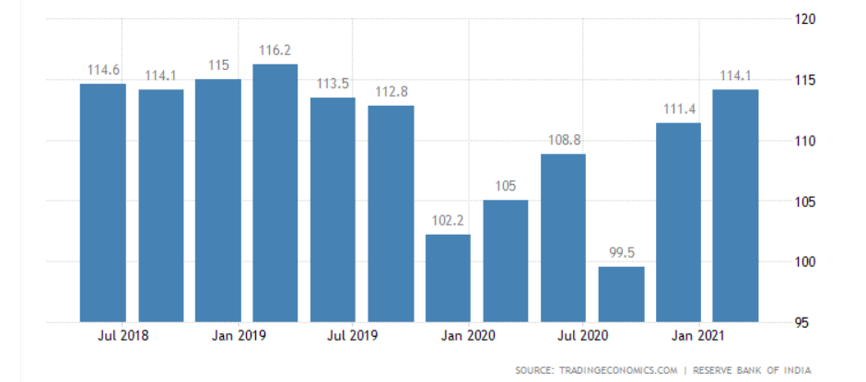
India Business Confidence Trend
12

Slide 13
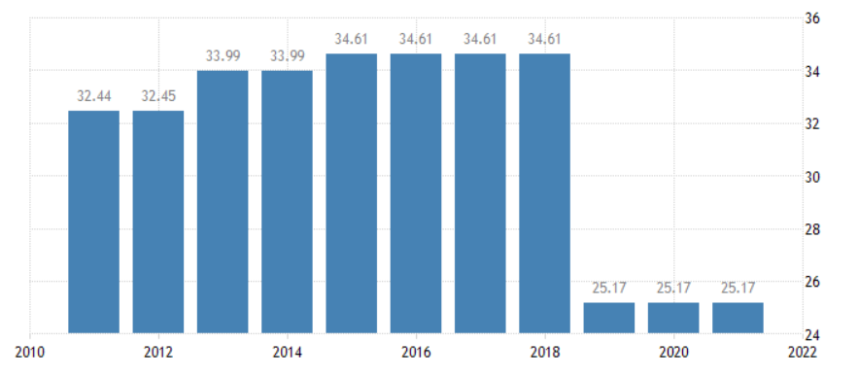
India Corporate Tax Rate

Slide 14
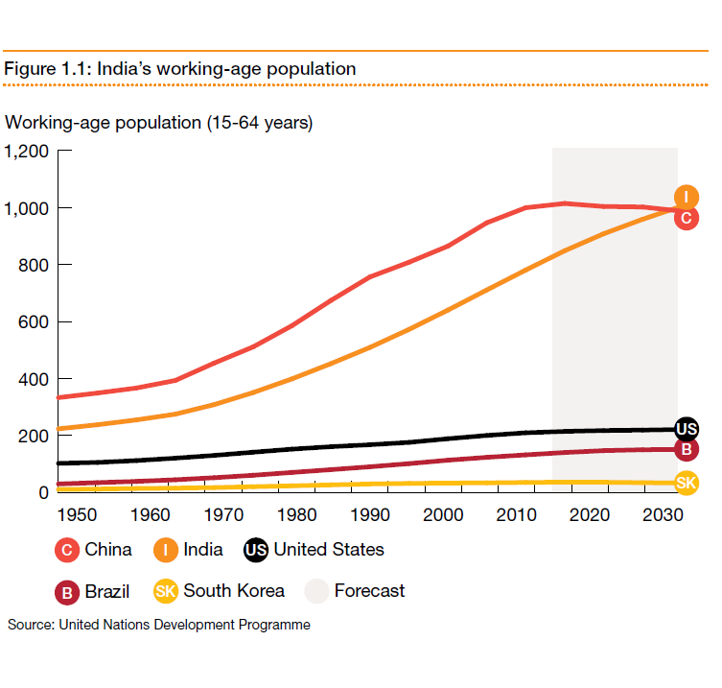
Demographic Advantage Remains Till 2050

Slide 15
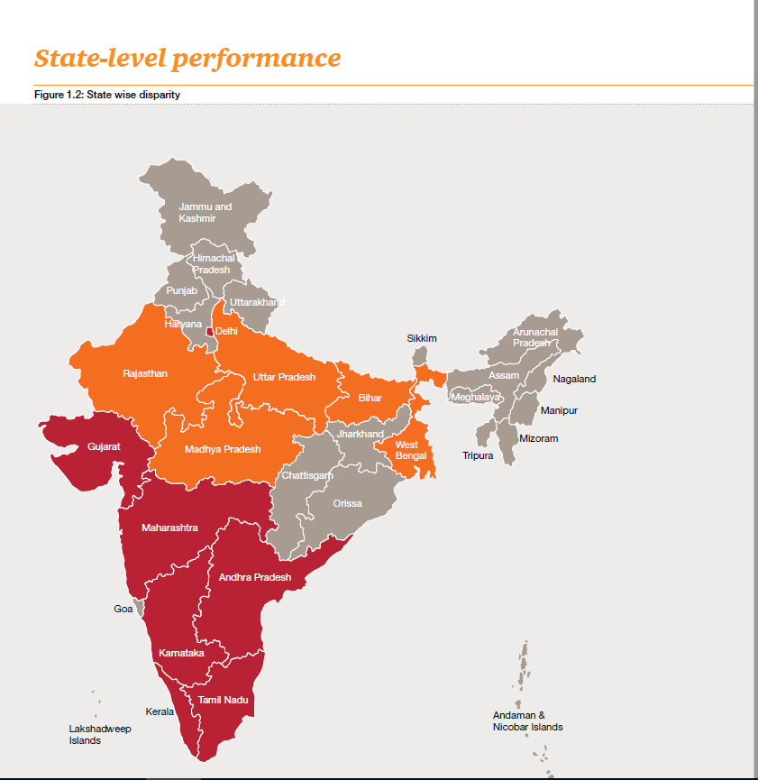
Economic Disparity Across Regions

Slide 16
Business
Journey Initiatives

Slide 17
Achievements
Major orders for Oil Pumps for new application of Oxygen generation Plants
Good Success in Medical Industry for oil pumps.
Won the tender for Cochin Shipyard for vacuum lifting equipment with Becker Dry Vane Pump.
Never lost an OEM for dry vane pump once they started working with Upbringing.
Supply of simple system with oil pumps, storage tank, control panel & other accessories.
Successful local installation of Flame Proof Motors to Becker oil pumps for specific industries demanding safety.
Pro-active Initiatives
Initiated Becker pump monitoring system to monitor various parameters of the pump through IOT & Cloud Connectivity in co-ordination with Mr. Stefan Beirlein.
Pharma Initiative – Special efforts to multiply our success across pharma industry.
Quick response to customers for their service & technical related issues.
Keeping in mind about expected future growth and to boost the various business activities / initiatives, Milind Bhalerao will join Upbringing full time from 1st April, 2022 (Resolution attached)

Slide 18
 | Year | Sales INR Mio
 | 2007 | 6.3
 | 2008 | 10.5
 | 2009 | 16.52
 | 2010 | 30.91
 | 2011 | 39.03
 | 2012 | 52
 | 2013 | 63.8
 | 2014 | 80.14
 | 2015 | 101.33
 | 2016 | 126.67
 | 2017 | 150
 | 2018 | 162.82
 | 2019 | 135.5
 | 2020 | 147.861
 | 2021 | 160
Estimated sales for 2021-22 will be 200 million INR

Slide 19
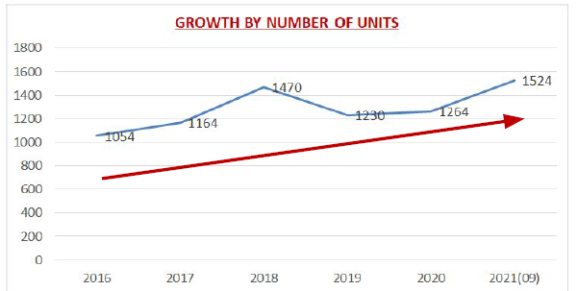
Volumes – Qty of Pumps

Slide 20
Product wise Break Up (since2011)
VT/ KVT series – 6221 nos Dry Vacuum Vane Pumps
T/DVT/DT series – 1224 nos Presure-Vacuum Combined
U/O series – 216 nos Oil Lubricated Vane Pumps
SV Series – 952 nos Side Channel Blowers
VTLF/DTLF - 174 nos Large Dry Vane Pumps
Total pumps sold since 2011 - 8787 nos ( 2011-2020)

Slide 21
Major OEMs
No. | NAME | SEGMENT | ACHIEVED | MODEL
1 | ACG PAM Group | Pharma | 261 | KVT 3.80/VT 4.40/VT 4.10/VT 4.25/SV 5.90/SV 201
2 | Pace Packaging | Pharma | 122 | VT 4.25
3 | Uflex Ltd | Packaging Machine | 171 | VT 4.16
4 | Line O Matic | Graphic Art | 032 | T 4.25 /VT 4.40
5 | NKP Pharma | Pharma Packaging | 047 | VT 4.16 /KVT 3.80
6 | Excel Machienry | Graphic Art | 035 | DVT 3.60
7 | HMT Machines | Graphics | 004 | DVT 3.60
8 | Pratham Technologies | Pharma Machinery | 028 | T 4.25 /VT 4.8
9 | Alpana Visual Packging | Packaging | 005 | DVT 3.60

Slide 22
Major OEMs
No. | NAME | SEGMENT | ACHIEVED | MODEL
10 | Saan Engineers | Pharma | 033 | SV 300/2 & KVT 3.80
11 | Glatt System | Pharma | 022 | KVT 3.140 &VTLF 2.250
12 | Tapasya Engineering | Pneumatic Conveying | 003 | KVT 3.140 & KVT 3.80
13 | EM SHIVMANI/ ENERGY PACK | Packaging | 008 | VT 4.8
14 | PARAS PHARMA | Pharma Machines | 000 | KVT 3.80 +VT 4.40
15 | Anchor Mark | Pharma | 016 | KVT 3.80
16 | Solace Engg | Pharma | 000 | SV 300/1 & SV 300/2
17 | RPFM Technology | Pharma | 053 | VT 4.16/4.25/4.25/KVT 3.80/SV blowers
18 | Pakona Engg | PACKAGING | 011 | VT 4.40

Slide 23
Major OEMs
No. | NAME | SEGMENT | ACHIEVED | MODEL
19 | AMACE | ADDICTIVE 3-D MFG | 1 | HEAT EXCHANGER
20 | AMBICA PHARMA | PHARMA | 006 | VT 4.25 /u 5.70
21 | AVISH MACHINES | BOX MAKING MACHINES | 005 | VT 4.10 / Vt 4.16
22 | BINDWELL TECHNOLOGY |  | 029 | T 4.16
23 | BOWMAN & ARCHER | PHARMA MACHINERY | 003 | SV 500
24 | CAPTECH SYSTEMS | PHARMA MACHINERY | 001 | KVT 3.80
25 | CORBETT IND | PNEUMATIC LIFTING | 011 | VT 4.8
26 | COGENT AUTOMATION | SYSTEM INTEGRATER | 001 | U 5.100
27 | CYBERNETIK TECHNOLOGIES | PHARMA | 002 | SV 1100

Slide 24
Major OEMs
No. | NAME | SEGMENT | ACHIEVED | MODEL
28 | DECBECTOCHEM | PHARMA | 003 | U 5.300 / U 5.165
29 | EXTENITY SYSTEMS | PHARMA MACHINERY | 002 | SV 300
30 | FABLIFE PROCESS | PHARMA MACHINERY | 001 | SV 700
31 | FERROCARE MACHINES | OIL FILTRATION | 001 | U 5.70
32 | GANSON PVT LTD | PHARMA MACHINERY | 022 | SV 300 / SV 400
33 | HASSIA PACKAGING | PHARMA MACHINERY | 001 | KVT 3.80
34 | HUARONG PLASTIC MACHINERY | PLASTIC MACHIENRY | 002 | VT 4.16
35 | KEVIN PROCESS | PHARMA MACHINERY | 008 | KVT 3.80 / SV 500
36 | KOHIMA MACHINE TOOLS | PACKAGING MACHINERY | 005 | T 4.25

Slide 25
Major OEMs
No. | NAME | SEGMENT | ACHIEVED | MODEL
37 | KRISTOR VACUUM EQUIPMENTS | ELETCRICAL / OIL FILTERTAION | 001 | U 5.70
38 | LAXMI PHARMA EQUIPMENT | PHARMA MACHINERY | 002 | VT 4.16
39 | MACHINECRAFT TECHNOLOGY | PHARMA MACHINERY | 001 | U 5.100
40 | MECHON IND | PHARMA MACHINERY | 002 | U 5.100/ U 5.300
41 | NU-VU CONAIR | PLASTIC MACHIENRY | 004 | SV 5.90/SV 130/SV 201/SV 300
42 | PACIFAB TECHNOLOGY | PHARMA MACHINERY | 023 | VT 4.4/VT 4.8/KVT 3.80
43 | PACKMECH | PACKAGING MACHINERY | 002 | VT 4.8
44 | PENTAGON ASSEMBLY | ASSEMBLY AUTOMATION | 002 | VT 4.16 / VT 4.40
45

Slide 26
Major OEMs
No. | NAME | SEGMENT | ACHIEVED | MODEL
46 | TECH MASTER | ENVELOP MAKING MACHINE | 001 | U 5.100
47 | TECHNOSHEEL AUTOMATION | AUTOMATION | 001 | VT 4.25
48 | TECHNO VALUE SOLUTIONS | CLEAN ROOM APPLICATION | 001 | VT4.40
49 | TEJ MACHINE TOOLS | MACHINE BUILDING | 002 | VT4.16
50 | THERMAX LTD | WATER TREATMENT | 004 | SV 300
51 | TRUETECH MACHIENRY | GRAPHIC MACHINERY | 004 | DVT 3.80 / DVT 3.100 / T 4.25
52 | UNIJET PNEUMATICS | LIFTING & PNEUMATIC | 005 | VT 4.4 / VT 4.8 / VT 4.10
53 | XPERT PACKAGING | PACKAGING | 001 | VT 4.10
54 | ZIXSOM PLAST | THERMO FORMING | 001 | U 5.100

Slide 27
Major END USERS
City | Company | Industry | Pump Model | Remarks
Myosre & Salboni | Bharatiya Reserve Bank Note Mudran Pvt Ltd | Security Printing | Pump + Spares | Govt Organisation in currency printing ,maintaining more than 150 pumps
Tirupati | Amararaja Battereies Ltd | Battery | U 5.100+spare parts
Banglore,Kolkatta | ITC Ltd | Printing & Packaging & FMCG | KVT 3.80/3.100+Spares | Huge & regular buyer for Spares
Haridwar,Assam | Hindustan Unilever Ltd | FMCG | VT 4.8/4.16/4.25+Spares
Chennai,Mysore | J.K.Tyre | Tyre Industry | KVT 3.140 /KVX 3.140 | Regular buyer for Spares
Maharashtra & Punjab | Godrej & Boyce | Appliances | U 4.400 +4.100 +4.250+spares
Srilanka | Biomed International (P)Ltd |  | Spare parts for U 4.40/4.100.4.190 | Regular Buyer
Srilanka | Nestle Lanka LLP |  | VT 4.25+spares

Slide 28
Prospectus OEM Updation
City | Company | Industry | Pump Model | Annual Qty | Remarks
Mumbai | ACG -Pharma | Pharma | VT/KVT | 200
Ahmedabad | Pace Packaging | Packaging | VT 4.25 | 170 | Buying Regularly
Noida | Uflex Ltd | Packaging | VT 4.16 | 220 | Buying Regularly
Pune | Glatt Systems | Pharma | VTLF | 25 | Buying Regularly
Mumbai | Sann Engg | Pharma | SV 300 | 35 | Buying Regularly
Ahmedabad | RPFM | Pharma | SV /VT | 30 | Buying Regularly
Mumbai | Gansons | Pharma | SV 300 | 40 | Buying Regularly
Ahmedabad | Excel Machineries | Graphic | DVT 3.60 | 30 | Buying Regularly
Chennai | Ecotech | Water Treatement | DT /KDT | 30 | Importing from Gebr Becker
Mumbai | Tapasya Engg | Pharma | KVT/VTLF | 25 | Buying Regularly
Hyderabad | Qualitus | Pharma | VT | 15 | Buying Regularly
Ahmedabad | Vac-u-max | Pharma | SV 300/700 | 15 | Buying for Projects

Slide 29
Prospectus OEM Updation
City | Company | Industry | Pump Model | Annual Qty | Remarks
Vadodara | Solace Engineering | Pharma industry | Blowers SV 400 & higher capacity. | 30 | Buying SV 300/2 & SV 300/1 3 KW & 4 KW
Mumbai | Anchor Mark | Pharma Industry | KVT 3.80 | 15 | Buying Regularly
Ahmedabad | Ambika | Pharma Industry | VT 4.25 | 10 | Buying for Projects
Pune | Hassia Packaging | Packaging | VT 4.40 | 15 | Buying Regularly
Nashik | Technoseal |  | VT /KVT | 15 | New OEM against Busch
Trichi | HMT MAchinery | Packaging | DVT 3.60 | 10 | Buying Regularly
Coimbatore | Unijet | Conveying | VARIAIR | 10 | New OEM
Mumbai | Snowbell | Pharma | VT/KVT | 10 | Buying Regularly
Delhi | Alpana visuals | Graphics | DVT | 10 | Buying Regularly

Slide 30
Upbringing Growth Story for a Premium Brand
When UPB started co-operation in around 2007, there were hardly 2 to 3 end customers importing the products.
From 2007 to 2021 we have developed many small / big OEMs, End customers.
  50+ OEMS with continuous business
  20+ New OEMs in pipeline.
  500+ End customers & growing.
We are present across many industry segments with major focus on below top 5 industries.
  General Machine Building
  Packaging
  Printing
  Wood Working
  Medical
Upbringing is registered in many Government establishments.
Modern Office space. Fully equipped service center & warehouse.

Slide 31
Multiple Possibilities of Cooperation
Exclusive Agency and Distributorship
Joint Venture with Minority or Majority
Form a company to be eventually handed over to you when the business pick up volume
Assist you in forming a local subsidiary

Slide 32

Thank you & we look forward to working with you

