Slide 1
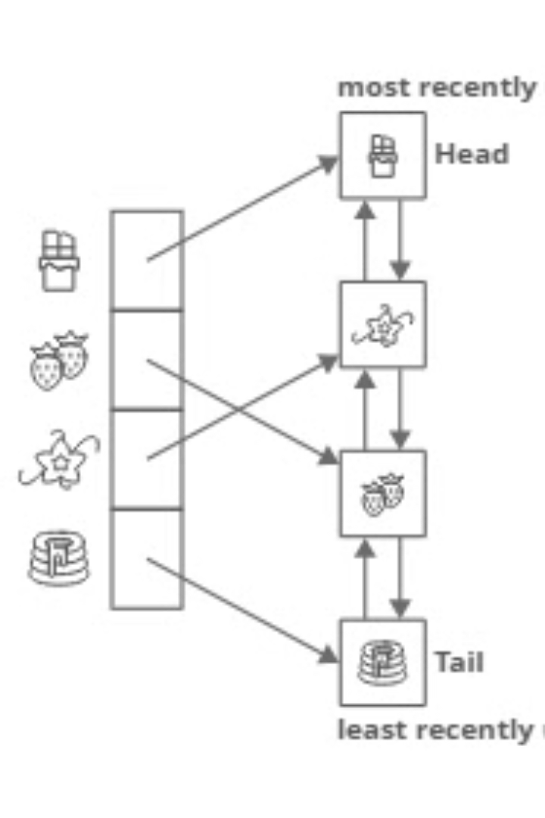
Advanced LRU Cache Presentation
An advanced LRU cache combines treaps, hashmaps, and doubly linked lists. This approach overcomes limitations of basic LRU caches. It provides efficient performance, explained in this presentation. This presentation outlines the structure and operation of this advanced cache.

Slide 2
Problem Statement
Design and implement an efficient Least Recently Used (LRU) cache that supports dynamic resizing and kth-most-recent element lookup using an augmented Treap data structure.

Slide 3
Objectives
To implement an LRU cache that supports get and put operations with optimal time complexity.
To integrate a balanced Treap for maintaining access order and enabling quick kth-recently-used key retrieval.
To provide additional cache operations like dynamic resizing, full cache clearing, and sequential access tracking.

Slide 4
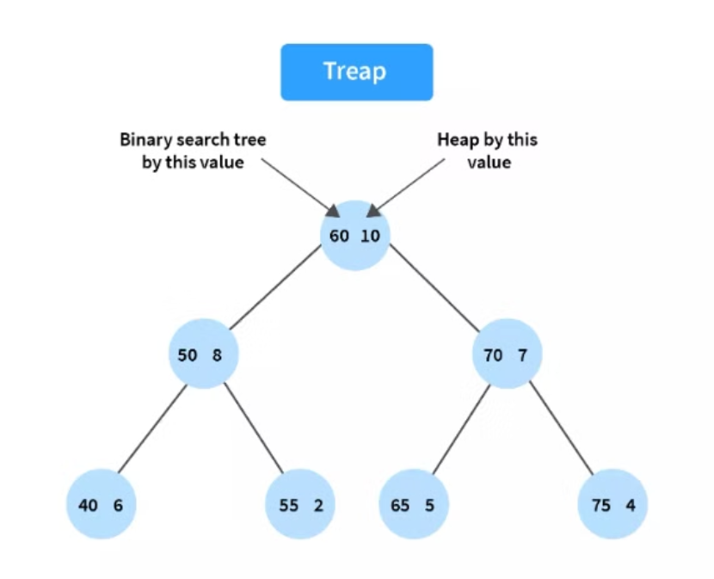
Data Structures: Treap
Treap: Tree + Heap
A Treap combines a Binary Search Tree (BST) and a Heap.
Node Fields
seqKey: For LRU logic (incremental access order)
cacheKey: The actual cache identifier
priority: Random value to maintain heap balance
size: Subtree size
left, right: Child pointers
Core Operations
Rotation: Maintains heap order
Split: Divides Treap by key
Merge: Combines two Treaps efficiently

Slide 5
Hashmap and Doubly Linked List
HashMap Uses unordered_map<key, TreapNode*> for O(1) average-time key lookups. Quickly locates nodes in the Treap by their cache keys.
Doubly Linked List Maintains the order of access for implementing LRU (Least Recently Used) eviction. Enables efficient updates and deletions from any position.
In this design, the Treap’s seqKey serves as an implicit link, simulating DLL behavior while keeping the structure balanced and efficient.

Slide 6
LRU Cache Operations
put() and get() Operations
put(key, value)
Checks if the key already exists in the HashMap.
If yes: Removes the existing node from the Treap.
Creates a new TreapNode with:
Updated value
New, incremented seqKey (for LRU tracking)
Random priority
Inserts the new node into both the Treap and HashMap.
If the cache is full, removes the least recently used node (smallest seqKey) from both structures.
get(key)
Retrieves the node using the HashMap.
Removes the old node from the Treap.
Creates and inserts a new node with:
Same value
Updated seqKey (marks recent access)
Ensures LRU order is preserved in the Treap.

Slide 7

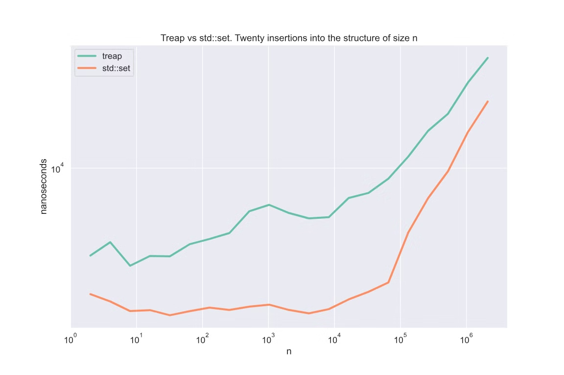
Performance Analysis
Time Complexity
Both put() and get() operations take O(log n) time due to Treap operations (insert, delete, and re-balance).
HashMap lookups are O(1) on average.
Space Complexity
Total space is O(n) to store n nodes in the Treap and HashMap.
Advantages
Handles non-uniform access patterns more efficiently than traditional LRU (e.g., frequently accessed items stay near the top of the Treap).
Maintains a balanced structure using randomized priorities.
Trade-offs
Higher implementation complexity compared to standard LRU (which uses a HashMap + Doubly Linked List).
Overhead due to node recreation and re-insertion on every access.

Slide 8
Conclusion and Future Directions
The advanced LRU Cache integrates:
Treaps for balanced ordering with LRU tracking
HashMap for fast lookups
Doubly Linked List logic via seqKey for access order
Offers a powerful, efficient solution for real-world caching scenarios—especially with non-uniform access patterns.
Future Improvements:
Optimize memory usage by reusing nodes
Tune priority generation strategies
Explore concurrent/lock-free versions for multi-threaded environments

Slide 9


References
Introduction to Algorithms by Thomas H. Cormen, Charles E. Leiserson, Ronald L. Rivest, and Clifford Stein.
Advanced Data Structures by Peter Brass

Slide 10
Technology Stack Used
Language: C++ (STL, Smart Pointers)
Data Structures: Treap, Doubly Linked List, Hash Map
Tools: GCC/G++, VS Code/Vim, gdb
Platform: Ubuntu / Linux environment (CLI-based interaction)

Slide 11
Made By
Third Year Computer Engineering Students - Division 1 Batch T5
612203078 - Tejas Joshi
612203091 - Kaustubh Kharat
612203097 - Tejas Kolhe

