Slide 1
TaskBoard
DEVOPS FINAL CAPSTONE · SESSION 21
A SaaS-style project management app, followed from a developer laptop to a monitored Kubernetes cluster.
React + Vite
FastAPI
PostgreSQL
Pytest
Docker
GitHub Actions
Trivy
GHCR
Terraform
AWS EKS
Helm
Ingress
HPA
Prometheus
Grafana
Tejas Varshney · github.com/TejasVarshney/devops-capstone-project
Notes:
This is TaskBoard, my DevOps final capstone. In the next few minutes I'll follow one real application from my laptop, through automated tests, containers, a CI/CD pipeline with a security gate, and infrastructure as code, all the way into a monitored Kubernetes cluster.
The recorded walkthrough (TaskBoard_DevOps_Capstone_Demo.mp4) follows the same order as these slides.

Slide 2
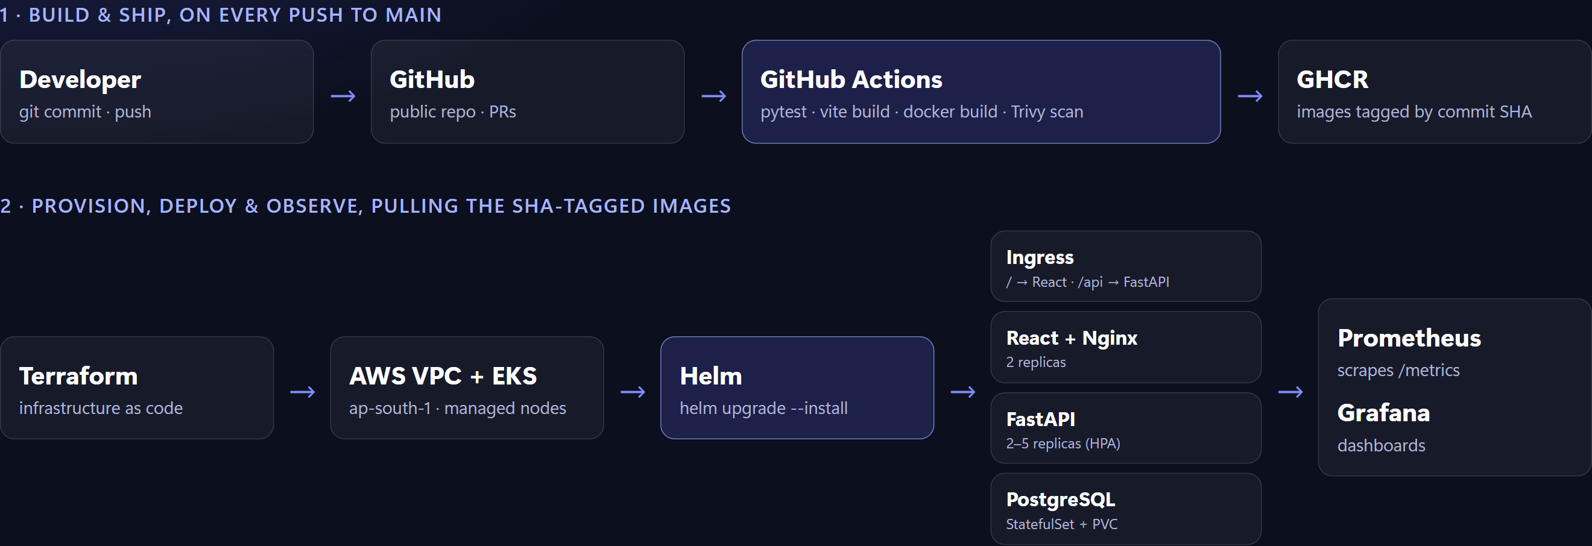
From commit to monitored cluster
OVERVIEW
Every image is tagged with the Git commit SHA, so a running Pod traces back to the exact commit that built it.
Notes:
Here's the whole path. A push to GitHub triggers GitHub Actions. Pytest and the frontend build run first. Then both Docker images are built, scanned by Trivy, and pushed to the GitHub Container Registry, tagged with the commit SHA. Terraform provisions an AWS VPC and an EKS cluster. Helm deploys the React frontend, the FastAPI backend and PostgreSQL behind an Ingress, and Prometheus and Grafana watch all of it.

Slide 3
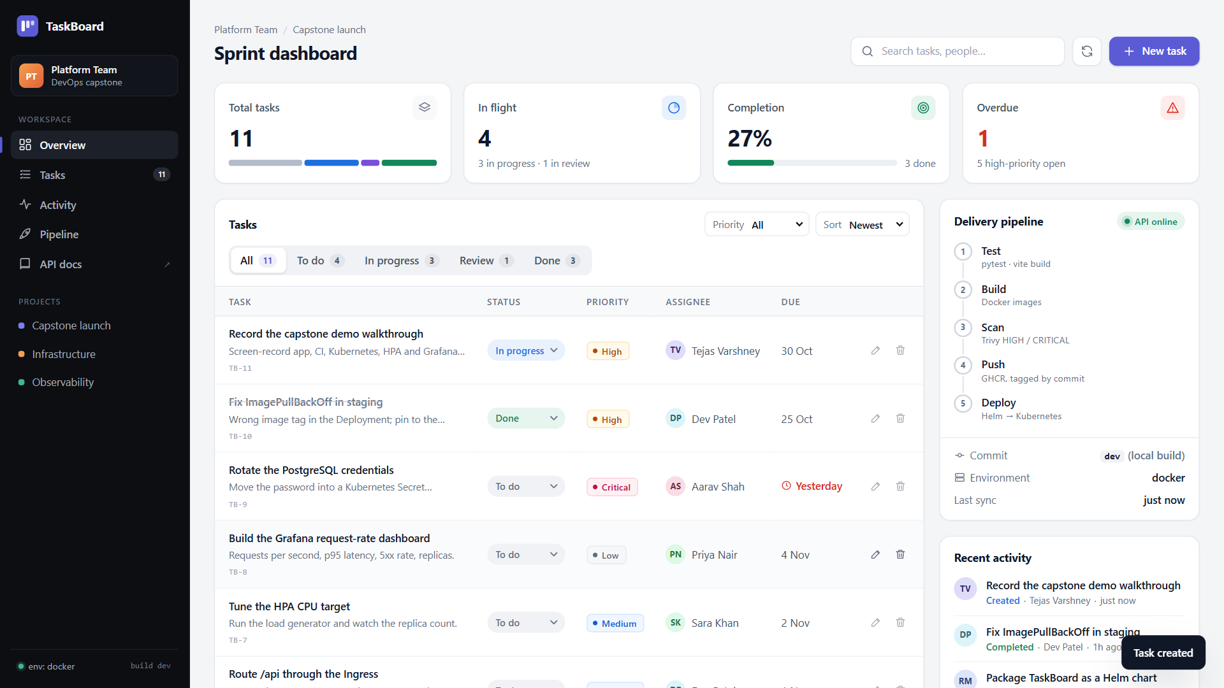
A SaaS-style sprint dashboard
M1 · APPLICATION
React + Vite
KPI cards, filterable task table, priority badges, activity feed and a pipeline card.
Relative API calls
The browser only calls /api/...; Nginx or the Ingress routes to FastAPI.
Responsive
Table becomes cards on phones; loading, error and offline states.
Notes:
Let's start with the application. TaskBoard is a sprint dashboard built with React and Vite. It has KPI cards, a filterable task table with priority badges, an activity feed, and a delivery-pipeline card that shows which commit the running image was built from.
Creating a task opens this modal. I'll add: record the capstone demo walkthrough. High priority, in progress, due on the thirtieth.
After saving, the task appears at the top of the table, the KPI cards update, and the activity feed records it. The browser only ever calls relative URLs like slash API slash tasks. Nginx, and later the Kubernetes Ingress, route them to the backend.
The layout is responsive. On a phone, the table turns into cards and the sidebar becomes a drawer. The UI also has loading, error and connection-lost states.

Slide 4
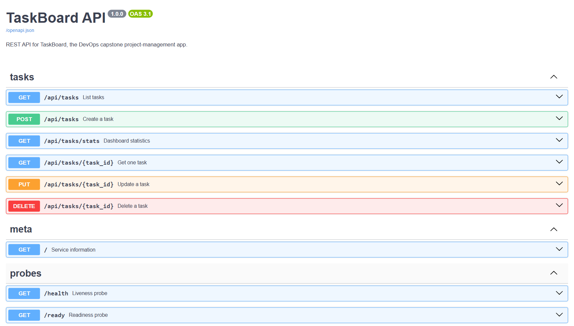
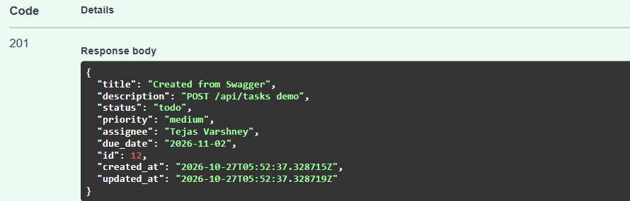
FastAPI REST API with Swagger
M1 · BACKEND
POST /api/tasks → 201 Created
REST endpoints
GET, POST, PUT and DELETE on /api/tasks, plus /stats, /health, /ready and /metrics.
Validated
Pydantic rejects bad input with 422; unknown IDs return 404.
Notes:
The backend is FastAPI with SQLAlchemy. Swagger documents every endpoint: list, get, create, update and delete tasks, a stats endpoint, plus health, readiness and metrics.
Here I create a task straight from Swagger. The API validates the body with Pydantic and returns 201 Created, with the new ID and timestamps.

Slide 5
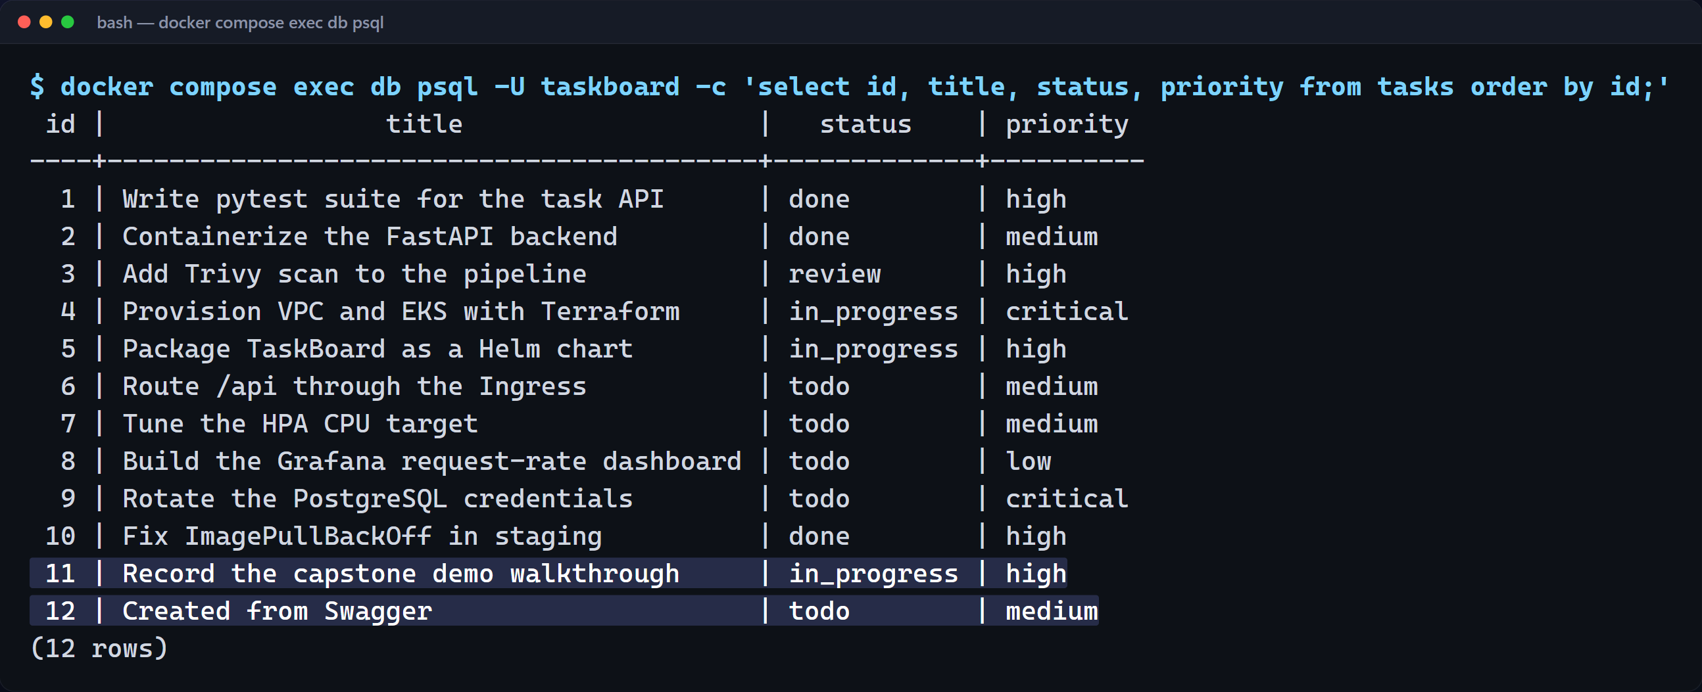
PostgreSQL, managed by Alembic migrations
M1 · DATABASE
Migrations
0001 creates the tasks table, 0002 seeds demo data. Rows 11 and 12 were created live in the demo.
/health: liveness
Cheap and never touches the database, so a DB outage does not restart every API Pod.
/ready: readiness
Runs SELECT 1 and returns 503 when PostgreSQL is unreachable; Kubernetes stops routing to that Pod.
Notes:
And this is the tasks table in PostgreSQL. Alembic migrations create it: migration one creates the table, migration two seeds demo data. The two tasks I just created are rows eleven and twelve.
Health and readiness answer different questions. Slash health is a cheap liveness check that never touches the database. Slash ready runs a select-one query against PostgreSQL, so Kubernetes stops sending traffic to a Pod that can't reach its database, without restarting it.

Slide 6
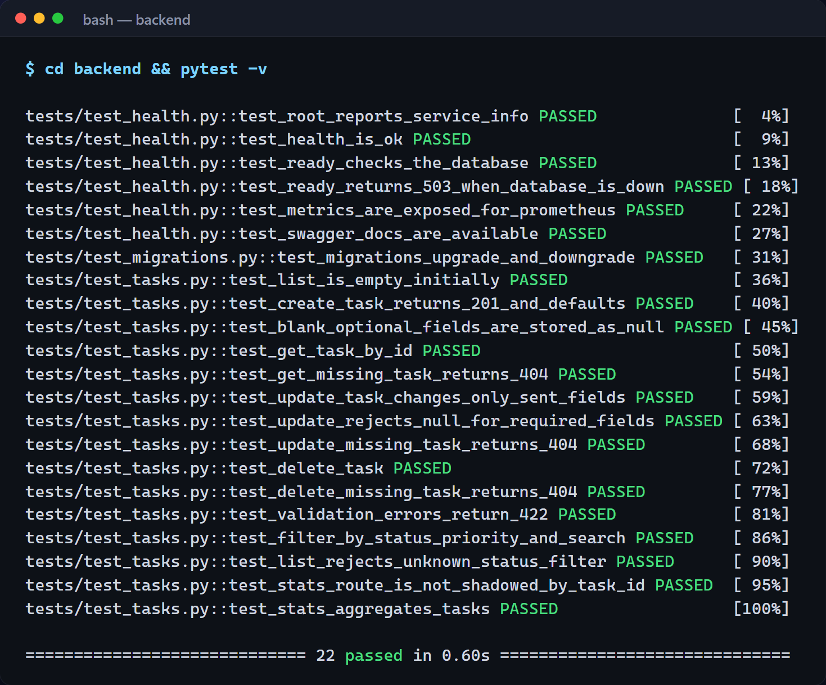
Pytest: the first quality gate
M2 · TESTING
22 passed
in 0.60 s locally, 0.30 s in CI; pytest.ini + conftest.py
Isolated
In-memory SQLite via conftest.py, never the production database.
Coverage
CRUD on every endpoint, 404/422 paths, filters, stats, probes (including a DB outage), metrics and the real migrations.
Notes:
Before anything is containerised, Pytest runs. Twenty-two tests cover CRUD on every endpoint, the 404 and validation-error paths, filtering and stats, the health, readiness and metrics probes, including a simulated database outage, and the real Alembic migrations, up and down. They run against in-memory SQLite, never the real database. This is the first quality gate.
Bad code -> pytest fails -> pipeline stops -> no broken image is promoted.

Slide 7
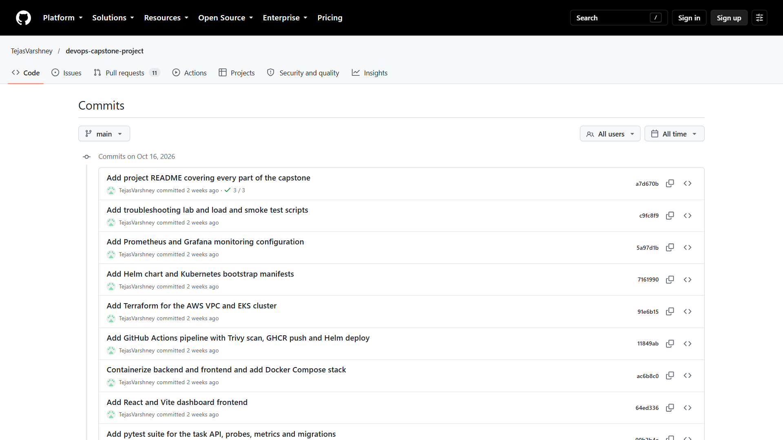
Public repository, meaningful history
M3 · GIT & GITHUB
11 focused commits
One per layer: backend, tests, frontend, containers, pipeline, Terraform, Helm, monitoring, labs.
.gitignore
.env and .env.*, __pycache__/, .venv/, node_modules/, .terraform/, *.tfstate and *.tfvars (only terraform.tfvars.example is committed).
Notes:
Everything lives in a public GitHub repository, built up in focused commits: the backend, the tests, the frontend, containers, the pipeline, Terraform, Helm, monitoring and the troubleshooting lab. The git ignore file keeps dot env files, virtual environments, node modules and Terraform state out of Git.
Repository: https://github.com/TejasVarshney/devops-capstone-project

Slide 8
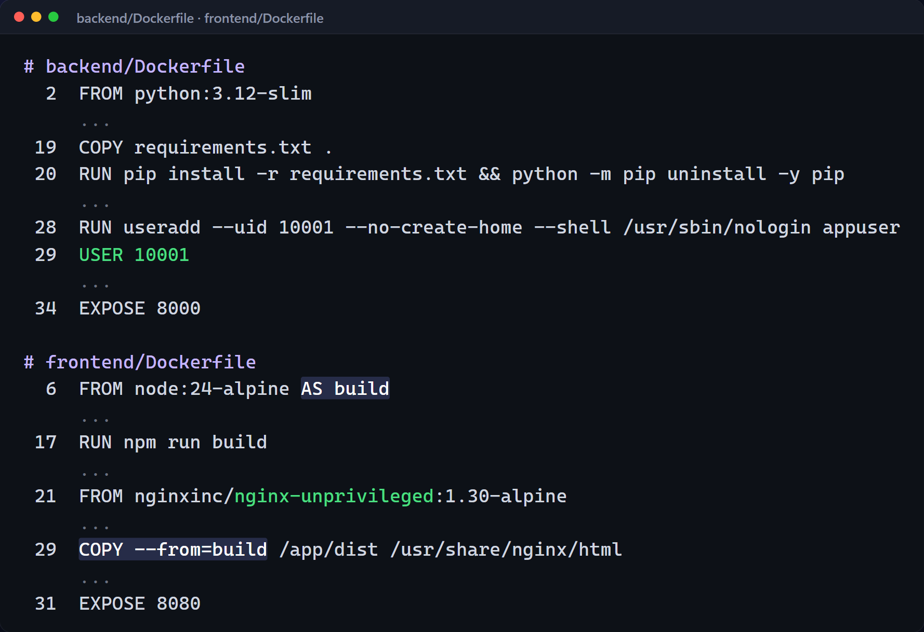
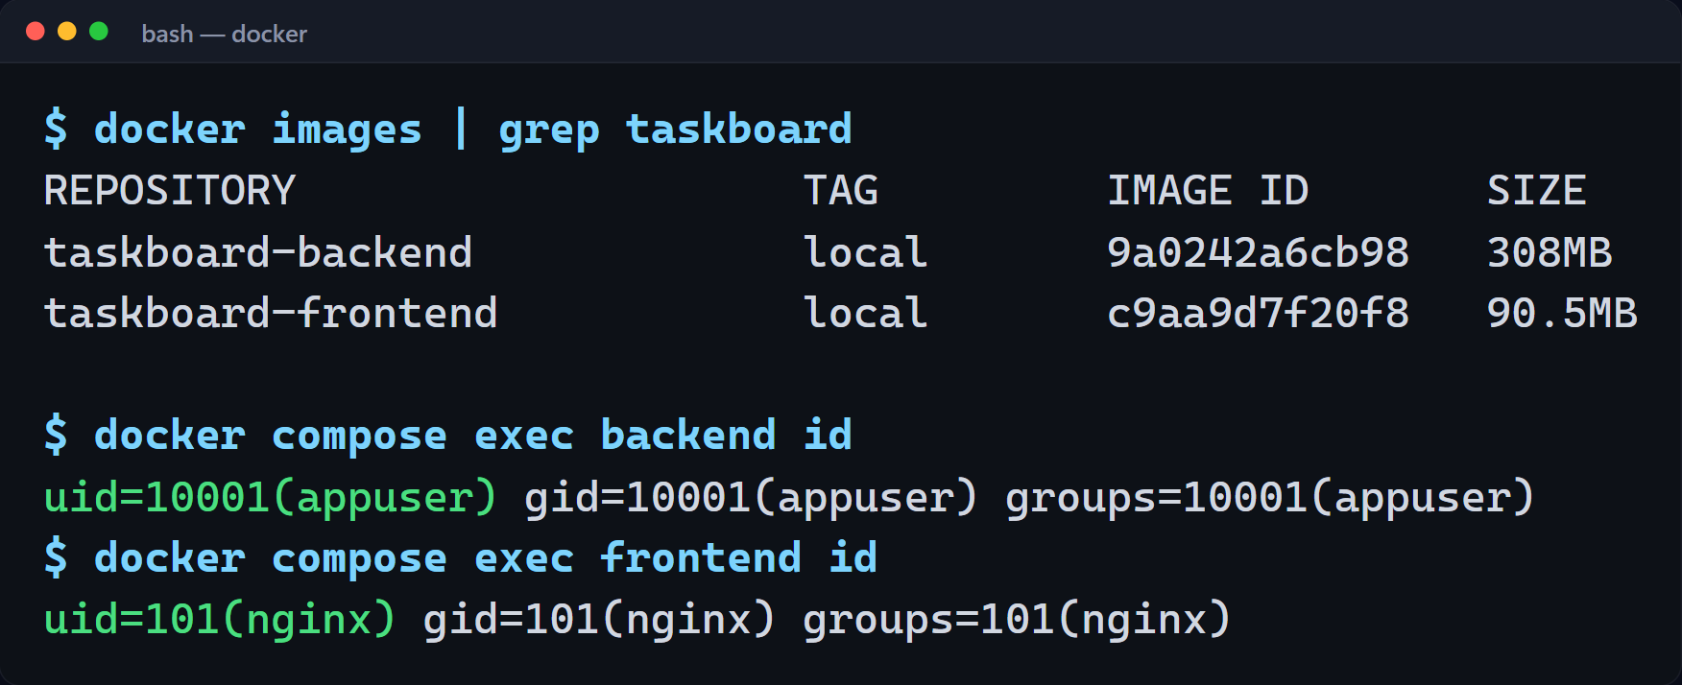
Small, non-root images and one-command Compose
M4 · DOCKER
Multi-stage frontend
Node builds the React app; only dist/ ships in unprivileged Nginx (UID 101).
docker compose up --build
db, backend and frontend start in order, gated by health checks.
Notes:
The backend image starts from Python 3.12 slim, installs dependencies in a cached layer, removes pip, and switches to a non-root user. The frontend is a multi-stage build. Node compiles the React app, and only the static files are copied into an unprivileged Nginx image, so no build tooling ships to production.
docker compose up starts all three services with one command. PostgreSQL has a health check. The backend waits for it, runs its migrations and turns healthy, and only then does the frontend start.
Here are the two images, and proof that neither container runs as root. The backend runs as user ten thousand and one, and Nginx as user one hundred and one.

Slide 9
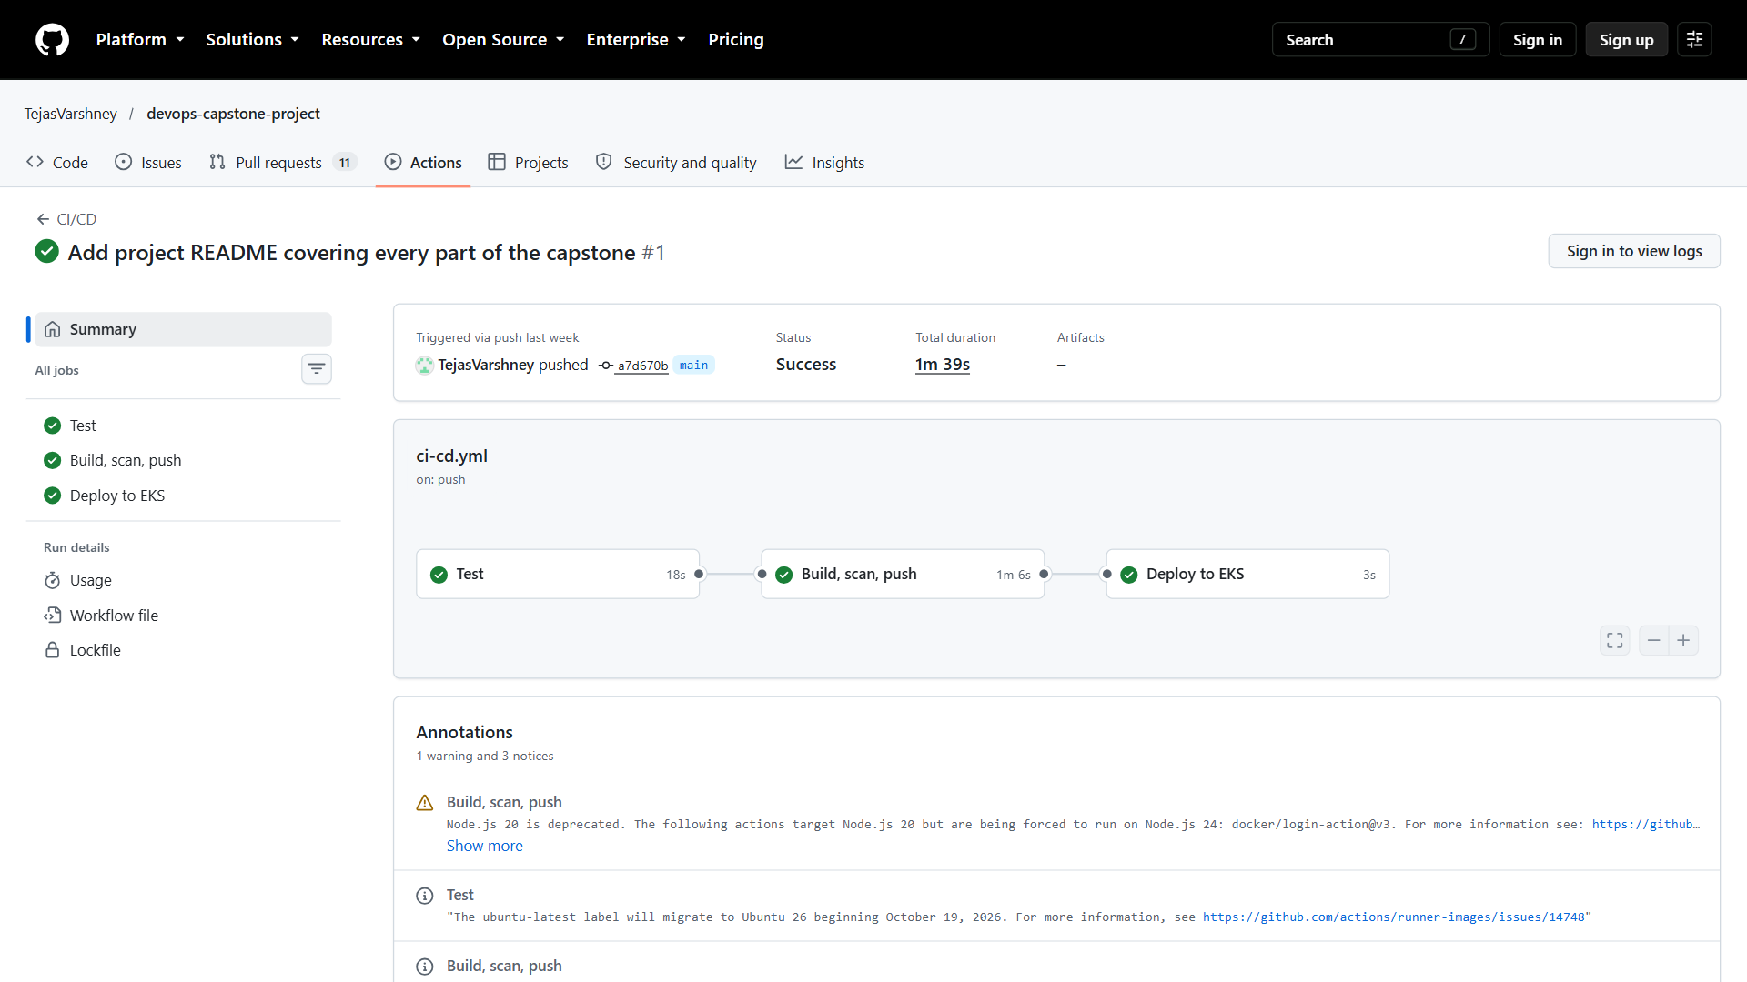
GitHub Actions: test → build, scan, push → deploy
M5 · CI/CD
1. Test
18 s · pytest + React build
↓
2. Build · scan · push
1 m 6 s · Docker build, Trivy, push to GHCR
↓
3. Deploy to EKS
3 s · helm upgrade --install; skipped until AWS secrets exist
Notes:
The pipeline is one workflow file. It runs on every push and pull request to main, in three jobs: test, then build, scan and push, then deploy. Each job needs the previous one, so a failing test stops the pipeline, and a broken image is never pushed.
This is a real green run on main. Test took eighteen seconds, build, scan and push about a minute. The deploy job is skipped by design until AWS credentials are added as repository secrets, which keeps the pipeline green before the cluster exists.
Run URL: https://github.com/TejasVarshney/devops-capstone-project/actions/runs/38946081098

Slide 10
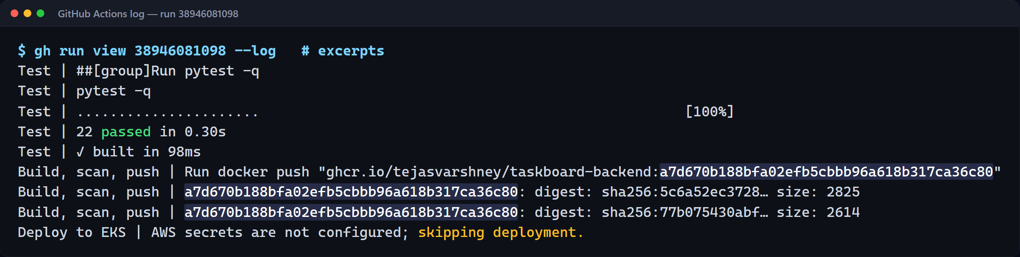
Every image is tagged with its commit SHA
M5 · CI/CD
Triggers
Every push and pull request to main. PRs build and scan but never push.
No latest tag
commit A → image A. Any running Pod traces back to its source commit.
Gated jobs
needs: test → needs: build-scan-push. A failing test stops everything.
Notes:
Inside the log, pytest reports twenty-two passed, the React build succeeds, and the push step uploads both images tagged with the full commit SHA, never latest. That's traceability: any running Pod can be traced back to the exact commit that built it.

Slide 11
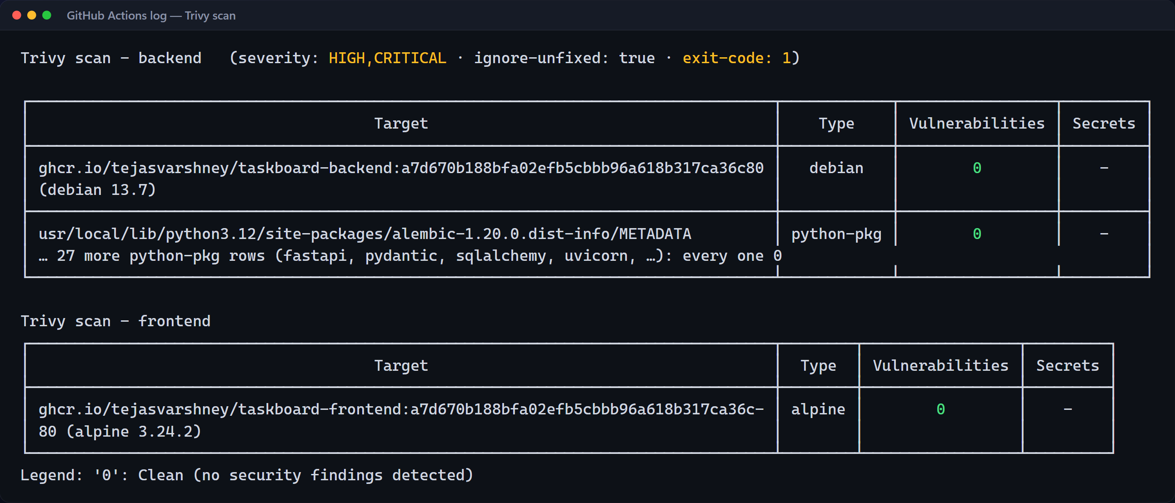
Trivy blocks HIGH and CRITICAL CVEs
M6 · DEVSECOPS
Gate config
severity: HIGH,CRITICAL; ignore-unfixed: true; exit-code: 1 fails the build. The action is pinned to a full commit SHA.
What it scanned and what it means. Trivy scanned the OS packages of both images (Debian 13.7 for the backend, Alpine 3.24 for the frontend) and every Python package in the backend. It found zero fixable HIGH or CRITICAL vulnerabilities, so the gate passed; a single finding would exit with code 1 and stop the pipeline before the push. The clean result comes from applying Debian security updates in the Dockerfile and removing pip, whose vendored libraries carried HIGH CVEs.
Notes:
Before anything is pushed, Trivy scans both images for HIGH and CRITICAL vulnerabilities that already have a fix, and exits with code one on any finding, which fails the build. This run was clean: zero findings in the Debian base and every Python package of the backend, and zero in the Alpine-based frontend. That's not luck: the Dockerfile applies Debian security updates and removes pip, whose vendored libraries carried HIGH CVEs. The Trivy action itself is pinned to a full commit SHA, so a moved tag can't change what the pipeline runs.

Slide 12
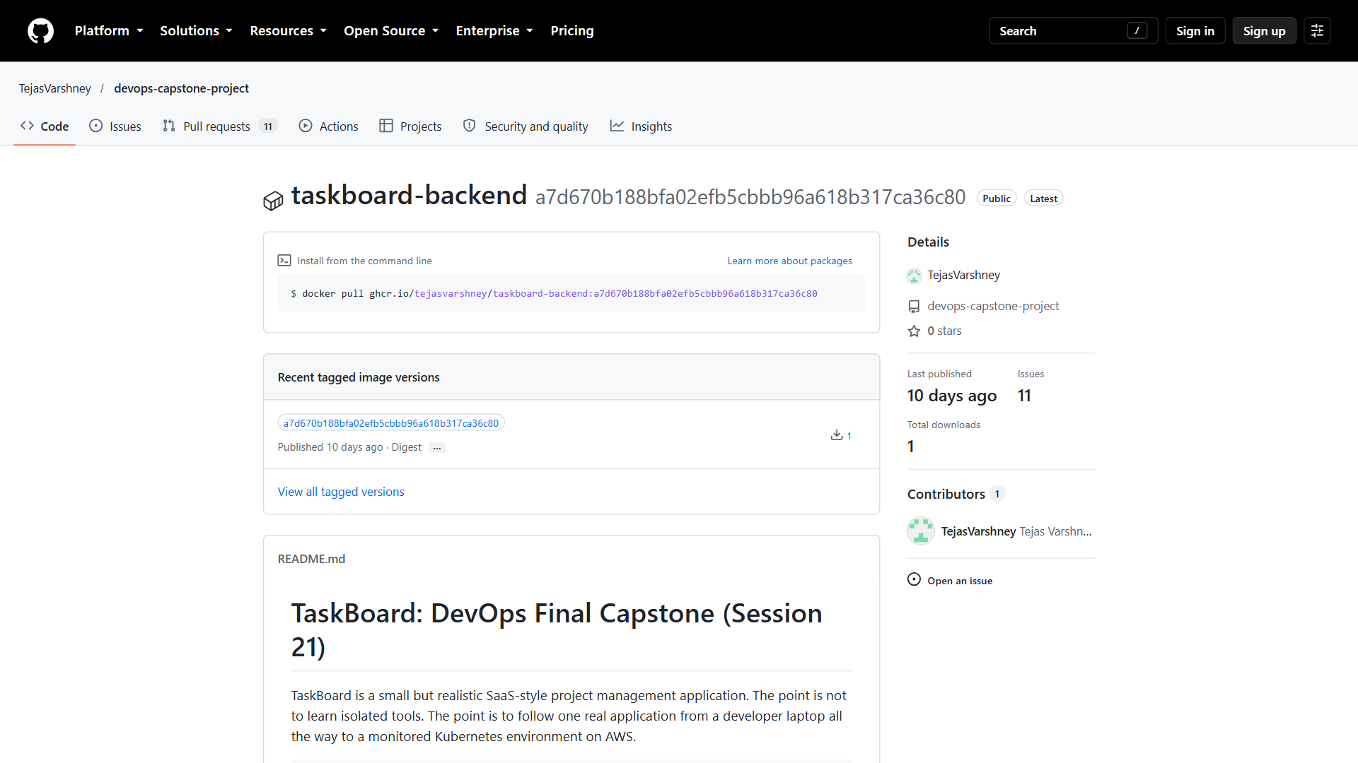
GitHub Container Registry
M5 · REGISTRY
Two public packages
taskboard-backend and taskboard-frontend, linked to the repository.
Immutable tags
a7d670b188bf… is the commit that built the image. No latest.
Pulled by Helm
The deploy job sets image.tag to the SHA.
Notes:
The images land in GitHub Container Registry as public packages, linked to the repository and tagged with the commit SHA. There's no latest tag to hide which version is running.

Slide 13
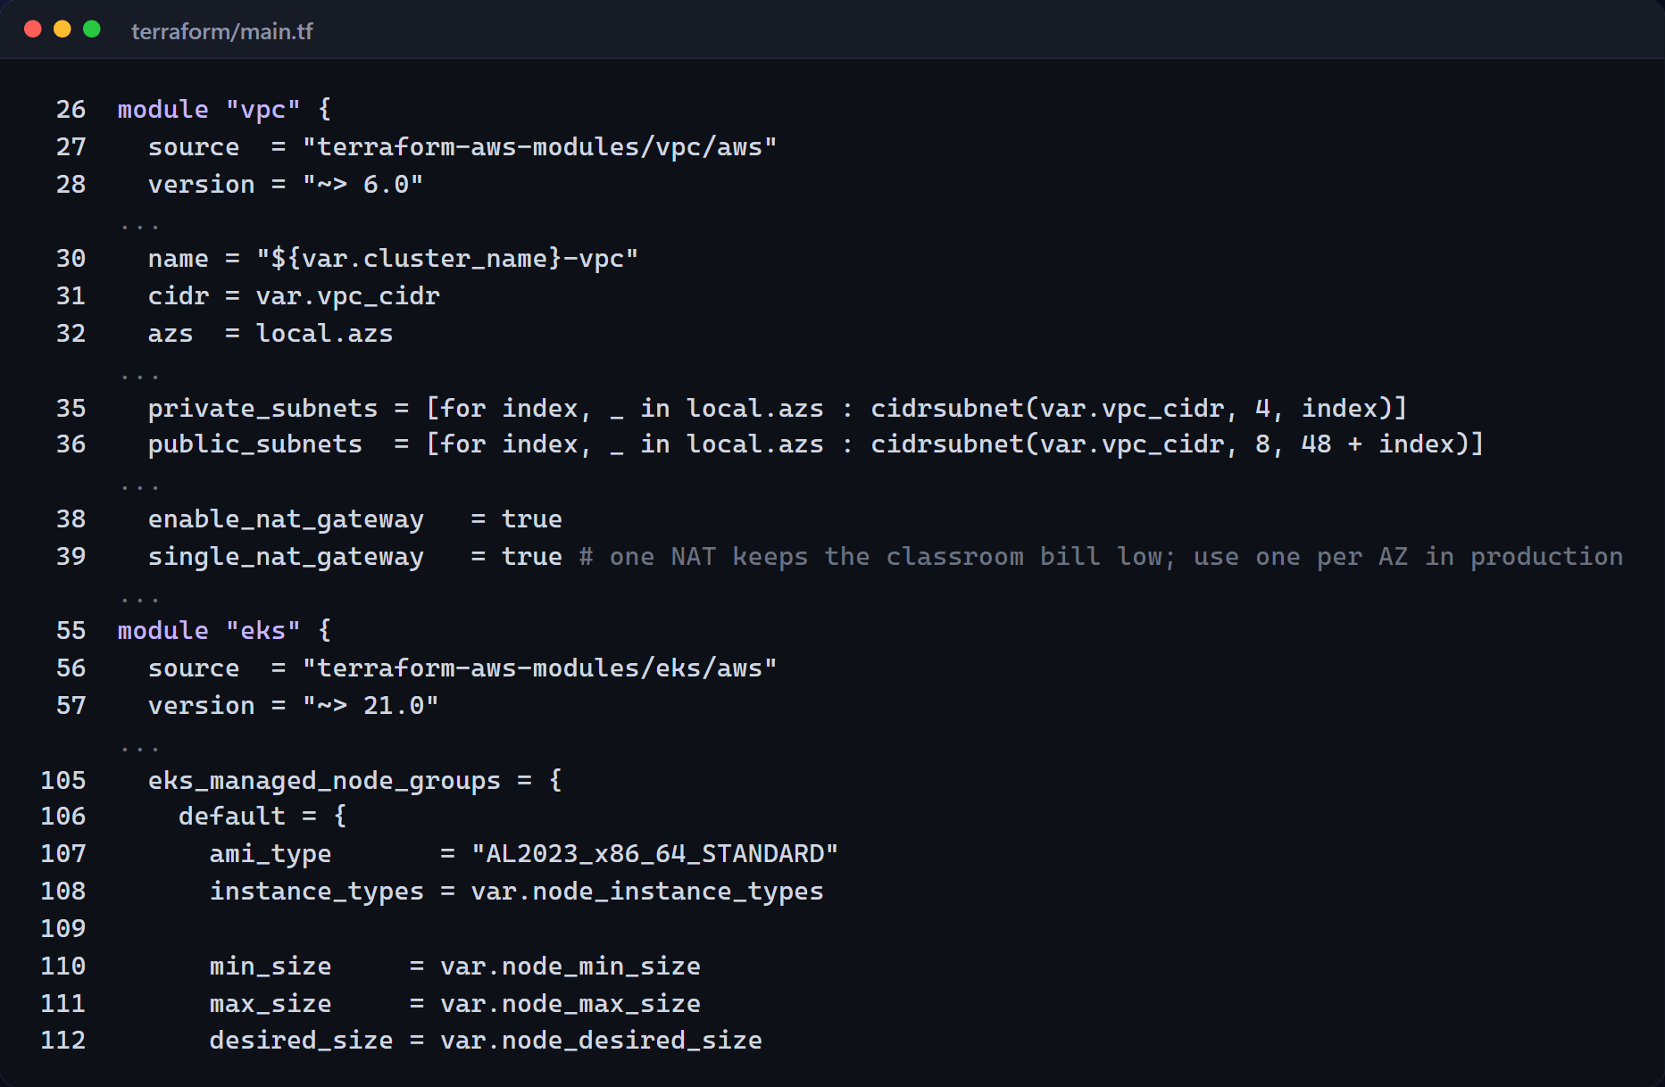
AWS VPC + EKS as code (ap-south-1)
M7 · TERRAFORM
VPC
2 availability zones
Public subnets
load balancers, NAT
Private subnets
worker nodes
NAT gateway
one, to keep the bill low
EKS cluster
CoreDNS, VPC CNI, EBS CSI, metrics-server
Managed node group
2 × t3.medium, scales to 4
Notes:
Kubernetes doesn't create its own network, so Terraform does. Using the official AWS modules, it builds a VPC across two availability zones in Mumbai, with public subnets for load balancers, private subnets for the worker nodes and a NAT gateway, then an EKS cluster with a managed node group of two t3 medium nodes that can scale to four, plus the EBS CSI driver and metrics-server add-ons.

Slide 14
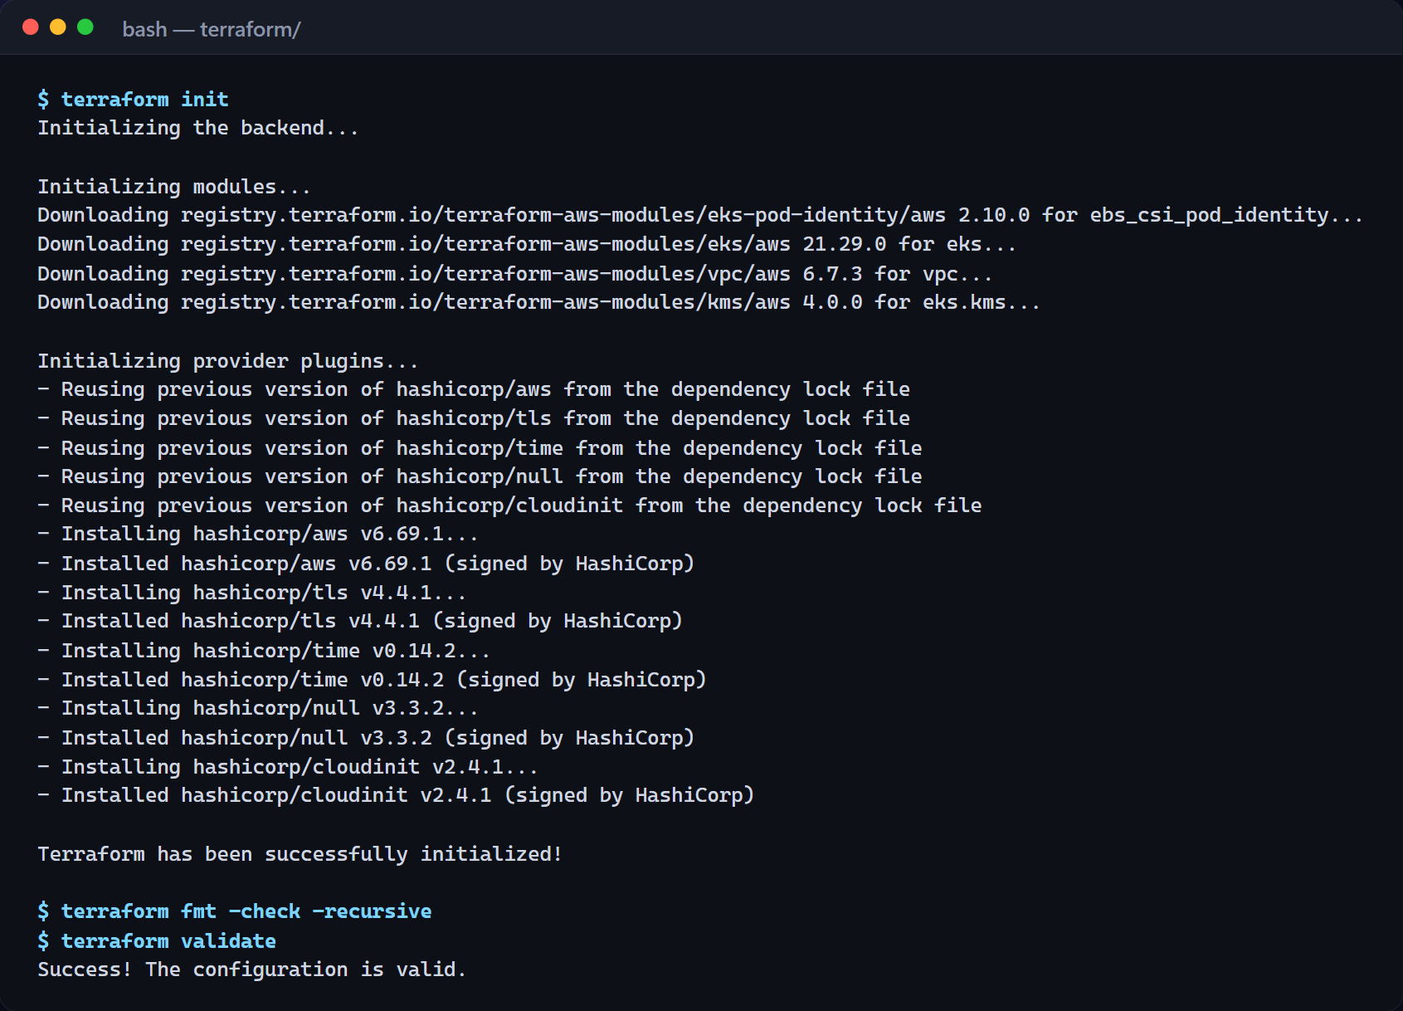
init · fmt · validate, then plan → apply → destroy
M7 · TERRAFORM
Verified here
terraform init downloads the AWS provider and modules; fmt -check and validate pass.
Lifecycle
terraform plan → apply → aws eks update-kubeconfig → helm deploy → terraform destroy after the evaluation.
No secrets in Git
State, *.tfvars and .terraform/ are ignored; only terraform.tfvars.example is committed.
Notes:
terraform init downloads the AWS provider and modules, fmt confirms the formatting, and validate confirms the configuration is valid. From here the lifecycle is plan, apply, update the kubeconfig, and after the evaluation, destroy, so nothing keeps billing. No credentials ever go into Git: state files and tfvars are ignored, and only the example file is committed. For this recording I run the Kubernetes layer on a local minikube cluster with the very same Helm chart.

Slide 15
Run on AWS: add these three screenshots
M7 · AWS EVIDENCE
Paste screenshot: terraform plan
The plan summary ("Plan: N to add, 0 to change, 0 to destroy").
Paste screenshot: AWS Console
VPC and the taskboard-eks cluster with its node group in ap-south-1.
Paste screenshot: terraform destroy
The "Destroy complete!" line, proving nothing is left billing.
These need a live AWS account (EKS, NAT and EC2 are billed per hour). The Kubernetes slides that follow use the same Helm chart on a local minikube cluster.
Notes:
Rubric M7 asks for terraform plan output, an AWS Console screenshot of the VPC and EKS cluster in ap-south-1, and terraform destroy output. Run:
cd terraform && terraform init && terraform plan && terraform apply
aws eks update-kubeconfig --region ap-south-1 --name taskboard-eks
...demo...
helm uninstall taskboard -n taskboard && terraform destroy
Replace the three frames on this slide with those screenshots.

Slide 16
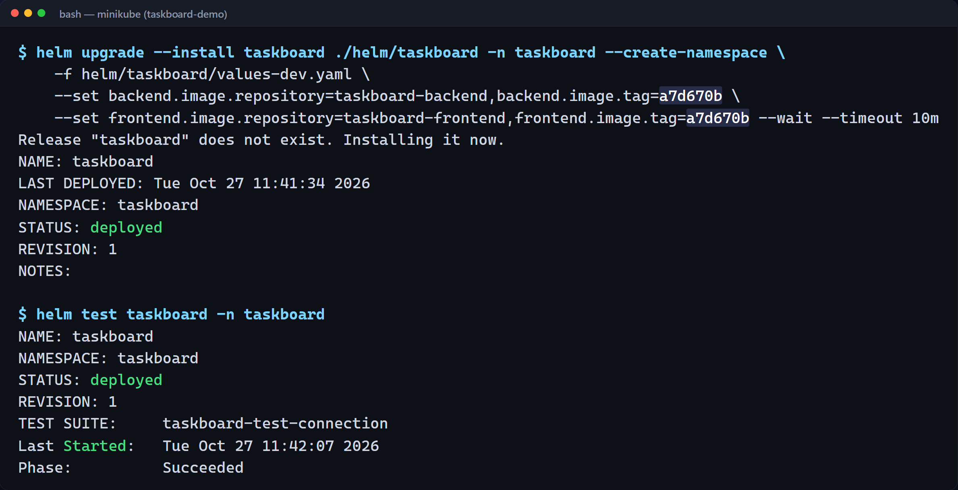
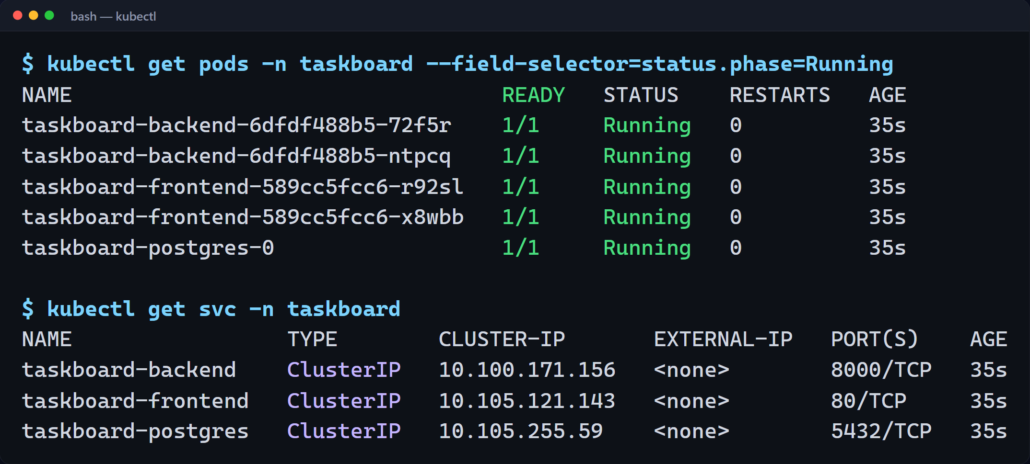
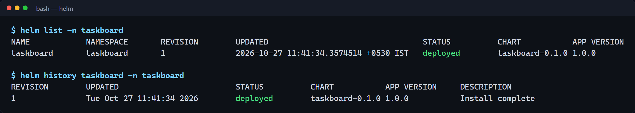
One command deploys the whole release
M8 · HELM
One chart, every object
Deployments, PostgreSQL StatefulSet + PVC, ClusterIP Services, Ingress, HPA, ServiceMonitor, alerts and the Grafana dashboard.
All Pods Running
2 backend + 2 frontend replicas and PostgreSQL; helm test passed.
Notes:
Deployment uses Helm. One helm upgrade install command renders the Deployments, the PostgreSQL StatefulSet with its persistent volume claim, the Services, the Ingress and the autoscaler. The image tag is required and set to the commit SHA.
All Pods are running: two backend replicas, two frontend replicas, and PostgreSQL. ClusterIP Services give each tier one stable name, so the frontend talks to taskboard-backend, never to a Pod IP that might change.
Helm tracks the release. Helm list shows the deployed chart and version, and helm history keeps every revision, which is what makes helm rollback possible.
Chart: helm/taskboard (Deployments, PostgreSQL StatefulSet + PVC, ClusterIP Services, Ingress, HPA, ServiceMonitor, PrometheusRule, Grafana dashboard ConfigMap).

Slide 17
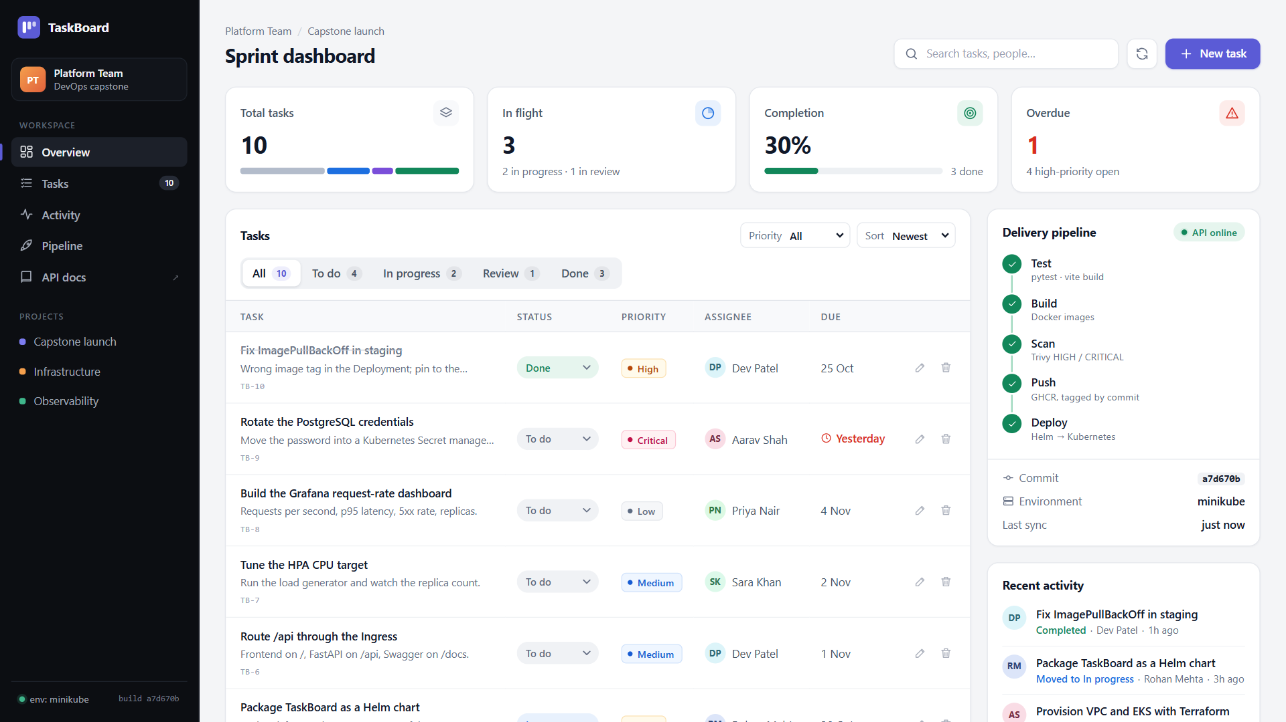
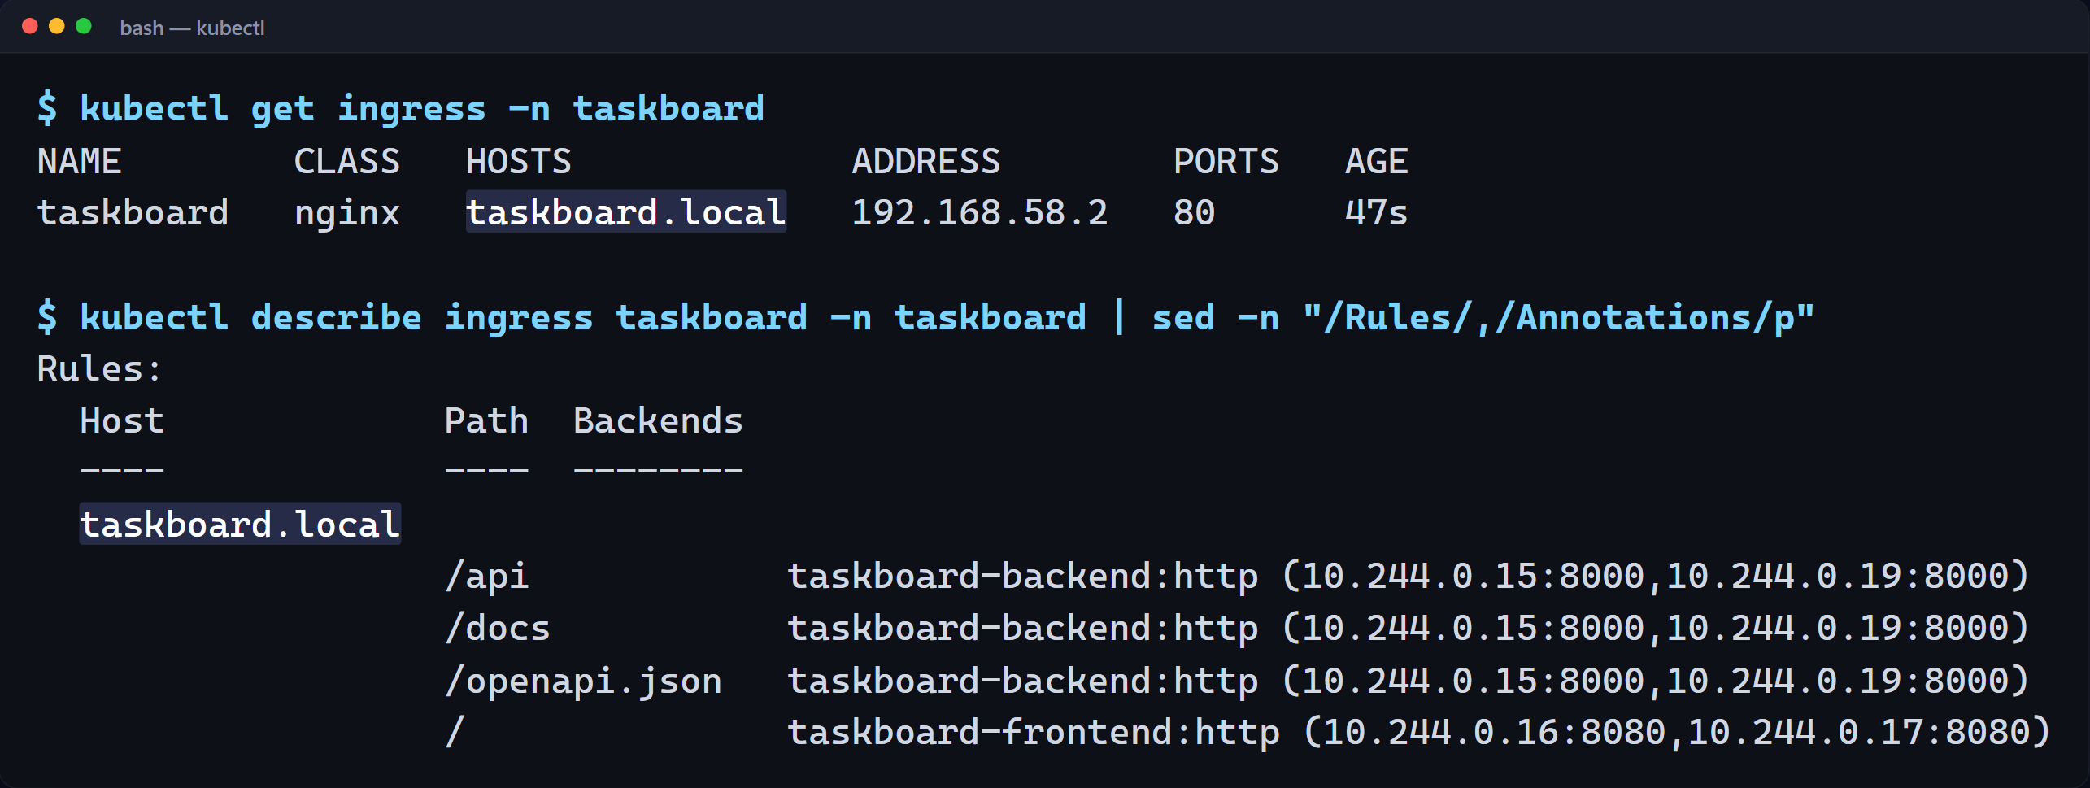
taskboard.local: / to React, /api to FastAPI
M8 · INGRESS
Controller required
An Ingress is only configuration. The NGINX ingress controller implements it here; values-eks.yaml uses Traefik behind an AWS load balancer.
http://taskboard.local
Served by the Pods in the cluster; the pipeline card shows commit a7d670b and env minikube.
Notes:
The Ingress routes slash to the frontend, and slash API and slash docs to the backend, on the host taskboard dot local. An Ingress is only configuration; here the NGINX ingress controller implements it.
And here's TaskBoard opened through the Ingress hostname, served by the Pods in the cluster. The pipeline card now shows the commit the images were built from.

Slide 18
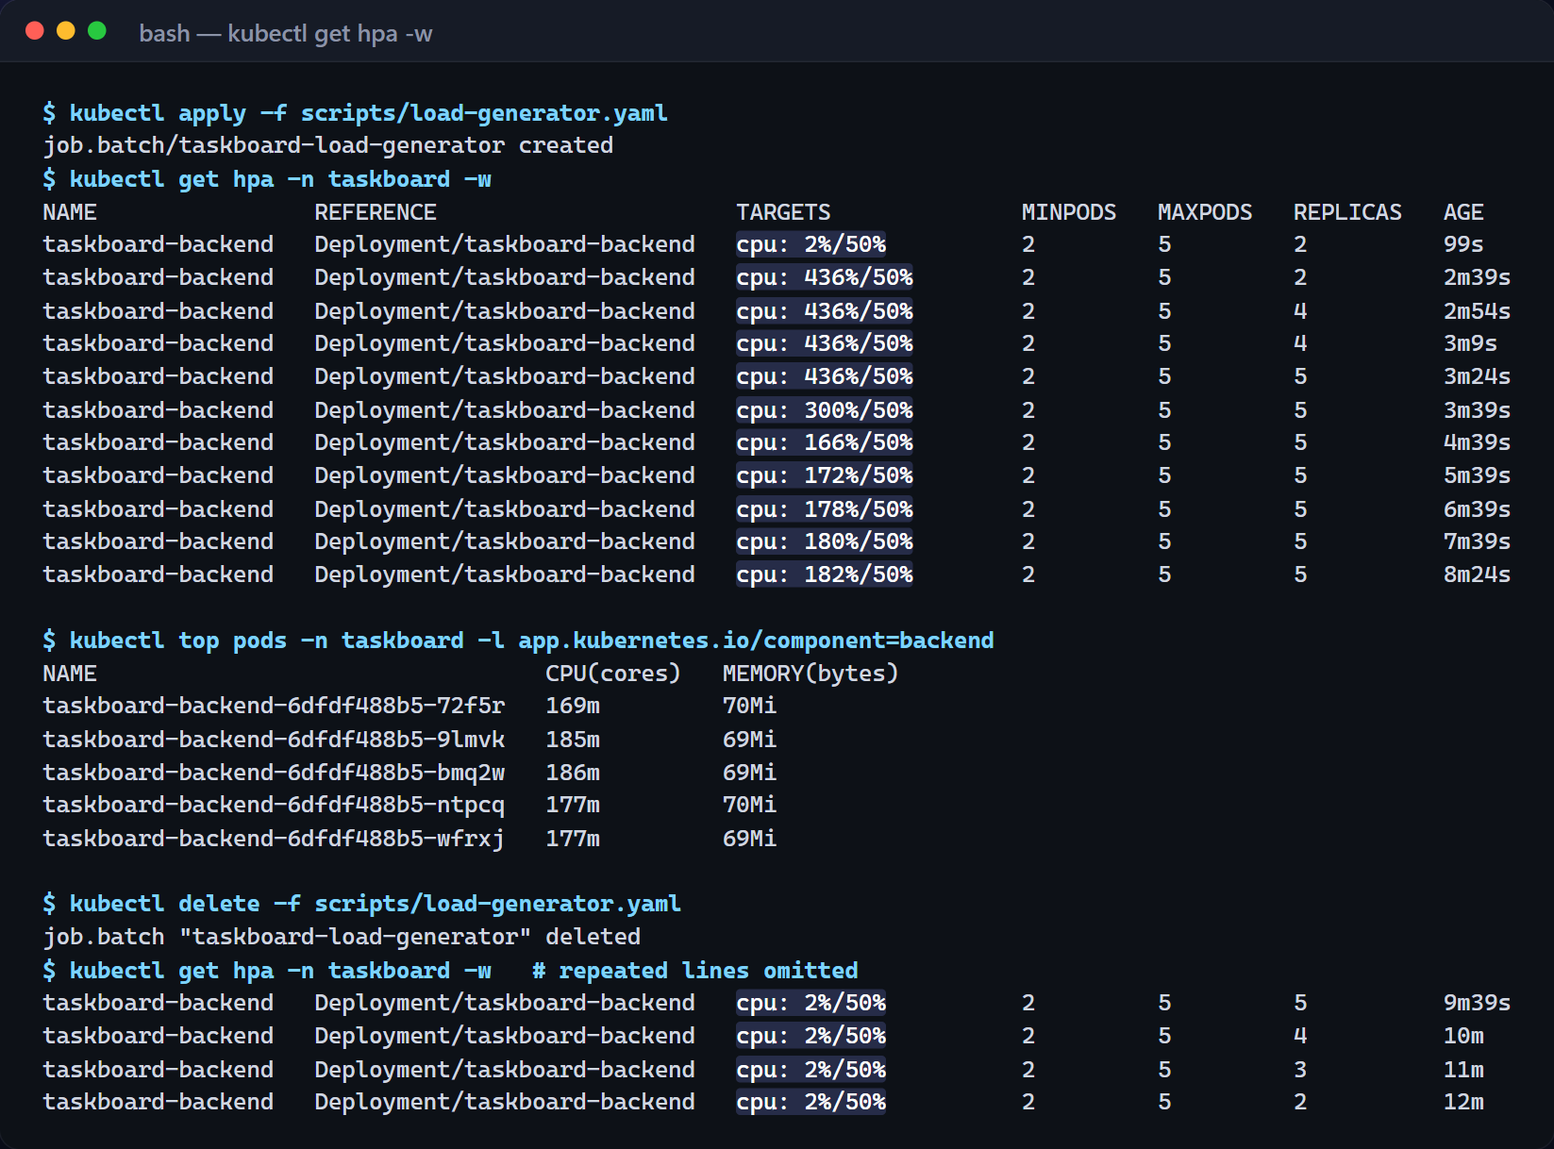
HPA scales the backend on CPU
M8 · AUTOSCALING
2 → 5
replicas under load (max 5)
436%
CPU at peak vs a 50% target
→ 2
back to minimum about 5 minutes after the load stopped
Notes:
The Horizontal Pod Autoscaler scales the backend on CPU. It needs resource requests, which the chart sets, and metrics-server. I start the in-cluster load generator, CPU climbs past the fifty percent target, and the autoscaler goes from two to four to five replicas, its maximum. When the load stops, CPU falls to two percent and it scales back down to two.
Load: kubectl apply -f scripts/load-generator.yaml (4 busybox workers hitting the backend Service).

Slide 19
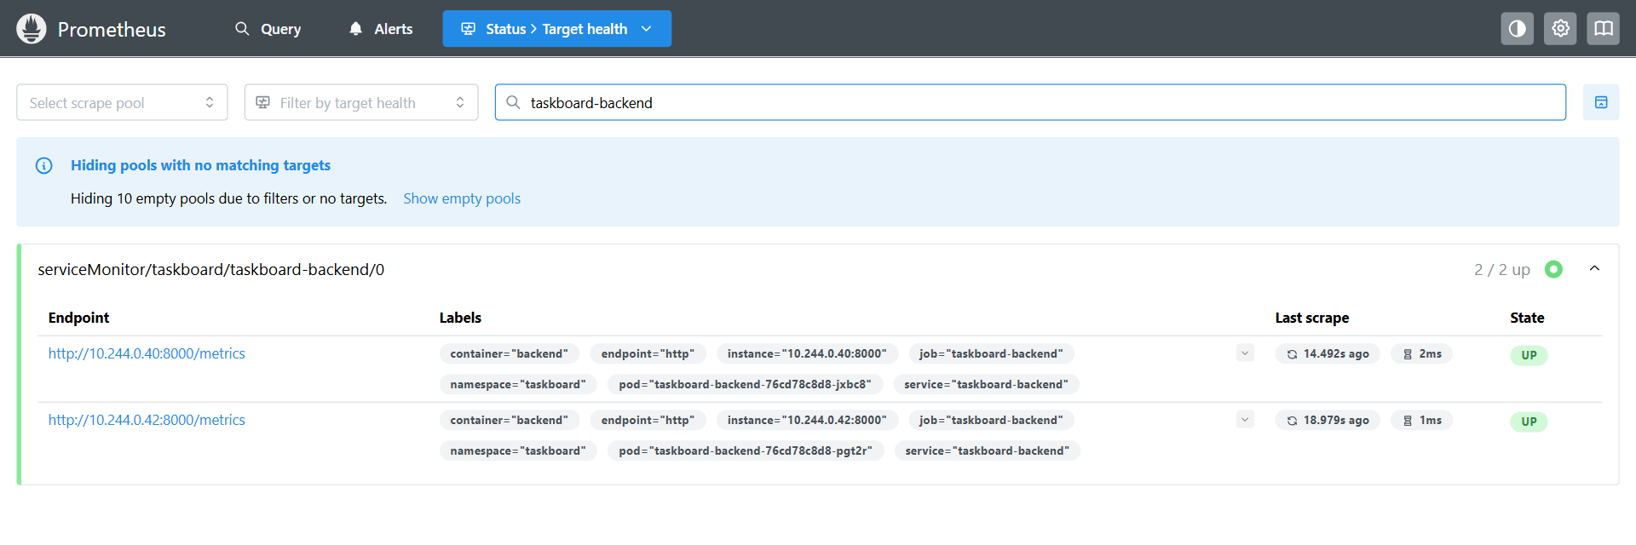
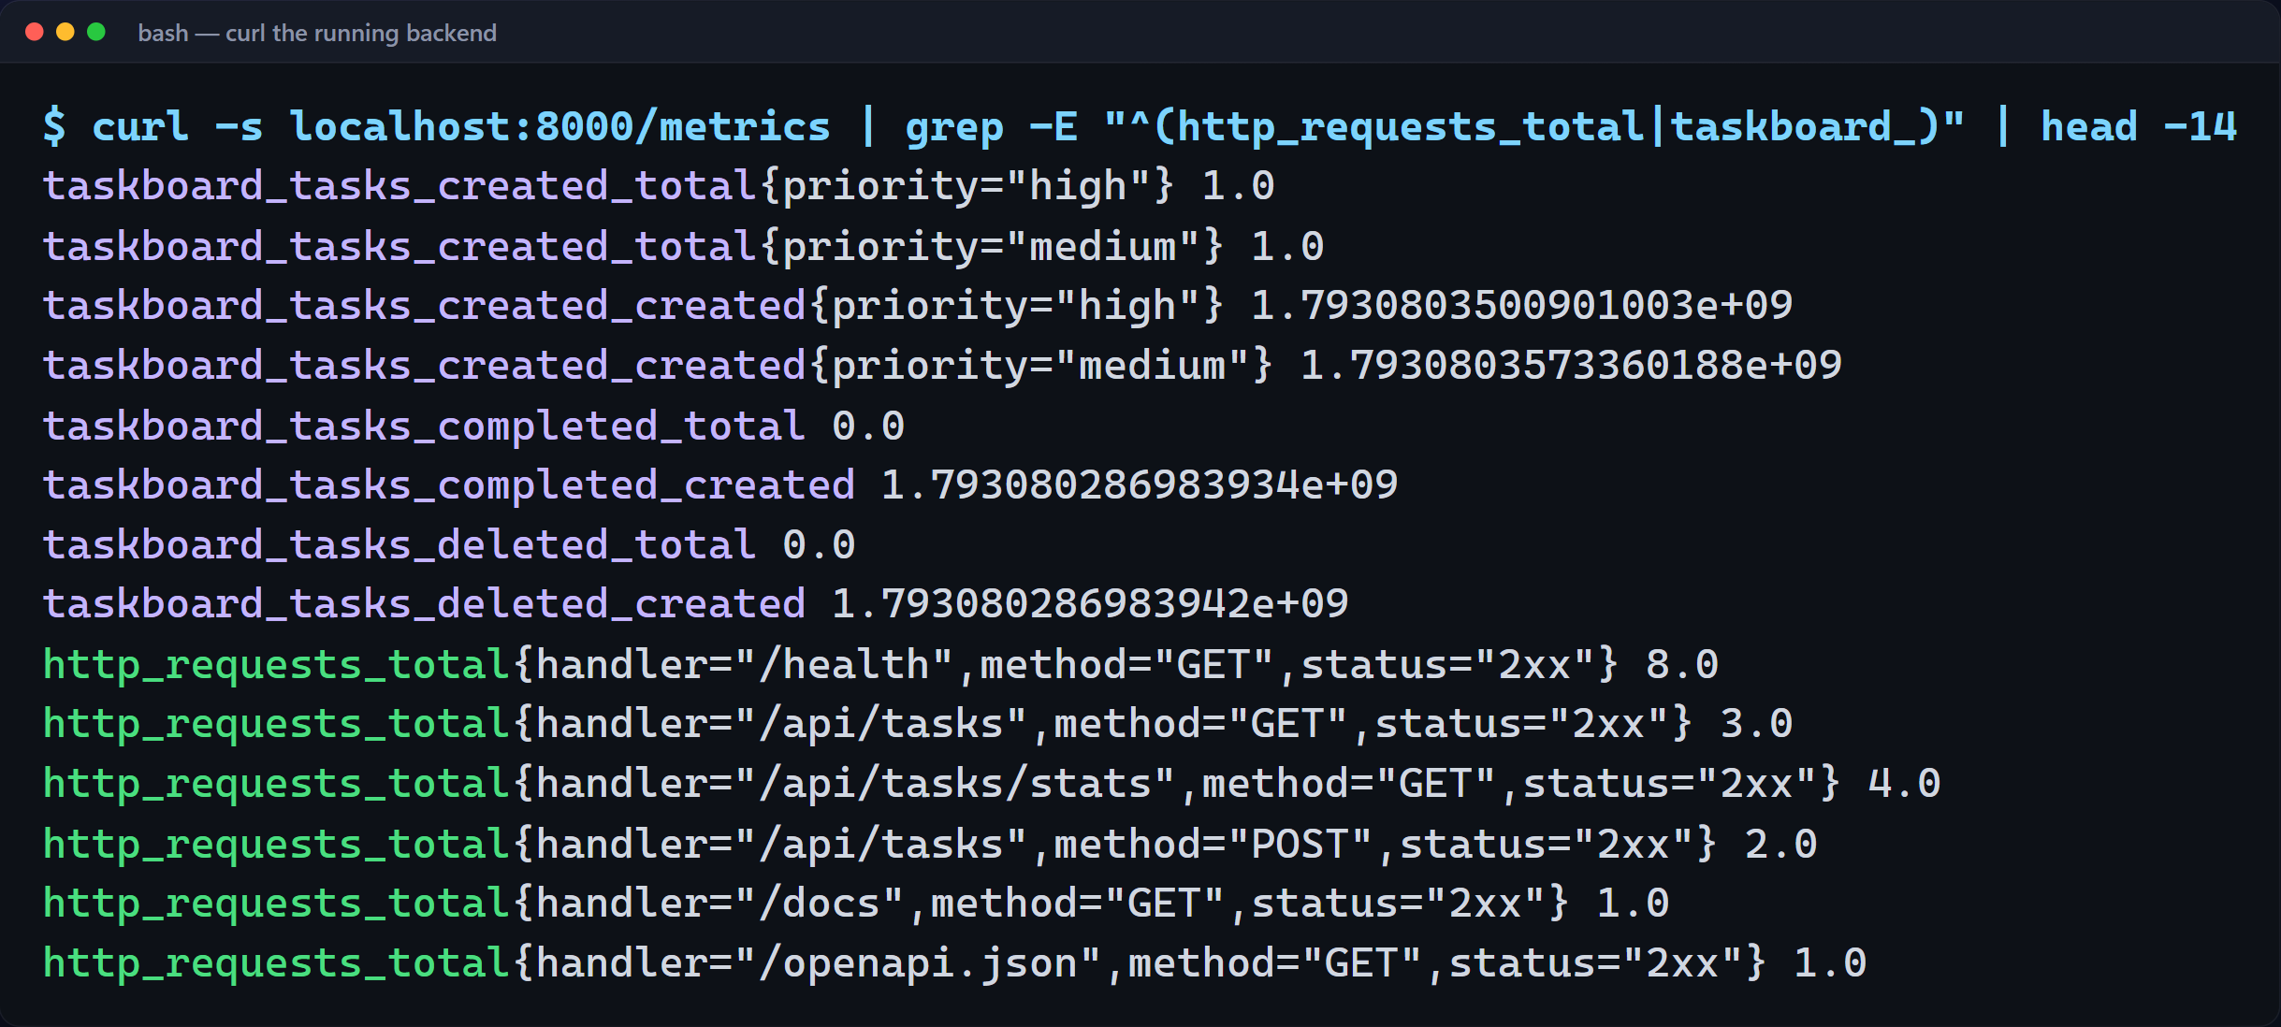
Prometheus scrapes /metrics from every backend Pod
M9 · OBSERVABILITY
ServiceMonitor
Shipped in the Helm chart; tells the Prometheus Operator to scrape /metrics on every backend Pod. All targets UP.
Alerts
PrometheusRule: backend down, 5xx rate above 5%, p95 latency above 500 ms.
Business metrics
taskboard_tasks_created_total, plus completed and deleted counters.
Notes:
The backend exposes Prometheus metrics at slash metrics: request counts and latency histograms from the FastAPI instrumentator, plus business counters such as tasks created, completed and deleted.
Prometheus runs in the cluster through kube-prometheus-stack. The chart's ServiceMonitor tells the operator what to scrape, and both backend Pods show as up.

Slide 20
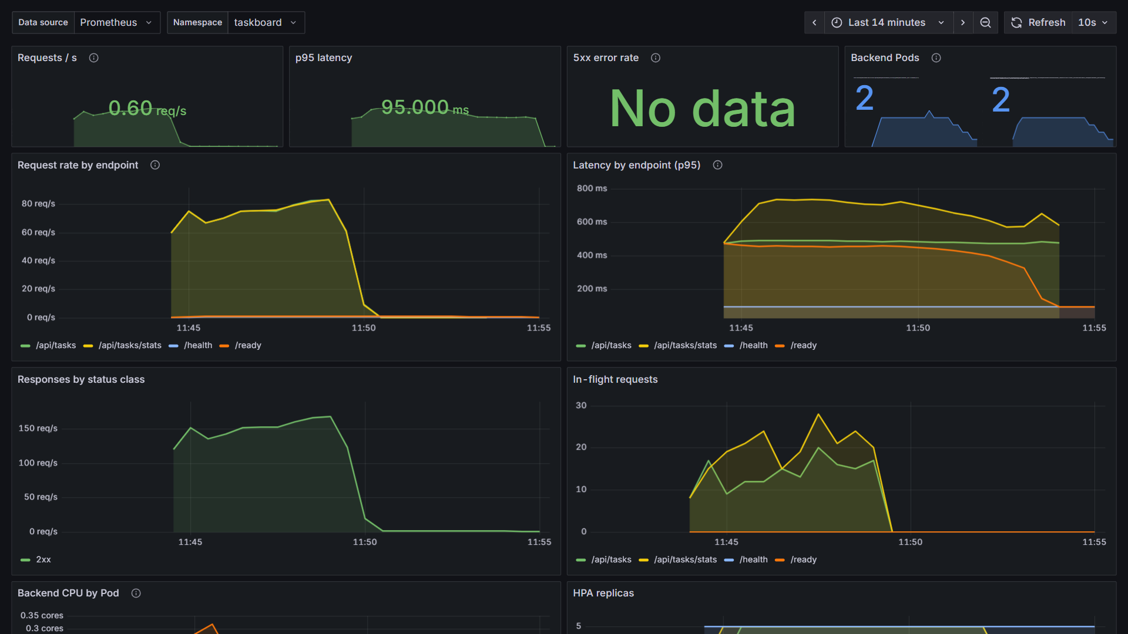
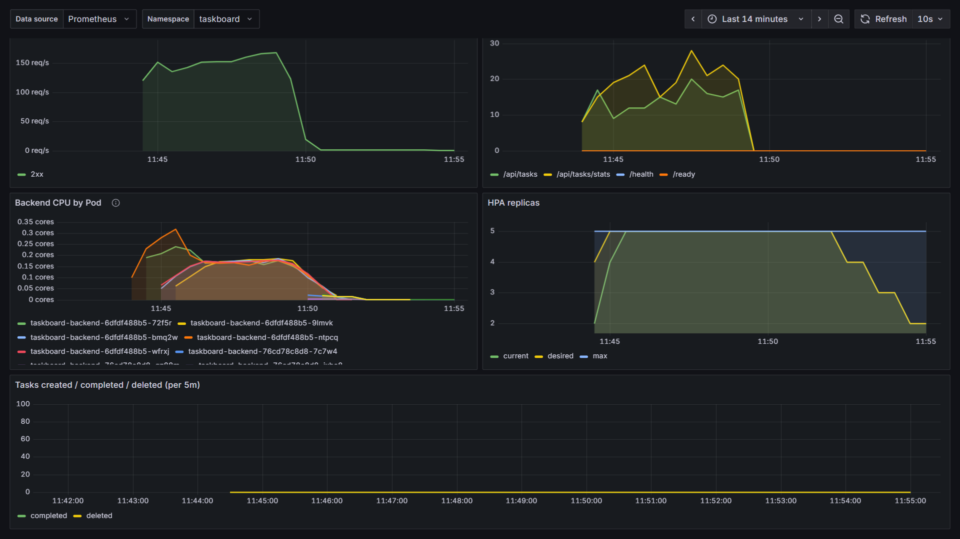
Grafana: TaskBoard API overview during the load test
M9 · OBSERVABILITY
~160/s
0
2 → 5 → 2
~50k
peak requests per second
5xx responses
HPA replicas
requests served, all 2xx
Notes:
Grafana loads the TaskBoard dashboard automatically from a ConfigMap shipped in the Helm chart. Across the load test you can see the request rate climb to about a hundred and sixty requests per second, the p95 latency of each endpoint, and only 2xx responses. The 5xx panel shows no data because there were zero server errors.
Further down, CPU per Pod rises with the load and spreads across the new replicas, and the HPA panel shows the autoscaler going from two replicas to five, then stepping back down to two once the load stops.

Slide 21
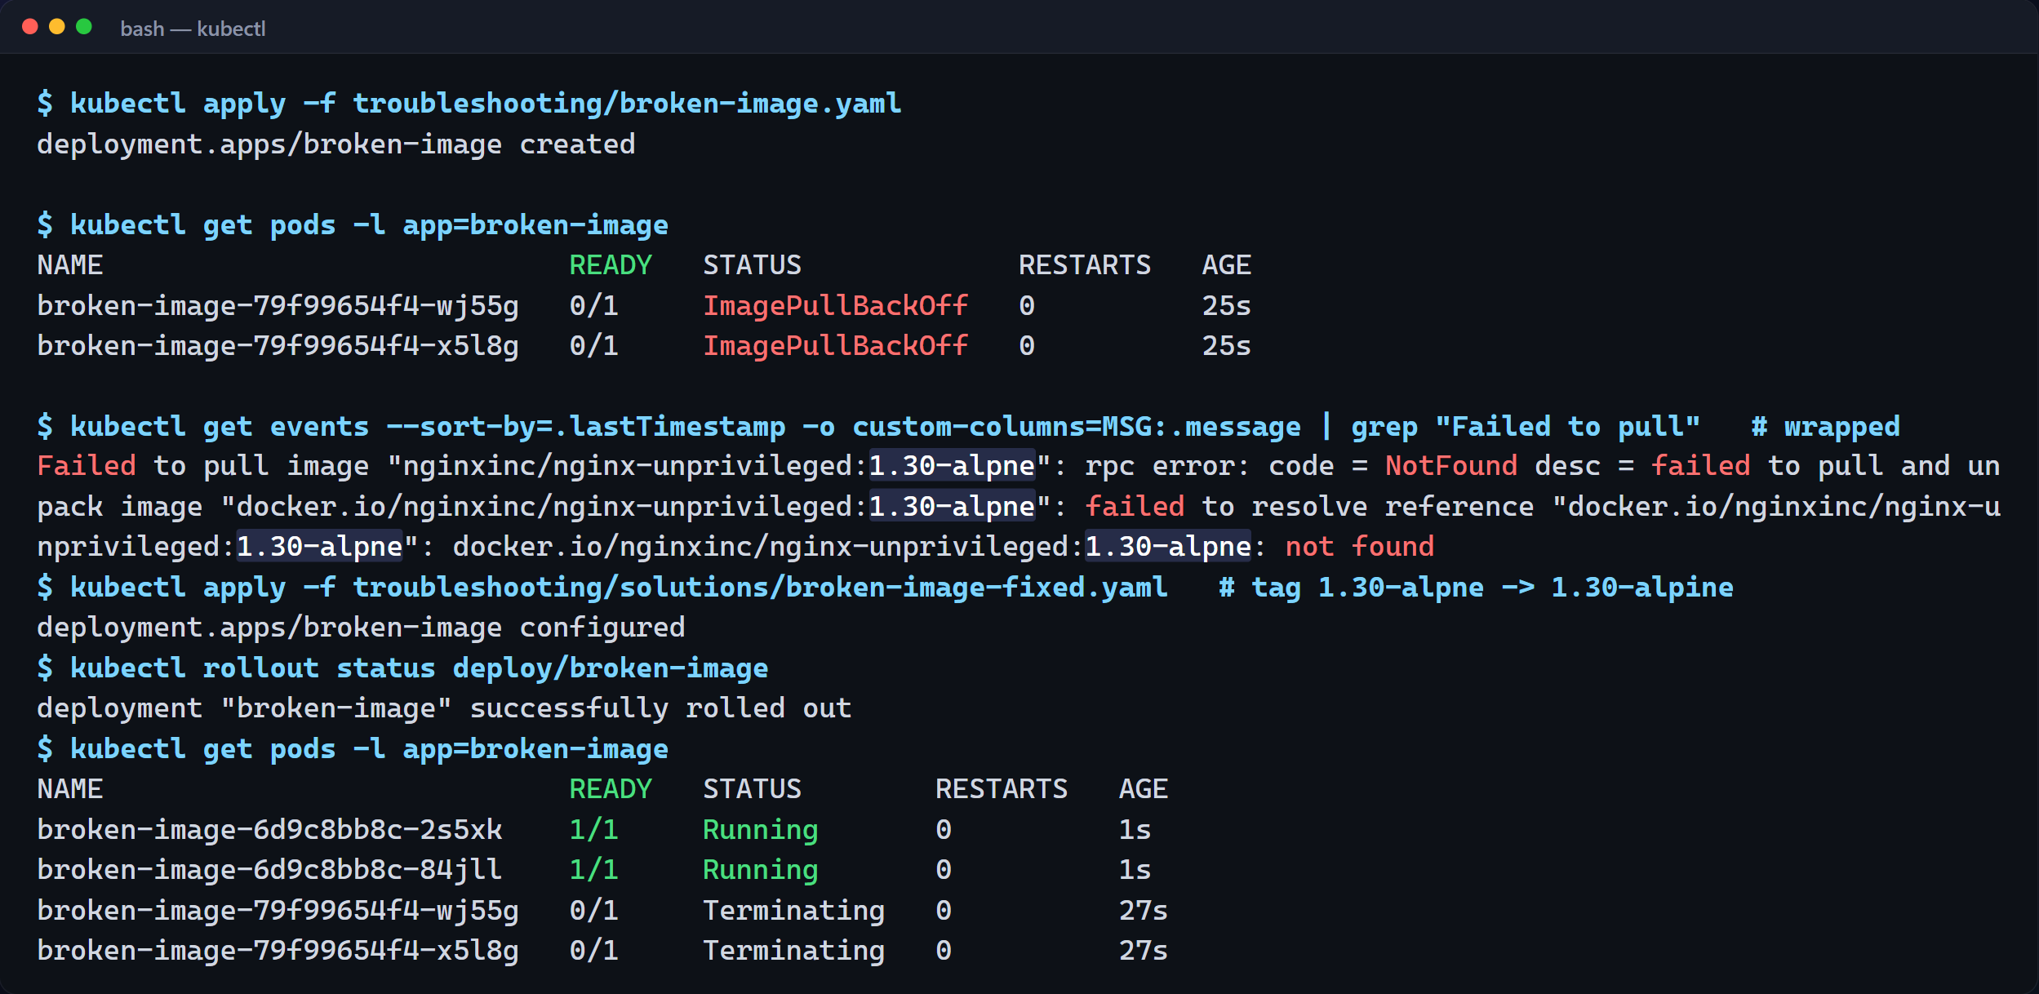
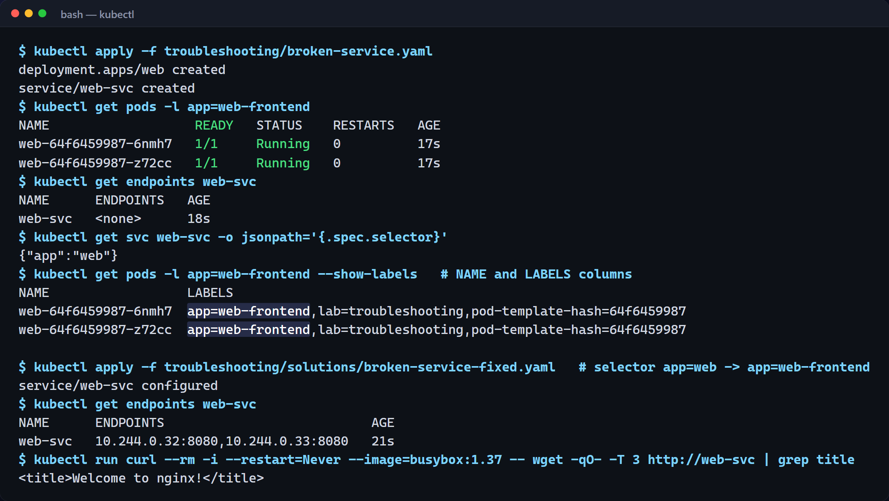
Break it, diagnose it, fix it
TROUBLESHOOTING LAB
ImagePullBackOff
Events say the tag 1.30-alpne was not found: a typo. Fixing the tag rolls out healthy Pods.
No endpoints
Pods Running, endpoints <none>. Selector app=web ≠ label app=web-frontend; fixing the selector restores traffic.
Notes:
Now the troubleshooting lab. This Deployment never becomes ready: the Pods are stuck in ImagePullBackOff. The events show why: the image tag says alpne instead of alpine. That tag doesn't exist in the registry. Fixing the tag rolls out healthy Pods.
In the second lab the Pods are healthy but the Service has no endpoints. Comparing the Service selector with the Pod labels shows the mismatch. A Service selects Pods by label: no matching labels, no endpoints, no traffic. Fixing the selector brings the endpoints back.

Slide 22
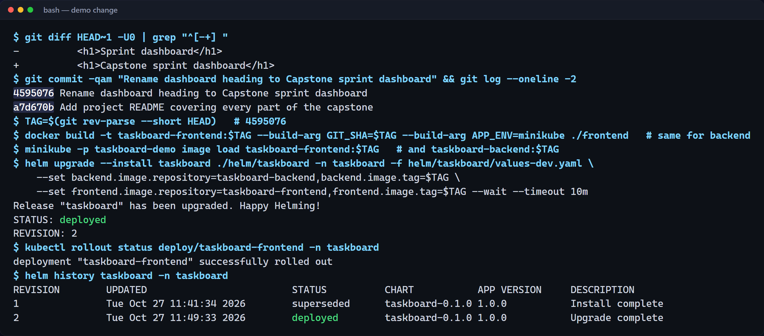

Commit → image → helm upgrade → new revision
M10 · LIVE DEMO
1 · Commit
4595076 renames the dashboard heading.
2 · Image + helm upgrade
New SHA tag, revision 2; maxUnavailable: 0, so no downtime.
3 · Rollback ready
Revision 1 is kept: helm rollback taskboard 1.
Notes:
Finally, the full loop. I make a small change, renaming the dashboard heading, and commit it. The new commit gets its own image tag, and helm upgrade rolls it out with zero downtime, because the rolling update never drops below the current capacity. Helm history now shows revision two, and revision one is kept for rollback. Pushed to main, the same change goes through the pipeline you saw earlier, and its deploy job runs the same helm upgrade against EKS, using the images from GHCR.
Refreshing the app through the Ingress shows the change, and the pipeline card shows the new commit SHA.
Live version: edit a file, git commit, git push to main, show the Actions run, then refresh the app via the Ingress.

Slide 23
Every module, with evidence
RUBRIC COVERAGE
Module | Evidence | Status
M1 Application | Dashboard, Swagger CRUD, psql tasks table, Alembic migrations | Shown
M2 Testing | pytest -v: 22 passed, in-memory SQLite, conftest.py + pytest.ini | Shown
M3 Git & GitHub | Public repo, 11 descriptive commits, .gitignore | Shown
M4 Docker | Non-root images, multi-stage frontend, compose up --build healthy | Shown
M5 CI/CD | Green run on main, pytest + build, GHCR push tagged by SHA | Shown
M6 DevSecOps | Trivy HIGH/CRITICAL gate on both images, clean result explained | Shown
M7 Terraform | Code, init/fmt/validate; plan, console and destroy need AWS | Add AWS run
M8 Kubernetes + Helm | helm install, 2+2 replicas, ClusterIP, Ingress, HPA 2 → 5 | Shown
M9 Observability | /metrics, Prometheus targets UP, Grafana with live panels | Shown
M10 Presentation | README, deck, walkthrough, local commit → rev 2; a CI run for a new push is still to show | Push live
Notes:
Map each module to the slide and video segment that shows it. M7 still needs the AWS screenshots from a real terraform apply/destroy.

Slide 24
Thank you
CODE → PIPELINE → IMAGE → CLUSTER → MONITORING
One application, one commit SHA, traceable from source code to a monitored, autoscaling Kubernetes deployment. Questions?
github.com/TejasVarshney/devops-capstone-project
Notes:
That's the whole path: application, Git, CI, Docker, security scanning, the registry, Terraform, Kubernetes, Helm, Ingress, autoscaling, monitoring and troubleshooting. One application and one commit SHA, traceable from source code to a monitored, autoscaling deployment. Thank you.

