Slide 1
Chapter-IV Applying Your Testing Skills

Slide 2
Configuration testing : Configuration testing is the process of testing the system with each one of the supported software and hardware configurations.
Executing Tests with Various Configurations:
Operating System Configuration - Win XP, Win 7 32 bit/64 bit, Win 8 32 bit/64 bit
Database Configuration - Oracle, DB2, MySql, MSSQL Server, Sybase
Browser Configuration - IE 8, IE 9, FF 16.0, Chrome

Slide 3
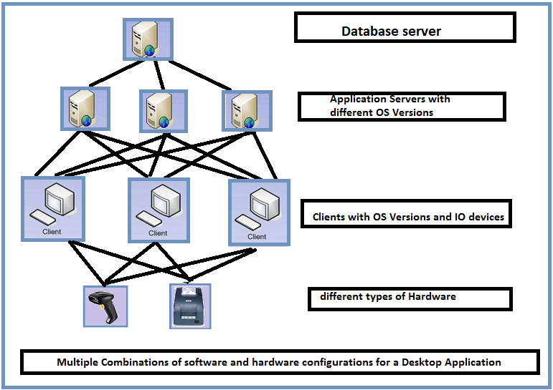
Configuration Testing is a software testing technique in which the software application is tested with multiple combinations of software and hardware in order to evaluate the functional requirements and find out optimal configurations under which the software application works without any defects or flaws.

Slide 4
Objectives of Configuration Testing
Validating the application to determine if it fulfils the configurability requirements
Manually causing failures which help in identifying the defects that are not efficiently found during testing
Determine an optimal configuration of the application under test.
Analysing the system performance by adding or modifying the hardware resources.
Analysing system Efficiency based on the prioritization.
Verification of the system in a geographically distributed Environment to verify how effectively the system performs.

Slide 5
Approaching the Task: general process that you should use when planning your configuration testing.
Decide the Types of Hardware You’ll Need
Decide What Hardware Brands, Models, and Device Drivers Are Available.
Decide Which Hardware Features, Modes, and Options Are Possible.
Pare Down the Identified Hardware Configurations to a Manageable Set.
Identify Your Software’s Unique Features That Work with the Hardware Configurations.
Design the Test Cases to Run on Each Configuration.
Execute the Tests on Each Configuration.
Rerun the Tests Until the Results Satisfy Your Team.
Obtaining the Hardware
Identifying Hardware Standards
Configuration Testing Other Hardware

Slide 6
Configuration Testing Types:
Software Configuration Testing
Hardware Configuration Testing

Slide 7
Compatibility Testing: Checking the functionality of an application on different software, hardware platforms, network, and browsers is known as compatibility testing.
Types of Compatibility testing
Software :Browser/Platoform-os/Versions
Hardware
Network
Mobile

Slide 8
Software compatibility testing means checking that your software interacts with and shares information correctly with other software.
Examples of compatible software are
Cutting text from a Web page and pasting it into a document opened in your word processor.
2. Saving accounting data from one spreadsheet program and then loading it into a completely different spreadsheet program

Slide 9
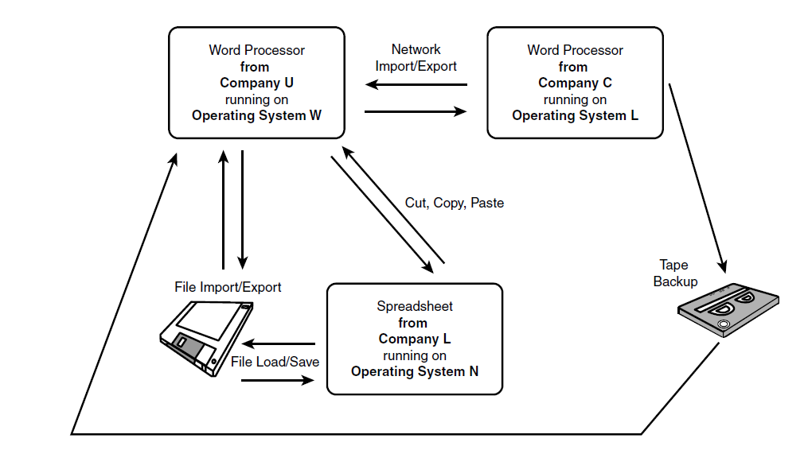

Slide 10
Backward and Forward Compatibility:
If something is backward compatible, it will work with previous versions of the software.
If something is forward compatible, it will work with future versions of the software.
a .txt or text file. With Notepad 98
Windows 98 is backward compatible all the way back to MS-DOS 1.0.
It’s also forward compatible to Windows 2000

Slide 11
Data Sharing Compatibility: A well-written Program that supports and adheres to published standards and allows users to easily transfer data to and from other software is a great compatible product.
File save and file load are the data-sharing methods.
File export and file import
Cut, copy, and paste are the most familiar methods for sharing data among programs without transferring the data to a disk.
DDE(Dynamic Data Exchange) & OLE(Object Linking and Embedding)
Clipboard is that with DDE and OLE, data can flow from one application to the other in real time. Cutting and copying is a manual operation. With DDE and OLE, the transfer can happen automatically.

Slide 12
User Interface Testing: GUI Testing is a software testing type that checks the Graphical User Interface of the Software. The purpose of Graphical User Interface (GUI) Testing is to ensure the functionalities of software application work as per specifications by checking screens and controls like menus, buttons, icons, etc.
Usability is how appropriate, functional, and effective that interaction is.
The means that you use to interact with a software program is called its user interface, or UI.
Command Line Interface is where you type text and computer responds to that command.
GUI stands for Graphical User Interface

Slide 13
Traits common to a good UI
Follows standards and guidelines.
Flexible
Correct
Intuitive
Comfortable
Useful
Consistent

Slide 14
Follows Standards or Guidelines: These standards and guidelines were developed by experts in software usability.
The single most important user interface trait is that your software follows existing standards and guidelines.
If your software strictly follows the rules, most of the other traits of a good UI will happen automatically.

Slide 15
Intuitive:
Is the user interface clean, unobtrusive, not busy?
Is the UI organized and laid out well?
Is there excessive functionality?
If all else fails, does the help system really help you?

Slide 16
Consistent: Consistency within your software and with other software is a key attribute.
Users develop habits and expect that if they do something a certain way in one program, another will do the same operation the same way.
Shortcut keys and menu selections.
Terminology and naming
Audience
Placement and keyboard equivalents for buttons

Slide 17
Flexible: Users like choices—not too many, but enough to allow them to select what they want to do and how they want to do it.
Of course, with flexibility comes complexity.
State jumping: Flexible software provides more options and more ways to accomplish the same task.
State termination and skipping: software can skip numerous prompts or windows and go directly to where they want to go.
Data input and output. Users want different ways to enter their data and see their results.

Slide 18
Comfortable: Software should be comfortable to use.
Appropriateness. Software should look and feel proper for what it’s doing and who it’s for.
Error handling. A program should warn users before a critical operation and allow users to restore data lost because of a mistake.
Performance. Being fast isn’t always a good thing.

Slide 19
Correct: When you’re testing for correctness, you’re testing whether the UI does what it’s supposed to do.
Marketing differences. Are there extra or missing functions, or functions that perform operations different from what the marketing material says?
Language and spelling. Programmers know how to spell only computer language keywords and often create some very interesting user messages.
Bad media. Media is any supporting icons, images, sounds, or videos that go with your software’s UI.
WYSIWYG (what you see is what you get). Make sure that whatever the UI tells you that you have is really what you do have.

Slide 20
Useful: The final trait of a good user interface is whether it’s useful.
The features you see actually contribute to the software’s value .
Do they help users do what the software is intended to do?

Slide 21
Testing for the Disabled: Accessibility Testing: A serious topic that falls under the area of usability testing is that of accessibility testing, or testing for the disabled.
Visual impairments
Hearing impairments
Motion impairments
Cognitive and language

Slide 22
Checklist
Check all the GUI elements for size, position, width, length, and acceptance of characters or numbers. For instance, you must be able to provide inputs to the input fields.
Check you can execute the intended functionality of the application using the GUI
Check Error Messages are displayed correctly
Check for Clear demarcation of different sections on screen
Check Font used in an application is readable
Check the alignment of the text is proper
Check the Color of the font and warning messages is aesthetically pleasing
Check that the images have good clarity
Check that the images are properly aligned
Check the positioning of GUI elements for different screen resolution.

Slide 23
Examples
Testing the colors of the fonts.
Testing the colors of the error messages, warning messages.
Testing whether the image has good clarity or not.
Testing the alignment of the images.
Testing of the spelling.
The user must not get frustrated while using the system interface.
Testing whether the interface is attractive or not.
Testing of the scrollbars according to the size of the page if any.
Testing of the disabled fields if any.
Testing of the size of the images.
Testing of the headings whether it is properly aligned or not.
Testing of the color of the hyperlink.

Slide 24
Website Testing: Web testing is a software testing practice to test websites or web applications for potential bugs. It’s a complete testing of web-based applications before making live.
A web-based system needs to be checked completely from end-to-end before it goes live for end users.
Web Testing checks for
Functionality
usability
Security
compatibility
Interface
performance of the web application or website.

Slide 25
Web page features. A partial list of them includes
Text of different sizes, fonts, and colors
Graphics and photos
Hyperlinked text and graphics
Varying advertisements
Drop-down selection boxes
Fields in which the users can enter data

Slide 26
Black-Box Testing:
Text: Font/Colour /Alignment/Corner/Alt Text/visibility
Links: Outgoing links/Internal links/Anchor Links/MailTo Links/orphan pages
Forms :Forms are the text boxes, list boxes, and other fields for entering or selecting information on a Web page.
Cookies
Test HTML and CSS
Graphics
Objects and Other Simple Miscellaneous Functionality

Slide 27
Gray-Box Testing: Gray Box Testing is a software testing method, which is a combination of both White Box Testing and Black Box Testing method.
Gray box testing is a software testing technique to test a software product or application with partial knowledge of internal structure of the application. The purpose of grey box testing is to search and identify the defects due to improper code structure or improper use of applications.

Slide 28
White-Box Testing:
Dynamic Content. Dynamic content is graphics and text that changes based on certain conditions—for example, the time of day, the user’s preferences, or specific user actions.
Database-Driven Web Pages. Many e-commerce Web pages that show catalogs or inventories are database driven.
Programmatically Created Web Pages.
Server Performance and Loading.
Security

Slide 29
Configuration and Compatibility Testing: Web pages are perfect examples of where you can apply this type of testing.
Hardware Platform
Browser Software and Version.
Browser Plug-Ins.
Browser Options
Video Resolution and Color Depth
Text Size
Modem Speeds

Slide 30
Usability Testing: The following list is adapted from his Top Ten Mistakes in Web Design:
Gratuitous Use of Bleeding-Edge Technology.
Scrolling Text, Marquees, and Constantly Running Animations
Long Scrolling Pages.
Non-Standard Link Colors
Outdated Information.
Overly Long Download Times
Lack of Navigation Support
Orphan Pages.
Complex Web Site Addresses (URLs).
Using Frames

Slide 31
Interface Testing: Three areas to be tested here are - Application, Web and Database Server.
Database Testing:Database is one critical component of your web application and stress must be laid to test it thoroughly.

Slide 32
Performance testing - Performed to verify the server response time and throughput under various load conditions.
Load testing - It is the simplest form of testing conducted to understand the behaviour of the system under a specific load.
Stress testing - It is performed to find the upper limit capacity of the system and also to determine how the system performs if the current load goes well above the expected maximum.
Soak testing - Soak Testing also known as endurance testing, is performed to determine the system parameters under continuous expected load. The main aim is to discover the system's performance under sustained use.
Spike testing - Spike testing is performed by increasing the number of users suddenly by a very large amount and measuring the performance of the system. The main aim is to determine whether the system will be able to sustain the work load.

Slide 33
Security testing - Performed to verify if the application is secured on web as data theft and unauthorized access are more common issues and below are some of the techniques to verify the security level of the system.
Injection
Broken Authentication and Session Management
Cross-Site Scripting (XSS)
Insecure Direct Object References
Security Misconfiguration
Sensitive Data Exposure
Missing Function Level Access Control
Cross-Site Request Forgery (CSRF)
Using Components with Known Vulnerabilities
Unvalidated Redirects and Forwards

