Slide 1

THE MAVEN PIZZA PLACE
By Roll No.
Tejas Golhar PGD-22-DS-87
Guided by
Prof. Swapnil Pawar Sir
Data Science and Artificial Intelligence
Department of Technology
Savitribai Phule Pune University

Slide 2
Content :
• Introduction
• Data Contents
• Requirements with Queries
• Data Screenshot
• Dashboard

Slide 3
Data Introduction :
A year's worth of sales from a pizza place, including the date and time of each order and the pizzas served, with additional details on the type, size, quantity, price, and ingredients.

Slide 4
Data Content
Order_Id: The unique identifier for each order.
Pizza_Id: The unique identifier for each pizza.
Pizza_Type: The type of pizza ordered, such as pepperoni or veggie.
Category: The category of the pizza, such as meat or vegetarian.
Pizza_Name: The name of the pizza ordered.
Order_Date: The date the order was placed.
Order_Time: The time the order was placed.
Quantity: The number of pizzas ordered.
Price: The price of each pizza.
Item_Total: The total price of the order.

Slide 5
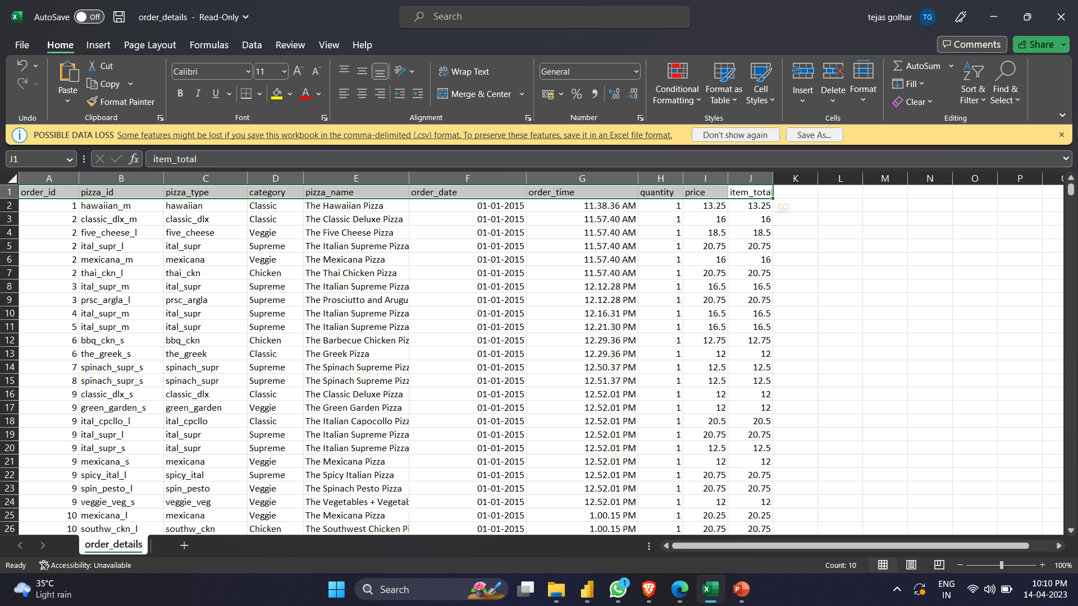
Data Screenshot

Slide 6
Requirements with Queries
SUBSTITUTE FOR PRICE 20.5 = SUBSTITUTE('order_details[1]'[price],"20.5","20.75”)
PRICE INCREASE FOR CATEGORY CHIKEN AND NAME THE CALIFORNIA CHIKEN = IF(AND('order_details[1]'[category]="chicken",'order_details[1]'[pizza_name]="The California Chicken Pizza"),'order_details[1]'[price]+0.25,'order_details[1]'[price])
CONCATENATE DATE AND TIME = 'order_details[1]'[order_date]&" "& 'order_details[1]'[order_time]
INCREASE PRICE THE GREEN GARDEN PIZZA OR THE NAPOLITANA = IF('order_details[1]'[pizza_name]="The Green Garden Pizza" || 'order_details[1]'[pizza_name]="The Napolitana Pizza",'order_details[1]'[price]+1,'order_details[1]'[price])
Upper case for category = UPPER('order_details[1]'[category])

Slide 7
PRICE RATING = IF('order_details[1]'[price]<9.75,"low rate",IF('order_details[1]'[price]<12.5,"pocket_friendly",IF('order_details[1]'[price]<16.75,"average",IF('order_details[1]'[price]<20.25,"hight rate",IF('order_details[1]'[price]<25.5,"higher rate","expensive")))))
WEEKDAY = WEEKDAY('order_details[1]'[order_date].[Date])
WEEKEND = IF('order_details[1]'[weekday] IN {1,7},"weekend","weekdays")
BOOLEN TO CHEAK CATEGORY CLASSIC= IF('order_details[1]'[Upper case for category]="CLASSIC",TRUE(),FALSE())
TO INCREASE ITEM_TOTAL 16.5 TO 17 = IF('order_details[1]'[item_total]=16.5,17,'order_details[1]'[item_total])

Slide 8
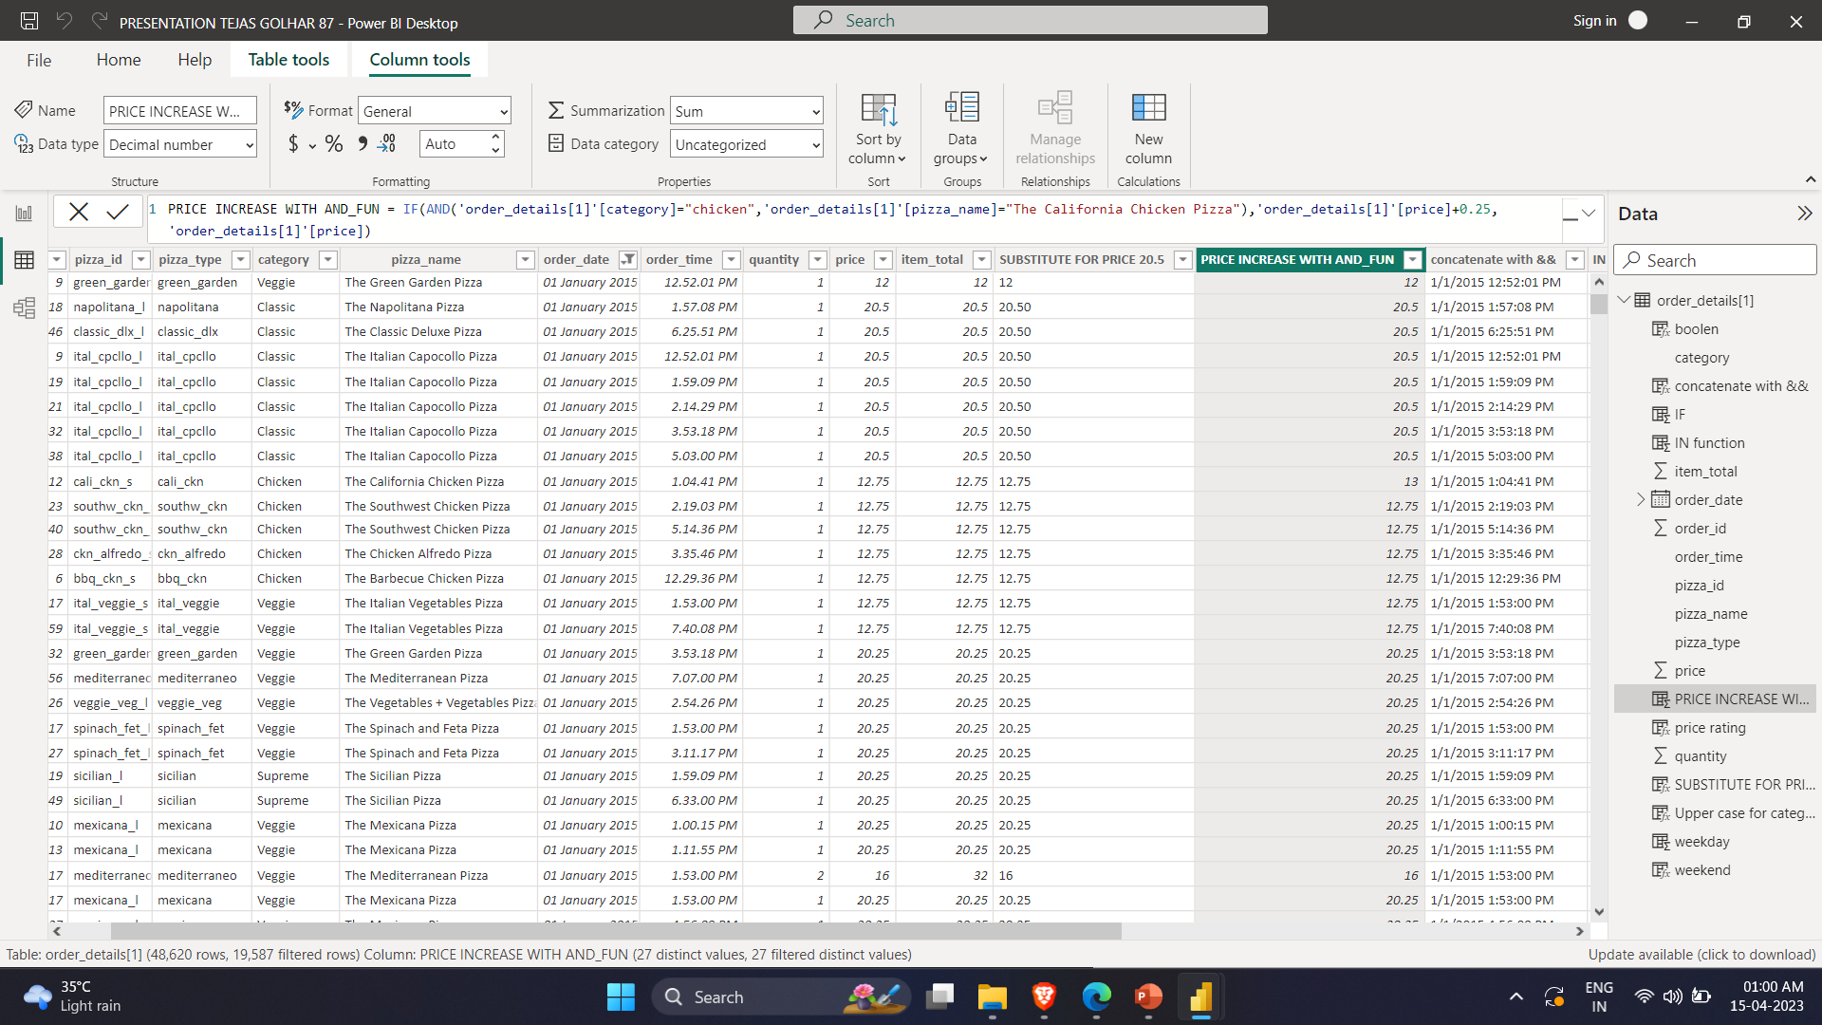
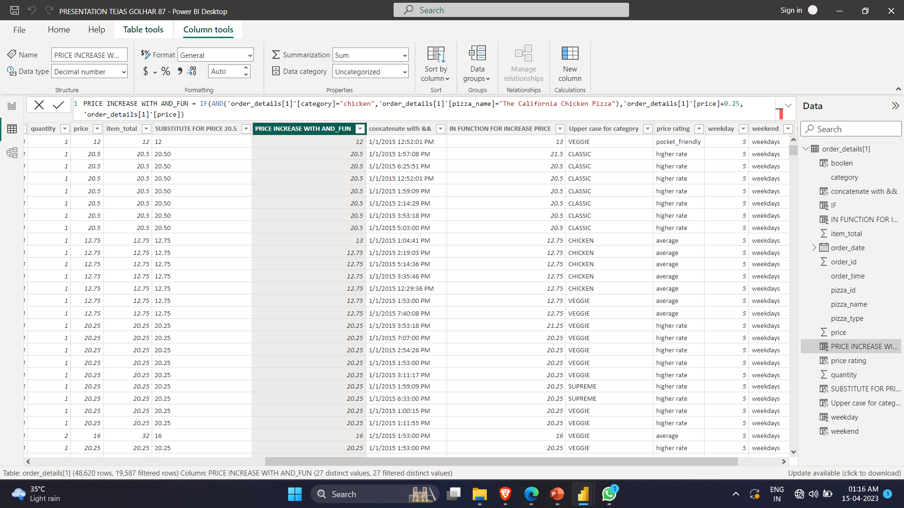
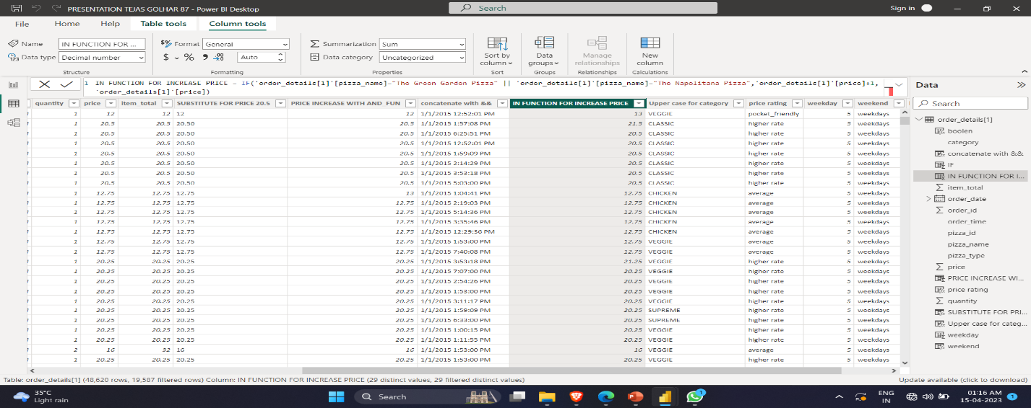
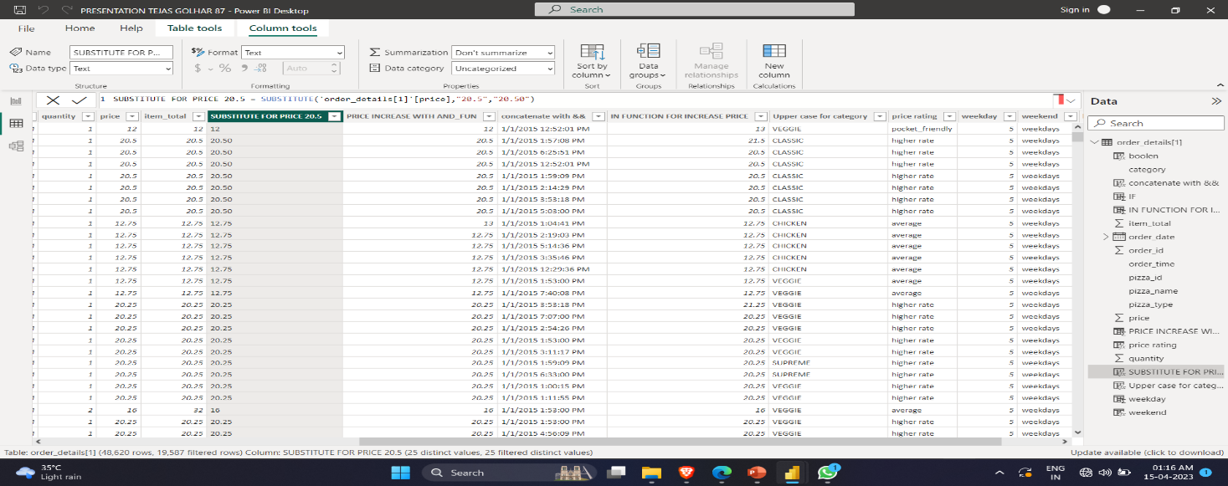
DATA SCREENSHOTS

Slide 9
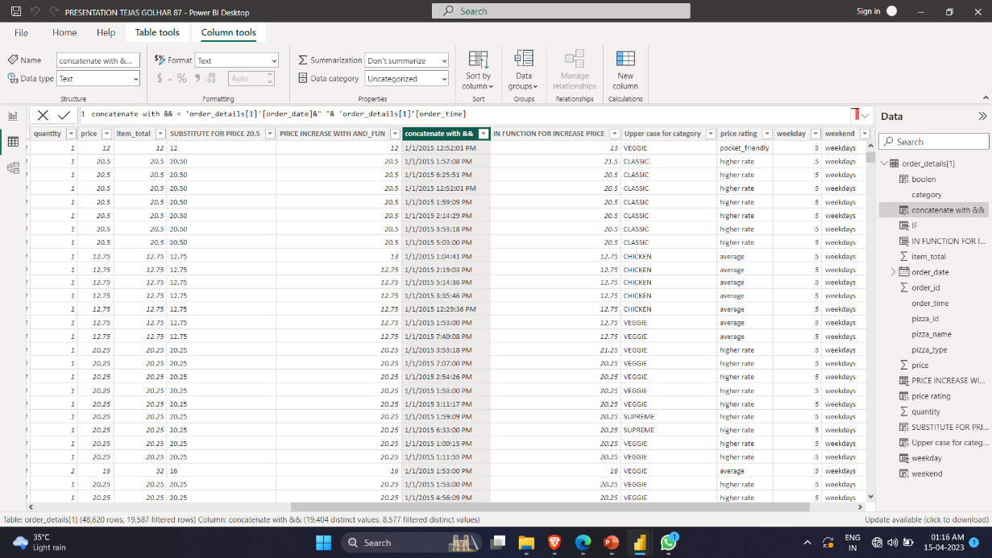
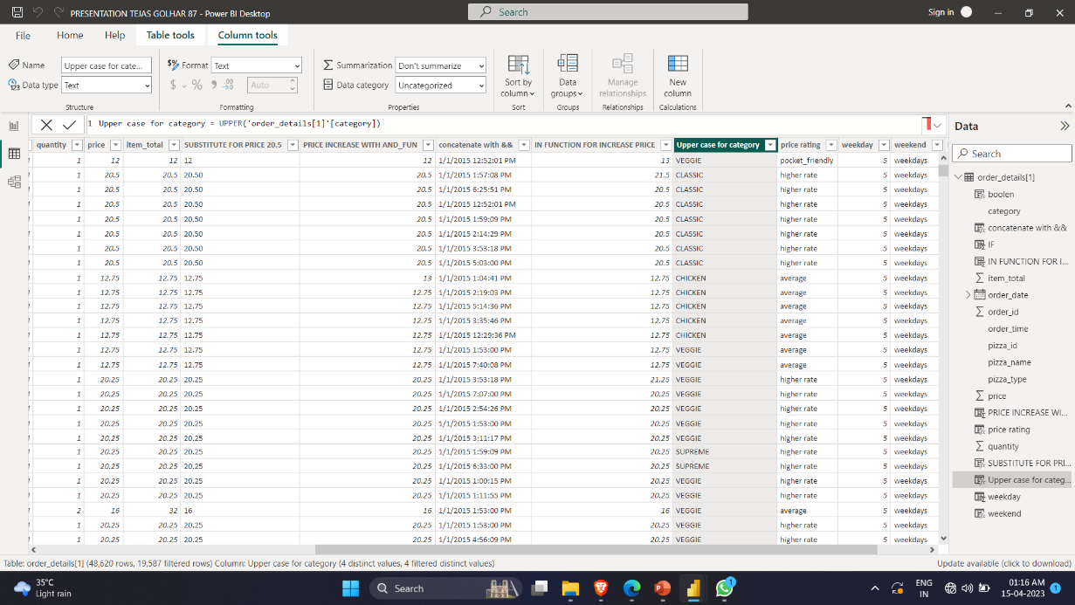
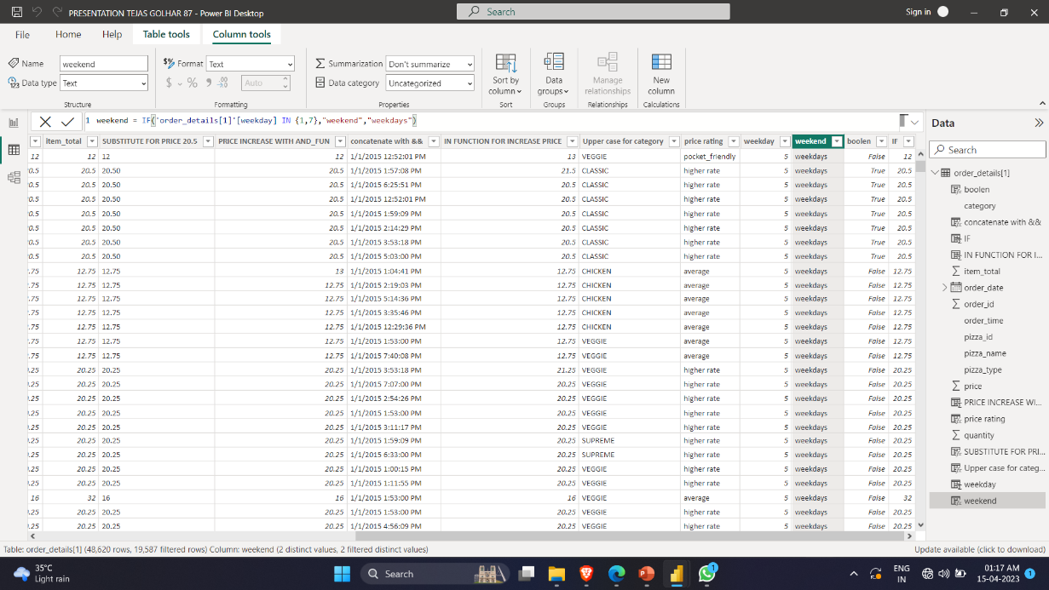
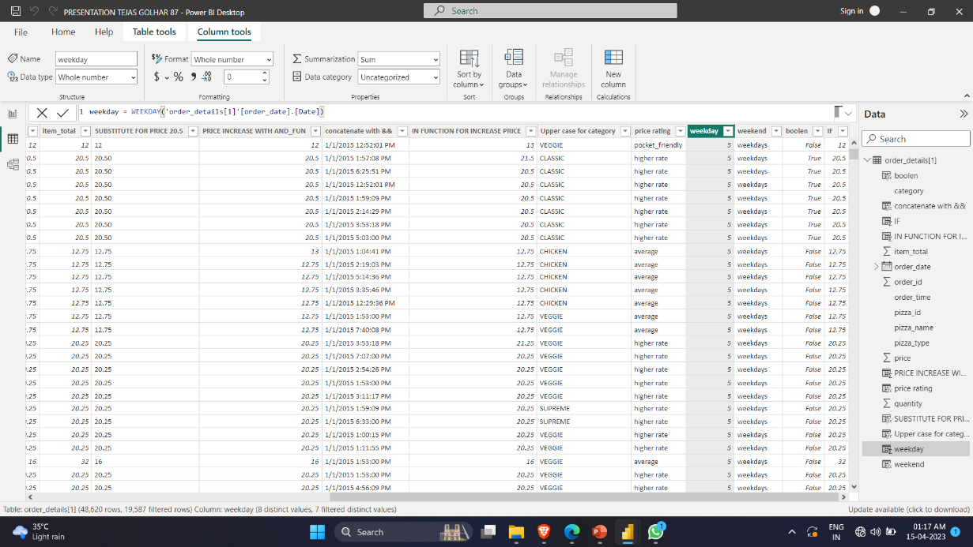

Slide 10
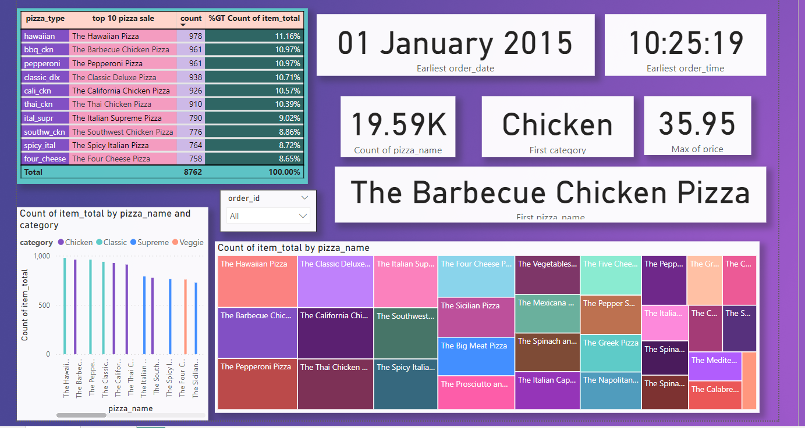

Slide 11
DASHBOARD
Sales By Date: A chart that shows the daily sales trend over a selected period of time.
Pizza Category Breakdown: A chart that shows the distribution of pizzas sold across different categories.
Maximum Price : A chart that shows the Maximum value of Pizza
The Count of Item_Total : A chart that shows the count pizza
From order id we get information about pizza and order.
There are Pie Chart, Clustered Bar Chart, Funnel, Treemap and Cards to Visualization the Dataset

Slide 12
Conclusion
Based on the pizza order sales dataset, it can be concluded that there is a steady demand for pizza across different categories and types.
The top-selling pizzas generate a significant portion of the total revenue, and there is a notable variation in sales by date and time of day.
Additionally, the analysis of customer behavior suggests a regular customer base that orders pizza at an average frequency.
Overall, this dataset provides valuable insights for pizza businesses to optimize their operations and marketing strategies.

Slide 13
Thank You

