Slide 1
SALARY PREDICTION MODEL
By-Tejashree R

Slide 2
About the data
- Saved as a .csv file
- Has 13 columns
12 – features ( First Name, Last Name, Sex, DOJ, Current Date, Designation, Age, Unit, Leaves Used, Leaves remaining, Ratings, past experience)
1 – Target Variable (Salary)

Slide 3
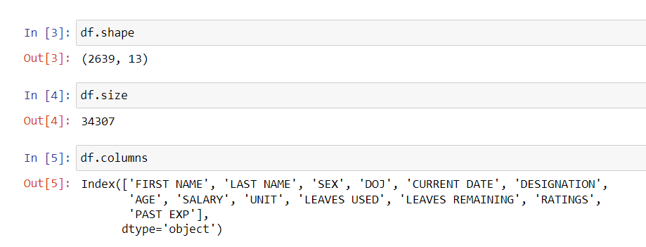
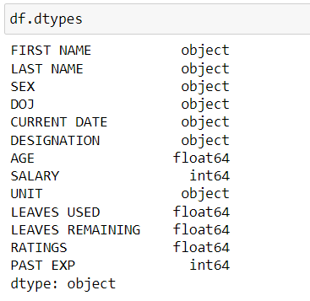
1. Exploratory data analysis (EDA)
In EDA we need to analyse the dataset and know all the data available with us
Shape of the DataFrame
Size of the DataFrame
Column names
DataTypes of each column

Slide 4
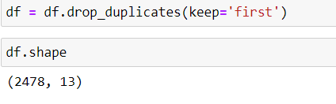
2. Data preprocessing
- Here we need to handle all null values in the data. Since this data has only 13 null values we would rather remove them, than impute with mean or median values.
- Remove duplicate values if any
Null values or missing values contribute as noise to the data. It makes it difficult for the model to learn from this data. And the model ends up making wrong predictions. Hence they have to handled properly.

Slide 5
- We can drop the unnecessary columns namely – FIRST NAME and LAST NAME as they don’t affect the prediction in any way.
-
- The DOJ and CURRENT DATE columns are of dtypes Object. So we convert them to date-time data type using pd.to_datetime function.
- We have to do a little bit of data visualization to detect any outliers and to identify the range of the data.
- So for the categorical columns we perform data visualization. SEX, DESIGNATION and UNIT to find the no of record belonging to each of the classes.

Slide 6
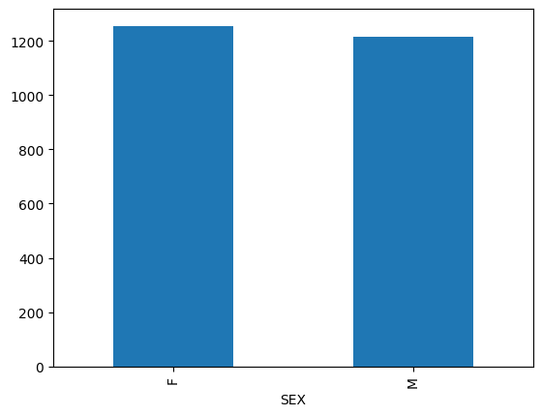
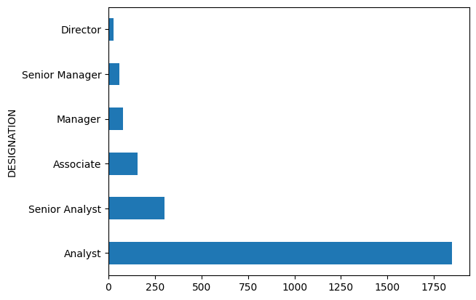
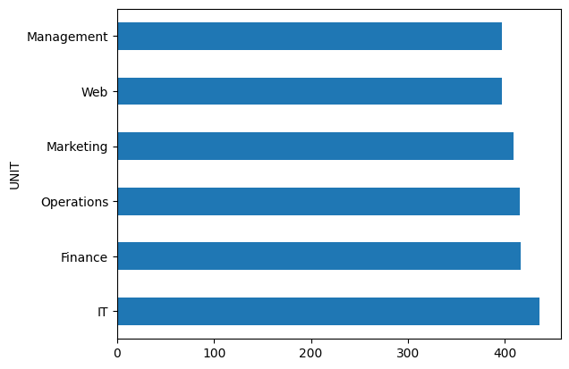
CATEGORICAL COLUMNS
This helps us understand if our data is biased. In such cases data has to be augmented and imputed with proper data.

Slide 7
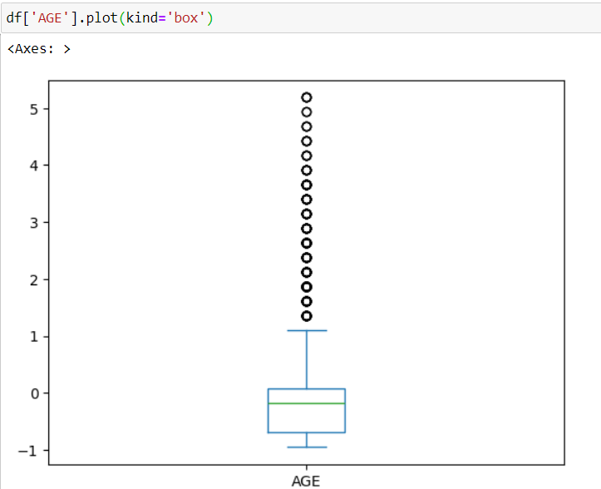
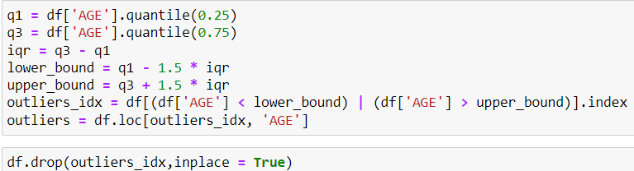
For the numerical columns we plot a box plot to identify min,max, mean, median and outliers(if any)
- AGE – initially had lots of outliers so we remove those outliers using IQR

Slide 8
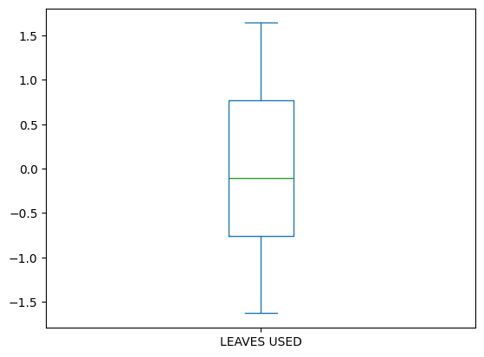
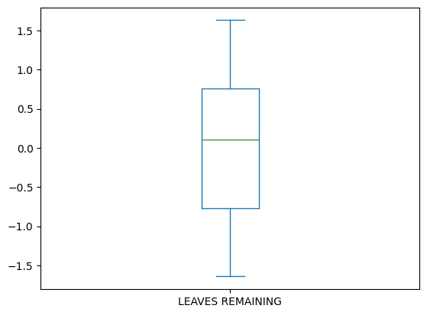
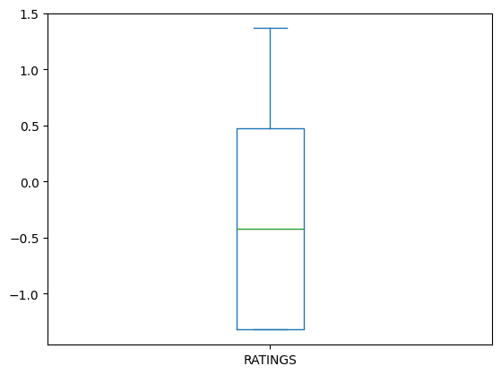
Similarly we perform visualization for the columns - LEAVES USED, LEAVES REMAINING, RATINGS
- Now that we have cleaned our data and handled null values and outliers our data is free from noise.

Slide 9
3.Feature engineering
- Here we have 2 features DOJ and current date, From these we can derieve another feature viz. Experience.
- Experience is the difference between the DOJ column and the current date column,
-
- We perform label encoding for the categorical columns as our models can only handle numerical values.
SEX – Male – 0, Female – 1

Slide 10
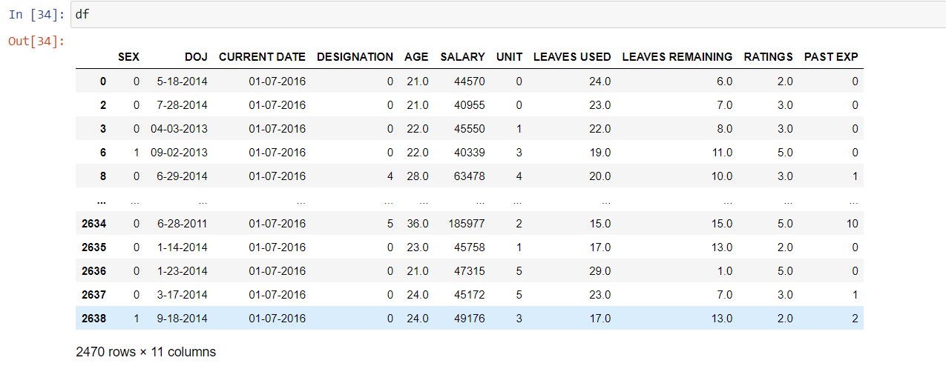
Now, our data looks like this

Slide 11
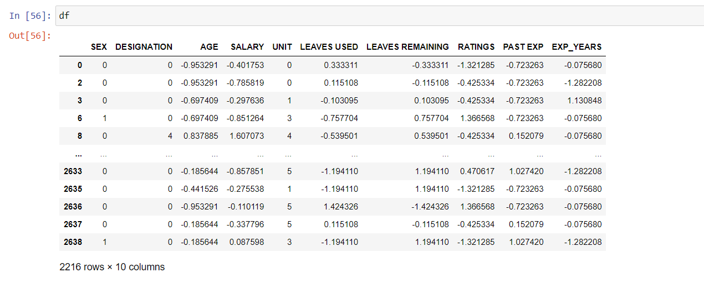
Now we perform Standardization for all the numerical values – AGE, LEAVES USED, LEAVES REMAINING, RATINGS, PAST EXP, EXP_YEARS and SALARY
After performing standardization all our values lie in a certain range and now the DataFrame looks like this.

Slide 12
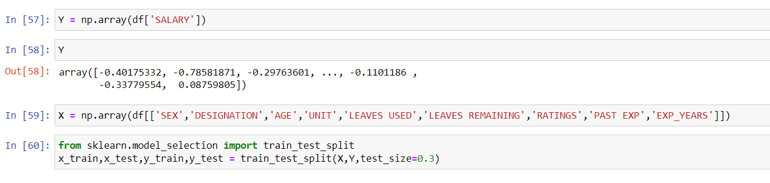
4. MACHINE LEARNING MODEL DEVELOPMENT
- separating the data into features and target variable.
Features – they are columns based on which the model makes predictions.
Target variable – is the column that the model has to predict.
- And again splitting it into training data and test data.
Train data – this is the data from which the model learns
Test data – this the data based on which the model’s performance is tested.

Slide 13
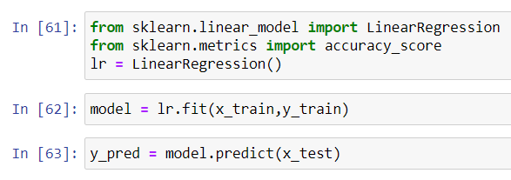
Linear regression model
Linear Regression models the relationship between a continuous target variable and one or more features using a straight line.
It estimates the equation of this line by minimizing the difference between the line’s prediction and the actual target values.

Slide 14
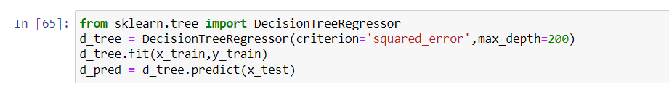
DECISION TREES
Decision trees make prediction by asking a series of yes/no questions based on features
Thse are easy to interpret.
They can handle both continuous and categorical features without much preprocessing.

Slide 15
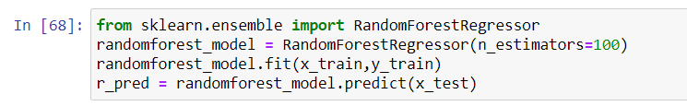
RANDOM FOREST REGRESSOR
Random forest combine multiple decision trees, creating a ‘ forest’ for prediction. Each tree is built on a random subset of features and data points, promoting diversity.
Predictions are made by averaging across the trees. It reduces overfitting and improves performance compared to a single tree.

Slide 16
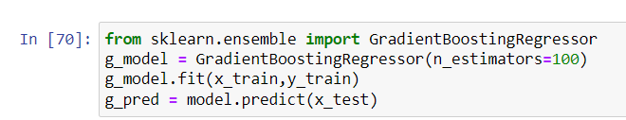
GRADIENT BOOSTING
Gradient Boosting builds an ensemble of weak decision decision trees sequentialy. Each new tree focuses on correcting the errors of the previous trees, aiming for more accurate overall model.
It uses gradient descent to determine the direction in which each new tree should improve the ensemble’s predictions.
This sequential learning with error correction leads to a powerful model.

Slide 17
5. MODEL EVALUATION
We evaluate the performance of each of these values based on R2 score, Root mean squared error, Mean squared error and mean absolute error.
R2 score - Represents the proportion of variance in the dependent variable that can be explained by the independent variables in a regression model.
Root mean squared error – Used to measure the average magnitude of the error between the predicted values from a model and the actual values in a regression model.
Mean Squared error – Used to measure the average squared difference between the predicted values from a model and the actual values in a regression model.
Mean Absolute error – used to measure the average absolute difference between the predicted values from a model and the actual values in a regression model
As these are prediction models we cannot use classification reports and accuracy score.

Slide 18
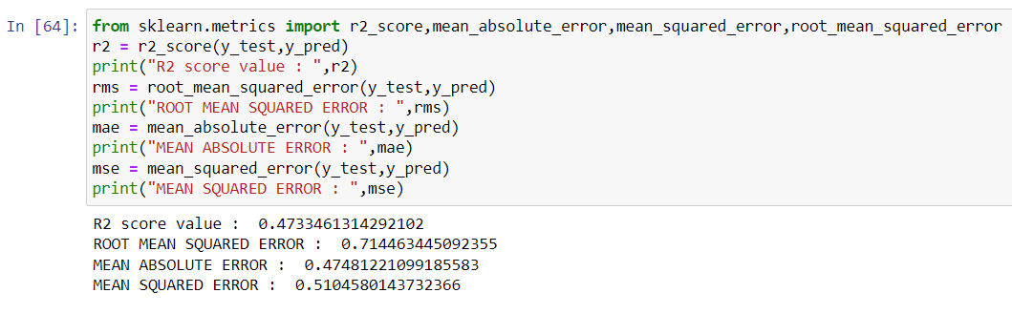
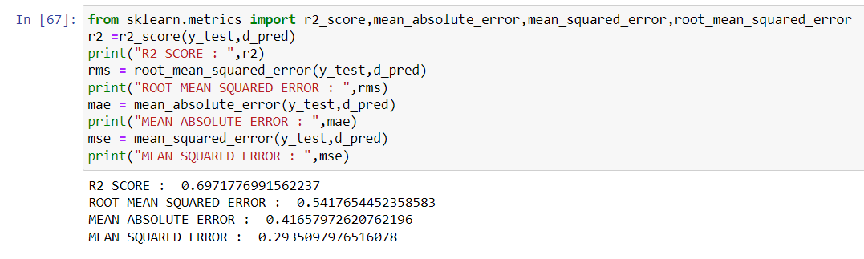
LINEAR REGRESSION MODEL
DECISION TREE MODEL

Slide 19
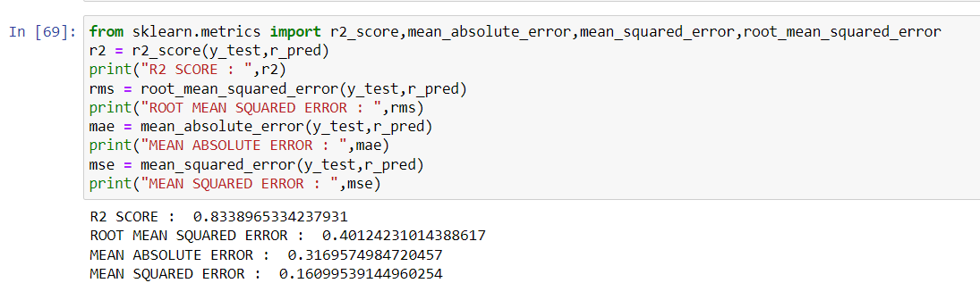
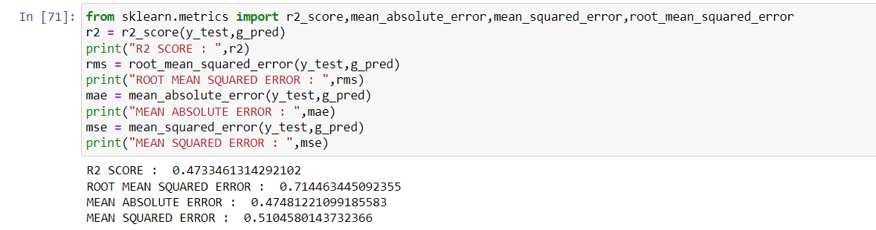
RANDOM FOREST MODEL
GRADIENT BOOSTING

Slide 20
We can see that the R2 score of the gradient boosting model is the highest when compared to the other models.
So we go ahead with the gradient boosting model.

Slide 21
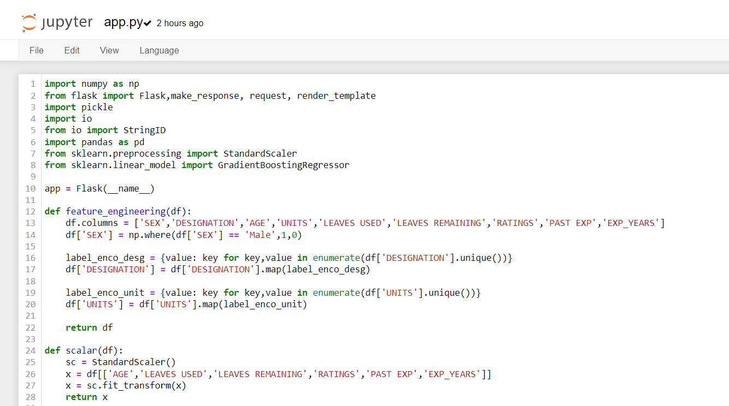
MODEL DEPLOYMENT
Using flask we have the deploy the given model.

Slide 22
