Slide 1
PROJECT ON CHICAGO CRIME ANALYSIS GROUP J TEJASHREE RAJAGOPALAN

Slide 2
Introduction
Crime remains a persistent challenge within societies worldwide, impacting public safety, community well-being, and individual livelihoods. In our endeavor to address this issue, we have embarked on an analysis of crime data from the vibrant city of Chicago, focusing on the year 2022. The Chicago Crime dataset report serves as our primary source, offering a comprehensive record of incidents that have transpired over the course of the year.
Motivation
Our project is motivated by the need to address crimes in Chicago using data-driven insights. We identify the top 5 crimes in 2022, analyze monthly frequencies for proactive planning, and determine unsafe hours for strategic resource deployment. Using supervised machine learning, we classify crime hotspots to empower law enforcement with actionable intelligence, enhancing crime prevention and public safety. Ultimately, our goal is to foster a safer environment for all Chicago residents.

Slide 3
Dataset Description
Source: Chicago Data Portal (https://data.cityofchicago.org/Public-Safety/Crimes-2022/9hwr-2zxp/about_data)
Format: .csv
Size: 54.4 MB
Year: 2022
Rows: 239,329
Columns: 22
Libraries Used:
Data Handling: Pandas, NumPy
Visualization: Matplotlib, Seaborn
Date Handling: Datetime
Modeling: Scikit-learn
Utility: Joblib

Slide 4
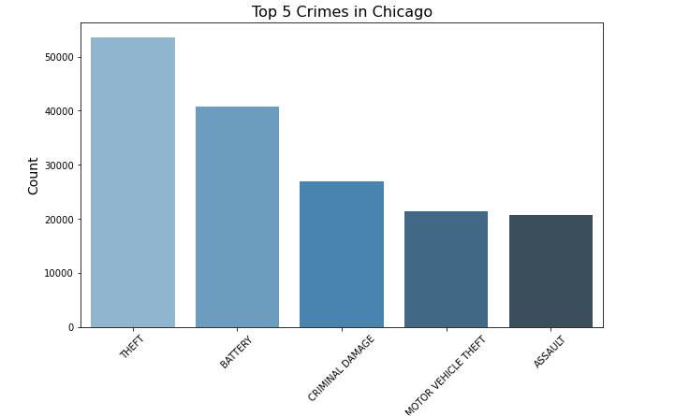
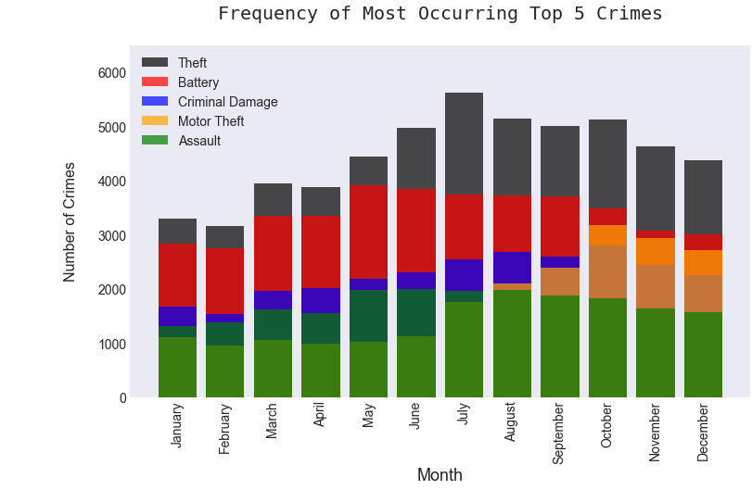
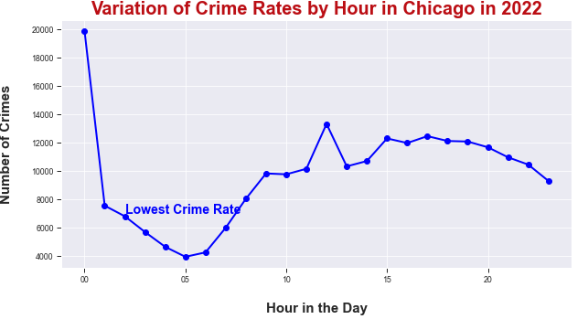
Analysis
Imported Necessary Libraries: Utilized libraries including Pandas, NumPy, Matplotlib, Seaborn, Datetime, and Scikit-learn.
Loaded and Inspected the Dataset: Examined the structure and content of the dataset to understand its characteristics.
Data Cleaning: Identified missing values, primarily in location-related columns. Dropped missing values to ensure data integrity and accuracy for analysis.
Exploratory Data Analysis: Identified distinct crimes in Chicago (2022) and visualized the top 5 crimes.
Feature Engineering: Converted datetime to extract month, day, and hour information.
Plotted crime frequency by month, revealing spikes in July, August, September, and October.
Identified Unsafe Hours: Calculated crime occurrences by hour and visualized trends.
Observed a decrease in crime rates from midnight to early morning hours.

Slide 5
Results
Utilizing Supervised Machine Learning to Predict Crime Hotspots, we categorize them into low (0), medium (1), and high alarm (2) levels. We've introduced a new feature, "alarm," as the dependent variable, while employing month, day, hour, and district as independent variables for training and testing the models.
Decision Tree: Accuracy: 73.10%
Random Forest: Accuracy: 78.08%
Gradient Boosting Classifier: Accuracy: 79.88%
Logistic Regression: Accuracy: 76.31%
Support Vector Machine (SVM): Accuracy: 76.47%
1. Gradient Boosting Classifier achieved the highest accuracy (79.88%), followed by Random Forest.
2. Decision Tree and Logistic Regression exhibited moderate performance.
3. SVM had a similar accuracy to Logistic Regression but struggled with high alarm predictions.
Limitations:
1. Not all crimes had a good correlation with parameters such as latitude and longitude..
2. The potential imbalance in the distribution of crime occurrences across different alarm levels may affect the accuracy of hotspot predictions. Addressing class imbalance through appropriate techniques could enhance the reliability of the predictive models.

Slide 6
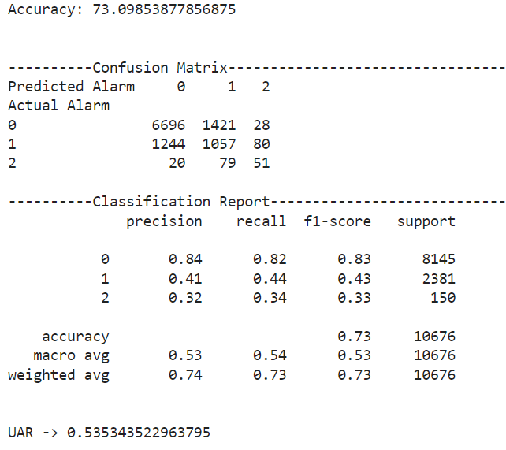
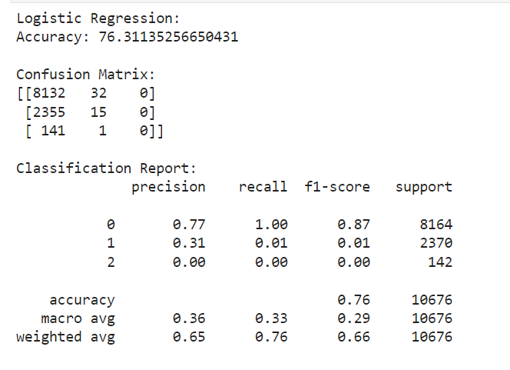
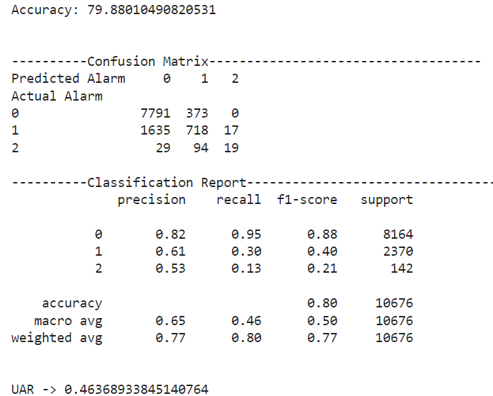
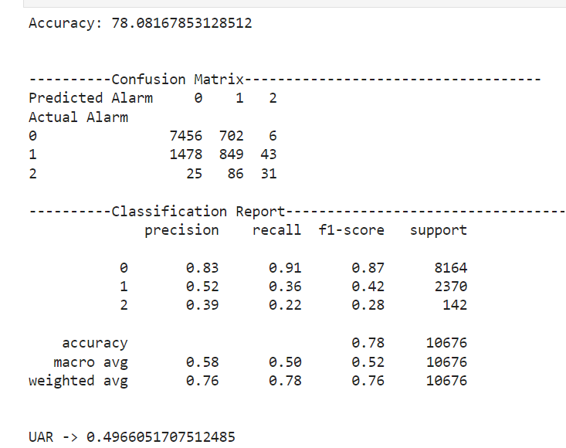
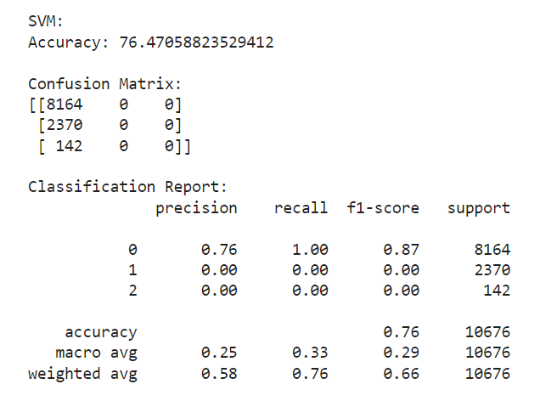
Results
Decision Tree Classifier
Logistic Regression
Gradient Boosting Classifier
Random Forest Classifier
SVM

Slide 7
Conclusion
In conclusion, our project has utilized advanced data analysis techniques to analyze crime data from the city of Chicago in 2022. Through exploratory data analysis, feature engineering, and supervised machine learning, we have identified trends, patterns, and hotspots within the city's criminal landscape.
Future Work
Compare crime occurrence between day and night to identify crimes more prevalent during certain times, aiding in targeted policing strategies.
Explore additional datasets spanning multiple years for comprehensive analysis to understand the relationship between crime types and arrest rates to identify patterns and prioritize law enforcement efforts accordingly.

Slide 8
THANK YOU

