Slide 1
Naïve Bayes Algorithm
Formula, Coin Example, Playing Tennis Problem, Applications, Advantages & Disadvantages

Slide 2
Definition of Naïve Bayes
Naïve Bayes is a supervised machine learning classification algorithm.
It is based on Bayes Theorem.
It predicts probabilities using prior knowledge and evidence.
It assumes all features are independent.

Slide 3
Bayes Theorem Formula
P(C|X) = [P(X|C) × P(C)] / P(X)
P(C|X) → Posterior Probability
P(X|C) → Likelihood
P(C) → Prior Probability
P(X) → Evidence
Prior Knowledge + New Evidence = Posterior Probability

Slide 4
Coin Problem Statement
There are two coins:
Coin A → Fair Coin
Coin B → Biased Coin
We toss a randomly selected coin and get HEAD.
Predict which coin was selected.

Slide 5
Coin Probabilities
P(H|A) = 0.5
P(H|B) = 0.8
P(A) = 0.6
P(B) = 0.4

Slide 6
Coin Problem Mathematical Solution
P(H) = P(H|A)P(A) + P(H|B)P(B)
P(H) = (0.5 × 0.6) + (0.8 × 0.4)
P(H) = 0.3 + 0.32 = 0.62
P(A|H) = (0.5 × 0.6) / 0.62 = 0.48
P(B|H) = (0.8 × 0.4) / 0.62 = 0.52
Since 0.52 > 0.48, Coin B is most likely selected.

Slide 7
Playing Tennis or Not Problem
Predict whether a person will play tennis or not.
Features: Outlook = Sunny
Humidity = High
Wind = Weak
Classes: YES or NO

Slide 8
Naïve Bayes Formula for Tennis Problem
P(Yes|X) ∝ P(Yes) × P(Sunny|Yes) × P(HighHumidity|Yes) × P(WeakWind|Yes)

Slide 9
Playing Tennis Mathematical Calculation
P(Yes) = 9/14 = 0.64
P(Sunny|Yes) = 2/9 = 0.22
P(HighHumidity|Yes) = 3/9 = 0.33
P(WeakWind|Yes) = 6/9 = 0.67
Final Probability = 0.64 × 0.22 × 0.33 × 0.67
≈ 0.031
Highest probability gives final prediction.

Slide 10
Real-Time Applications
Spam Email Detection
Medical Diagnosis
Weather Forecasting
YouTube Recommendations
Bank Fraud Detection
Face Unlock Systems
Online Shopping Recommendations

Slide 11
Advantages of Naïve Bayes
Simple and easy to implement
Fast prediction
Works well with large datasets
Requires less training data
Best for text classification

Slide 12
Disadvantages of Naïve Bayes
Assumes feature independence
Less accurate for complex data
Zero probability problem
Not suitable for correlated features

Slide 13
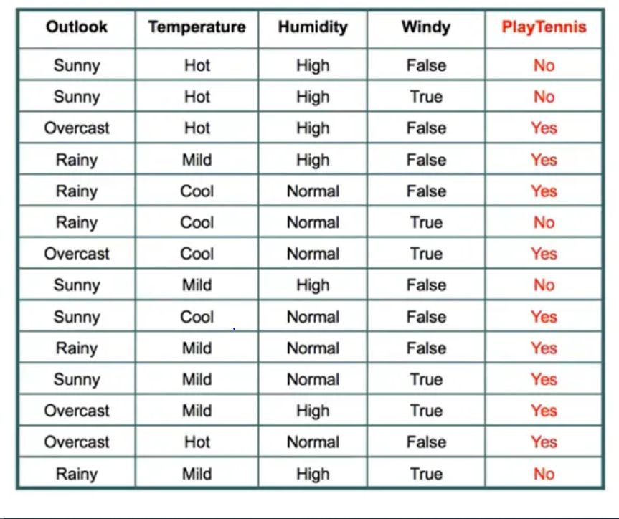

Slide 14
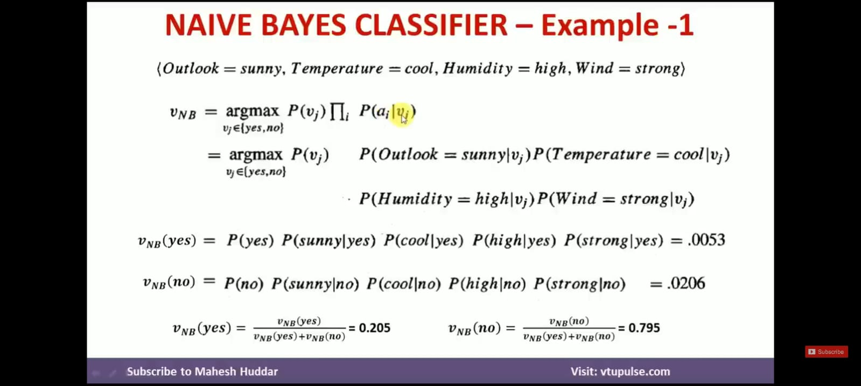

Slide 15
Interview Definition
Naïve Bayes is a probabilistic supervised machine learning classification algorithm based on Bayes theorem that assumes all input features are independent.

Slide 16
Thank You
Questions?

