Slide 1
Outline
Decision Tree Representations
  ID3 and C4.5 learning algorithms (Quinlan 1986)
  CART learning algorithm (Breiman et al. 1985)
Entropy, Information Gain
Overfitting
Intro AI
Decision Trees

Slide 2

Training Data Example: Goal is to Predict When This Player Will Play Tennis?
Intro AI
Decision Trees

Slide 3
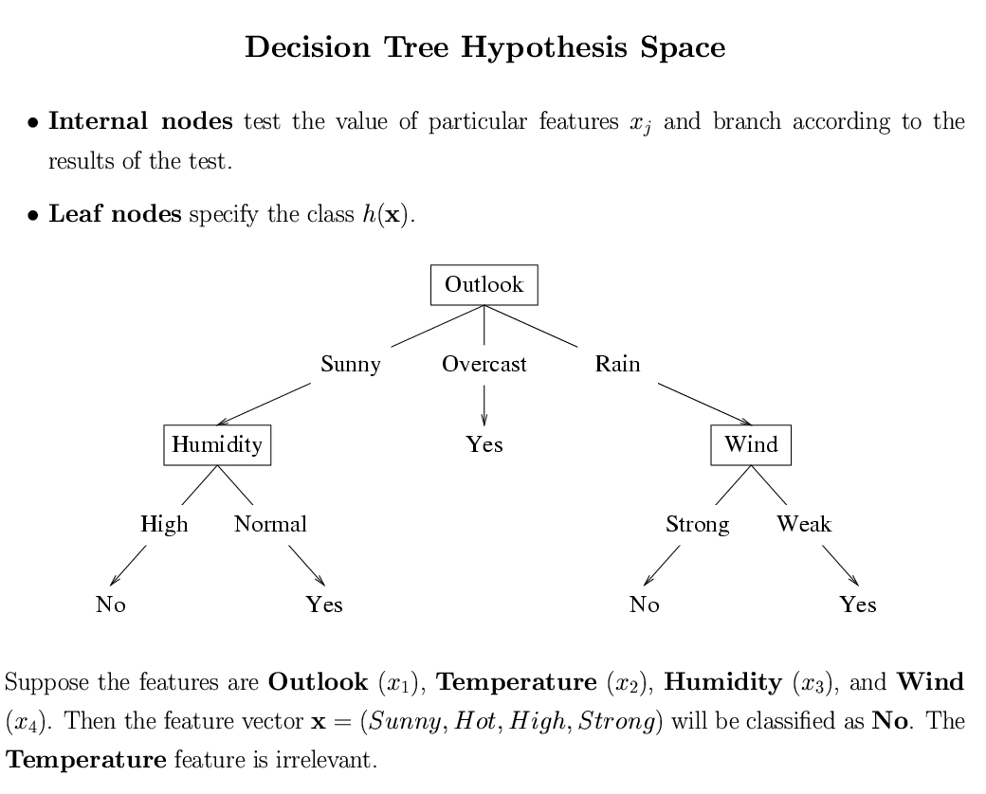
Intro AI
Decision Trees

Slide 4
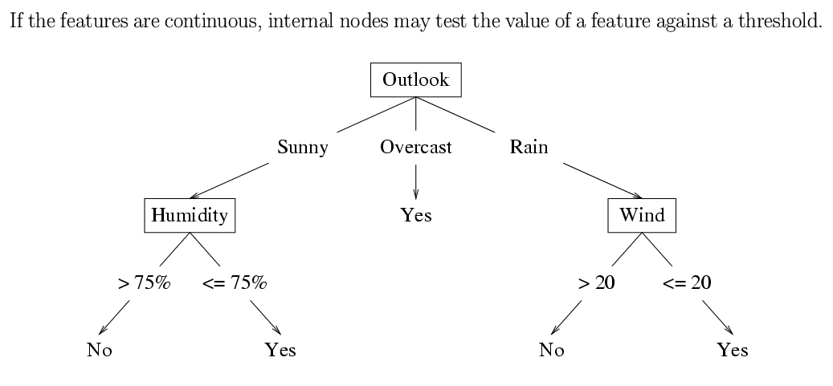
Intro AI
Decision Trees

Slide 5
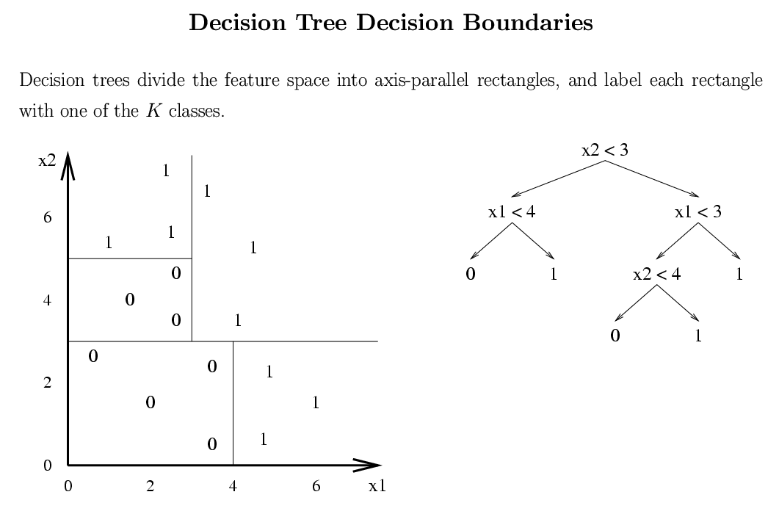
Intro AI
Decision Trees

Slide 6
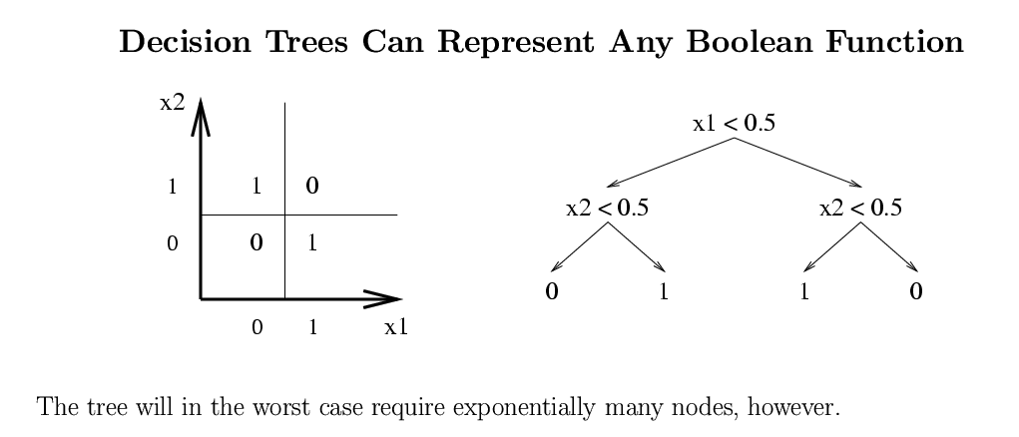
Intro AI
Decision Trees

Slide 7
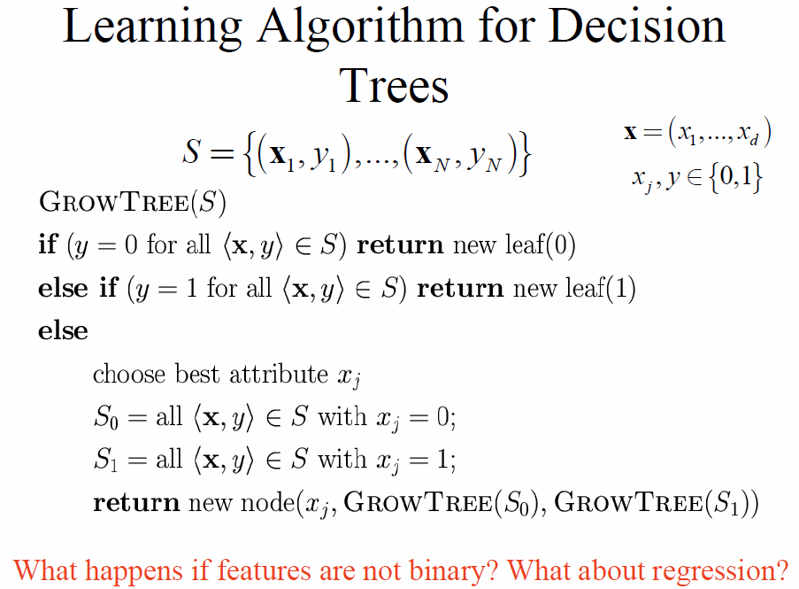
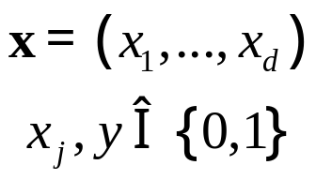
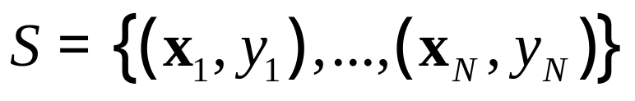
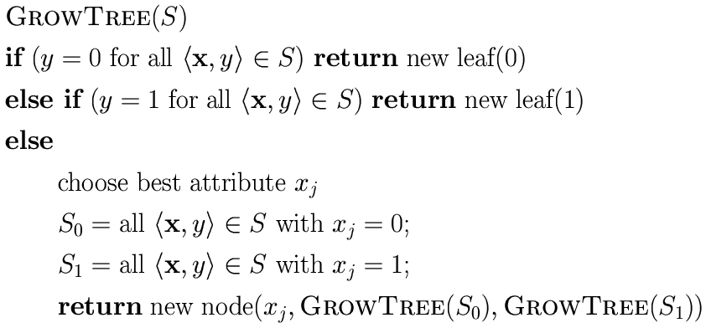
Learning Algorithm for Decision Trees
What happens if features are not binary? What about regression?
Intro AI
Decision Trees

Slide 8
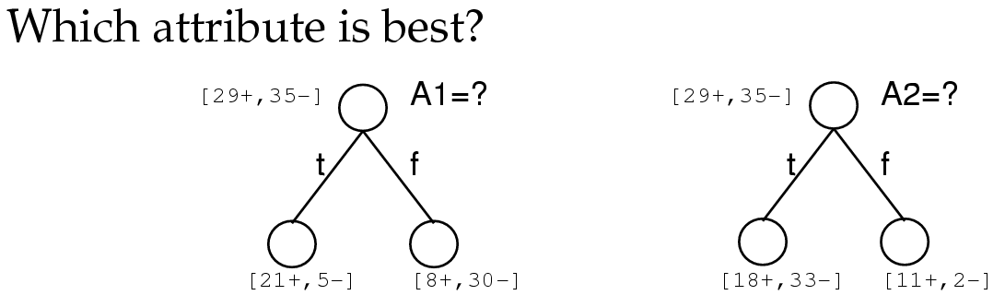
Choosing the Best Attribute
A1 and A2 are “attributes” (i.e. features or inputs).
Number +
and – examples
before and after
a split.
- Many different frameworks for choosing BEST have been proposed!
- We will look at Entropy Gain.
Intro AI
Decision Trees

Slide 9
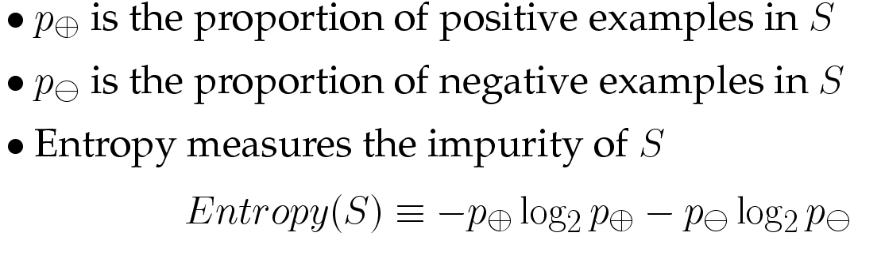
Entropy
Intro AI
Decision Trees

Slide 10
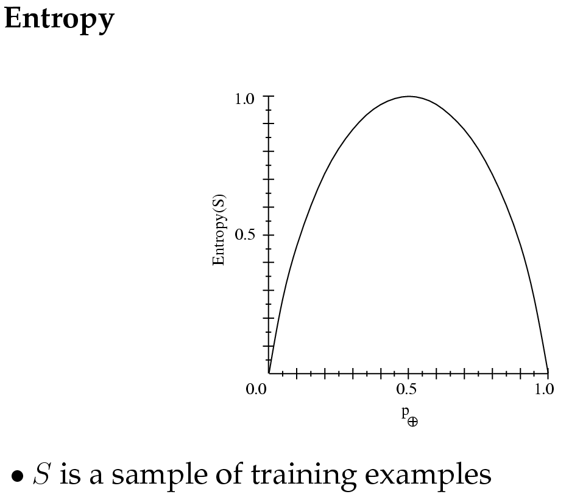
Entropy is like a measure of impurity…
Intro AI
Decision Trees

Slide 11
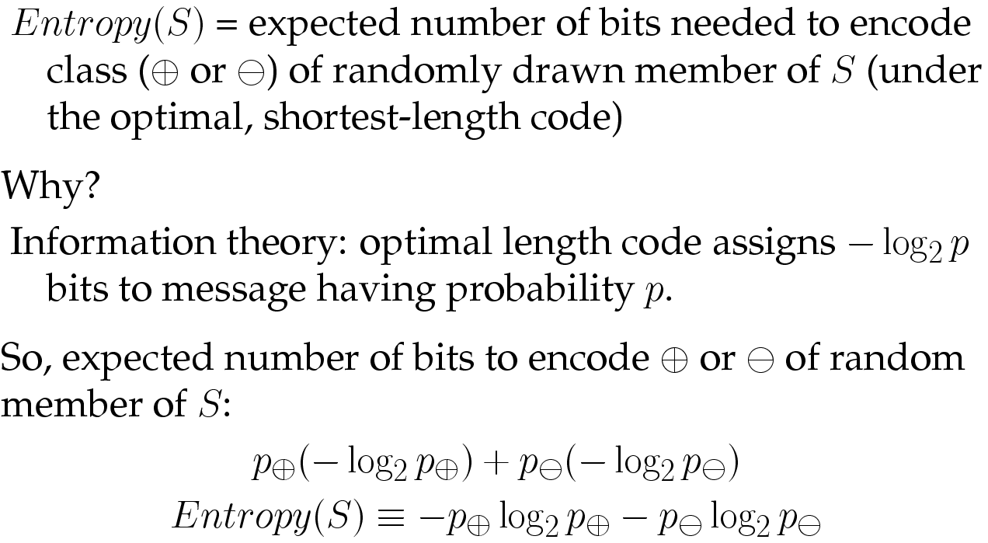
Entropy
Intro AI
Decision Trees

Slide 12
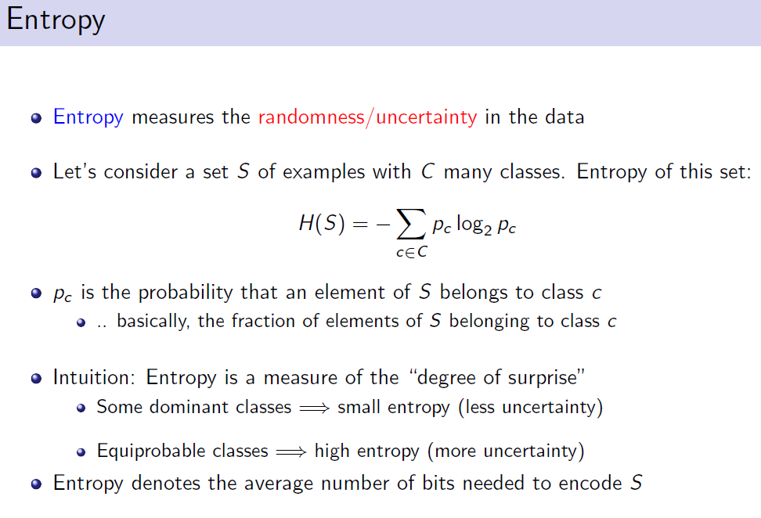
Intro AI
Decision Trees

Slide 13
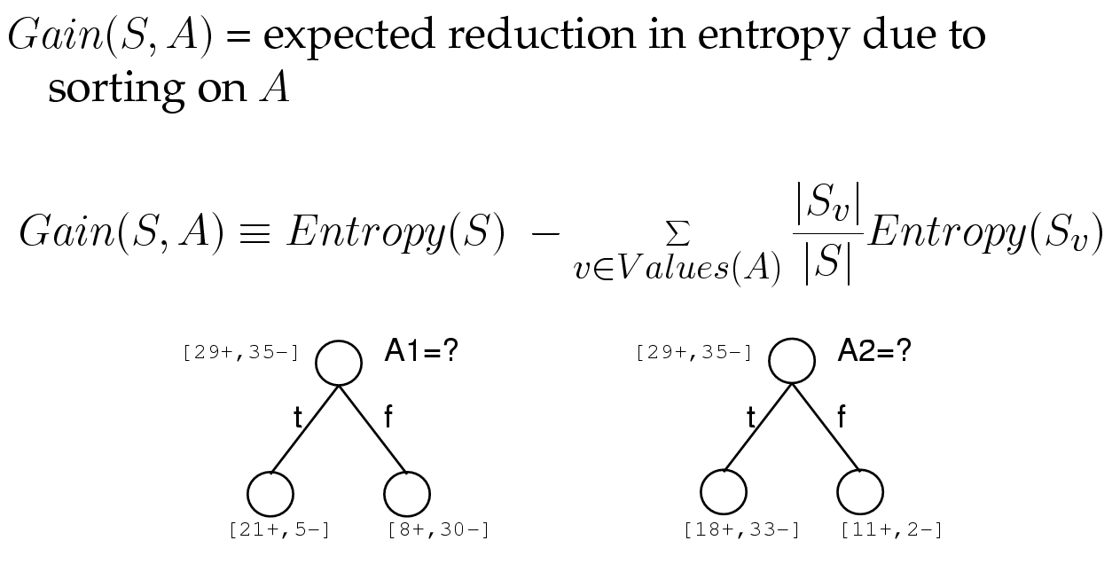
Information Gain
Intro AI
Decision Trees

Slide 14
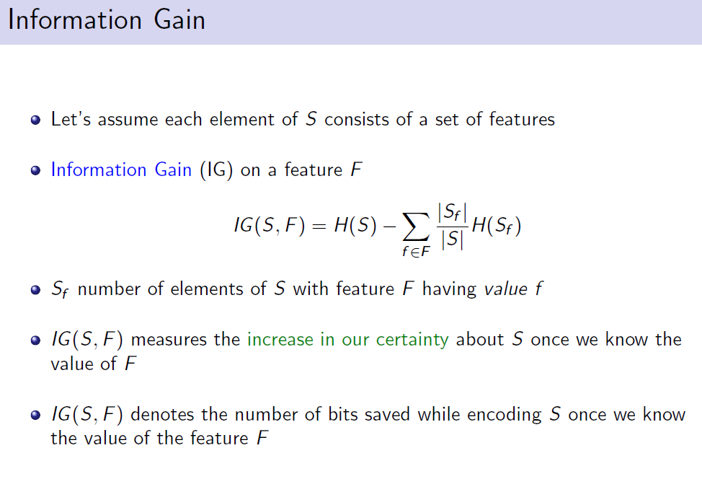
Intro AI
Decision Trees

Slide 15
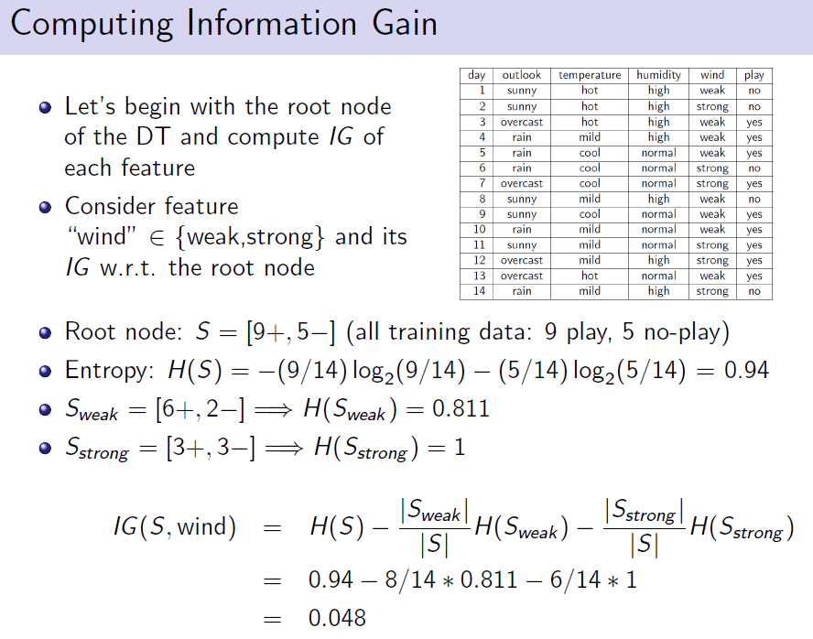
Intro AI
Decision Trees

Slide 16
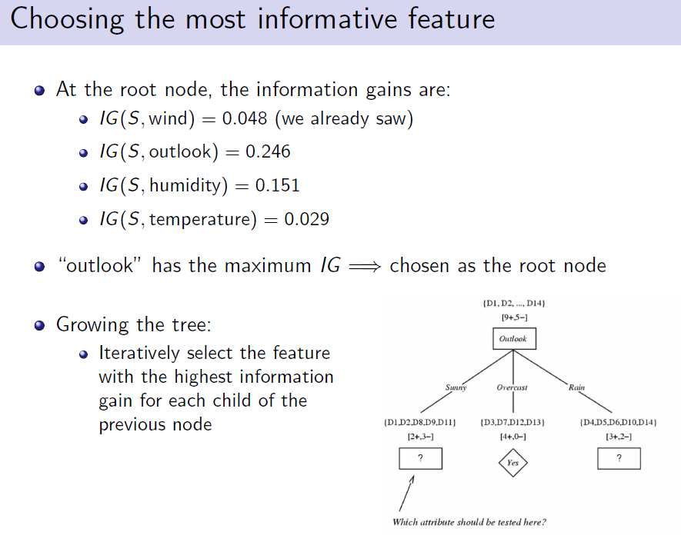
Intro AI
Decision Trees

Slide 17
Training Example
Intro AI
Decision Trees

Slide 18
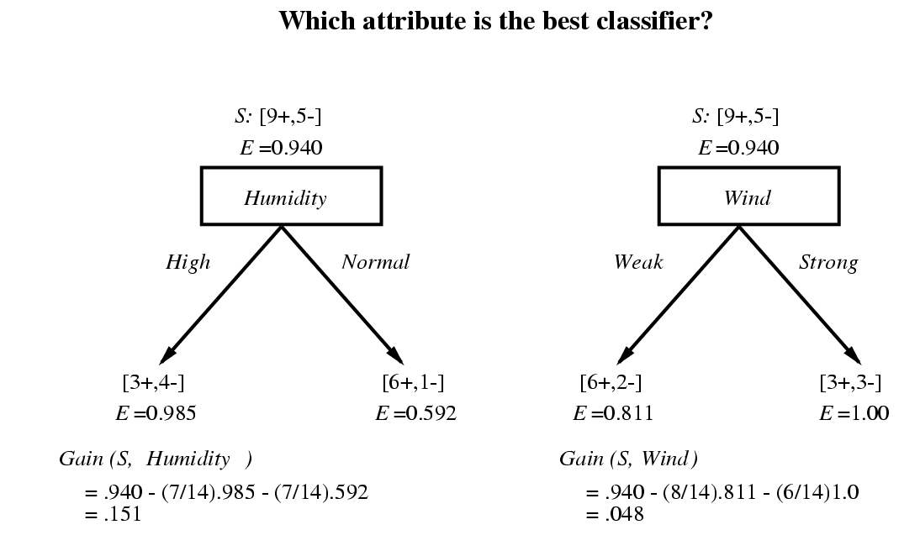
Selecting the Next Attribute
Intro AI
Decision Trees

Slide 19
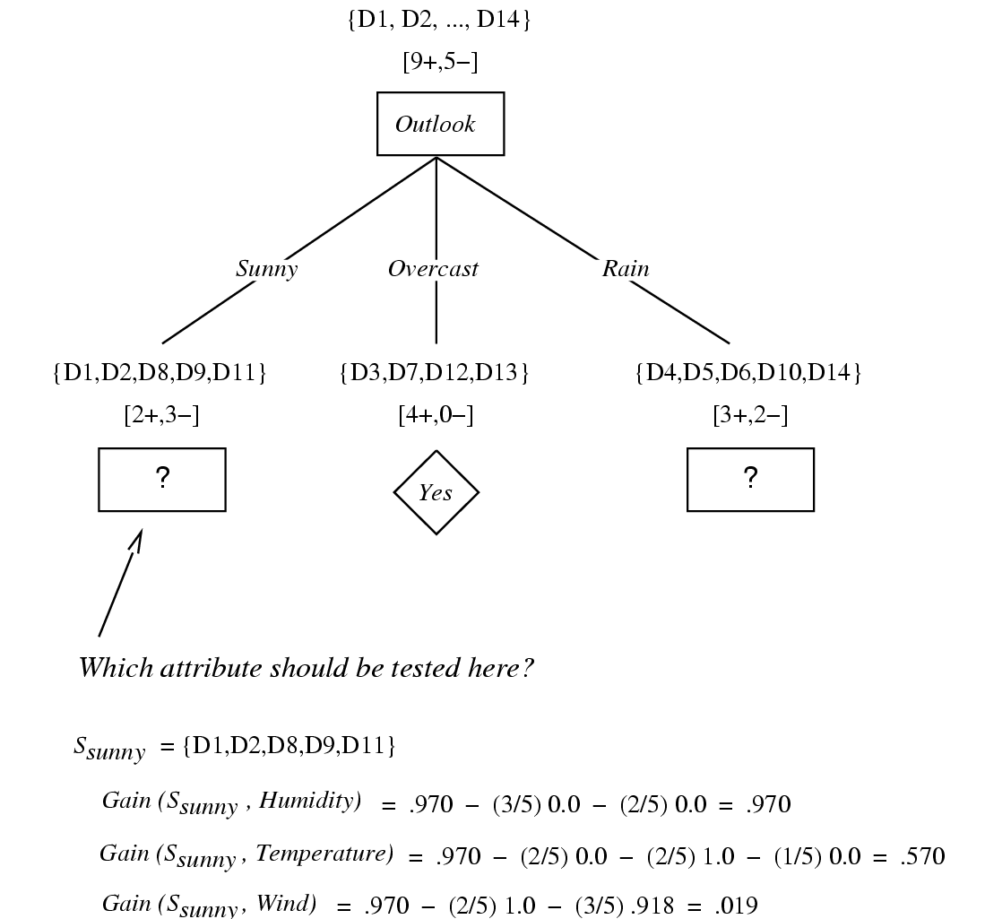
Intro AI
Decision Trees

Slide 20
Non-Boolean Features
Features with multiple discrete values
  Multi-way splits
  Test for one value versus the rest
  Group values into disjoint sets
Real-valued features
  Use thresholds
Regression
  Splits based on mean squared error metric
Intro AI
Decision Trees

Slide 21
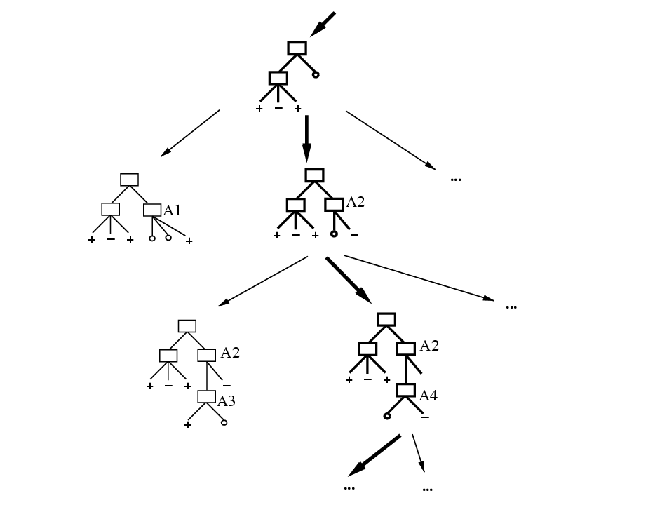
Hypothesis Space Search
You do not get the globally optimal tree!
Search space is exponential.
Intro AI
Decision Trees

Slide 22
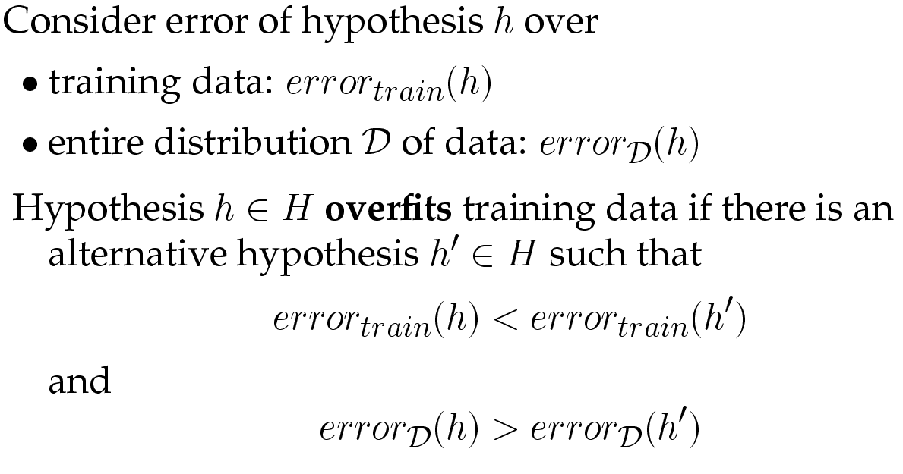
Overfitting
Intro AI
Decision Trees

Slide 23
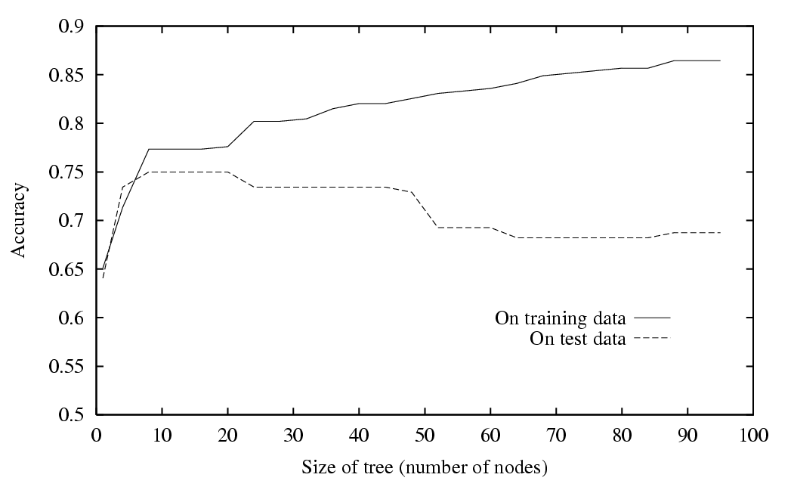
Overfitting in Decision Trees
Intro AI
Decision Trees

Slide 24
Validation Data is Used to Control Overfitting
Prune tree to reduce error on validation set
Intro AI
Decision Trees

Slide 25
Homework
Which feature will be at the root node of the decision tree trained for the following data? In other words which attribute makes a person most attractive?
Height | Hair | Eyes | Attractive?
small | blonde | brown | No
tall | dark | brown | No
tall | blonde | blue | Yes
tall | dark | Blue | No
small | dark | Blue | No
tall | red | Blue | Yes
tall | blonde | brown | No
small | blonde | blue | Yes
Intro AI
Decision Trees

