Slide 1
Random Forest
Complete explanation of Random Forest and GridSearchCV Hyperparameters

Slide 2
What is Random Forest?
Ensemble method that combines multiple Decision Trees using Bagging and Voting.

Slide 3
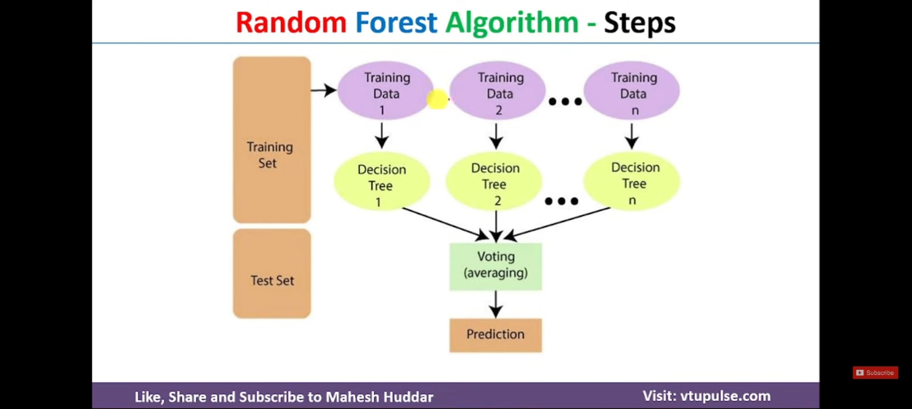

Slide 4
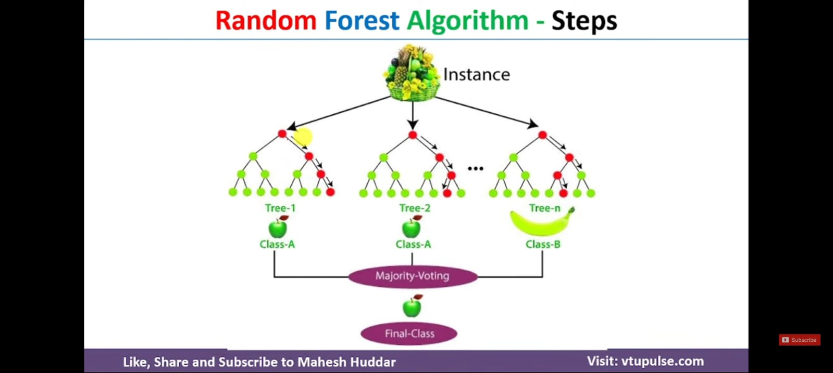

Slide 5
How Random Forest Works
1. Bootstrap Sampling
2. Build Multiple Trees
3. Random Feature Selection
4. Majority Voting

Slide 6
n_estimators
Number of trees in the forest.
Values: [200, 650, 1100, 1550, 2000]
More trees = better stability but slower training.

Slide 7
max_features
Controls number of features considered at each split.
auto = all features
sqrt = square root of features
log2 = log2(features)

Slide 8
max_depth
Maximum depth of each tree.
Values: [10, 35, 60, 85, 110, None]
Controls overfitting and underfitting.

Slide 9
min_samples_split
Minimum samples required before splitting a node.
Values: [5, 10]

Slide 10
min_samples_leaf
Minimum samples required in a leaf node.
Values: [2, 4]
Prevents tiny leaf nodes.

Slide 11
Hyperparameter Grid
n_estimators × max_features × max_depth × min_samples_split × min_samples_leaf = 360 combinations

Slide 12
GridSearchCV
Finds best parameter combination using Cross Validation.
scoring='f1'
cv=3
n_jobs=-1
verbose=2

Slide 13
Cross Validation
3-Fold CV:
Train on 2 folds, test on 1 fold.
Repeat 3 times and average score.

Slide 14
Model Training
rf_cv.fit(processed_x_train, y_train, sample_weight=sample_weights)

Slide 15
Best Parameters
rf_cv.best_params_ returns the best hyperparameter combination.

Slide 16
Interview Questions
Difference between min_samples_split and min_samples_leaf.
Why use Random Forest?
Advantages and limitations.

Slide 17
Thank You
Random Forest + Hyperparameter Tuning Complete.

