Slide 1
1. Query all the customers having car model Pulsar
select * from nissan_dataset where model = 'pulsar';

Slide 2
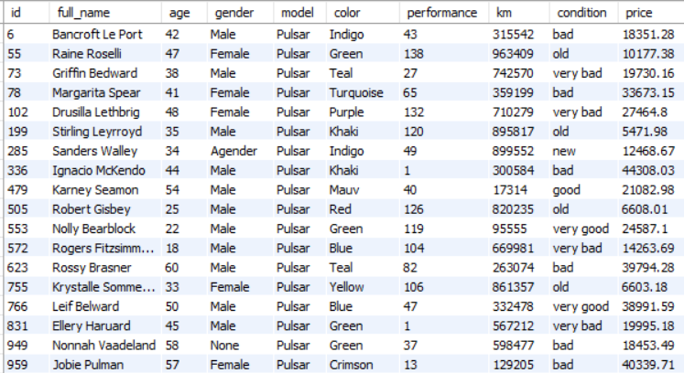
Output

Slide 3

2. Query count of ids for the customers having car model Pulsar
select count(id) as count from nissan_dataset
where id in (select id from nissan_dataset where model = 'pulsar’);
Output

Slide 4
3. Query all the customers from the nissan dataset those are having car model as Pulsar and output should in ascending order of price
select e.*,
row_number() over (order by price) as row_num
from nissan_dataset e where model = 'pulsar’;

Slide 5
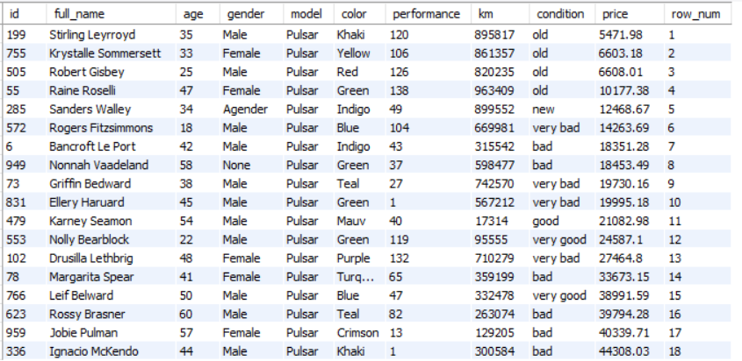
OUTPUT

Slide 6

4. Query average of price from nissan dataset in which car model should Pulsar
select avg(price) as avg_pricefrom (select * from nissan_dataset where model = 'pulsar') as model_1;
Output

Slide 7
5. Show the car models having different colors
Select distinct n1.model, n1.color
from nissan_dataset n1
join nissan_dataset n2
on n2.model = n1.model and n2.color != n1.color;

Slide 8
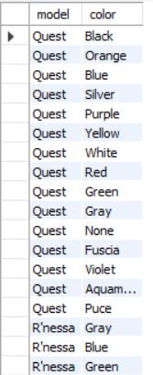
OUTPUT

Slide 9
6. Show the car models in a group and calculate their average and arrange them in a descending order of price
with best_cars as
(
select model, avg(price) as avg_price
from nissan_dataset group by model
)
select model, avg_price from best_cars
order by avg_price desc;

Slide 10
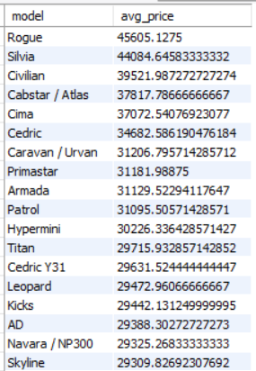
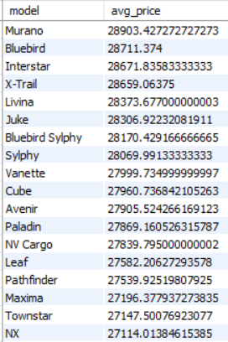
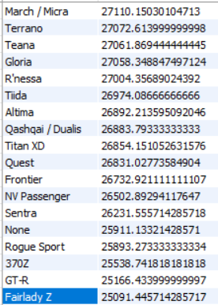
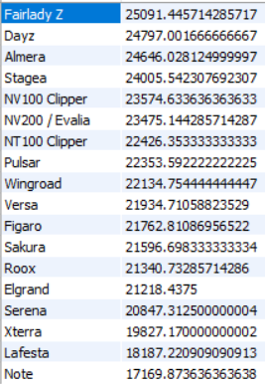
Output

Slide 11
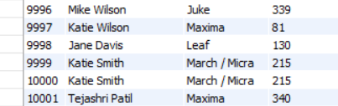
7. Create a copy of a original table, from that copied table insert a new record into the table
create view models as
select id, full_name, model, performance from nissan_dataset;
insert into models values (10001,'Tejashri Patil','Maxima', 340);
select * from models;
Output

Slide 12
8. Create a procedure for inserting a new record in a table
delimiter **
create procedure addentry
(
in nid int,
in nfull_name text,
in nage int,
in ngender text,
in nmodel text,
in ncolor text,
in nperformance int,
in nkm int,
in nprice double
)
begin
insert into nissan_dataset (id, full_name, age, gender, model, color, performance, km, price) values (nid, nfull_name, nage, ngender, nmodel, ncolor, nperformance, nkm,nprice);
end;
**
delimiter ;
call addentry(10001, 'Tejashri Patil', 27, 'Female', 'Maxima', 'Blue', 350, 4200, 425000);
select * from nissan_dataset;

Slide 13
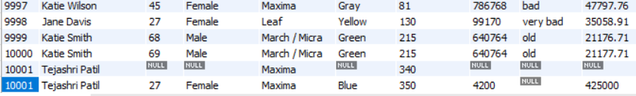
Output

Slide 14
9. Whenever a new record is created with the model name Frontier, change it to the Murano
delimiter **
create trigger before_insert_model
before insert on nissan_dataset
for each row
Begin
if new.model = 'Frontier' then set new.model = 'Murano’;
end if;
end;
**
delimiter ;
insert into nissan_dataset (model, color) values ('Frontier','Yellow’);
select * from nissan_dataset;

Slide 15
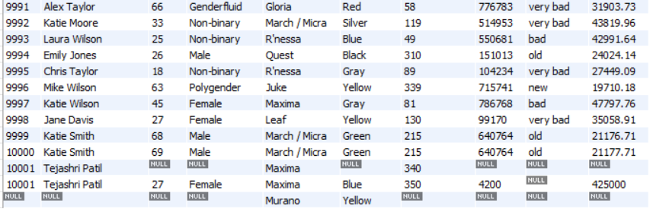
OUTPUT

