Slide 1
SQL Mini Project
Name – Tejashri Patil
Course – Advanced certification course in data analytics in collaboration with IBM
Batch – 11989

Slide 2
Project on database of cars
Nowadays everyone wants to buy a car. But sometimes it is very difficult to buy good car in a budget. This project includes the “Nissan_dataset.” It is having details of second hand cars including the previous car owners.
Dataset is having 10 fields such as id, full_name, age, gender, model, color, performance, km, condition, price

Slide 3
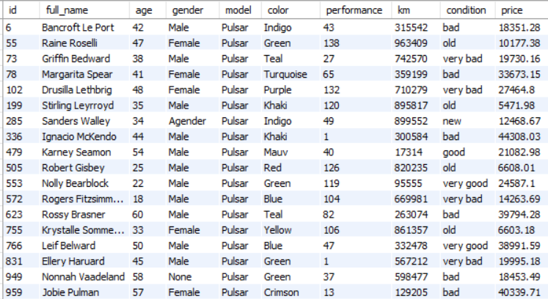
1. Query all the customers having car model Pulsar
select * from nissan_dataset where model = 'pulsar';
Output

Slide 4

2. Query count of ids for the customers having car model Pulsar
select count(id) as count from nissan_dataset
where id in (select id from nissan_dataset where model = 'pulsar’);
Output

Slide 5
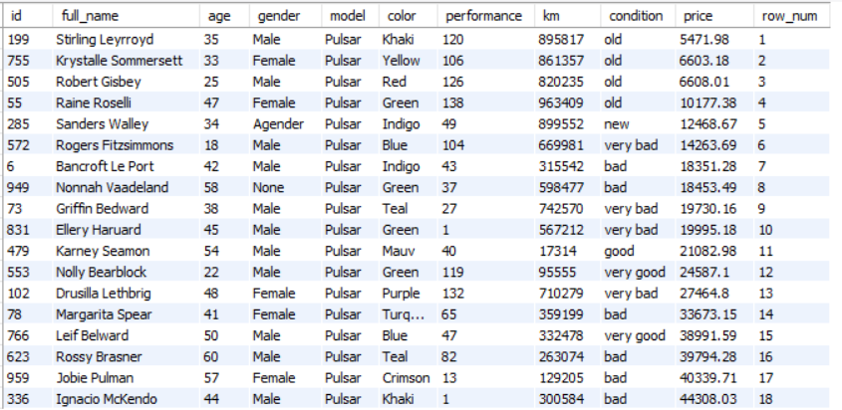
3. Query all the customers from the nissan dataset those are having car model as Pulsar and output should in ascending order of price
select e.*,
row_number() over (order by price) as row_num
from nissan_dataset e where model = 'pulsar’;
OUTPUT

Slide 6

4. Query average of price from nissan dataset in which car model should Pulsar
select avg(price) as avg_price from (select * from nissan_dataset where model = 'pulsar') as model_1;
Output

Slide 7
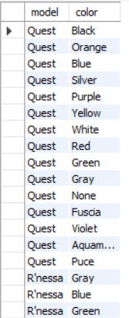
5. Show the car models having different colors
Select distinct n1.model, n1.color
from nissan_dataset n1
join nissan_dataset n2
on n2.model = n1.model and n2.color != n1.color;
OUTPUT

Slide 8
6. Show the car models in a group and calculate their average and arrange them in a descending order of price
with best_cars as
(
select model, avg(price) as avg_price
from nissan_dataset group by model
)
select model, avg_price from best_cars
order by avg_price desc;

Slide 9
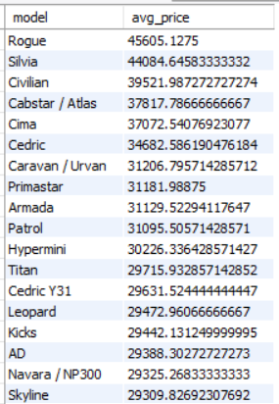
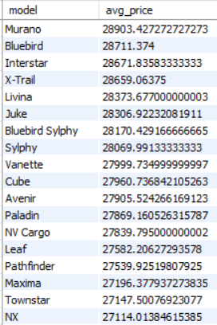
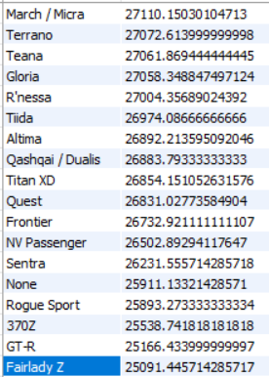
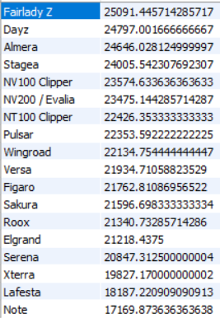
Output

Slide 10
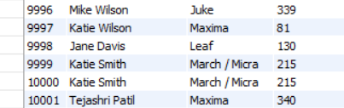
7. Create a copy of a original table, from that copied table insert a new record into the table
create view models as
select id, full_name, model, performance from nissan_dataset;
insert into models values (10001,'Tejashri Patil','Maxima', 340);
select * from models;
Output

Slide 11
8. Create a procedure for inserting a new record in a table
delimiter **
create procedure addentry
(
in nid int,
in nfull_name text,
in nage int,
in ngender text,
in nmodel text,
in ncolor text,
in nperformance int,
in nkm int,
in nprice double
)
begin
insert into nissan_dataset (id, full_name, age, gender, model, color, performance, km, price) values (nid, nfull_name, nage, ngender, nmodel, ncolor, nperformance, nkm,nprice);
end;
**
delimiter ;
call addentry(10001, 'Tejashri Patil', 27, 'Female', 'Maxima', 'Blue', 350, 4200, 425000);
select * from nissan_dataset;

Slide 12
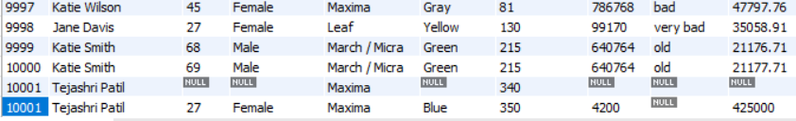
Output

Slide 13
9. Whenever a new record is created with the model name Frontier, change it to the Murano
delimiter **
create trigger before_insert_model
before insert on nissan_dataset
for each row
Begin
if new.model = 'Frontier' then set new.model = 'Murano’;
end if;
end;
**
delimiter ;
insert into nissan_dataset (model, color) values ('Frontier','Yellow’);
select * from nissan_dataset;

Slide 14
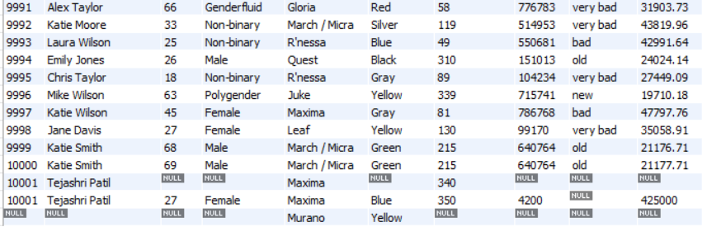
OUTPUT

Slide 15
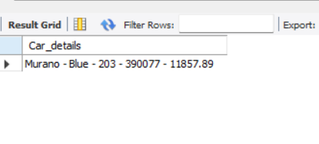
10. Give the car details in which car model should be Murano and price should less than 30000. select concat(model,' - ', color,' - ', performance,' - ', km,' - ', price) as Car_details from nissan_dataset where model = 'Murano' and color = 'Blue' and price < 30000;
OUTPUT

Slide 16
Conclusion
It keeps record of each and everything inside showroom.
Anyone can find the best car within their budget to buy
Vey easy comparison between the model, price, km, cars condition and price
Buyer can compare through all of these. He/She can choose the best model within the best price and a best condition car

