Slide 1



Genesis Ideathon: Final Presentation
Team ID: GEN26-A0H-I076
Team Name: NerdSquad
Domain: Domain 8-Space, Aerospace, Mobility and Next-Gen Infras-tructure
Amrita Vishwa Vidyapeetham, Coimbatore Campus
Date: 11th October 2026

Slide 2
Presentation Outline
Problem Statement
Problem Understanding
Existing Gaps & Challenges
Our Proposed Solution
Technical Approach
Innovation & Uniqueness
Feasibility & Scalability
Cost for Product
Use Cases
Impacts and Benefits
Sustainable Development Goals
Individual Member Contribution

Slide 3

Problem Statement
High line utilization and mixed-speed train traffic (fast passenger vs. slow freight) cause severe schedule disruptions. A minor delay of 5 minutes quickly escalates into a multi-hour network gridlock due to manual dispatching and lack of real-time predictive insights.

Slide 4
Problem Understanding
Who experiences this problem?
Railway traffic controllers and section dispatchers handling live train movements under extreme operational pressure.
What causes the problem?
Heavy reliance on manual decision-making and static, rigid schedules that fail to calculate optimal real-time rerouting or siding holds.
How does it affect users or stakeholders?
A minor 5-minute delay escalates into a multi-hour network gridlock, leading to heavy fuel waste from train idling and severely missed freight delivery deadlines.

Slide 5
Existing Gaps & Challenges
Existing gap or limitation 1:
Total absence of a 30-minute predictive look-ahead system that seamlessly factors in track switch changeover times, safety margins, and siding availabilities simultaneously.
Existing gap or limitation 2:
Outdated manual dispatching boards that force long, inefficient 30-minute detours instead of quick 8-minute siding holds.
Main challenge that remains unsolved:
Balancing mixed-speed traffic (high-speed passenger trains vs. heavy freight) in real time without causing system-wide cascading delays.

Slide 6
Our Proposed Solution
Core idea or product:
An AI-driven intelligent co-pilot and traffic engine for heavy railways utilizing graph theory and multi-objective optimization.
How the solution works at a high level:
It ingests live rail feeds, models track networks as dynamic graphs, runs
multi-objective constraint solvers to predict bottlenecks, and presents optimal routing recommendations to controllers.
Main value delivered to users:
Slashes delay propagation by 43 percent, completely eliminates single-line deadlocks, and drastically reduces fuel waste from unnecessary train idling.

Slide 7
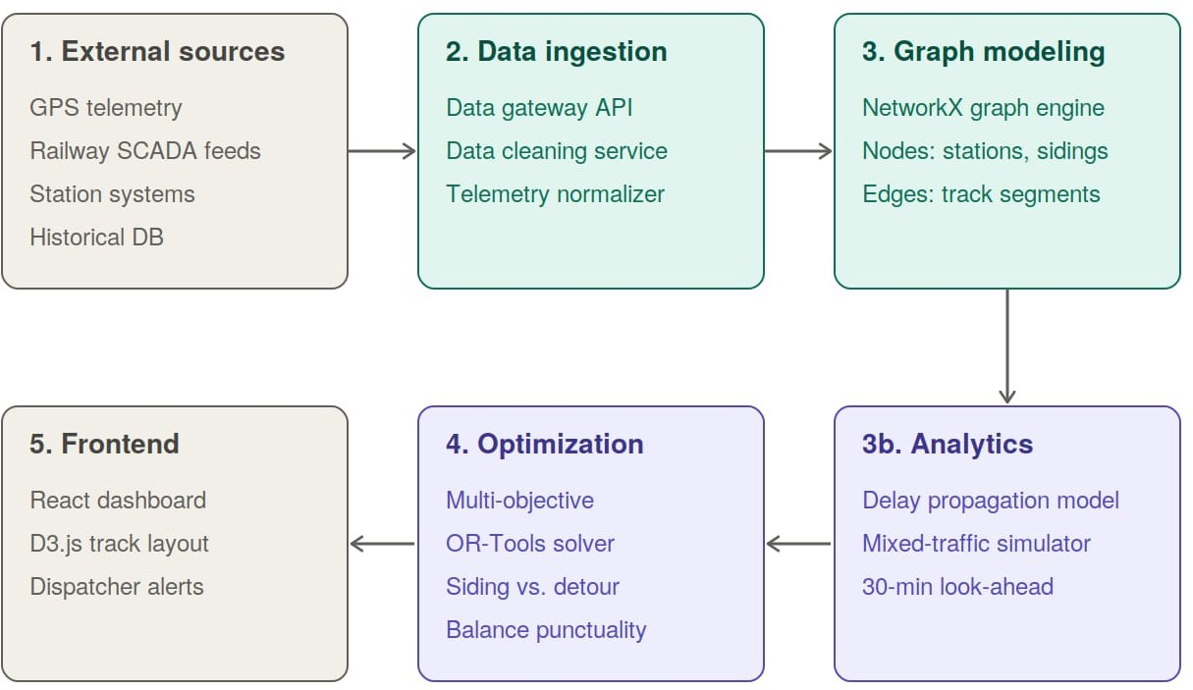
Technical Approach
Figure: RailSync System Architecture Flow
*Real-time telemetry feeds into the NetworkX graph model. The OR-Tools engine resolves conflicts and sends optimal routing decisions to the dispatcher dashboard.
Tech Stack
Frontend: React, D3.js
Backend:Node.js, Python
Database: PostgreSQL
AI/ML, APIs, or Hardware: OR-Tools, Net-workX, High-availability cloud cluster / edge servers

Slide 8
Innovation & Uniqueness
What is new or different?
It acts as an interactive AI co-pilot that dynamically calculates time-tradeoffs (e.g., 8-minute siding hold vs. 30-minute detour) rather than enforcing rigid, static rules.
Why is this approach suited to the problem?
Rail networks are dynamic systems of interconnected nodes; graph-based modeling and constraint programming map natively to track switches, sidings, and train physics.
What is the key differentiator?
Holistic multi-objective optimization that balances passenger punctuality, freight throughput, and fuel conservation simultaneously in real time.

Slide 9
Feasibility & Scalability
Feasibility: Built using mature, production-proven optimization frameworks (Google OR-Tools, NetworkX) and standard enterprise web technologies designed to integrate with existing railway telemetry feeds.
Scalability: The graph-based architecture allows seamless scaling to new railway zones, multi-track corridors, and dedicated freight lines by simply expanding node-edge definitions.
Risks: Handling intermittent telemetry data drops or hardware latency; Mitigated by deploying high-availability edge servers at divisional control centers for resilient local offline-first computing.

Slide 10
Cost for Product (Optional)
Development or hardware cost: High-availability edge servers or cloud compute cluster setup for real-time optimization processing.
Hosting or maintenance cost: Continuous cloud infrastructure hosting, API maintenance, and algorithm refinement.
Estimated total: High initial operational investment offset massively by immediate ROI from multi-tonne fuel savings and optimized asset utilization without laying new tracks.

Slide 11
Use Cases (compulsorily 3 use cases must be there)
Use case 1:
Primary Controller Co-Pilot — Section dispatchers use the real-time decision support system to instantly resolve localized track conflicts during peak operational hours.
Use case 2:
Mixed-Speed Corridor Management — Managing high-density tracks smoothly by dynamically prioritizing fast passenger expresses over heavy freight without gridlocks.
Use case 3:
Emergency Disruption Recovery — Rapidly recalculating alternative routing and schedules during unplanned track maintenance, signal failures, or severe weather events.

Slide 12
Impacts and Benefits
Benefit to the target users:
Drastically reduces controller cognitive overload and stress during peak hours by providing automated, optimal recommendations.
Social, economic, or environmental impact:
Lowers carbon emissions and fuel waste by cutting down train idling times while ensuring timely freight and passenger transit.
Expected measurable outcome:
Achieves a 43 percent reduction in delay propagation and total elimination of single-line deadlocks

Slide 13
Sustainable Development Goals (SDGs)
SDG Number | Target Number | Goal Name | Connection
SDG 9 | Target 9.1 | Industry, Innovation, and Infrastructure | Enhances the efficiency, resilience, and capacity utilization of existing railway infrastructure through smart AI tech.
SDG 13 | Target 13.2 | Climate Action | Directly reduces fossil fuel burn and carbon footprint by eliminating prolonged train idling and forced inefficient detours.

Slide 14
Individual Member Contribution
Member | Contribution or responsibility
Tejashwini M R | System requirements, railway constraint logic, and overall project coordination.
Shreya V | Predictive delay algorithm development and dataset preprocessing.
Libika Sri S | UI design, D3.js track layout visualization, and real-time dashboard build.
Swetha P | Developing constraint programming logic, graph modeling (NetworkX), and backend API development.

Slide 15
Yukti ID
Yukti ID
IR2026-1051036

