Slide 1
MESH STACK

Slide 2
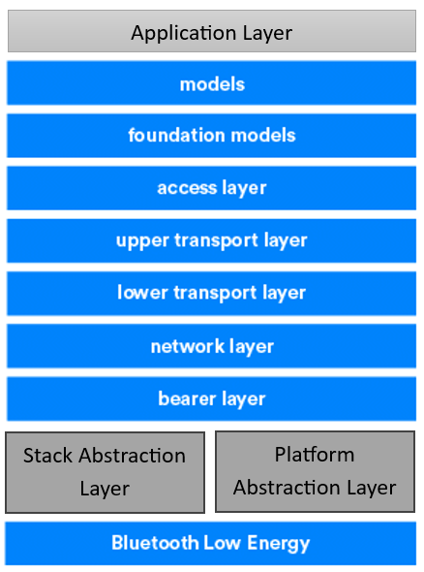

MESH STACK ARCHITECTURE
Bluetooth Low Energy (BLE) Mesh is a networking standard that enables many-to-many communication among a large number of devices, built on top of the existing Bluetooth Low Energy (BLE) protocol.
Platform Abstraction Layer(PAL): Focus on Abstracting Hardware/OS details. So, we can port the Mesh Stack onto any Chipsets easily by simply changing the PAL.
Stack Abstraction Layer(SAL): The Stack Abstraction Layer (SAL) abstracts the underlying BLE Stack implementation, allowing our Mesh Stack to be easily ported onto any 3rd party BLE stack, such as those provided by Bluez, Silicon Labs, or TI.

Slide 3
Thank You

