Slide 1
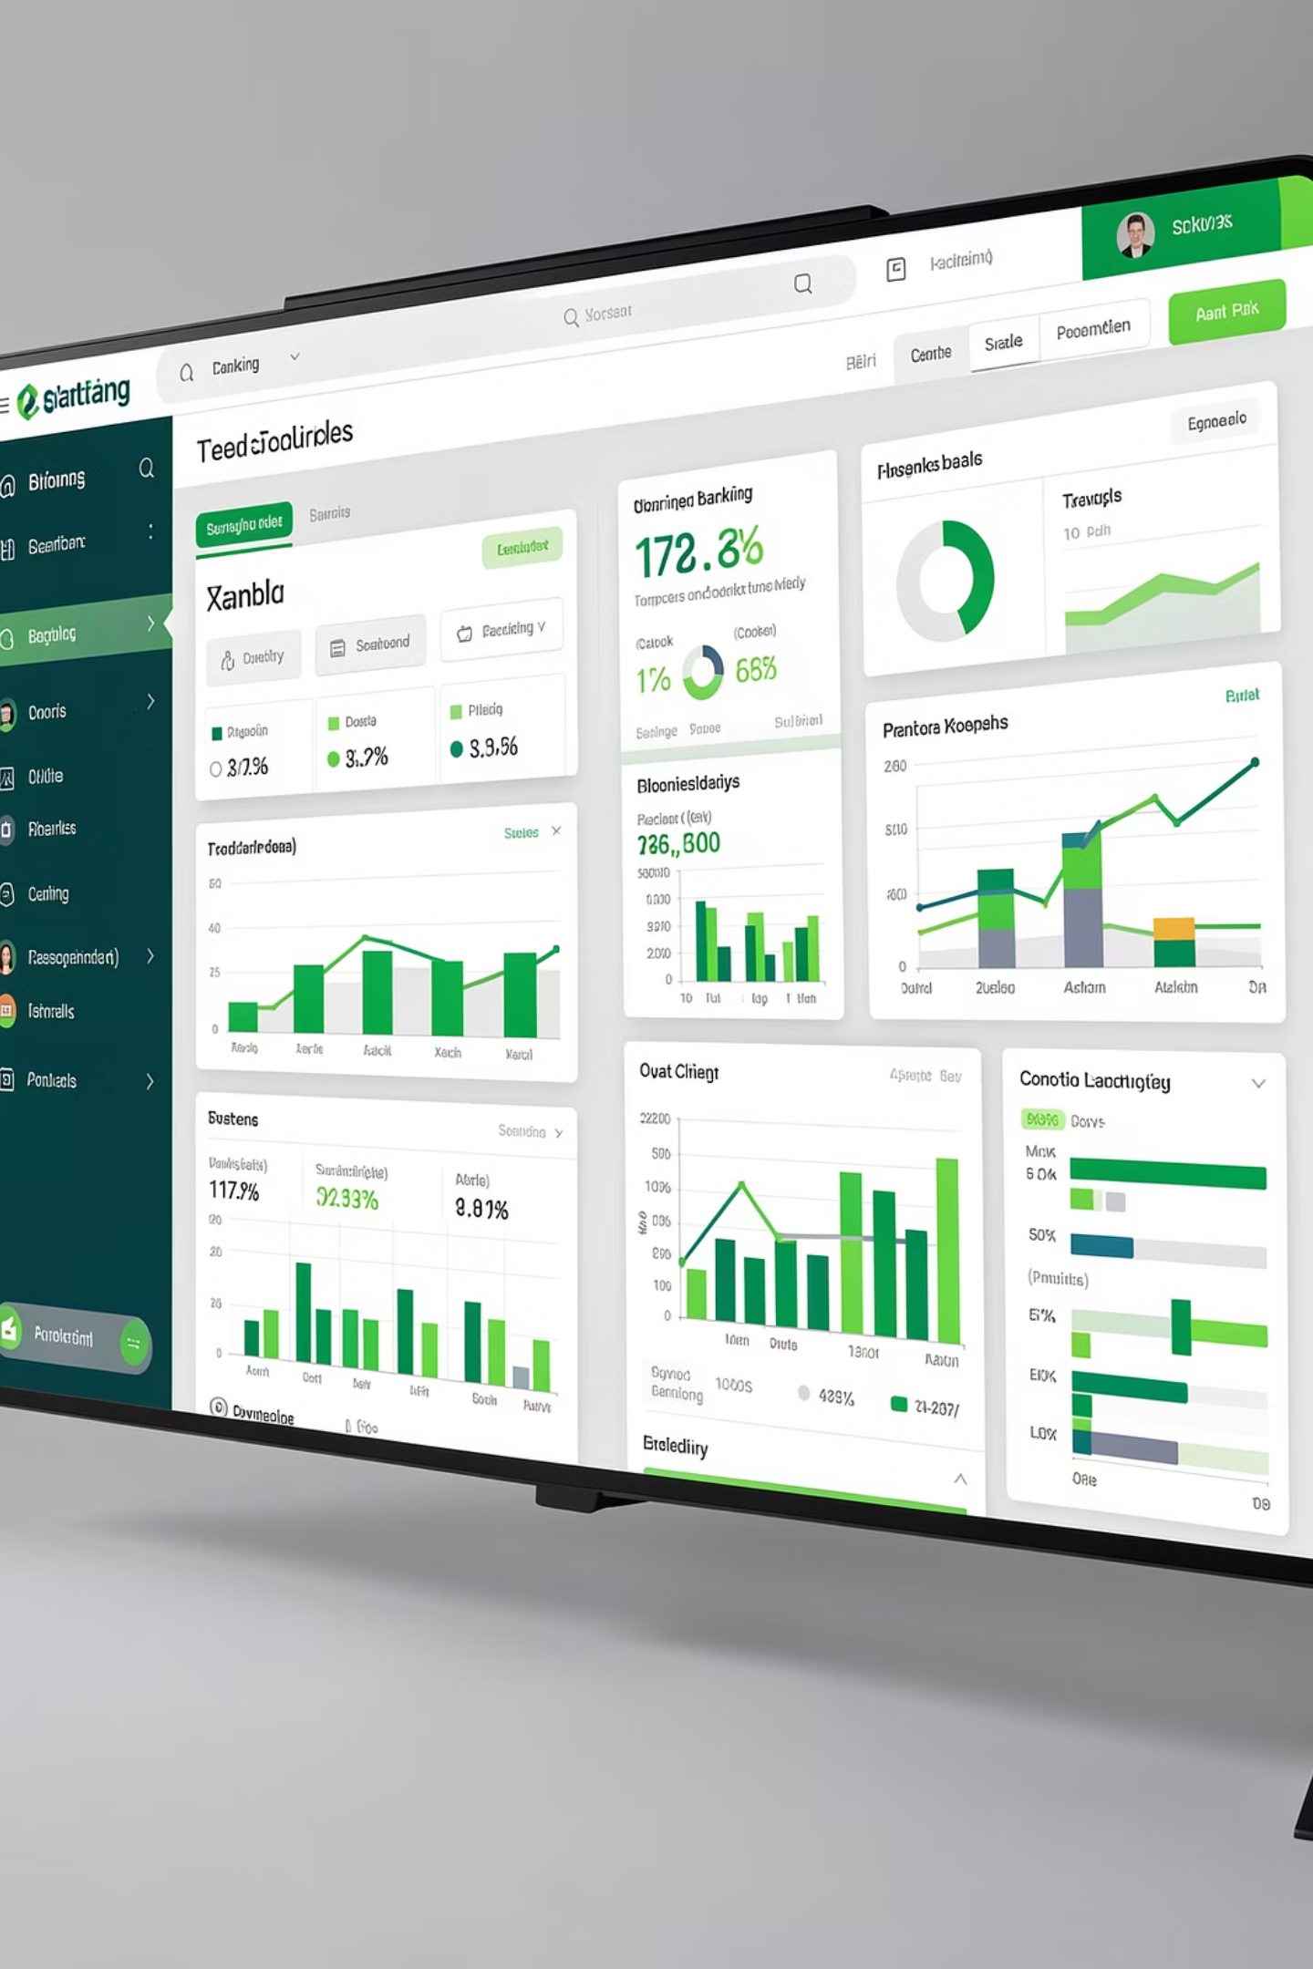
Banking Dashboard Analytics
Leveraging Power BI to minimize lending risk through data-driven insights and comprehensive client profiling.

Slide 2
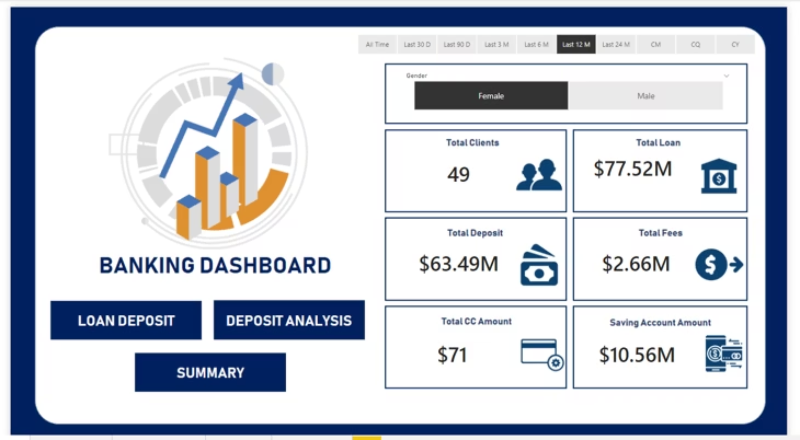
CHALLENGE
The Problem
Risk Analytics in Banking
Banks need to understand risk analytics to minimize money loss when lending to customers. The challenge is evaluating applicant profiles to determine loan repayment likelihood before approval.
Data-driven decision making is essential for financial services to protect assets while serving clients effectively.

Slide 3
SOLUTION
Power BI Dashboard Solution
Data Visualization
Profile Assessment
Risk Mitigation
Latest Power BI tools create interactive dashboards for comprehensive analysis
Evaluate applicant profiles to determine loan approval decisions
Approve loans for likely repayers, reject high-risk applications

Slide 4





Dataset Structure
Comprehensive Banking Data
The dataset contains bank details and client information across multiple interlinked tables connected through primary and foreign keys.
Banking Relationship
Period
Client-Banking
Investment Advisor
Banking Relationship
Client-Banking
Gender
Investment Advisor
Period

Slide 5
DATA PREPARATION
Data Cleaning Process
01
02
Engagement Timeframe
Engagement Days
Created column tracking client timeline in banks
Calculated days from joining date to present
03
04
Income Bands
Processing Fees
Categorized estimated income: <$100K as Low, <$300K as Mid
Calculated fees based on fee structure (0.05 for high)

Slide 6
Key Calculated Functions
Power BI Functions
SUM
DISTINCTCOUNT
SUMX
Essential calculations for banking analytics
Adds all numbers in a column, returns decimal
Returns sum of expression for each table row
Counts unique values in a column
SWITCH
DATEDIFF
Evaluates expression against values list
Returns interval boundaries between dates

Slide 7







KPIS
Core Banking Metrics
Total Clients
Total Loan
Total Deposit
Total Fees
Total number of banking clients tracked via DISTINCTCOUNT
Sum of bank loans, business lending, and credit card balances
Combined bank deposits, savings, foreign currency, and checking accounts
Account setup and maintenance charges calculated via SUMX
Credit Card Balance
Engagement Length
Total amount owed by cardholders to credit card banks
Total days customers have been with the bank

Slide 8
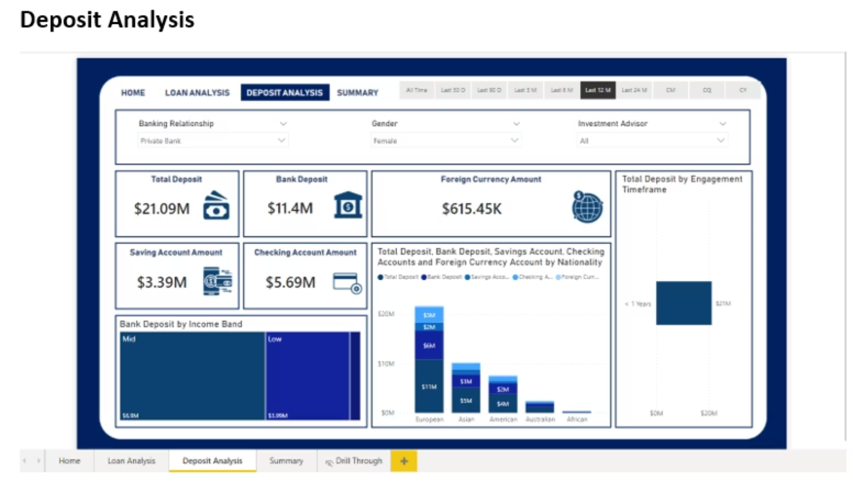
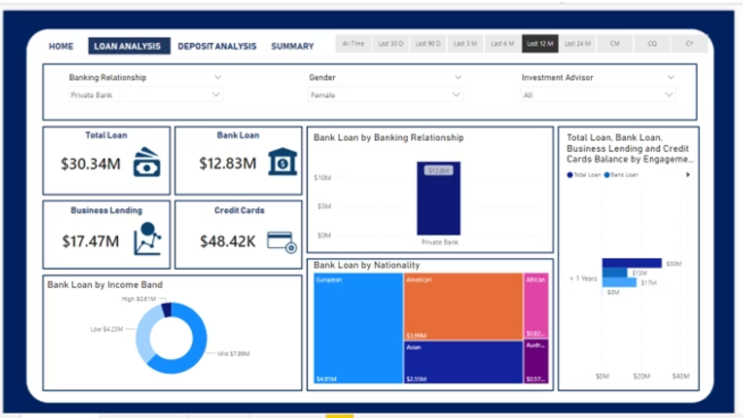
loan analysis

Slide 9





Dashboard Visualizations
Four Key Views
Home
Overview and navigation hub
Loan Analysis
Detailed loan metrics by investor and gender
Deposit Analysis
Account deposits across categories
Summary Dashboard
Consolidated KPIs and insights

Slide 10
IMPACT
Business Value & Future Applications
Conclusion
Future Work
Power BI dashboards are among the most effective resources for banking sector data visualization. This solution enables key banking metrics and KPIs tracking for informed decision-making.
Track total loan amounts per investor
Identify client distribution across bank types
Analyze loan patterns by nationality
Monitor account type investments
Build competitive strategies based on insights

Slide 11

Empowering Data-Driven Banking
Transform risk assessment through comprehensive analytics and visualization, enabling smarter lending decisions that protect assets while serving clients effectively.

