Slide 1

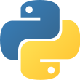
Why…Python ?
- Tejas sawant

Slide 2
What is Python?
Python is a popular high-level programming language used in various applications
Python is an easy language to learn because of its simple syntax

Slide 3
Python Syntax
if 5 > 2: print("Five is greater than two!")
Basic syntax
print(“ HELLO I AM TEJAS”)
Output:- Five is greater then two !
Output :- HELLO I AM TEJAS

Slide 4
Python Comments
Single line comments :- # is used
example :- #this is single-line comment
Multiline Comments :- """
This is a comment written in more than just one line """

Slide 5
Python Variables
Creating Variables :-
Example :- x = 5 y = "John" print(x) print(y)
Casting :-
x = str(3) # x will be '3' y = int(3) # y will be 3 z = float(3) # z will be 3.0
Get the Type :-
x = 5 y = "John" print(type(x)) print(type(y))
Case-Sensitive :-
a = 4 A = "Sally" #A will not overwrite a

Slide 6
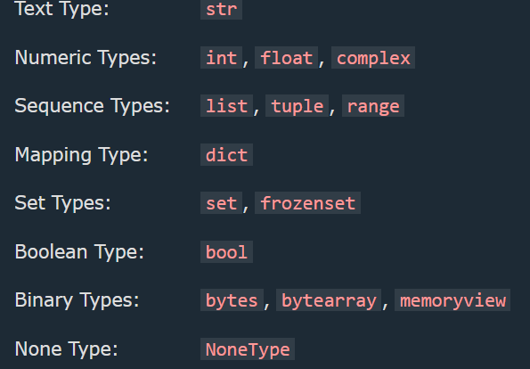
Built-in Data Types
Example Data Type
x =“Hello World” str
x = 20 int
x = 20.5 float
x = 1j complex

Slide 7
Slicing strings
Modify Strings
b = "Hello, World!" print(b[2:5])
a = "Hello, World!" print(a.upper())
String Concatenation
F String:-
a = "Hello" b = "World" c = a + b print(c)
Age=25
Name = “Tejas”
Print (f” my name is {Name},my age is
{Age}”)

Slide 8
Python Arithmetic Operators
+ Addition x + y
- Subtraction x – y
* Multiplication x * y
/ Division x / y
% Modulus x % y
** Exponentiation x ** y
// Floor division x // y

Slide 9
Python If ... Else
a = 200 b = 33 if b > a: print("b is greater than a") elif a == b: print("a and b are equal") else: print("a is greater than b")
#Conditions
Output:- a is greater than b

Slide 10
Python Loops
Python has two primitive loop commands:
while loops
i = 1 while i < 6: print(i) i += 1
for loops
For i in range(0,5):
print(i)
Output :- 1
2
3
4
5
Output :- 0
1
2
3
4

Slide 11
Python Functions
#Function always starts with lower-case and only characters
def add( a, b): #def is used to define a function
print("addition of a and b is ")
return a + b
def sub( a, b):
print(“ Sub of a and b is ")
return a -b
print(add(5,7)) # Arguments
print(sub(5,7))
# Parameters
Output :- addition of a and b is 12
Sub of a and b is -2

Slide 12
Python Lambda
lambda arguments : expression
#lambda function is also called a one-line function
x = lambda a : a + 10
print(x(5))
Output :- 15

Slide 13
Map Function
def myfunc(n): return len(n) x = map(myfunc, ('apple', 'banana', 'cherry’))
map(function, iterables)

Slide 14

Filter Function
ages = [5, 12, 17, 18, 24, 32] def myFunc(x): if x < 18: return False else: return True adults = filter(myFunc, ages) for x in adults: print(x)
filter(function, iterable)

Slide 15
What is a Module?
To create a module just save the code you want in a file with the file extension .py
Create a Module
def greeting(name): print("Hello, " + name)
Use a Module
import mymodule mymodule.greeting("Jonathan")

Slide 16
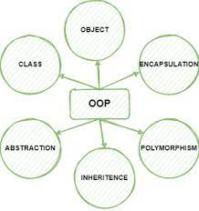
OOPs
Class
Object
Method
Inheritance
Polymorphism
Data Abstraction
Encapsulation

Slide 17


Class
A Class is like an object constructor, or a "blueprint" for creating objects
.
Create a Class –
class MyClass: #class_start_capital x = 5
Create Object- #create instances of class
p1 = MyClass() print(p1.x)

Slide 18
CLASS & OBJECT & METHOD
The __init__() Function #Constructor 👷
The self Parameter #used inside class def method
Object Methods #func inside class are called method
class Person: #created class def __init__(self, name, age):#constructor self.name = name self.age = age def myfunc(): #method print("Hello my name is " + self.name) p1 = Person("John", 36) #creating object from class #instance p1.myfunc() #invoking a method by using dot

Slide 19
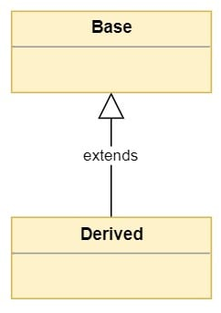
Inheritance
class Father: # parent class / base class def father(self): print("i am father") class Mother:: # parent class / base class def mother(self): print("i am mother") class Son(Father,Mother): #child class / derive class inherit def son(self): print("i am son")
S = Son()
S.mother()

Slide 20
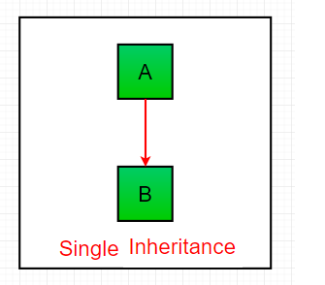
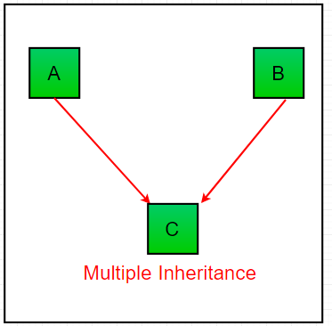
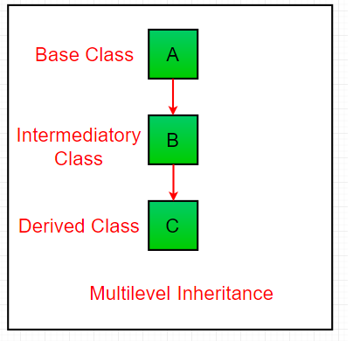
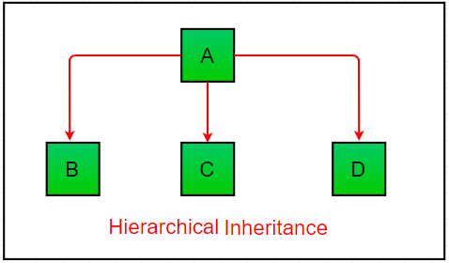
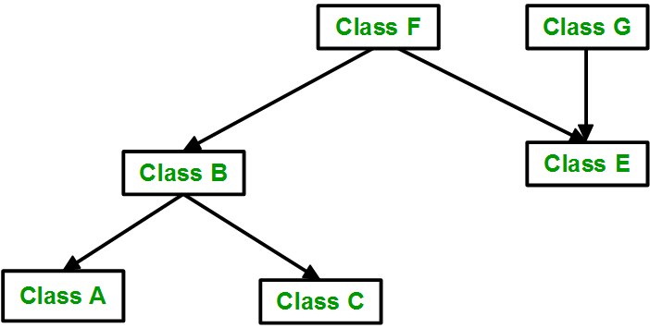
Types of Inheritance in Python #there are 5 types in inheritance
Hybrid inheritance

Slide 21
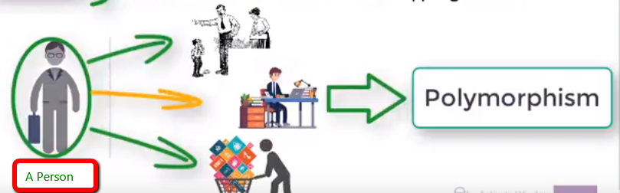
Polymorphism
Overloading ): #define two or more methods in the same class with the same name but with a different parameter list
class Abc: def sub(self,a , b ,c ): return a - b - c def sub(self,a , b): return a - b obj = Abc() print(obj.sub(5,6))
Overriding # allows us to defines methods in the child class that have the same name as the methods in the parent class.
class Tejas: #parent class or bass class
def sub(self,a , b ,c ): #method hidden return a - b - c class Ts(Tejas): # child class or direved class def sub(self,a , b , c): #method return a - b obj = Ts() print(obj.sub(5,6,20))
# Polymorphism lets us define methods in the child class that have the same name as the methods in the parent class

Slide 22

Data Abstraction
from abc import ABC,abstractmethod #importing ABC & abstractmethod to hide the implementation class Clg(ABC): @abstractmethod #using @abstractmethod to hide class def principal(self): pass @abstractmethod def student(self): pass def myself(self): pass
One or more than One @abstractmethod is used to hide implementation or create abstract class
Abstraction is that feature in OOP concept wherein the user is kept unaware of the basic implementation of a function property.
The user is only able to view basic functionalities whereas the internal details are hidden.

Slide 23
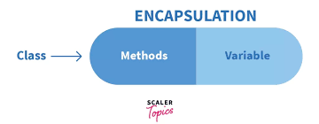
Encapsulation
# private self.__tejas # public self.tejas # protected self._tejas
We can not access private
We can access protected only by typing it correctly
Encapsulation in Python is the process of wrapping up variables and methods into a single entity

Slide 24
What is PIP?
PIP is a package manager for Python packages, or modules
What is a Package?
A package contains all the files you need for a module.
Modules are Python code libraries you can include in your project.

Slide 25
Python Try Except
The try block lets you test a block of code for errors.
The except block lets you handle the error.
The else block lets you execute code when there is no error.
The finally block lets you execute code, regardless of the result of the try- and except blocks.

Slide 26
Raise an exception
To throw (or raise) an exception, use the raise keyword

Slide 27
#Thanks_for_your_valuable_Time
thats_all = “_THANK___ YOU_”
Print(thats_all)

