Slide 1
NexusBiz
AI-Powered Business Idea Generator
🚀 Transform Ideas into Actionable Business Plans

Slide 2

Project Overview
Building the future of entrepreneurship with AI
Full-stack AI-powered business intelligence platform
Generates personalized business ideas based on your skills, budget & market
Creates comprehensive business plans with financial projections
Modern glassmorphic UI with stunning animations
Real-time AI processing with Anthropic Claude / Ollama
Export business plans to PDF for presentations

Slide 3
Key Features
Everything you need to launch your business empire
AI-Powered Ideas
Complete Business Plans
Financial Projections
Curate personalized business concepts based on market potential.
Comprehensive structural frameworks and actions.
Data-driven 3-year forecasting.
Marketing Strategy
Operations Planning
Idea Comparison
Targeted customer acquisition plans.
Detailed workflows and resource requirements.
Compare up to 3 business ideas side-by-side.

Slide 4
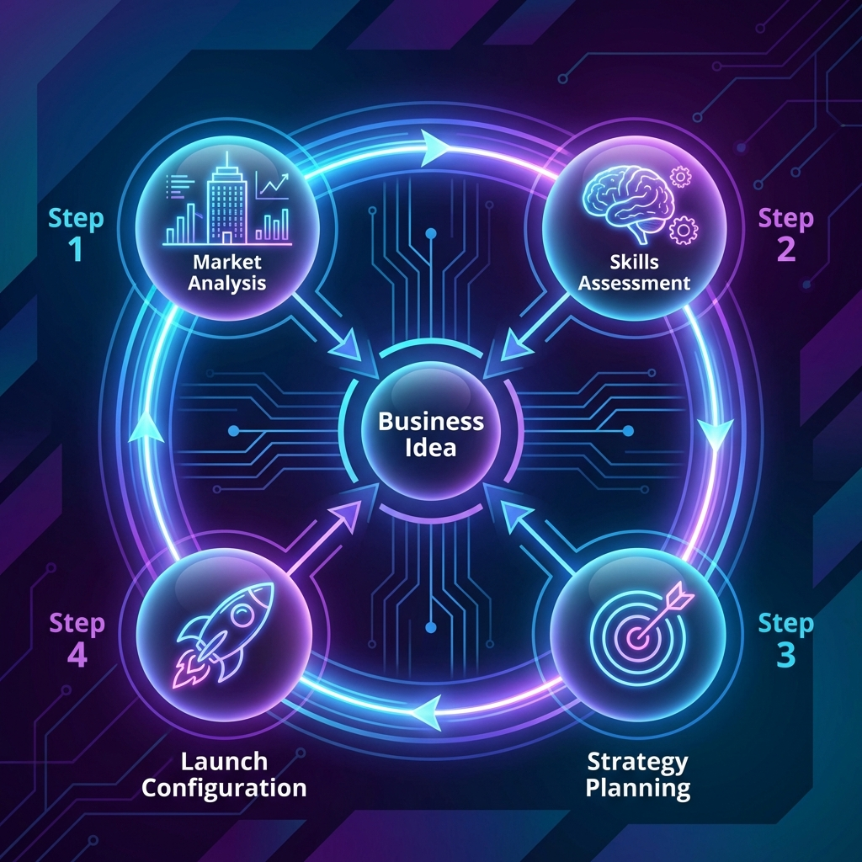
How It Works
4-step intelligent wizard
1. Market Analysis: Select industry, budget, location
2. Skills Assessment: Define skills & risk tolerance
3. Strategy Planning: Business model & target market
4. Launch Configuration: Generate AI ideas

Slide 5
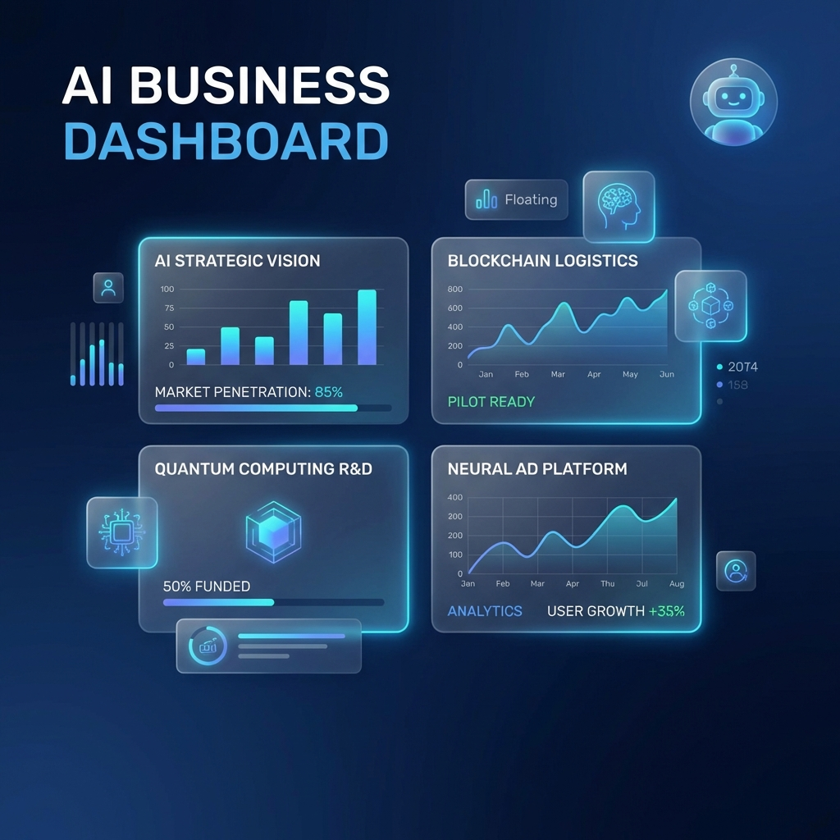
Results Dashboard
AI-synthesized business concepts
Bento Grid Layout for quick scanning
Real-time Search & Filtering
Compare Mode for side-by-side analysis
Market Sentiment indicators

Slide 6
Business Plan Generator
Comprehensive architectural specification
Executive Summary
Market Analysis
Financial Projections
Marketing Strategy
Operations
Technology
Legal & HR
Timeline & Risk
📥 Export to PDF Available

Slide 7
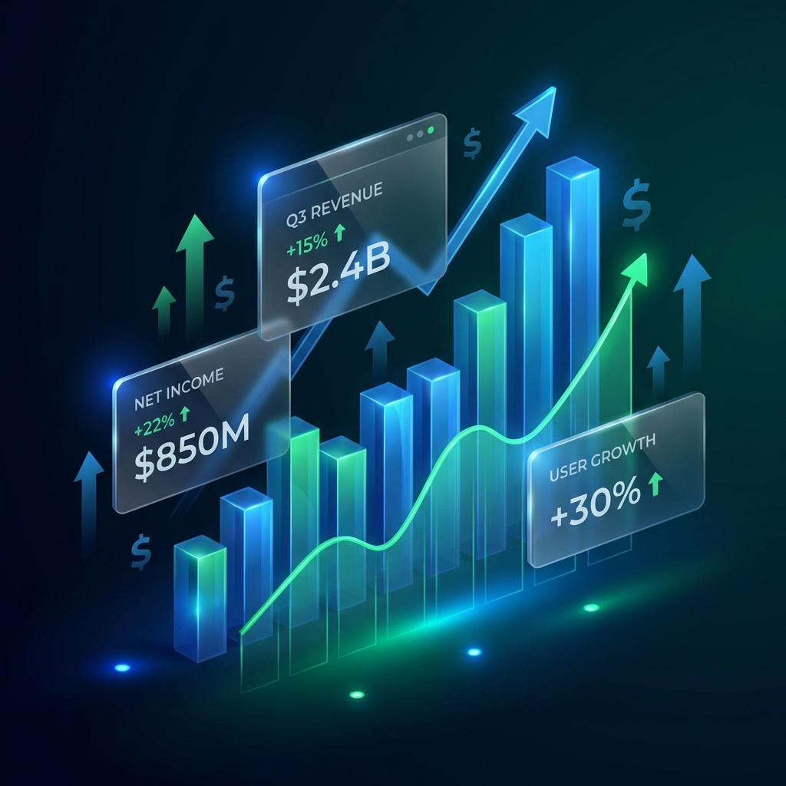
Financial Intelligence
Data-driven projections
3-Year Revenue Forecast: Interactive area charts with Year 1, 2, 3 projections
Breakeven Analysis: Calculated timeline to profitability
CapEx Requirements: Initial investment breakdown
Estimated Valuation: Year 3 business valuation
Quarterly Projections: Detailed Q1-Q6 revenue mapping
Visual Analytics: Beautiful charts powered by Recharts

Slide 8

Technology Stack
Enterprise-grade architecture
Frontend
React 18, TypeScript, Vite, Tailwind CSS
Backend
Node.js, Express.js, TypeScript, Zod
AI / ML
Anthropic Claude, Ollama, Groq API
Tools
Winston, Helmet, Rate Limiting

Slide 9
Thank You!
Ready to build your next business empire?
🚀 Start Building with NexusBiz

