Slide 1
Market Analysis Project
Title : Project Team / Team Members
Project Team ID - PTID-CDA-APR-25-430
Project Code - CDACL-006
Presented by - Nikhil kaloge & Tejas Patil

Slide 2
Task
SQL-Based Market Analysis: 20 Key Business Queries.
Attributes : Aisles Dataset , Departments Dataset ,
Order Products Prior Dataset , Orders Dataset ,
Products Dataset.
For Merging the table, you have to use columns where specified as
Primary Keys.
You’ll need to perform data manipulation, aggregation, merging, and analysis across multiple datasets, such as joining orders with products, aisles, and departments to get all the required informations.

Slide 3
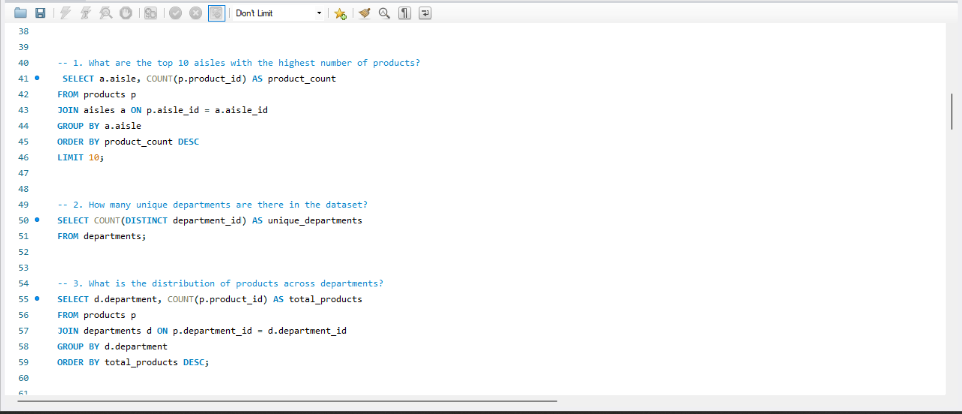
SQL Queries

Slide 4
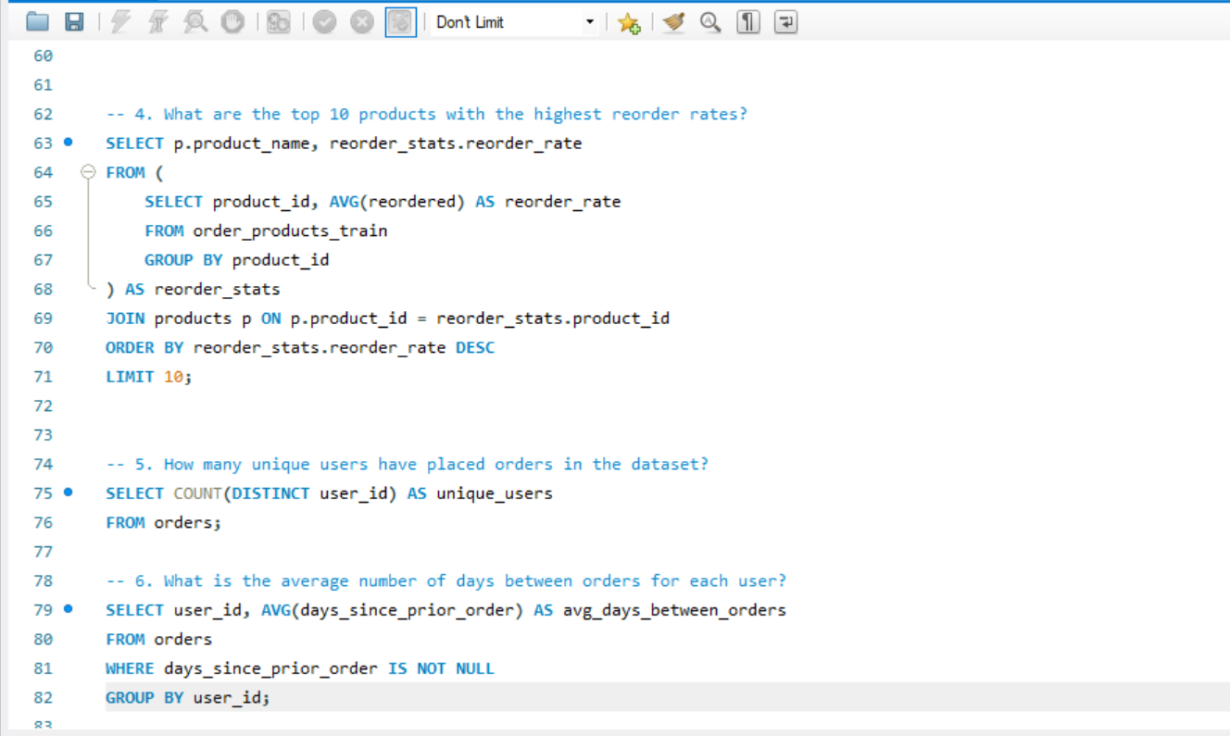
SQL Queries

Slide 5
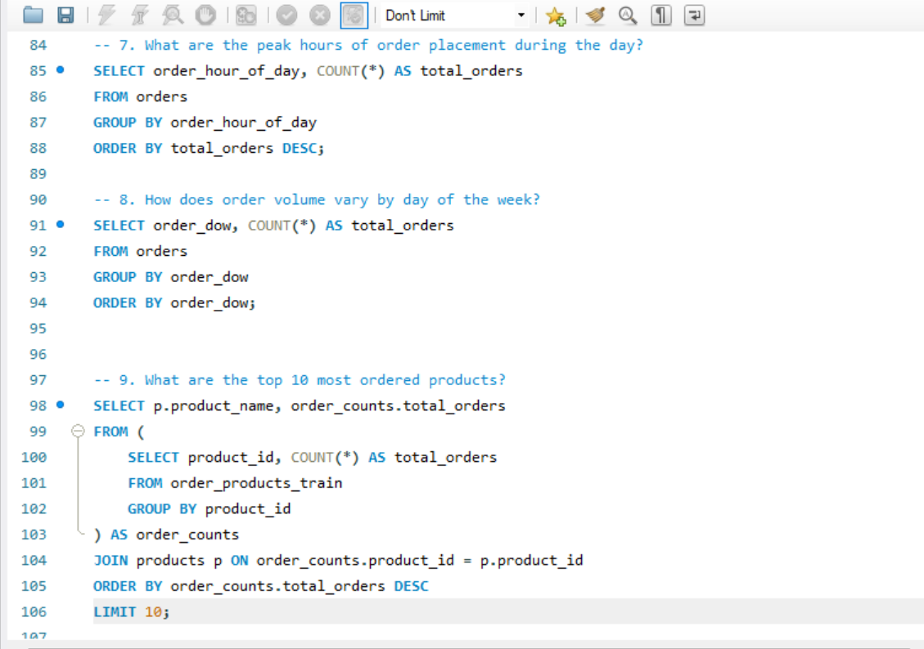
SQL Queries

Slide 6
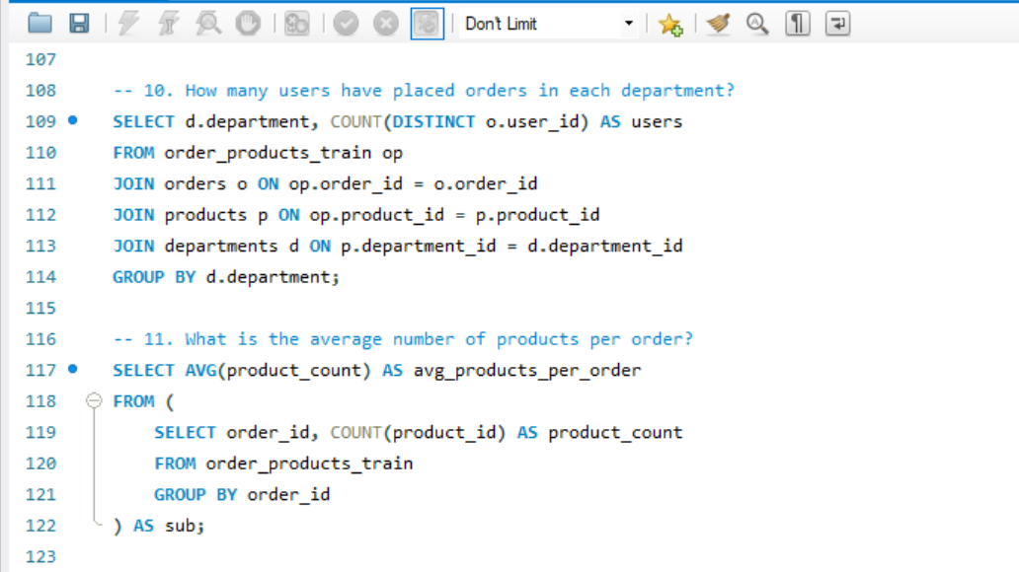
SQL Queries

Slide 7
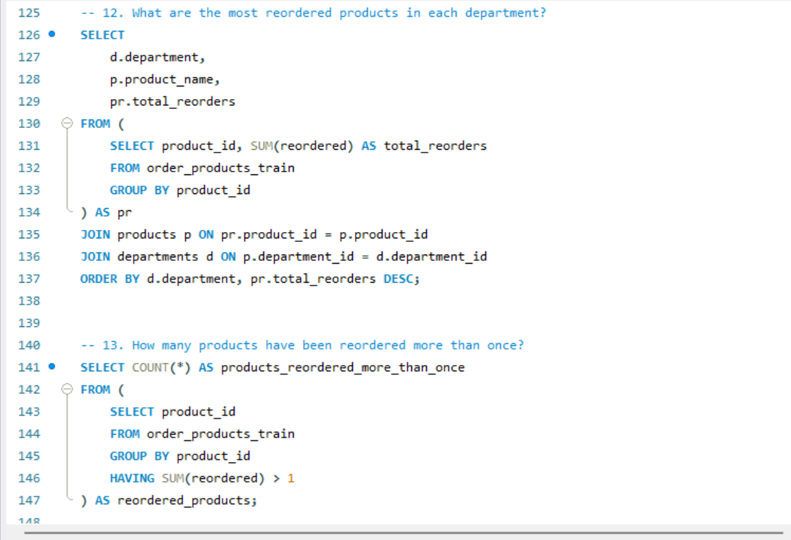

SQL Queries

Slide 8
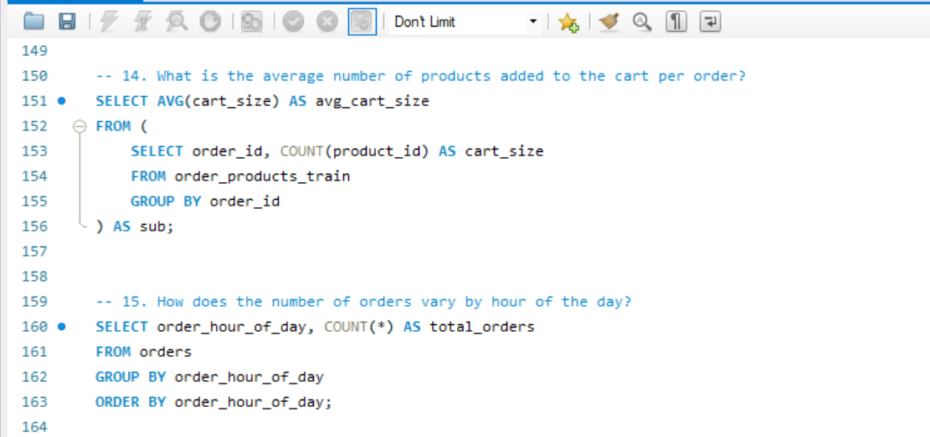
SQL Queries

Slide 9
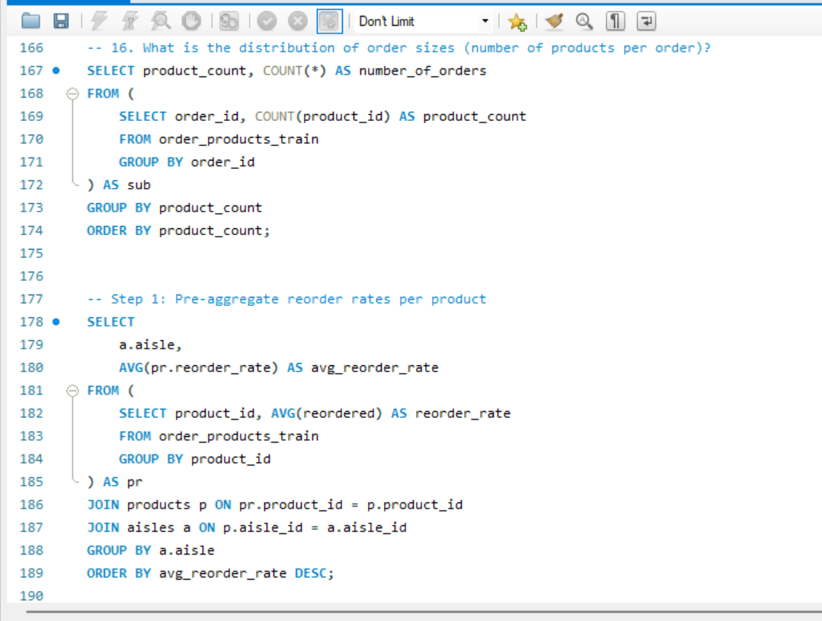
SQL Queries

Slide 10
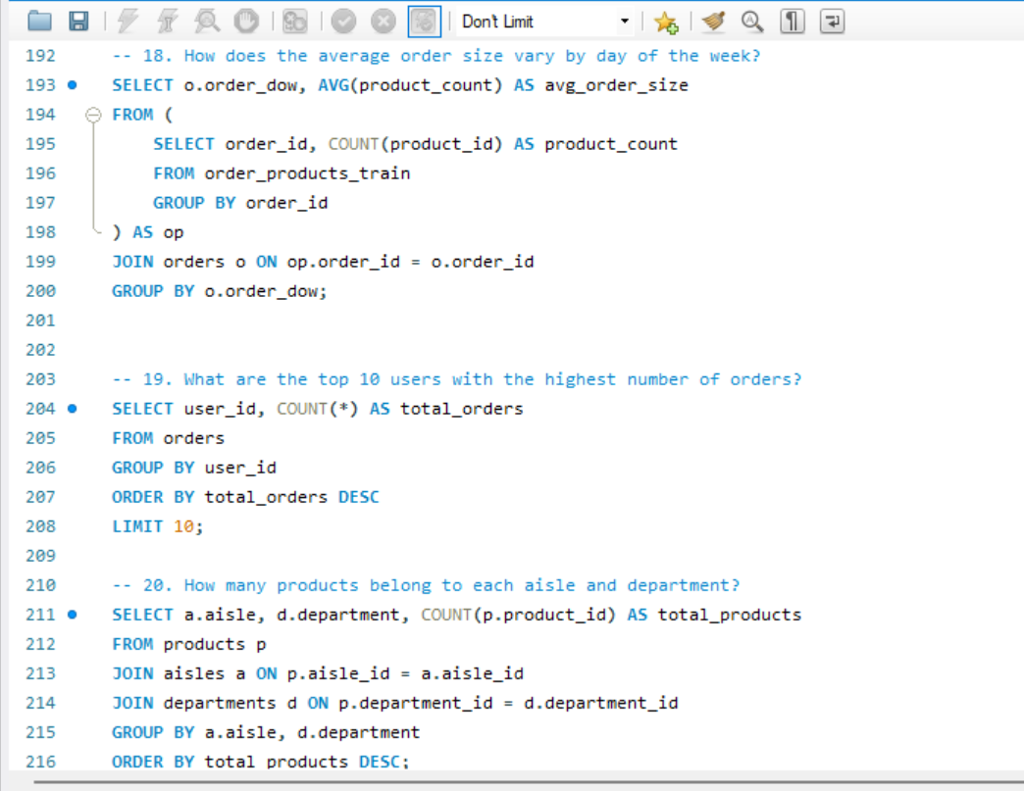
SQL Queries

Slide 11
Dashboard Overview – Overall
Total Orders: 3+ Million (Train + Prior) Total Products: ~49,000 across 134 aisles and 21 departments Unique Users: Over 200,000 Reorder Rate: Approximately 59% Peak Ordering Hours: 10 AM – 3 PM Top Categories: Produce, Dairy, Beverages Average Order Size: ~10 items Top Products: Bananas, Organic Strawberries, Eggs

Slide 12
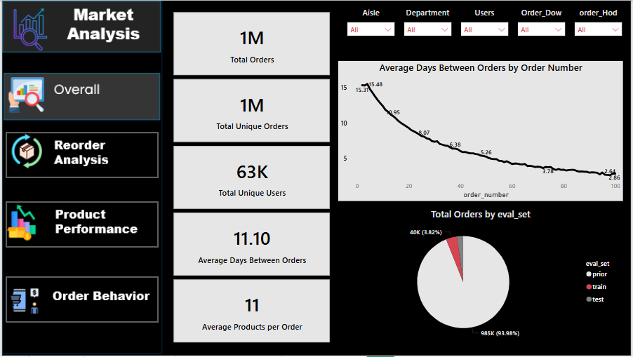
Dashboard Overview – Overall

Slide 13
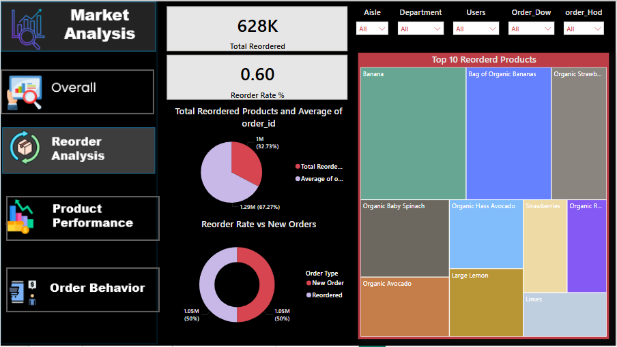
Dashboard – Order Behavior

Slide 14
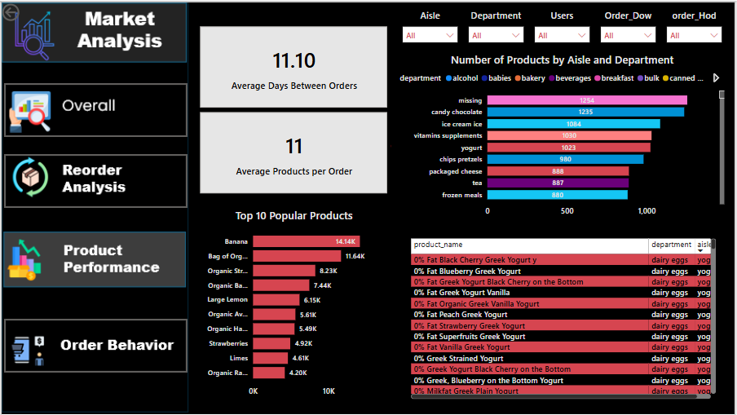
Dashboard – Product Performance

Slide 15
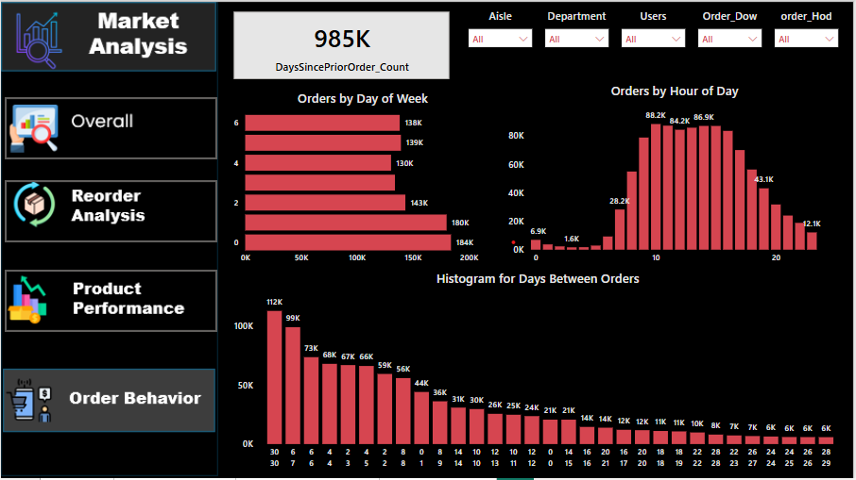
Dashboard – Reorder Analysis

Slide 16
Market Analysis
• Total Orders Analyzed: 1 Million
• Average Days Between Orders: 11.1
• Average Products Per Order: 11
• High Order Activity: Between 10 AM - 4 PM
• Popular Products: Bananas, Organic Strawberries, Yogurt
• Reorder Rate: 60%
• Key Insight: Majority of reorders come from a small group of frequently bought items
• Recommendation: Focus marketing efforts on top reordered products and optimize replenishment cycles

Slide 17
Executive Summary
Analyzed Instacart customer and product data to uncover shopping trends.
Data includes 3M+ orders, 200K+ users, and 49K+ products.
30% of products contribute to the majority of repeat purchases.
Peak order hours: 10 AM – 3 PM; top days: Sunday & Monday.
Produce and Dairy are top departments by volume and reorder rate.
Opportunities: personalization, inventory planning, UX enhancements.

Slide 18
Executive Summary
Analyzed store layout and product organization across aisles & departments.
Evaluated the product ordering process efficiency.
Reviewed training practices for handling product categories.
Identified operational gaps and suggested improvements.

Slide 19
Objectives
Assess department and aisle organization impact on sales.
Analyze staff training processes.
Provide actionable insights to improve business decision and user experience.
Analyze Instacart datasets to uncover user behavior, product trends, and reorder patterns.

Slide 20
Scope
Use of orders, products, aisles, department, and reorder datasets.
Focus on product performance, use behavior, and order structure
Excludes Pll and external market comparisons

Slide 21
Retail/Grocery Market Overview
Retail sector projected to grow at 4.5% CAGR globally.
Automation in ordering and shelf management is increasing.
Customer experience tied closely to in-store navigation and product availability.

Slide 22
Aisle & Department Structure
Departments grouped by product type (e.g., dairy, bakery, beverages).
Layout impacts product visibility and impulse buys.
Efficient categorization aids restocking and customer navigation.

Slide 23
Product Order Process
Stock checked via POS data or manual inventory.
Orders placed through centralized software or vendor portals.
Lead time affects shelf availability and freshness.

Slide 24
Training for Product Management
Staff trained on FIFO (First In First Out) methods.
Training includes storage, safety, and handling protocols.
Digital tools assist in learning (apps, e-learning modules).

Slide 25
SWOT Analysis
Strengths: Structured departments, trained staff.
Weaknesses: Manual checks, inconsistent restocking.
Opportunities: Digital tracking, automated ordering.
Threats: Competitor tech adoption, supply chain disruptions.

Slide 26
Competitor Benchmarking
Top competitors use AI-driven planograms.
Some offer mobile navigation aids to customers.
Staff are cross-trained for flexibility and efficiency.

Slide 27
Insights & Data
80% of reorders come from 30% of products
Peak order hours: 10am–3pm, especially on weekends
Top aisle: Fresh vegetables, followed by dairy and beverages
Average order contains 10.3 items
Reorder rate is highest in dairy and produce departments

Slide 28
Insights & Data
80% of sales occur in 30% of store space (front aisles).
Stockouts reduce repeat customer visits by 12%.
Training compliance linked to faster shelf restocks.

Slide 29
Page Navigation Insights
Users often revisit the same product categories
Searches frequently used for known brands or staples
Add-to-cart order suggests top items are added early
Opportunity to improve recommendations and category links

Slide 30
Key Recommendations
Digitize inventory and ordering workflows.
Reorganize top-selling products to high-traffic zones.
Enhance onboarding and refresher training programs.

Slide 31
Thank You!

