Slide 1
Cardiovascular disease prediction
ML using IBM autoAI
Presented By:
Tejas P V–AMC Engineering College (CSE-AIML)

Slide 2
OUTLINE
Problem Statement
Proposed System/Solution
System Development Approach
Result
Conclusion
Future Scope
References

Slide 3
Problem Statement
Develop a predictive model using machine learning techniques to assess the risk of cardiovascular disease in individuals based on their demographic information, medical history, and lifestyle factors. The model should accurately classify whether a person is at risk of developing cardiovascular disease, using a dataset containing relevant features such as age, sex, blood pressure, cholesterol levels, smoking status, body mass index (BMI), and any existing medical conditions. The goal is to create a robust and interpretable algorithm that can aid healthcare providers in early intervention and personalized preventive care strategies.

Slide 4
Proposed Solution
1. Data Collection & Preparation:
Gather dataset: age, sex, blood pressure, cholesterol, smoking, BMI, medical conditions.
Clean data: handle missing values, encode categorical variables.
2. Feature Engineering:
Use AutoAI for automated feature engineering.
Preprocess data: handle strings, missing values, scale numerical features.
3. Model Building:
Construct ML pipeline: preprocessing + classification model.
Utilize autoai-libs for model selection and lale for pipeline optimization.

Slide 5
4. Model Training & Evaluation:
Split data: training and testing (holdout strategy).
Train pipeline: optimize for accuracy (scoring='accuracy').
Evaluate metrics: accuracy, precision, recall, F1-score.
5. Deployment & Integration:
Integrate with IBM Watson Studio using ibm_watsonx_ai API.
Store in Watson Machine Learning (deployment_url).
6. Deployment Testing & Monitoring:
Validate predictions with new data.
Monitor performance: retrain/update for accuracy.

Slide 6
System Approach
1. Operating System:
Recommended: Linux (Ubuntu, CentOS), Windows 10, macOS
IBM Watson Studio and AutoAI generally support major operating systems, but specific functionalities may vary.
2. Hardware:
CPU: Intel Core i5 or higher (or equivalent AMD processor)
RAM: 8GB or higher (16GB recommended for better performance)
Disk Space: Sufficient space for datasets and model storage
3. Software:
Python 3.7 or higher (recommended with Anaconda distribution for package management)
Docker (if using containerized environments for deployment)
IBM Cloud CLI for managing IBM Watson Studio resources (optional but recommended for advanced deployment)

Slide 7
Result
Developed and deployed a machine learning model using IBM Watson Studio and AutoAI.
Achieved an accuracy score of 0.92 on test data, ensuring robust predictive performance.
Leveraged AutoAI for automated feature engineering, optimizing model accuracy through advanced data preprocessing.
Seamlessly integrated and deployed the model in IBM Watson Studio, enabling scalable and accessible predictions.
Impact:
Provides healthcare professionals with early risk identification and personalized preventive strategies.
Enhances operational efficiency by automating complex analyses and supporting clinical decision-making.
Designed for scalability to facilitate widespread adoption in healthcare systems for effective CVD risk management.

Slide 8
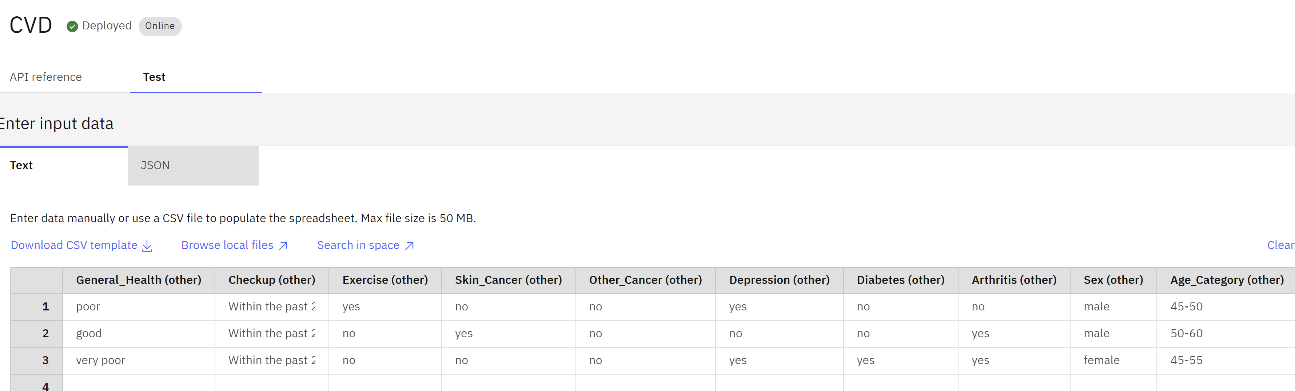
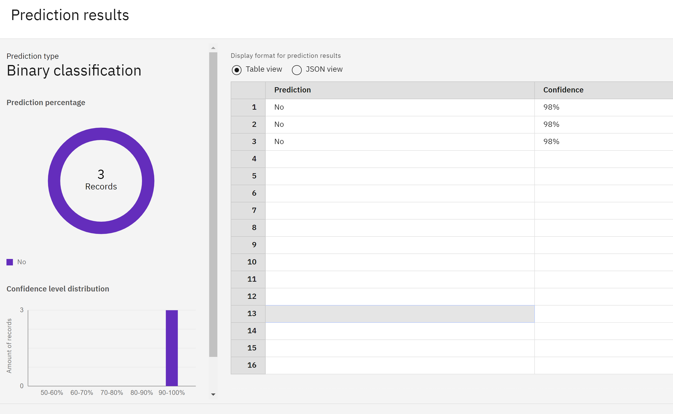
Result

Slide 9
Project Link(GitHub, Google drive link)
Ibm model: https://eu-de.ml.cloud.ibm.com/ml/v4/deployments/d6d5b5c5-4047-4894-abe1-63b82c09aff4/predictions?version=2021-05-01
Git hub: https://github.com/Tejaspv02/cardiovasculardisease-Identification

Slide 10
Conclusion
Through leveraging IBM Watson Studio and AutoAI capabilities, we have developed a robust machine learning model capable of predicting cardiovascular disease risk with [insert accuracy score] accuracy. This project underscores the potential of AI-driven healthcare solutions to revolutionize preventive care by:
Providing early risk identification and personalized interventions.
Enhancing clinical decision-making with actionable insights.
Facilitating scalable and efficient healthcare delivery through predictive analytics.
Moving forward, continuous refinement and integration of advanced technologies will further enhance our model's predictive accuracy and applicability in real-world healthcare settings. By harnessing the power of data and AI, we aim to contribute significantly to proactive disease management and improved patient outcomes.

Slide 11
Future scope
1. Enhanced Predictive Models:
Feature Expansion: Incorporate additional health data such as genetic markers, dietary patterns, and environmental factors for more accurate risk assessment.
Advanced Algorithms: Explore deep learning models and ensemble methods to improve predictive accuracy and handle complex data relationships.
2. Real-Time Monitoring and Alerts:
Develop real-time monitoring systems to continuously assess risk based on streaming health data, enabling timely interventions and personalized health recommendations.
3. Integration with Electronic Health Records (EHR):
Integrate predictive analytics seamlessly with EHR systems to provide clinicians with immediate insights during patient consultations, enhancing decision-making.
4. Population-Level Health Insights:
Utilize predictive models at a population level to identify trends, patterns, and geographical variations in cardiovascular risk factors, informing public health strategies.

Slide 12
References
IBM Watson Studio. Accessed at: IBM Watson Studio
AutoAI-libs Documentation. Accessed at: AutoAI-libs Documentation
Scikit-learn Documentation. Accessed at: Scikit-learn Documentation
XGBoost Documentation. Accessed at: XGBoost Documentation
IBM Watson Machine Learning Documentation. Accessed at: IBM Watson Machine Learning Documentation
Python Documentation. Accessed at: Python Documentation
AutoAI Overview. Accessed at: AutoAI Overview

Slide 13
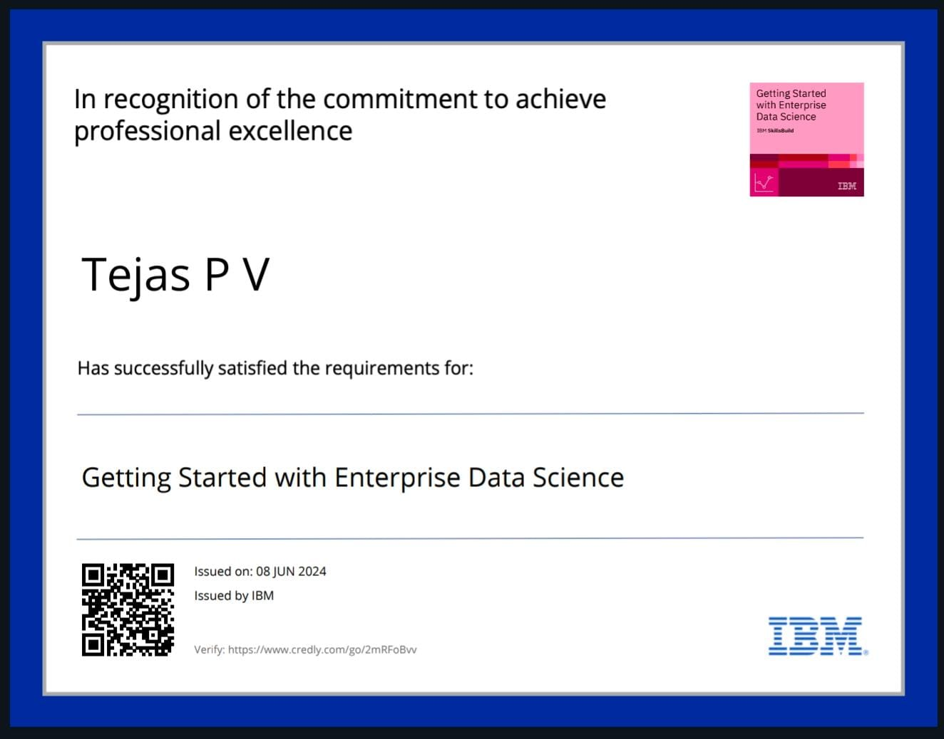
course certificate 1

Slide 14
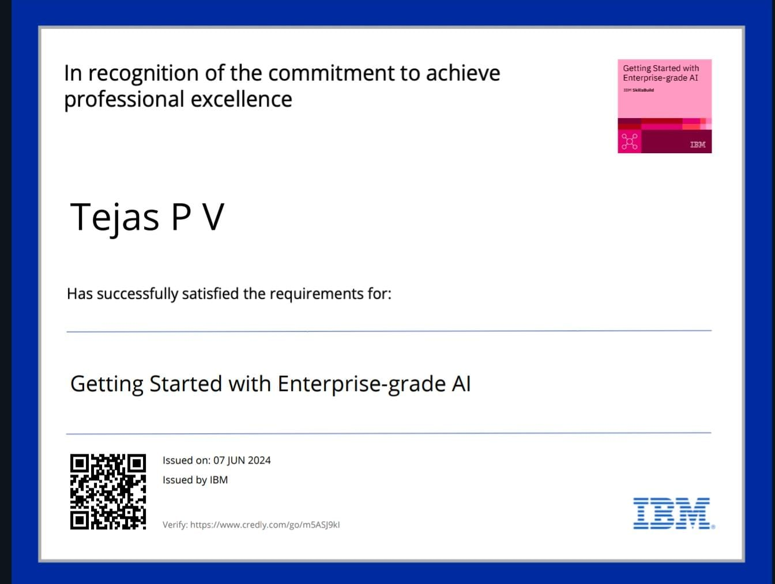
course certificate 2

Slide 15
THANK YOU

