Slide 1


SIMATS ENGINEERING
CO3_AT2_INTERACTIVE TREE SIMULATOR
Interactive Simulators to Generate Trees
STUDENT NAME
GUIDED BY
M TEJASRI
DR. SHAKILA
Slide 1

Slide 2
Introduction to Interactive Tree Simulators
■
What is a Tree Data Structure? A non-linear hierarchical structure consisting of nodes connected by edges, starting from a root node.
■
What is a Tree Simulator? A software visualizer that graphically builds and manipulates tree structures in real time.
■
Why are Tree Simulators Useful? Abstract pointer logic and recursive operations become easy to see and follow visually.
■
Interactive Learning: Students can experiment by inserting custom values and observing step-by-step structural changes.
Slide 2

Slide 3

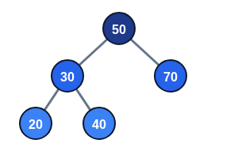
Why Use Tree Simulators?
■
Visual Understanding: Clear visual representation of parent-child node relationships.
■
Easy Node Insertion: Watch nodes dynamically position themselves.
■
Searching & Traversal: Trace algorithm paths frame-by-frame.
Binary Search Tree Layout
■
Step-by-Step Observation: Pause and analyze balancing or rotation operations.
Slide 3

Slide 4

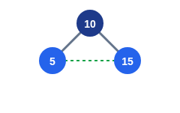
VisualGo – Interactive Tree Simulator
■
Animated BST & AVL Trees: Renders smooth animated transitions during node operations.
■
Custom Values: Insert or delete any custom numeric key to test tree responses.
■
Step-by-Step Execution: Side-by-side pseudocode highlights each executed line.
VisualGo BST Animation Focus
■
Tree Balancing: Clearly shows single and double rotations in AVL trees.
Slide 4

Slide 5

Binary Search Tree Visualizer
Key Operations
Learning Outcomes
■
Hands-on interactive tree building
■
Helps master BST ordering properties
■
Visual search highlighting target nodes
■
Demonstrates O(log n) search paths visually
■
Inorder traversal sorting visualization
■
Connects tree concepts to graph structures
Slide 5

Slide 6
Binary Tree Visualizer and Converter
■
Node List Input: Enter raw array representations or list values directly into the tool.
■
Automatic Tree Generation: Instantly converts text input into clean graphical binary tree diagrams.
■
Traversal Tracing: Automatically calculates Preorder, Inorder, and Postorder sequences.
■
Comparison & Verification: Allows students to verify manually solved homework problems against generated trees.
Slide 6

Slide 7
Virtual Labs IIITH – Tree Traversal Practice
Interactive Modules
Practical Benefits
■
Government-supported educational platform
■
Direct hands-on traversal practice
■
Immediate feedback on wrong sequence selections
■
Generates randomized tree challenge problems
■
Builds speed, precision, and exam readiness
■
Click nodes in exact traversal order
Slide 7

Slide 8
Comparison of Simulators
Tool | Main Feature | Best Use
VisualGo | Animated BST & AVL balancing step-by-step | Understanding balancing & rotations
BST Visualizer | Hands-on building, searching & sorting | Exploring BST search paths
BT Visualizer & Converter | Inputs node lists & auto-draws tree diagrams | Homework verification & diagramming
Virtual Labs IIITH | Interactive node-clicking traversal quizzes | Speed practice & quiz preparation
Slide 8

Slide 9

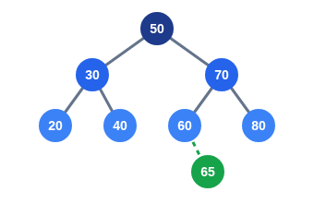
Simple Demonstration – BST Insertion
Steps to Insert Value 65:
■
1. Compare with Root (50): 65 > 50 → Move Right to 70.
■
2. Compare with Node (70): 65 < 70 → Move Left to 60.
■
3. Compare with Node (60): 65 > 60 → Move Right.
■
4. Position Found: Insert 65 as Right Child of 60.
Slide 9

Slide 10
Traversal Using Simulators
Traversal orders generated for the sample tree (50, 30, 70, 20, 40, 60, 80):
Slide 10

Slide 11

Benefits for Students
Visual & Concept Clarity
Skill Development
■
Interactive step-by-step visualization
■
Easy hands-on practice sessions
■
Faster understanding of complex algorithms
■
Helps students quickly spot logic mistakes
■
Improves overall algorithmic problem solving
■
Clear view of dynamic node adjustments
Slide 11

Slide 12

Conclusion
Interactive tree simulators make complex data structure operations much easier to understand through clear visual and hands-on learning.
■
Tools like VisualGo and BST Visualizer clarify search and balancing operations.
■
Binary Tree Visualizer & Converter simplifies diagramming and verification.
■
Virtual Labs IIITH offers active quiz-based traversal practice.
Slide 12

