Slide 1
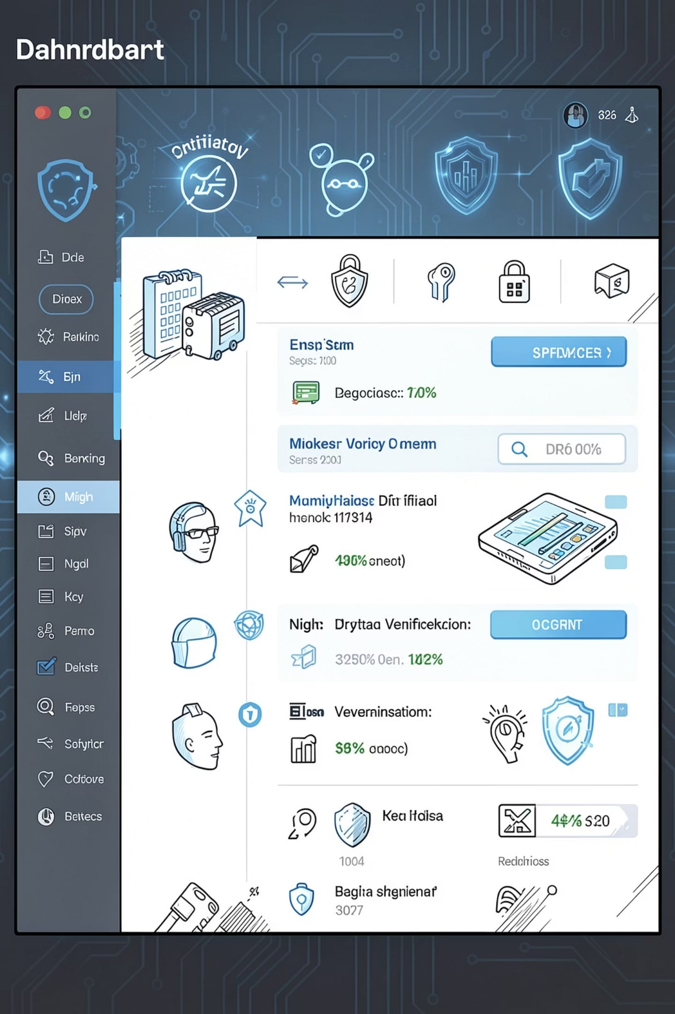
🏦 KYC Smart Validator
Enterprise Customer Onboarding System
Technologies: Spring Boot | MySQL | HTML | CSS | JavaScript | Bootstrap

Slide 2





Problem Statement
Manual KYC
Duplicate Records
Invalid PAN / Aadhaar
Verification is largely manual, slow, and error-prone.
Multiple entries for the same customer increase risk and reconciliation work.
Incorrect or forged identifiers compromise compliance.
Slow Onboarding
Poor Data Management
Long lead times reduce conversion and degrade customer experience.
Unstructured storage hinders reporting, auditability, and analytics.

Slide 3



Our Solution
KYC Smart Validator — an automated onboarding platform that validates identity documents, prevents duplicates, and centralizes customer data for secure, audit-ready operations.
Customer Registration
PAN & Aadhaar Validation
Secure Storage & History
Guided form capture with client-side validation and image support.
PAN format checks and Aadhaar verification using Verhoeff checksum logic.
Encrypted MySQL records with versioned customer history and audit logs.

Slide 4
Project Objectives
Automate Onboarding
Prevent Duplicates
Reduce manual effort and accelerate approval times.
Cross-field matching and unique-identifier checks at entry.
Validate PAN
Secure Storage
Format and checksum validation to ensure authenticity.
Encrypted persistence, role-based access, and audit trails.
Validate Aadhaar
Improve Efficiency
Verhoeff checksum implementation to detect invalid numbers.
Dashboard insights and history to reduce follow-ups and errors.

Slide 5




Technologies Used
Layer
Technologies & Tools
Frontend
HTML5 · CSS3 · JavaScript · Bootstrap 5
Backend
Spring Boot · Java
Database
MySQL (encrypted at rest)
Tools
Maven · Postman · Visual Studio Code

Slide 6
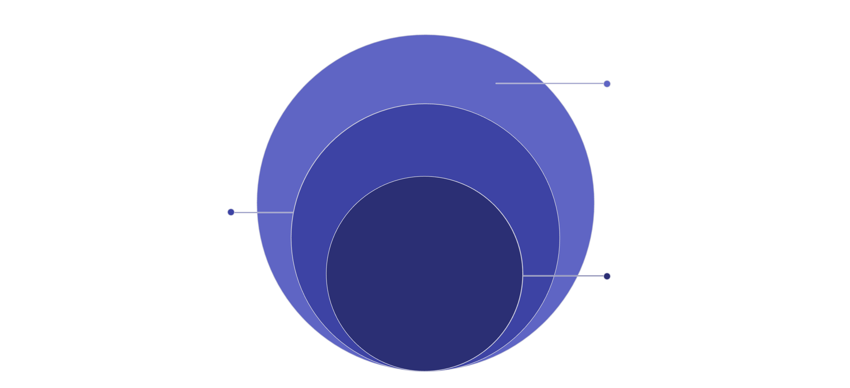
System Architecture
APIs & Frontend
Spring Boot REST APIs and HTML/CSS/JS frontend
Business Logic
Registration, PAN and Aadhaar validation
Core Data
MySQL database for persistence
This layered design separates presentation, API, business rules, and persistence for scalability and testability. APIs are RESTful and secured with role-based access control.

Slide 7
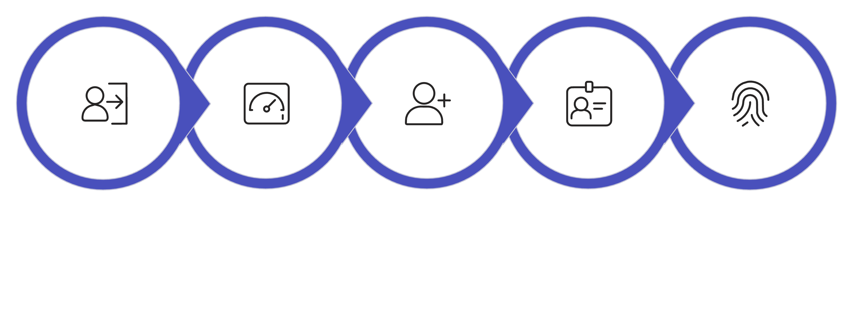
Project Workflow
Register Customer
Validate Aadhaar
Admin Login
Dashboard
Validate PAN
The workflow enforces validation at every step and writes immutable entries to the customer history for auditability.

Slide 8


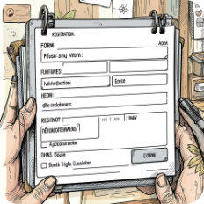

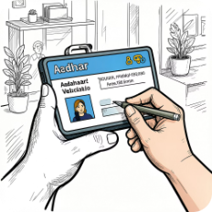

Core Features
Secure Login
Live Dashboard
Customer Registration
PAN Validation
Role-based sign-in for administrators with session controls.
Real-time stats: registrations, validation pass/fail, duplicates.
Validated entry forms, image attachments, and client-side checks.
Format verification and backend checks to flag invalid entries.
Aadhaar Validation
Customer History
Verhoeff checksum to detect mistyped or malformed numbers.
Full change history and searchability for audits and troubleshooting.

Slide 9






Future Enhancements
OCR PAN & Aadhaar
AI Fraud Detection
Auto-extract fields from uploaded images to eliminate manual entry.
Behavioral and pattern analysis to flag suspicious applications.
Face Verification
OTP (Email & SMS)
Liveness detection and selfie-to-ID matching to reduce impersonation.
Multi-channel verification for stronger identity assurance.
DigiLocker Integration
Cloud Deployment & Analytics
Trusted document retrieval and consent-driven verification.
Scalable hosting, backup, and advanced analytics dashboards.

Slide 10
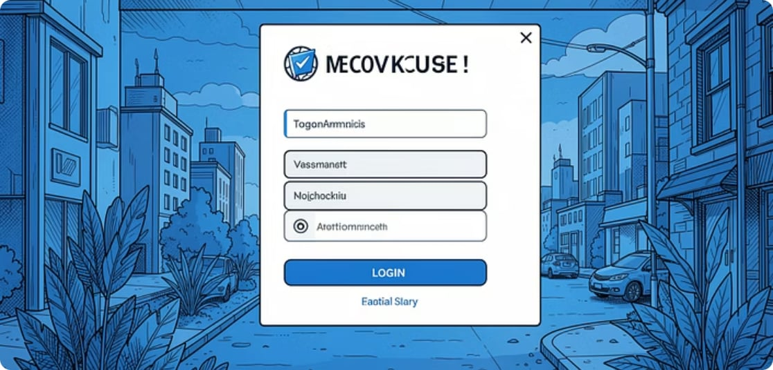

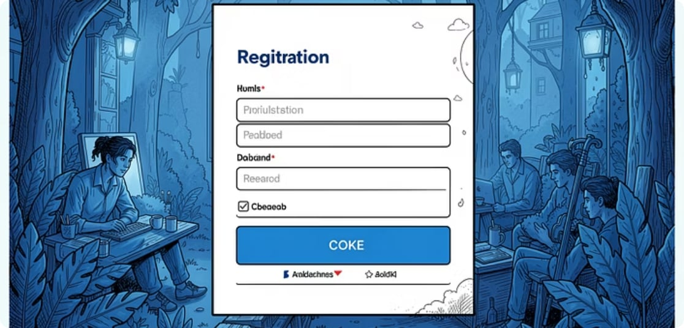


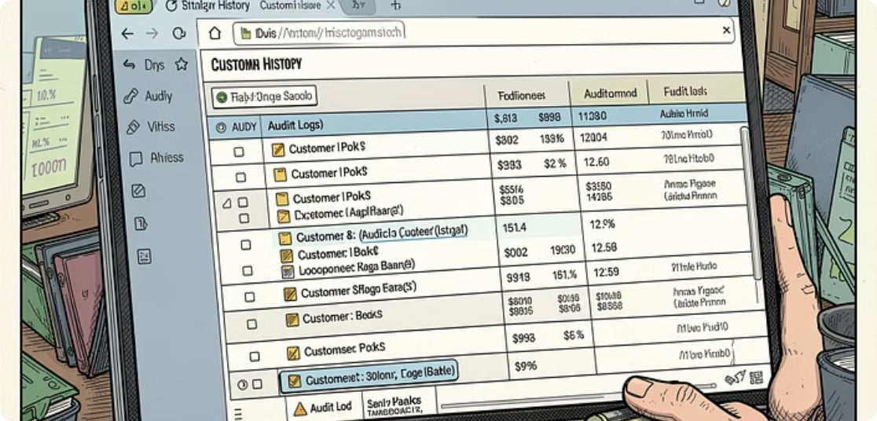
Conclusion
KYC Smart Validator is a full‑stack enterprise solution that automates onboarding, validates PAN and Aadhaar (including Verhoeff checksum), prevents duplicates, and stores secure, auditable customer histories. Built with Spring Boot, MySQL, and a Bootstrap frontend for rapid deployment and maintainability.
Thank You
Questions & Answers

