Slide 1
AI-Driven Web Application for Automated Disease Detection in Rice and Pulse Crops
An Infosys Springboard Virtual Internship 6.0 project, empowering
farmers with AI for healthier harvests.
Mentor & Coordinator
Mentor: Sasank Nukala
Coordinator: Uttam

Slide 2
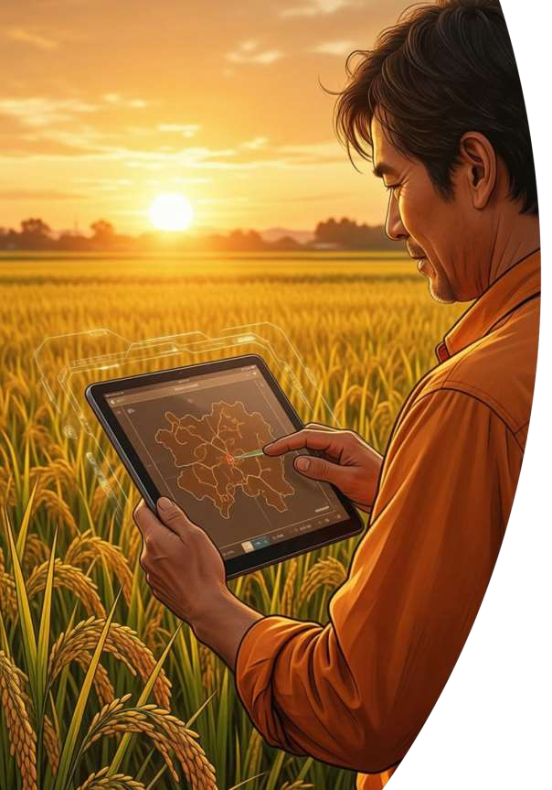
Project Overview: AI-Driven Disease Detection
Leveraging deep learning and a user-friendly web interface to detect and diagnose crop diseases from leaf images.
1 2
Primary Objective
Build a production-ready Streamlit web app with CNN for accurate leaf disease classification in rice and pulse crops.
Key Highlights
Custom CNN, Streamlit UI, 3 disease classes, PDF reports, AI Chatbot, Secure Auth.
3
Target Users
Farmers, Agricultural Extension Officers, Agronomists, Research Institutions.

Slide 3
Problem Statement: Agricultural Losses
Problem Statement
Crop diseases pose a significant threat to global food security and farmer livelihoods. Our project directly addresses these pressing issues.
Time-Consuming & Error-Prone
Costly Laboratory Testing
Limited Expert Access
Reduced Yield and Income

Slide 4

Project Purpose: Smart & User-Friendly AI
Project Objective
Identify rice and pulse crop diseases using AI-powered image analysis for timely farmer intervention.
Specific Objectives
Robust CNN design, secure authentication, real-time predictions, SOLID principles, comprehensive testing.
Expected Outcomes
Intuitive tool, accessible interface, early detection, targeted treatments, comprehensive documentation.
Real-World Impact
Early detection, web-based accessibility, cloud scalability, and data-driven decisions reduce crop loss and pesticide misuse.

Slide 5
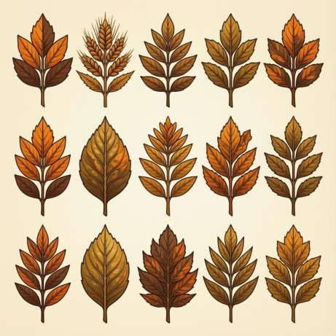
Dataset & Preprocessing for AI Accuracy
Dataset Overview
Total Images: 300+ collected
Image Size: Standardized to 224×224 pixels
Format: JPEG, JPG, PNG
Organization: Structured folders per class
Validation: Manual to remove corrupt samples
Disease Classes (3 Total)
Includes Bacterial Leaf Blight, Brown Spot, Leaf Scald.
Preprocessing & Augmentation
Input Image → Resize(224*224) → RGB Conversion → Convert to Tensor → Normalization(ImageNet mean & Std).
Data Augmentation Techniques like random horizontal flip, rotation, color jitter, are used.

Slide 6
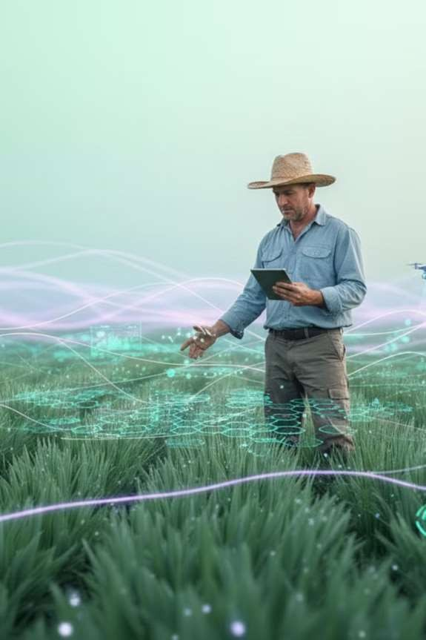
Seamless Workflow for Rapid Diagnosis
User Login
Secure access to the platform via personalized accounts.
Upload Leaf Image
Simple, intuitive interface for submitting crop leaf photos.
AI Model Prediction
Deep learning algorithms swiftly analyze the uploaded image.
Disease Identified
Instant diagnosis of specific crop diseases with high accuracy.
Cure Suggestions
Receive recommended treatments and essential care instructions.
PDF Report Generated
Download a comprehensive, detailed report for future reference.

Slide 7
How Disease Detection Works: The 6-Phase Pipeline
0 0
1
Image Acquisition
User uploads clear leaf image (JPEG/JPG/PNG, max 5MB) with format/size validation.
2
Preprocessing
Resize to 224×224, normalize with ImageNet stats, convert to PyTorch tensor.
0
0
3
Feature Extraction
CNN backbone extracts visual features, detecting patterns like
spots and lesions.
4
Classification
Fully connected layers map features to 3 classes; Softmax
produces probability distribution.
0
0
5
Confidence Scoring
Highest probability class selected; 60% threshold ensures
reliable predictions.
6
Result Presentation
Disease name, confidence, description, symptoms,
recommendations, and downloadable PDF report.

Slide 8
Tools and Technologies Used
Our project leverages a robust stack of cutting-edge tools and frameworks to ensure efficiency, scalability, and performance.
Deep Learning
PyTorch
Torchvision NumPy Matplotlib
Web & UI
Streamlit
Programming Languages
Python CSS3
Backend & Database
SQLite
ReportLab PDF Engine
Security & Testing
PyTest BCrypt
DevOps
Git
GitHub VS Code

Slide 9
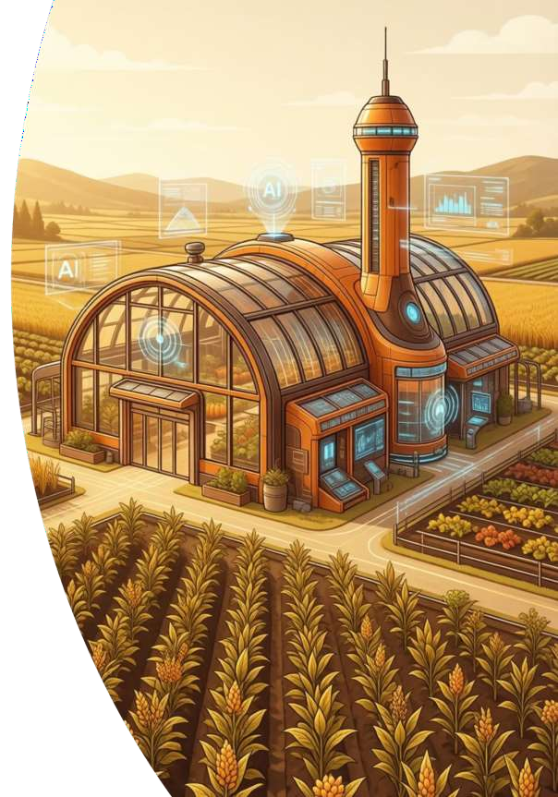
Outcomes
AI-Powered Detection
CNN classifies 3 disease classes with confidence scores.
Web Application
Streamlit-based platform accessible via any browser.
PDF Reports
Downloadable diagnosis reports with recommendations.
Secure Authentication
bcrypt (12 rounds) + SQLite user management.

Slide 10
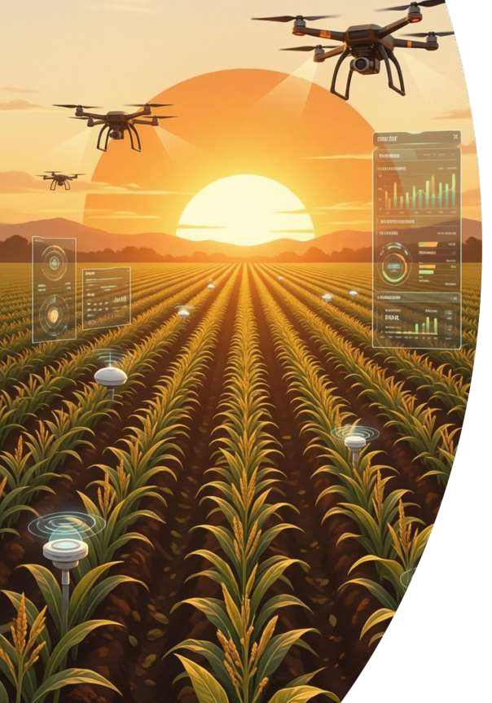
Future Scope: Expanding Horizons
Our vision extends beyond current capabilities to create a truly comprehensive and globally impactful solution for agricultural disease detection.
Expansion Integration
More diseases (20+ for diverse crops)
Mobile application for on-the-go
diagnosis
Offline mode for remote farming areas
GPS for precise location-based insights
Real-time weather data for predictive
analysis
Detailed, localized treatment guidance
Support & Accessibility
Multi-language support for global adoption
Expert connect features for personalized advice
Community forums for peer-to-peer
knowledge sharing

Slide 11


Thank You
We appreciate your time and interest in our AI-driven solution for crop disease detection. Together, we can build a
more resilient and sustainable future for agriculture.
Questions?
Get in Touch
Connect with Us

