Slide 1

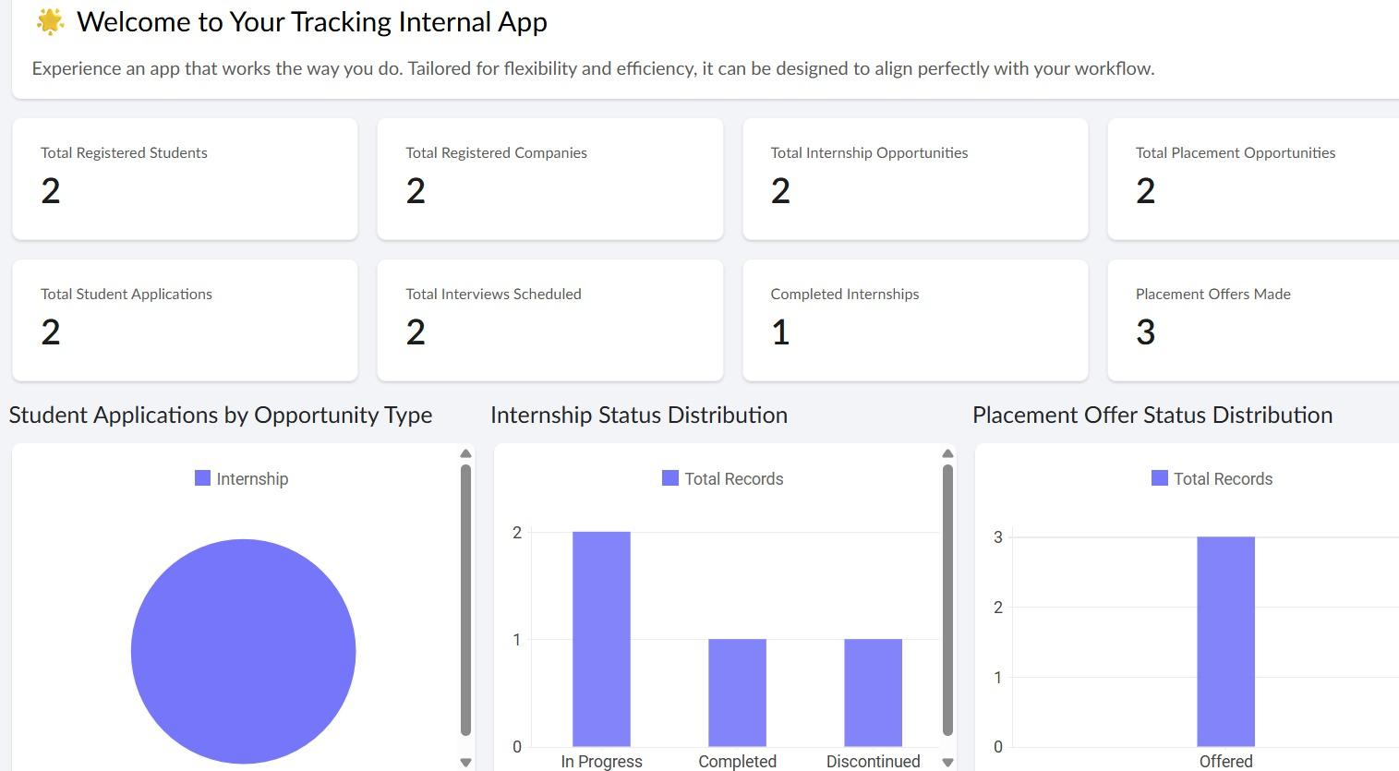
CB23F35 – LOW-CODE APPLICATION DEVELOPMENT USING ZOHO CREATOR
Internship and Placement Tracking System
A Zoho Creator application for students, companies, applications, interviews, internships and offers
Tejasri M (2116240701557)
B.E. Computer Science and Engineering · Rajalakshmi Engineering College
Course Faculty: Dr. J. Jinusophia · November 2026

Slide 2
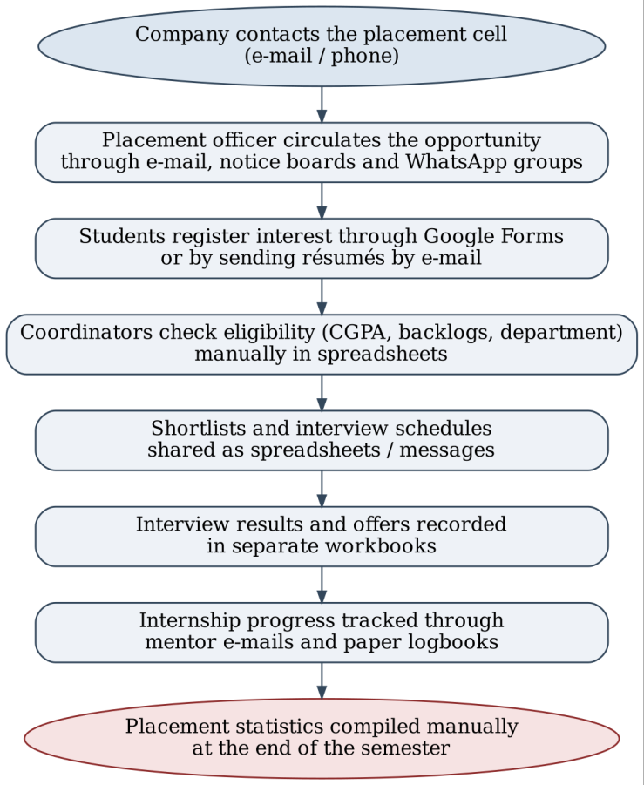





The problem with the current placement process
Manual eligibility screening
CGPA, backlog and department criteria are checked by hand for every applicant.
No visibility of status
Students keep asking coordinators where their application stands.
Scattered interviews and offers
Schedules, results and offers live in separate sheets and messages.
Untracked internships
Progress and certificates are followed up through e-mails and paper logbooks.
Manual reports, no access control
Statistics are compiled by hand and student data is shared freely.
Right: as-is process flow of the existing placement process (Figure 2.1 of the report)
Notes:
Training and placement cells handle hundreds of students and dozens of companies every year, but the work still runs on e-mail, notice boards, Google Forms and spreadsheets. Eligibility is checked manually, students cannot see application status, interview and offer data is scattered, internships are tracked on paper and statistics are compiled by hand.

Slide 3





Objectives
01
02
03
04
05
Data model
Automation
Lifecycle
Integration
Security
Normalised forms for students, companies, opportunities, applications, interviews, internship progress and offers.
Eligibility checks, status initialisation, internship completion, offer handling and notifications with Deluge.
Approval process and Blueprint for every application, with role-based dashboards and reports.
Zoho Mail notifications to students and staff; import of existing student lists.
Role-based access, record-level criteria and governance controls.
Notes:
Five objectives: a normalised data model, automation with Deluge and workflows, an approval process and Blueprint for the application lifecycle, Zoho Mail integration, and secure role-based deployment.

Slide 4




Proposed system: one application, four roles
A single Zoho Creator application with 8 interconnected forms, an approval process, a Blueprint, form workflows, 3 schedules, 13 reports and a Tracker Dashboard — on the web and the Zoho Creator mobile app.
Administrator (Placement Officer)
Placement Coordinator
Manages users, students and companies; publishes opportunities; records offers; sees all data and the dashboard.
Approves or rejects applications, moves them through Blueprint stages, schedules interviews and records results.
Student
Internship Mentor
Maintains profile, applies for opportunities, tracks status, views interviews, accepts or declines offers, submits internship logs.
Reviews weekly internship logs, adds remarks and verifies completion certificates.
Notes:
The proposed system brings everything into one application. Four roles: the Placement Officer as administrator, Placement Coordinators who process applications, Students, and Internship Mentors who verify internship progress.

Slide 5
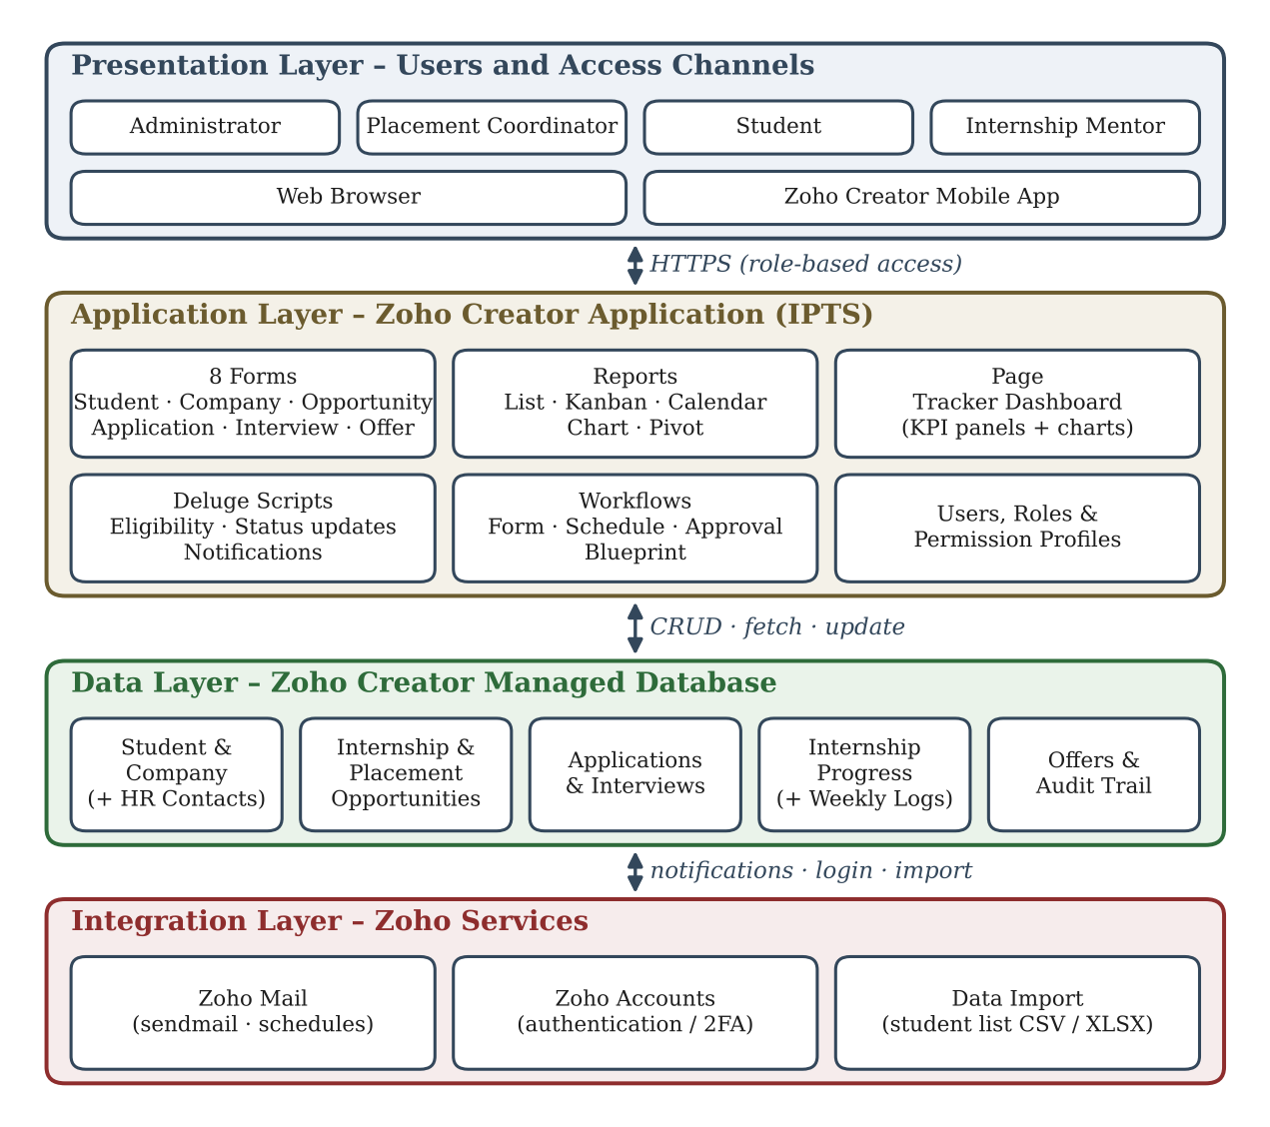
System architecture
Presentation layer
Four roles on the web browser and the Zoho Creator mobile app, over HTTPS with role-based access.
Application layer
8 forms, reports, the Tracker Dashboard, Deluge scripts, form / schedule / approval / Blueprint workflows, roles and permissions.
Data layer
Zoho Creator managed database: students, companies, opportunities, applications, interviews, internship logs and offers, with audit trail.
Integration layer
Zoho Mail for notifications and schedules, Zoho Accounts for login, CSV / XLSX import of student lists.
Notes:
IPTS follows a four-layer architecture: presentation, application, data and integration. All logic runs inside Zoho Creator; Zoho Mail handles notifications.

Slide 6
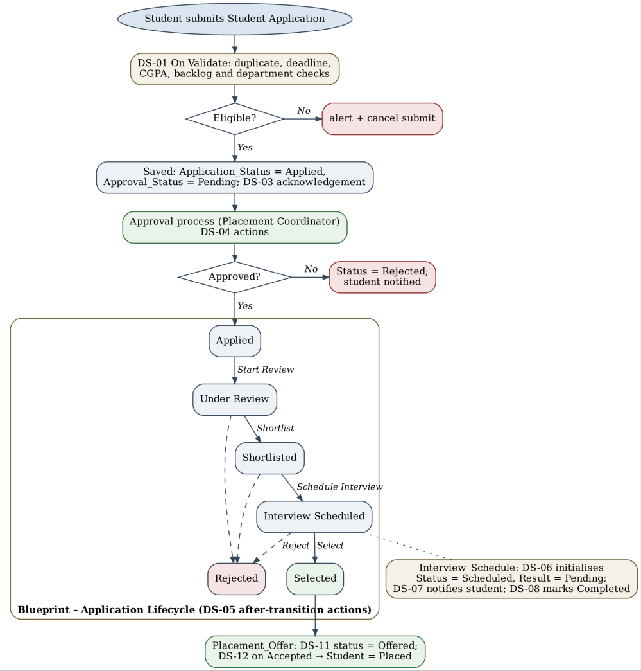
Application workflow: approval process + Blueprint
1
Submit
DS-01 checks duplicates, deadline, CGPA, backlogs and department; ineligible applications are blocked.
2
Approve
The Placement Coordinator approves or rejects the application (DS-04 sets status and notifies).
3
Blueprint
Applied → Under Review → Shortlisted → Interview Scheduled → Selected / Rejected (DS-05).
4
Interview
Interviews only for shortlisted applications (DS-06); results recorded, coordinator alerted (DS-08).
5
Offer
Offers only for Selected applications (DS-11); accepting an offer marks the student Placed (DS-12).
Notes:
When a student applies, DS-01 enforces eligibility. The coordinator approves or rejects, then the Blueprint moves the application through Under Review, Shortlisted, Interview Scheduled and finally Selected or Rejected. Interviews and offers are only allowed at the right stage, and accepting an offer marks the student as Placed.

Slide 7





Automation with 15 Deluge scripts
Eligibility & application
Approval & Blueprint
Interviews
DS-01, DS-03
DS-04, DS-05
DS-06 – DS-08
Reject duplicate, late and ineligible applications; acknowledge each application by e-mail.
Keep Application Status in step with the approval decision and Blueprint stage; notify the student.
Allow interviews only for shortlisted applications, notify students, alert coordinator after the final round.
Internship progress
Placement offers
Schedules
DS-09, DS-10
DS-11, DS-12
DS-13 – DS-15
Compute completion % from weekly logs; set Ongoing / Completed and update the student record.
Offers only for Selected candidates; manage offer status and mark the student Placed.
Daily interview reminders and closing of expired opportunities; weekly and monthly summaries.
A reusable function, notifyStudent (DS-02), sends every student e-mail.
Notes:
Fifteen Deluge scripts implement the business rules, grouped here by purpose. One reusable function, notifyStudent, is used for all student e-mails.

Slide 8
Tracker Dashboard
What it shows
Registered students
Registered companies
Internship and placement opportunities
Student applications
Interviews scheduled
Completed internships and offers made
Charts: applications by opportunity type, internship status distribution and placement offer status — all from live data, replacing manual end-of-semester statistics.
Notes:
The Tracker Dashboard gives the placement officer live counts and charts, replacing the manually compiled statistics of the old process.

Slide 9
Results and testing
Parameter | Existing system | Proposed application | Improvement
Eligibility screening | Manual check in spreadsheets | Automatic at submission (DS-01) | Manual screening eliminated
Application status | Students ask by phone or message | Live in My Applications, e-mail at every stage | Real-time transparency
Interview coordination | Schedules shared by messages | Interview records, calendar, daily reminders | Fewer missed interviews
Internship tracking | Mentor e-mails and paper logbooks | Weekly logs with automatic completion | Systematic follow-up
Statistics | Compiled at semester end | Dashboard plus weekly and monthly e-mails | No manual compilation
Data security | Spreadsheets shared freely | Role-based, record-level access, audit trail | Controlled and traceable
22
test cases traced to requirements — all passed
5
defects found during testing and fixed
4
roles verified for access and actions
Notes:
Compared with the existing process, eligibility is checked automatically, status is visible in real time, interviews and internships are tracked systematically, statistics are live and data access is controlled.

Slide 10




Conclusion and future enhancements
Conclusion
Future enhancements
IPTS replaces e-mails, forms and spreadsheets with one Zoho Creator application. Eligibility rules are enforced automatically, every application follows an approval process and a six-stage Blueprint, interviews, internships and offers are tracked in one place, and students and the placement cell see the same live data on web and mobile — with role-based security and an audit trail.
Zia résumé analysis and placement prediction
Recruiter portal for companies to post jobs and enter results
College ERP and Zoho Cliq integration via OAuth connections
Catalyst résumé parsing and Zoho Analytics trend reports
Thank you · Questions?
Notes:
In conclusion, IPTS meets all five objectives. Thank you; happy to take questions. Future work includes Zia-based résumé analysis, a recruiter portal, ERP and Cliq integration, and pro-code analytics.

