Slide 1

Tejasvi Addagada
Service Offerings

Slide 2
Data Management – Service Offerings
Align, Plan, Organize
Service Offerings
Data Management Strategy
Business case and sustainable funding model
Define Operating model – Business and technology Operating model
Organizational Modeling
Processes, Metrics and Thresholds standardization
Benefits Realization Model
Continuous Improvement
Vendor Analysis
Technology capabilities Customization
Program management
Trainings and Support
Data Management
Data Quality
Metadata / Content Management
Data Integration
Reference Data Management
Data Architecture
Data Security
Build, Acquire, Implement
Monitor, Evaluate, Assess
Deliver, Service, Support

Slide 3
Data Quality Management – Service Offerings
Align, Plan, Organize
Service Offerings
Establish Data quality program
Assess and Monitor Quality of existing System of Records and Reference
Assess and Monitor Reference Data
Analyze and Report Quality of new data
Integrate Data Quality into Project Management
Training and Support
Data Quality
Strategy Analysis
Stewardship
Operating model
Key/Critical Data framework
Assessment and Monitoring process
Dimensions standardization
Issue remediation
Org modeling
Data Quality rules
Data Profiling – set up
Monitor, Evaluate, Assess
Build, Acquire, Implement
Deliver, Service, Support

Slide 4
Content Management – Service Offerings
Align, Plan, Organize
Service Offerings
Establish Content Management service
Establish Metadata management service
Data classification
Data definition Standards and Guidelines
Metadata capture, management and rationalization
Training and Support
Tools and customization
Operating model and processes
Organizational structure
Data Relationship Management
Data Lifecycle Management
Content Management
Strategy Analysis
Business Metadata
Physical Metadata
Operational Metadata
Relationships
Lineage
Ontologies
Taxonomies
Landscape classification
Monitor, Evaluate, Assess
Build, Acquire, Implement
Deliver, Service, Support

Slide 5
Data Architecture – Service Offerings
Align, Plan, Organize
Service Offerings
Establish Architecture Roadmap
Platform governance structure and processes
Technology tool selection strategy
Data storage management strategy
Data infrastructure contingency planning
Training and Support
Integration with Metadata
Operating model and processes
Organizational structure
Modeling at all levels
Data Lifecycle Management
Architecture
Technology Architecture
Data tool stack
Storage Management
Data Integration
Data Modeling
Conceptual Modeling
Physical Modeling
Semantic Modeling
Alignment with Content Management
Monitor, Evaluate, Assess
Build, Acquire, Implement
Deliver, Service, Support

Slide 6
Data Privacy – Service Offerings
Align, Plan, Organize
Service Offerings
Establish privacy Roadmap
Establish organizational structure
Training and Support
Integration with Metadata
Operating model and processes
tool selection strategy
Data Sourcing agreements
Privacy classifications
Controls definition
Dynamic and persistent masking
Integration with UAM
Data Privacy
Strategy and Requirements for Data Privacy
Formally establish Governance oversight
Classification Standards
Operational risk planning
Data Lifecycle management
Access management
Data distribution
Controls Management
Monitor, Evaluate, Assess
Build, Acquire, Implement
Deliver, Service, Support

Slide 7
Data Governance – Service Offerings
Business Value Levers
Councils and Working group structure and Charter
PMO establishment
Organizational Structure
Stewardship through grassroots
Policy, procedures and frameworks definition
Policy self assessments
Program Governance charter and operationalization
Cross Organizational data governance
Assessment and Monitoring
Data governance structure definition
Assessment
Evaluate
Data Management
Align, Plan, Organize
Build Acquire Implement
Deliver, Service Support
Monitor, Evaluate, Assess
Integrate & Oversight
Stewardship
Monitor
Direct
Framework

Slide 8
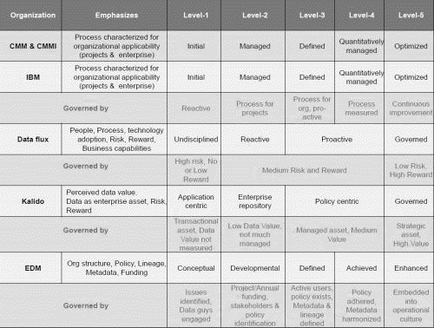
Maturity Assessment – Service Offerings
Traverse for sustainability
Choosing the right Maturity Model? What to consider?
Process and the nature of the outcomes with each of the process states
Adoption by People, Process and technology
Implementation of capabilities along with Risk and related Benefits
Perceived data value from (in)direct of Monetization data
Data being traversed from being a transactional asset to an enterprise asset
Implementation of Org structure, Policy, Lineage, Metadata, Funding and culture change
We leverage our strengths in benchmarking your capabilities against the standards.

Slide 9
Data Governance – Benefits
Increase efficiency of scoping activities performed in Strategy analysis
Reduce effort (person hours) spent on analyzing business requirements and eliciting data requirements
Reduce stakeholder communication overhead with common vocabulary and common understanding
Provides increased awareness and understanding around data in the enterprise for impact analysis
Provides specific standards that impart confidence in the data
Proves ease of sharing inter-operable data across services, systems, applications with less effort
Reduce general and administrative costs, such as cost of IT operations and personnel costs and technical support associated with Inter-operability, data sharing, data analysis.
Reduce Up-front costs, such as the integration of data and training needs.
Reduce future costs, such as maintenance of legacy systems, transformation, and decommissioning of information systems.
Reduce costs associated with maintaining replicated information.

