Slide 1
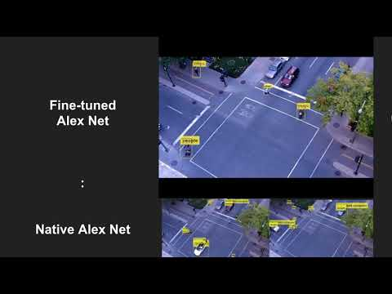

Slide 2

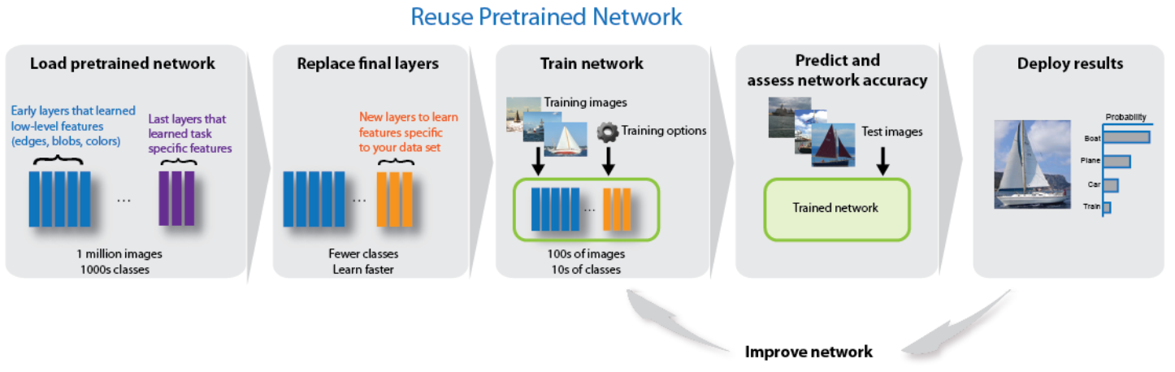
Moving object detection, tracking and classification from an unsteady camera
Shashank Tripathi
Akshita Mittel
Video from a moving camera
Feature point extraction Shi and Tomasi min eigen value algorithm ^{[1]}
Video Stabilization using Lukas-Kanade
Motion detector Background subtraction
Car
Classification
Fine tuning using pretrained AlexNet weights
People
[1] Shi, J., and C. Tomasi, "Good Features to Track," Proceedings of the IEEE Conference on Computer Vision and Pattern Recognition, June 1994, pp. 593–600
https://www.mathworks.com/help/nnet/deep-learning-image-classification.html

Slide 3
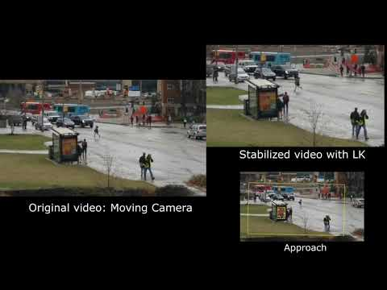
Video Stabilization using LK

Slide 4
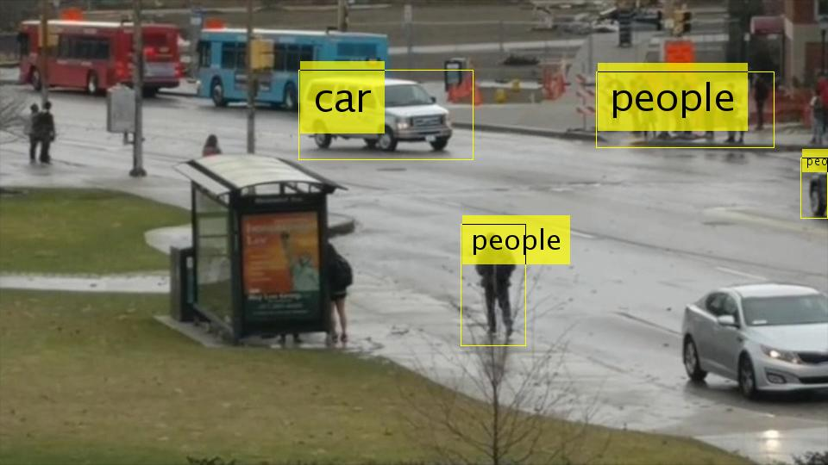
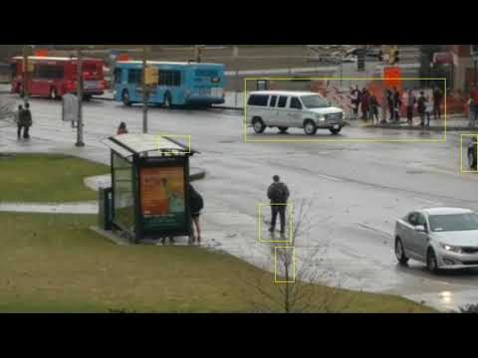
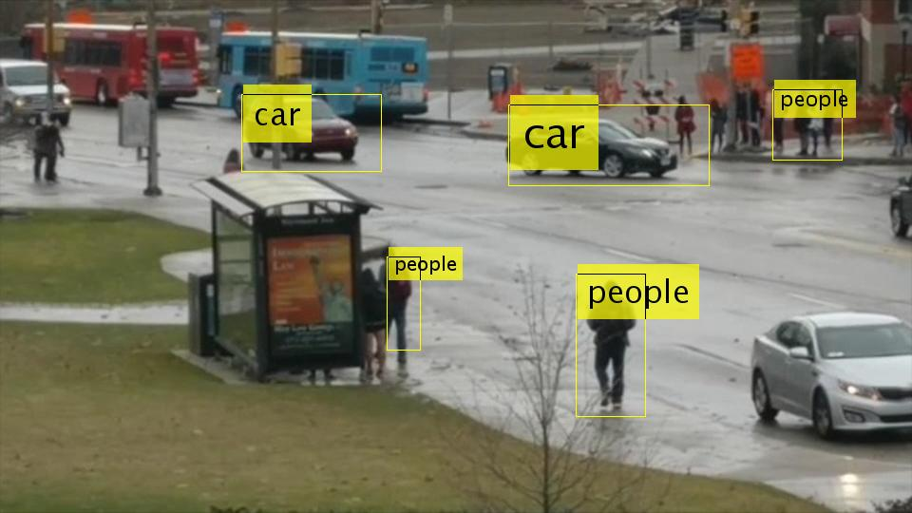
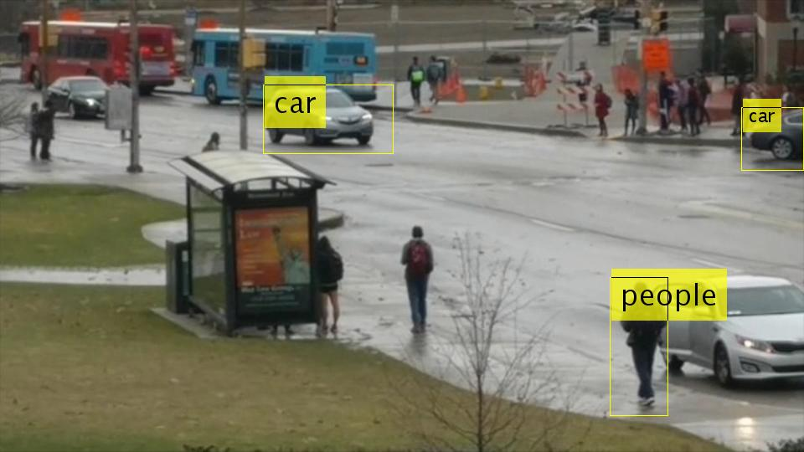

Slide 5
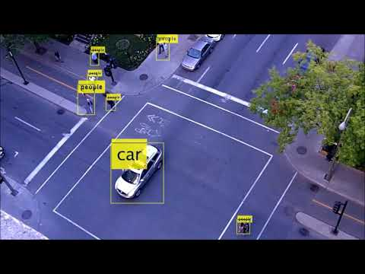
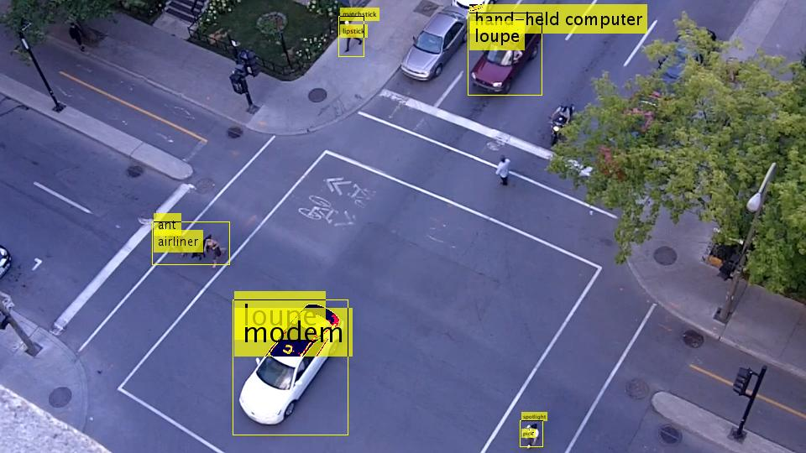
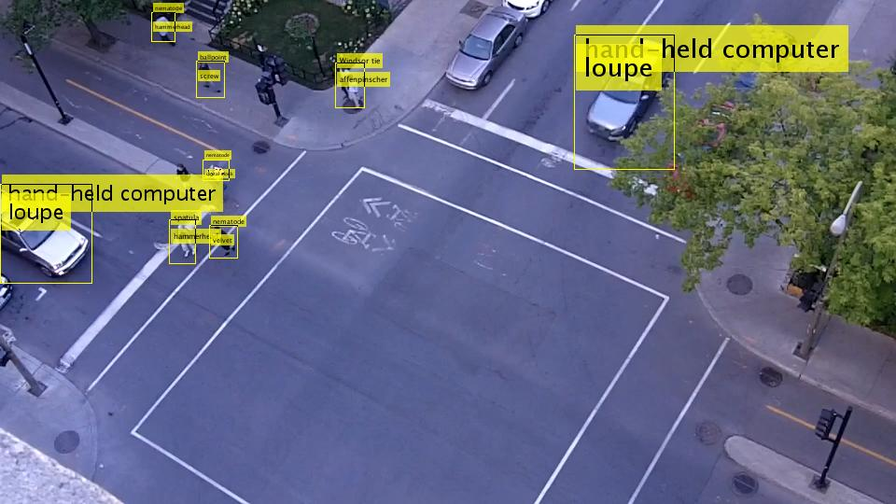
Fine-tuned
Alex Net
:
Native Alex Net

