Slide 1

MUSHROOM CLASSIFICATION(P225) (TEAM 3)
Pallavi Jadhav
Tejasvita Nale
Abhishek Jha
Shrotika Ghadge
Suhani Jain
Vijay Chandra Mentor
Rushika Reddy -Neha Ma’am

Slide 2
Business Problem
To classify if the Mushroom is Edible or Poisonous.

Slide 3
OBJECTIVE
Mushrooms are not just good to taste, but they have some medicinal properties as well. A research center would like to explore the different types of mushrooms, to understand which of them are edible, and which are not, so that they could discover some of the hidden properties of mushrooms, which could possibly heal certain terminal illnesses.
This dataset includes descriptions of samples corresponding to 23 species of gilled mushrooms in the Agaricus and Lepiota Family Mushroom drawn from The Audubon Society Field Guide to North American Mushrooms (1981). Each species is identified as definitely edible, definitely poisonous, or of unknown edibility and not recommended. This latter class was combined with the poisonous one.
Using the above information & the dataset and applying the different machine learning techniques to classify if the mushroom is edible or poisonous.

Slide 4
Project Flow
EDA
Feature Engineering
Model Building
Model deployment

Slide 5
DATASET DETAILS
The dataset used in this project is mushrooms.csv that contains 8124 instances of mushrooms with 23 features like cap-shape, cap-surface, cap-color, bruises, odor, etc.
The python libraries and packages we’ll use in this project are namely:
NumPy
Pandas
Seaborn
Matplotlib
Scikit-learn
We’ll use the specifications like cap shape, cap color, gill color, etc. to classify the mushrooms into edible and poisonous.

Slide 6
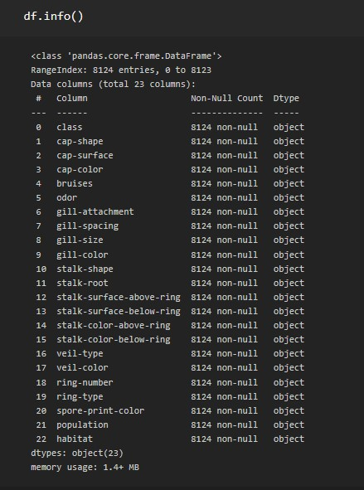
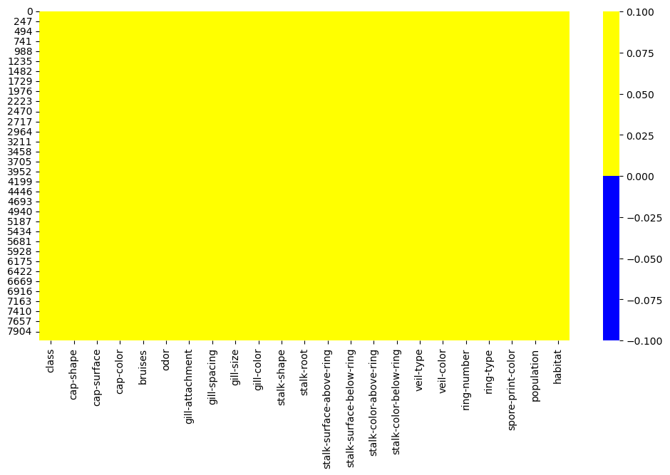
Exploratory Data Analysis (EDA)
After checking the data, No Missing values and datatype also identified accuretly.
we know the following about the features:
They are all categorical attributes (object).
They have repetitive values.
They have several categories.

Slide 7
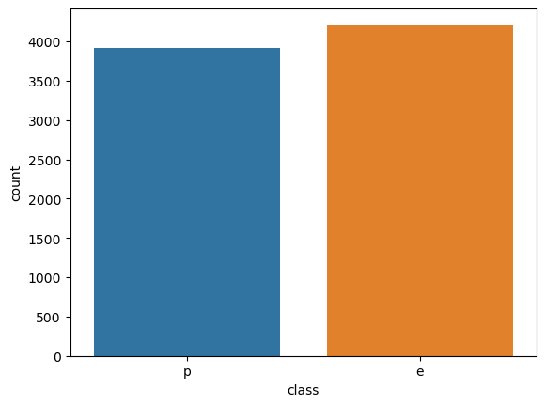
Data Visualization
Target column is not imbalanced, Distribution for 2 classes are approximatly equal. So their is no chance for machine to be biased for one class

Slide 8
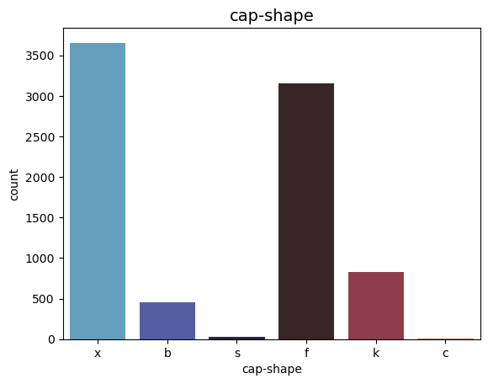
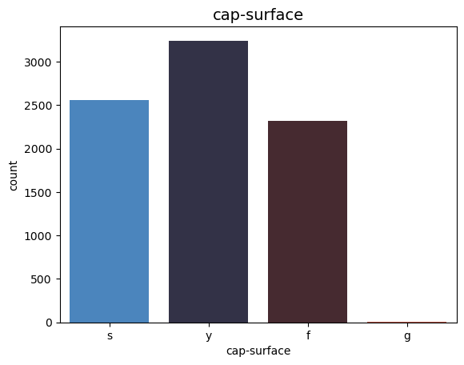
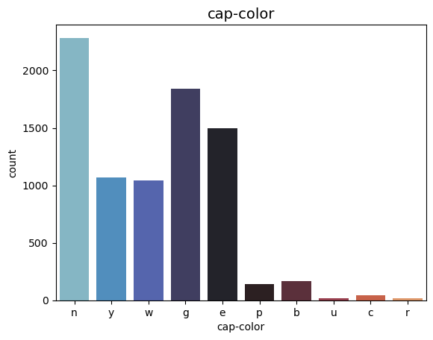
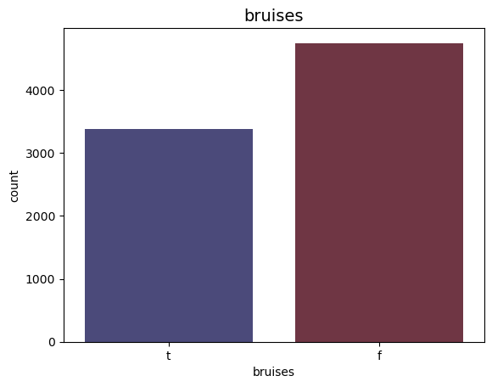
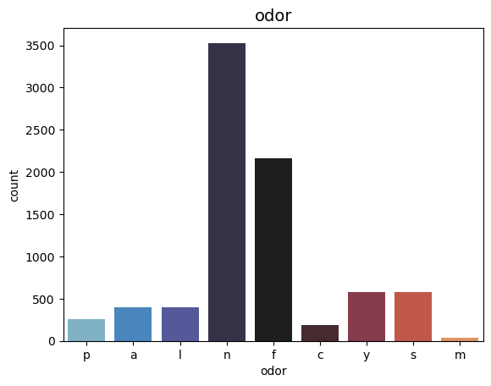
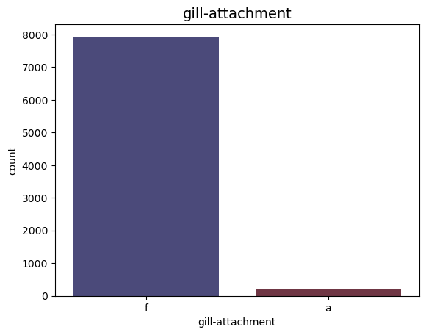
UNIVARIENT PLOT

Slide 9
INFERENCES
Most of the mushrooms in our dataset have a convex or a flat cap.
Most frequent cap surface is scaly.
Over half of the mushrooms in our dataset have a brown, red & grey cap colour.
count of mushroom with no bruised is high as compared to mushroom with bruised.
Most frequent scents are either no smell or a foul smell.
Almost our entire data has free gill attachment.so this column is pretty much useless in our analysis.
Most of the mushrooms in our dataset have a close gill spacing so it has little to no impact in our analysis.
Most of the mushrooms in our dataset have a broad gill sizes as compared to narrow.
Over half of the mushrooms in our dataset have a buff ,pink or a white gill colour.
Most of the mushrooms in our dataset have a tapering others are enlarging.
Most frequent stalk roots are bulbous.
Most frequent stalk surface above ring are either smooth or silky.
Most frequent stalk surface below ring are either smooth or silky next to no difference from stalk-surface-above-ring.
All veil type of the mushroom's are partial so this column is pretty much useless in our analysis.
Almost all of the mushroom's veil colour are white so this column is pretty much useless in our analysis.
Almost all of the mushroom's ring number amount are one, so this column is pretty much useless in our analysis.
Most of the mushrooms in our dataset have a pendant (48.84%),evanescent (34.17%) or a large (15.95%) ring type.
Most frequent colours are white, brown, black and chocolate, the other colours are insignificant.
Most frequent populations are either several or solitary.
Most frequent habitats are either woods or grasses.

Slide 10
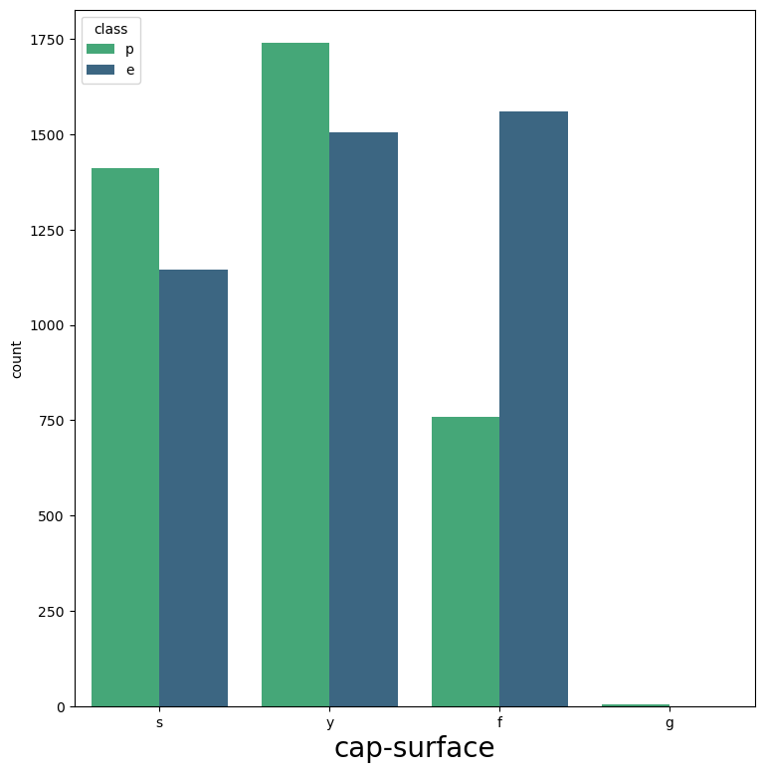
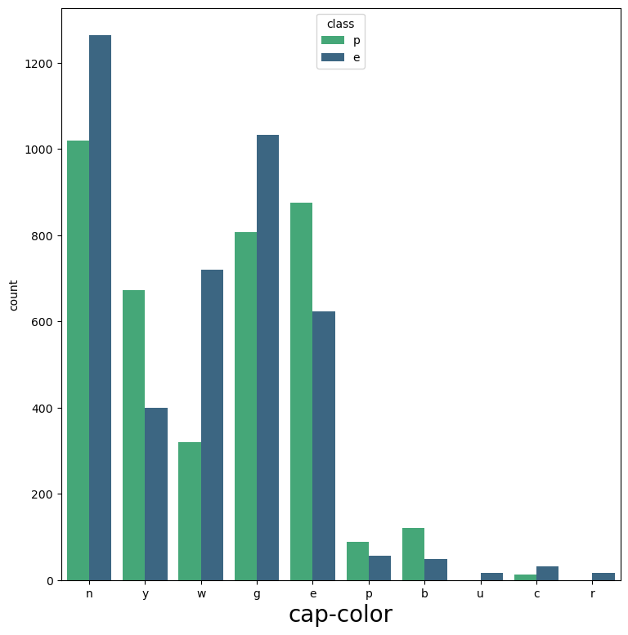
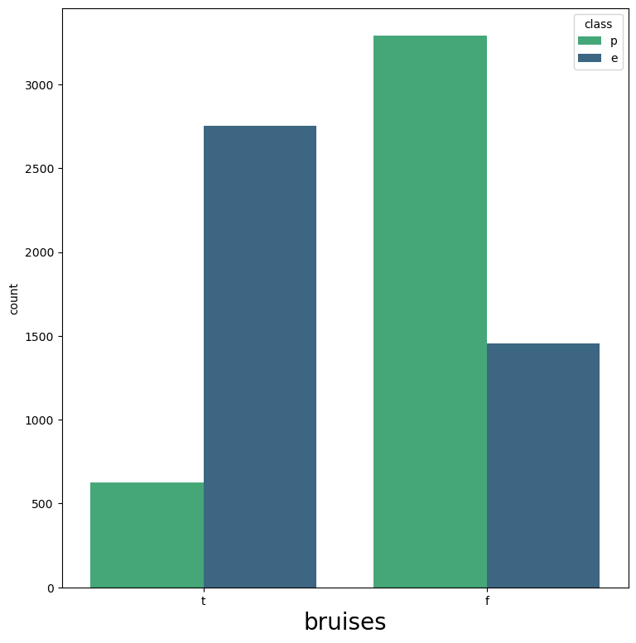
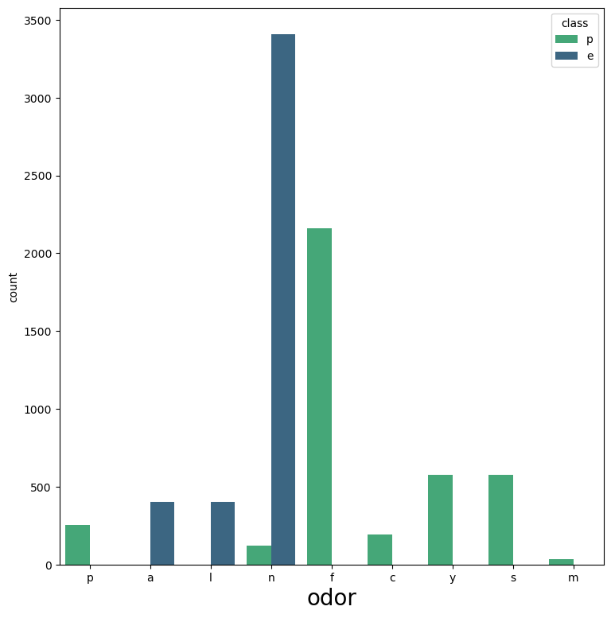
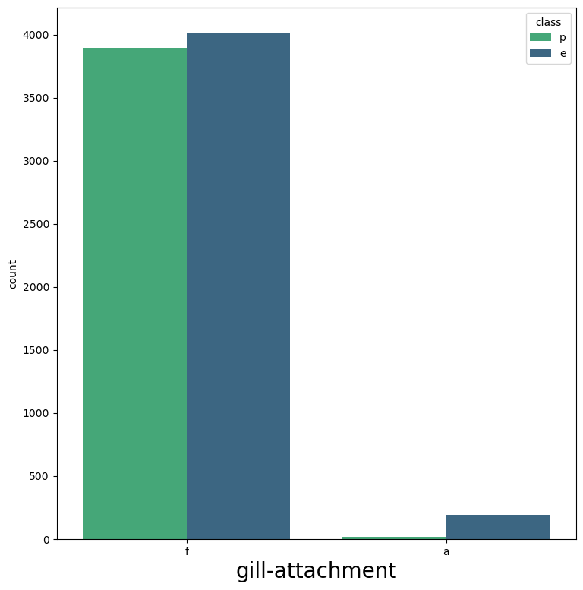
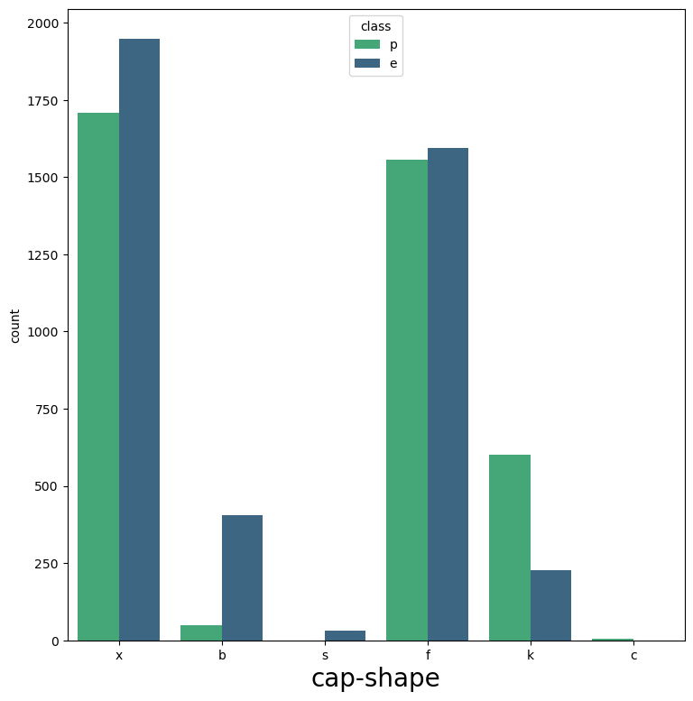
MULTIVARIENT PLOT

Slide 11
INFERENCES
Most of the knobbed mushrooms in our dataset are poisonous.
Most fibrous cap surface are edible.
Most white cap colour mushrooms are edible while most yellow cap colour mushrooms are poisonous.
Bruised mushrooms are usually edible while unbruised ones are usually the opposite.
No smell mushrooms are mostly edible by a wide margin while all foul smell mushrooms are poisonous.
The attached gills are almost always edible.
The crowded gills are almost always edible.
The narrow gill sized mushrooms are almost always poisonous.
The buff gill colour mushrooms are always poisonous.
stalk shape has insignificant difference between each value in terms of poisonous or edible.
Mushrooms with missing data of stalk roots are usually poisonous.
The silky mushrooms with stalk surface above ring & stalk surface above ring are usually poisonous, smooth are usually edible..
The white stalk coloured mushrooms are usually edible, pink ones are mostly poisonous.
All veil type of the mushroom's are partial.
Almost all of the mushroom's veil colour are white.
Almost all of the mushroom's ring number amount are one.
The pendant ring typed mushrooms are mostly edible, evanescent are mostly poisonous and large ring types are all poisonous.
The brown and black spore print colour ones are almost entirely edible while white and chocolate (20.09%) are mostly poisonous.
Mushrooms with a several population are mostly poisonous.
The woods or grasses grown mushrooms are mostly edible.

Slide 12
FEATURE ENGINEERING
Renaming Columns Name
Dropping Unnecessary columns
Outlier detection
Encoding

Slide 13
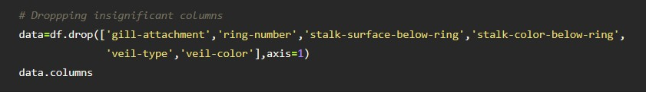
DROPPING COLUMNS
From the above analysis, following columns are not needed so we will drop them: gill-attachment, stalk-surface-below-ring, stalk-colour-below-ring, veil-type, veil-colour, ring-number

Slide 14
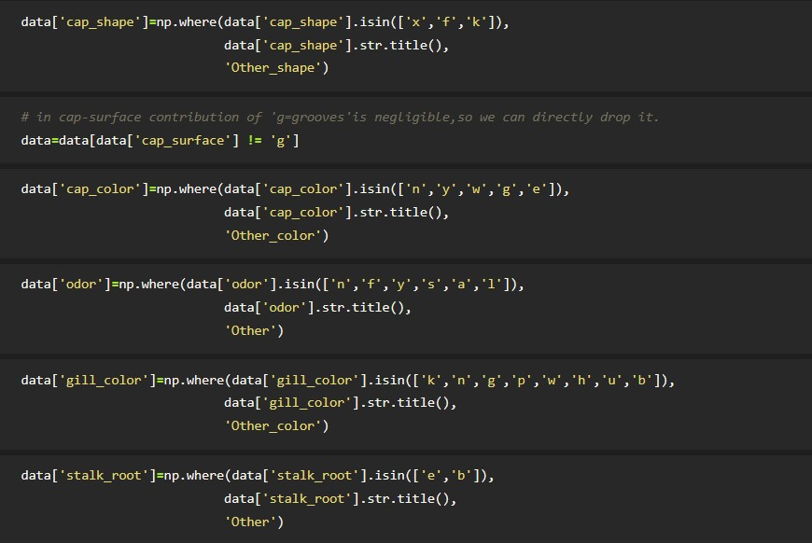
OUTLIERS DETECTION
In terms of categorical features, an outlier can be considered a categories of with little observations. So here we group together categories who's contribution is below 5%,under new category name 'Other'

Slide 15
Model Building
The Process of Modeling the Data:
1.Importing the model
2.Fitting the model
3.Predicting Mushroom types
4.Classification metrics –
Score Metrics for Classification:
Accuracy= (TP+TN/(TP+TN+FP+FN)
Precision = (TP)/(TP+FP)
Recall = (TP)/(TP+FN)
f1 score
A number between 0 and 1, the harmonic mean of precision & recall.

Slide 16
Models we used:
Logistic Classification
Decision Tree Classifier
Random Forest Classification
Bagging Classifier
AdaBoost
Voting Classifier
XGBoost Classifier
Support Vector Machines
K-Nearest Neighbors(KNN)
Naive Bayes

Slide 17
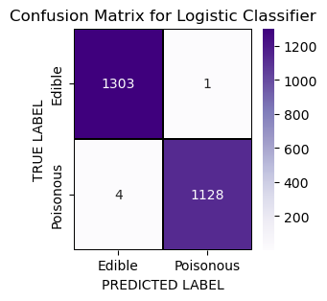
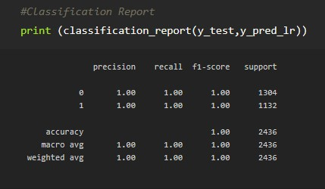
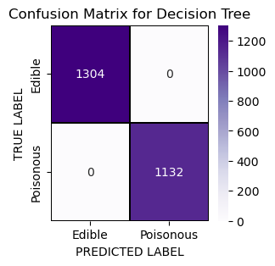
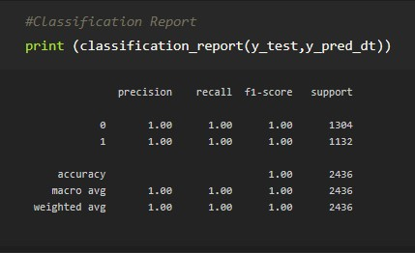
SOME OUTPUT FOR CONFUSION MATRIX & CLASSIFICATION REPORTS

Slide 18
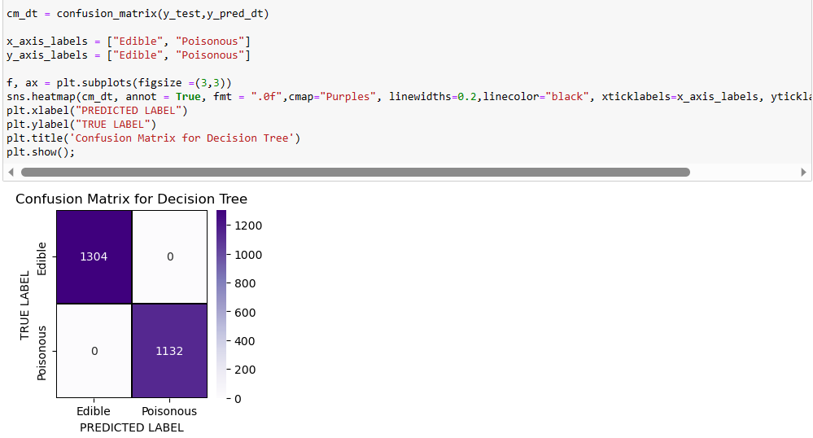
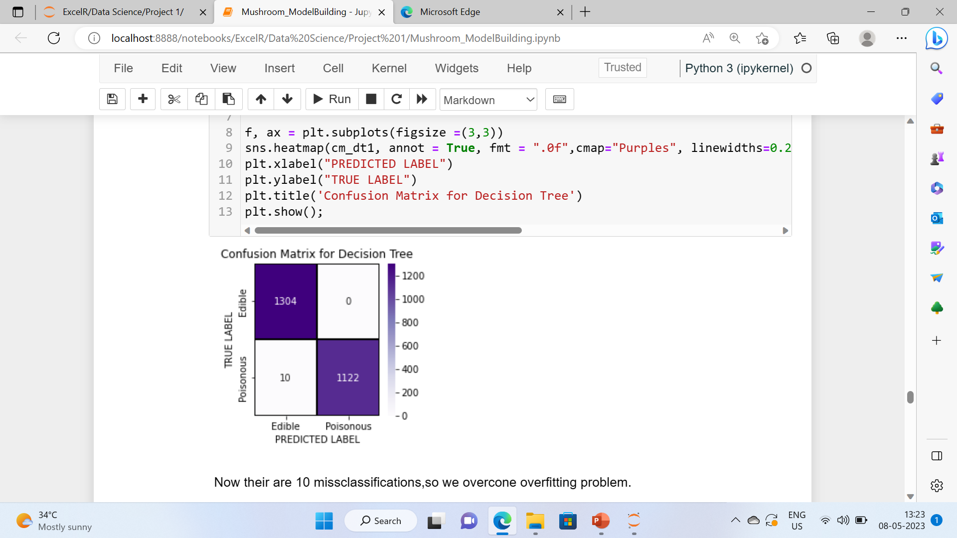
OVERFITTING PROBLEM
No misclassifications
10 misclassifications
By changing maximum length from 6 to 5.

Slide 19
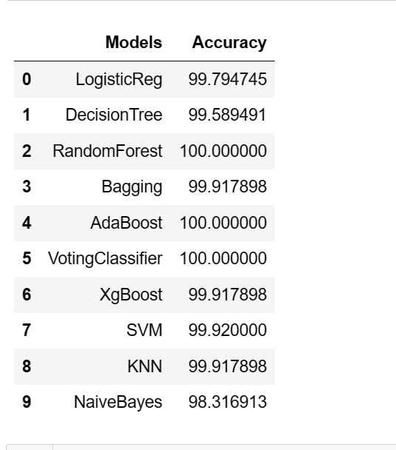
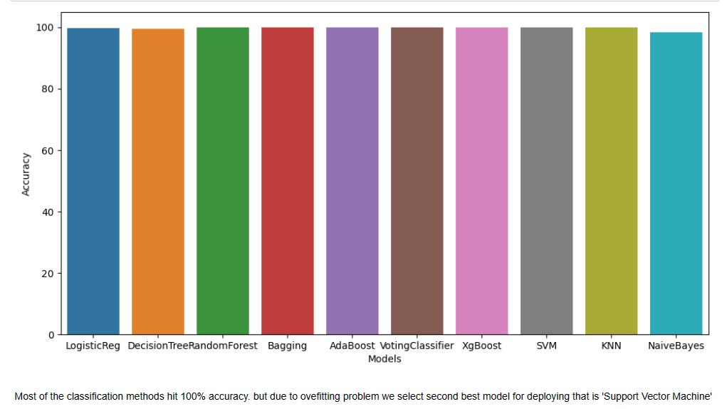
SUPPORT VECTOR MACHINE
Most of the classification methods hit 100% accuracy. but due to overfitting problem we select second best model for deploying that is 'Support Vector Machine' which allows some Misclassifications.

Slide 20
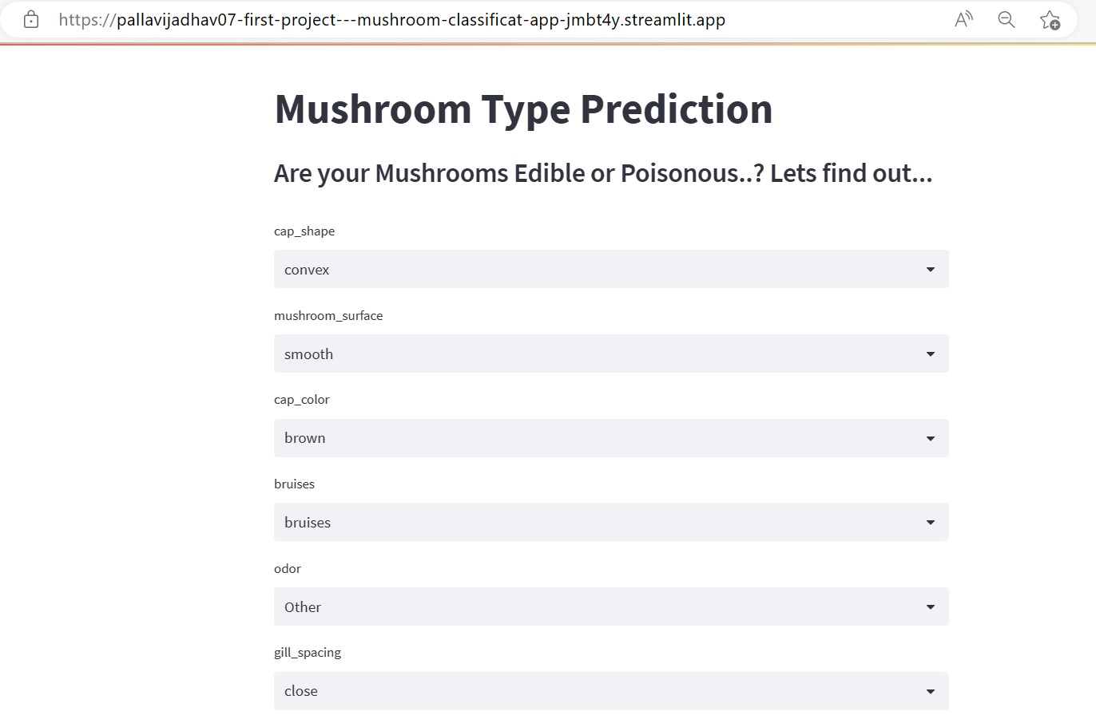
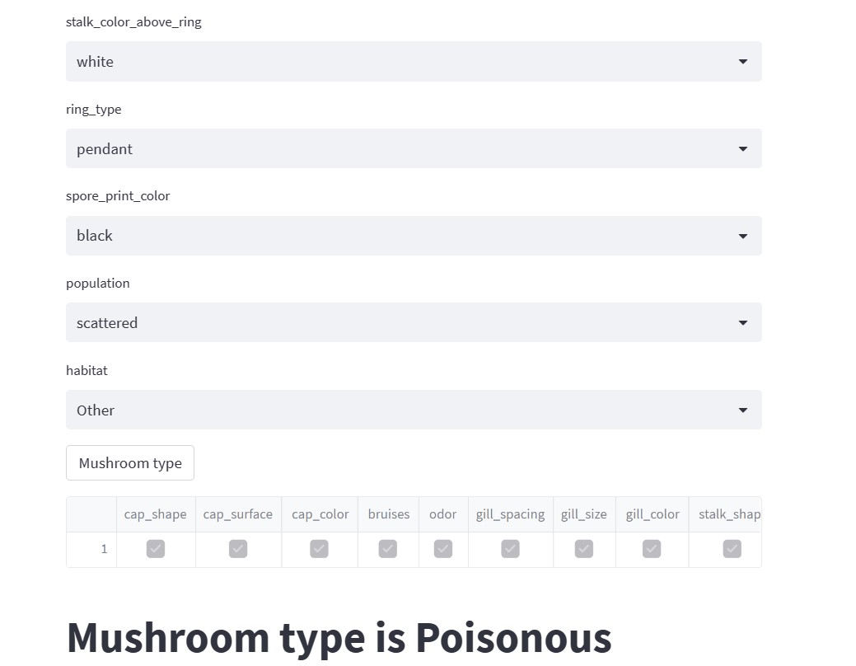
Model Deployment using Streamlit

Slide 21
THANK YOU

