Slide 1
RYTHU SEVA
Farmer Benefit Portal
A digital platform connecting farmers with government schemes,
agricultural services and financial benefits.
By
Dhanasani Himasai Tejaswani
1

Slide 2
Problem Statement
Why a farmer-focused digital portal is useful
Limited access
Scattered information
Benefit tracking
Scheme details, eligibility,
documents and official links
are not always available in one
simple place.
Farmers may need to visit
different offices or websites
to find schemes and services.
Farmers need a simple way to
view applications, benefits
and demo payment status.
Language barrier
Digital convenience
The portal supports English
and Telugu so information is
easier to understand.
A responsive interface can
bring important farmer services
together on low-cost devices.
2

Slide 3
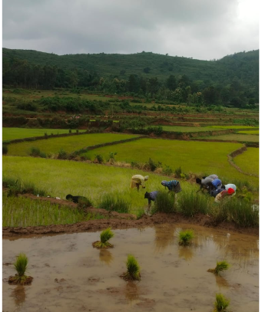
Proposed Solution
RYTHU SEVA brings key farmer services into one interface
• Central and Andhra Pradesh government scheme information
• Search and filter schemes by category
• Eligibility, benefits and required documents
• Official website links for further action
• Farmer profile and dashboard
• Benefits and payment-status demo
• English ↔ Telugu language switching
3

Slide 4
Key Features
What the current prototype demonstrates
Government Schemes
Scheme Search
Central + Andhra Pradesh scheme catalogue
Search schemes by name and category
Scheme Details
Farmer Dashboard
Description, eligibility, benefits and documents
Schemes, benefits, applications and bank status
Payment Demo
Documents
Sample benefit/payment status for demonstration
Checklist to help farmers prepare applications
Bilingual UI
Official Links
English and Telugu page-wide translation
Direct links to official scheme portals
4

Slide 5
Government Schemes Covered
Examples included in the project catalogue
Central Government
Andhra Pradesh
PM-KISAN • PMFBY • Kisan Credit Card
• PM-KUSUM • PMKSY
• Agriculture Infrastructure Fund
• Soil Health Card • FPOs
Annadatha Sukhibhava–PM KISAN
• Rythu Bharosa Kendras • Farm Mechanization
• APMIP • Crop Insurance • e-Panta
• Crop Damage Support • Horticulture & MIDH
Official access
Important note
The prototype provides official website buttons so
users can continue to the relevant government portal.
Scheme names, eligibility and guidelines can change.
A production version should verify current information
from official government sources.
5

Slide 6
Technology & Working
Frontend prototype architecture
HTML
CSS
JavaScript
Page structure, forms, dashboard sections,
scheme area and farmer information.
Agricultural green/blue theme, rounded cards,
hero background, responsive layout and
mobile design.
Search, filtering, scheme details, language
switching, login demo and
payment/document interactions.
Demo data & storage
Future backend
localStorage can retain demo language and
farmer-name/session information.
Secure authentication, database and
authorized government/financial integrations
would be required for real deployment.
6

Slide 7
Conclusion & Future Scope
• RYTHU SEVA brings farmer-focused information into one simple digital interface.
• It demonstrates scheme discovery, eligibility guidance, documents, dashboard services and bilingual access.
• Future versions can connect securely with verified government services and real application/payment data.
• The goal is to reduce information gaps and make farmer services easier to access.
🌾 RYTHU SEVA
Supporting Farmers
Strengthening Communities
7

Slide 8
website link:
https://rythusevafarmers.vercel.app/
Any Queries ?

Slide 9
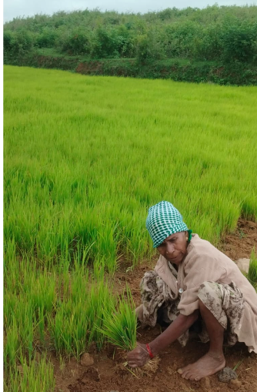
THANK YOU

