Slide 1

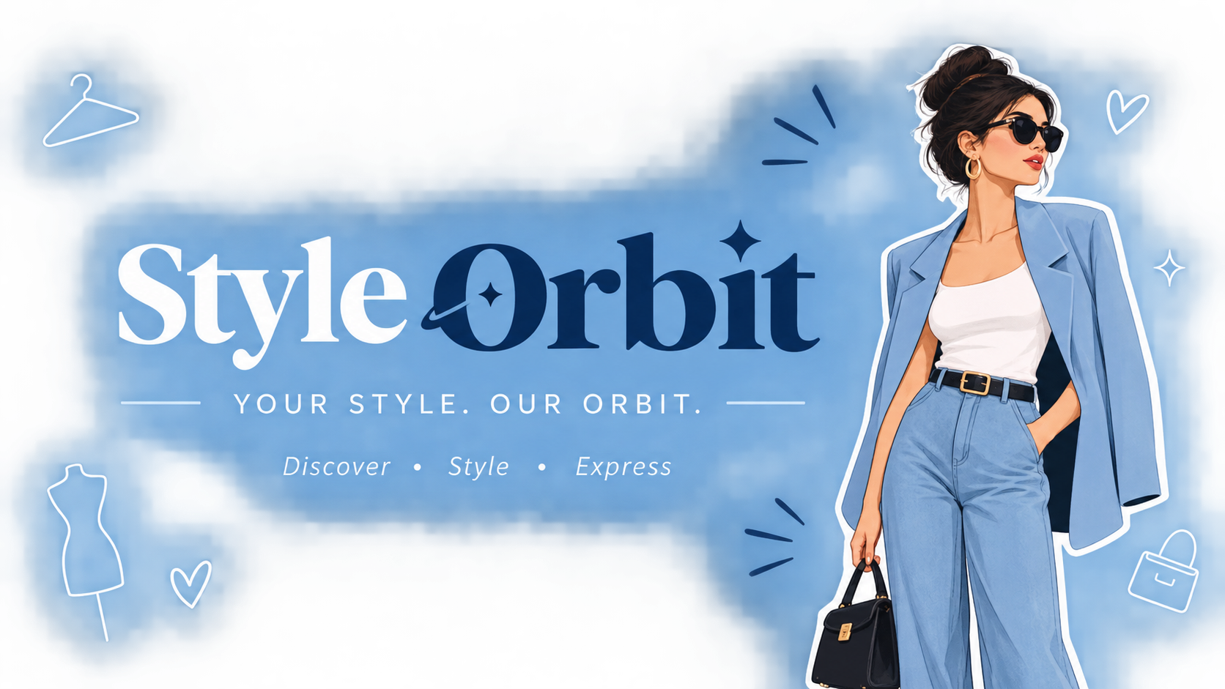

Slide 2
STYLEORBIT
Fashion Discovery Website
Discover Your Style
• Choose an Occasion
• Select an Outfit
Padma Labudubariki
T. Rohini Lavanya
Gemmela Abhitha
Killo Geetha
D Himasai Tejaswani
TEAM MEMBERS
JavaScript
HTML
CSS
👗
✓
👗
👠
StyleOrbit

Slide 3
Introduction & Problem Statement
The Challenge
The Idea
The Goal
• Browsing many outfit styles takes time.
• Finding an outfit for a specific occasion is difficult.
• Styles are rarely organized in one place.
StyleOrbit brings outfits together by occasion, in one simple and visual place.
Make fashion discovery easier and more organized.
StyleOrbit

Slide 4
Proposed Solution
Casual
College
Office
StyleOrbit provides a simple
occasion-based fashion discovery
experience.
Everyday styles
Smart & youthful
Professional
Party
Wedding
Traditional
Evening styles
Celebration wear
Ethnic styles
StyleOrbit

Slide 5
Technologies & Project Structure
A frontend web development project
CSS
JavascriptScript
HTML
Structure
• Creates website structure
• Navigation
• Hero section
• Occasion buttons
• Dress cards
• About and footer
Style
• Controls visual design
• Layout and spacing
• Colors and typography
• Cards and buttons
• Clean presentation
Behavior
• Adds user interaction
• Occasion filtering
• Scroll functionality
• Dress selection messages
StyleOrbit

Slide 6
Main Features
01
Explore
02
Choose
03
Browse
04
Select
Start from the hero section and explore the dress collection.
Select an occasion such as Casual, Office, Party or Wedding.
View outfit cards with images, names and descriptions.
Click the Select button to trigger an interactive JavaScript message.
StyleOrbit

Slide 7
User flow
1 Open StyleOrbit
function showDresses(category) {
// Shows the outfit cards for the chosen occasion
}
function scrollToDresses() {
// Scrolls down to the dress collection
}
function showMessage(text) {
// Displays a message when Select is clicked
}
2 Click an occasion
3 Browse dress cards
4 Click Select
5 Show the JavaScript message
StyleOrbit

Slide 8
Conclusion
StyleOrbit demonstrates how HTML, CSS and JavaScript can be combined to create a clean, visual and interactive fashion discovery website.
Webpage link: https://styleorbit.netlify.app/
Any Quereis ?

Slide 9
THANK YOU
Padma Labudubariki
Thaggi Rohini Lavanya
Gemmela Abhitha
Killo Geetha
Himasai Tejaswani Dhanasani
StyleOrbit

