Slide 1
Embedded Linux Development
Getting Started with the Raspberry Pi 4 Embedded Board

Slide 2
Outline
Introduction to Embedded Operating Systems
Taking off from where we left
Host, Target, Developmen Env, Debug Env and Operating Systems
The Linux Embedded System
The Basics - Tool chains, libraries, debuggers
The Board Support Package - Boot Loader, Kernel and File System
Introduction to Raspberry Pi4

Slide 3
Classifications of Embedded Systems
Owing to Memory Size & Power Consumption
Small ES - Low Power CPU, < 4MB ROM (Flash) and 8-16MB RAM
Medium ES- Med Power CPU, 32MB+ ROM and 64-128MB RAM with optional Secondary Storage
Large ES - High Power CPU, Large Memory Banks...
Owing to Timing Constraints
Stringent Deadlines - Hard and Soft Realtime
Mild Deadlines - Timing is not a major issue
Networkability
User Experience

Slide 4
Classification of Embedded Systems Programming
Hardwired Systems
Two-Tiered Architecture
Three-Tiered Architecture
User Space
Bare Metal Programming
User Application + Embedded OS / RTOS
Software
OS / Kernel Space
Hardware
Hardware
Hardware
Hardware

Slide 5
High End Embedded Systems – Components of the Board Development Environment
Software Terminologies
Toolchain - Set of executables that are required to compile and build an embedded systems image
Boot Loader – Piece of code which is required to load the Kernel and subsequent OS related software
Kernel - Part of the Operating System that provides its features and services
Root File System –
Software that abstracts the low-level hardware details and presents a logical file storage and access interface.
Contains all the files of the Operating System with a mechanism and programs to access them
Applications are developed and reside in the RFS and are accessed using various tools provided by the OS
Libraries – Pieces of code that implement specific functionality which can be used by other software
Build System
One on which the toolchain is built
Host Device
Any device capable of performing cross platform development
Linux Workstation, Unix System and Windows
Build the programs and create the object file, which will be executed on the target device
Target Device
The device onto which developed software has to be flashed and executed
X86, ARM, PowerPC, MIPS processor etc

Slide 6

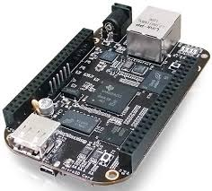
A Typical Embedded System Environment – Linked Setup
Kernel
Root Filesystem
Cross Platform Development Environment / Toolchains
Kernel
Root Filesystem
Bootloader
Build & Host Device
Target Device

Slide 7
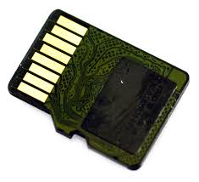
Development Configurations - Removable Storage Setup
Target Device
Cross Platform Development Environment
Bootloader
Secondary Bootloader
Kernel
Root Filesystem
Build & Host Device

Slide 8
Development Configurations - Standalone Setup
Bootloader
Kernel
Full Root Filesystem
Native Development Environment

Slide 9
The Embedded Linux Software Eco System
Build System for Linux Development
Toolchain
Board Support Package
Integrated Development Environment
Test Environment
Simulation/ Emulation Setup
Application Development Support
Target Hardware
Programming Flashing
Debug Environment
Compiler, Binary Utilities, Libraries
Boot Loader, Kernel,
Root File System

Slide 10
The Toolchain
“Building a [ … ] cross-toolchain for use in embedded systems development [ is ] a scary prospect, requiring iron will, days if not weeks of effort, lots of Unix and Gnu lore, and sometimes willingness to take dodgy shortcuts.”
-Dan Kegel, the main author of Crosstool

Slide 11
Toolchain
Compiler
Cross Compiler & Cross-Native Compiler
Binutils
Assembler & Linker, Profiler & Coverage
Debugger
Kernel & Application Debugger
Tracing Analysis
Object Copy & Object Dump
Programmer
Flash programming
Linux Compiler & Embedded C Compiler
Library
Secondary Storage Setup & Removable Storage Setup
Linux Kernel Headers
C- Runtime Libraries: Glibc & uCLibC

Slide 12
Toolchain: 1. Compiler
Build System - The system on which the compiler is compiled
Host System - The system on which the compiler is executed
Target System - The system for which the compiler generates the executable and the system on which executable runs
Native Compiler
Cross Compiler
Cross-Native Compiler
X86/Linux OS
X86/Linux OS
X86/Linux OS
Build System
Host System
Target System
X86/Linux OS
X86/LinuxOS
ARM
Build System
Host System
Target System
X86/Linux OS
ARM
ARM
Build System
Host System
Target System

Slide 13
Compiler
Cross Compiler
The cross compiler is generated by compiling the compiler source code (gcc) for a target platform (eg. ARM) using the native compiler of the build system
Eg: Native gcc of x86 platform is used to compile the gcc for arm-linux, setting the target to be arm architecture
The cross-compiler executes on the host system, but generates the executable which can be run only on the target platform
Eg: arm-linaro-linux-gnu-gcc –o hello hello.c
Generated executable will execute on the target platform only
Usage
Required to compile the Bootloader, Kernel and other drivers, required for boot process of the target board

Slide 14
Compiler
Cross-Native Compiler
This compiler is compiled on the build system, using the cross compiler of the target
Generates an executable for the target platform, which is the native compiler for the target
Executes on the target platform and is used to generate executables on the target platform, for the target platform
Here, the host platform and the target platform remain the same
Usage
Included into the Root File System of the target platform and can be used directly on the board
Used to compile applications on the target platform

Slide 15
The Compiler (ARM-LINUX-GCC)
ARM-GNU Compiler Collection
Contains the program to understand the grammar of a language and generate the object file specific to a particular hardware platforms
Native Compiler and Cross Compiler
Pre-built or Sources
Popular Compiler Distributors for ARM
Linaro - https://releases.linaro.org/14.04/components/toolchain/binaries/
CodeSoucery - https://www.mentor.com/embedded-software/sourcery-tools/sourcery-codebench/overview
Crosstool-ng - http://crosstool-ng.org/download/crosstool-ng/
Musl-cross - https://bitbucket.org/GregorR/musl-cross
Application Binary Interface (ABI)
Allows portability across binaries generated by various toolchain vendors

Slide 16
Toolchain: 2. Binutils
Source: https://www.gnu.org/software/binutils/
Latest Stable Version: 2.30
Utility | Use
as | GNU assembler
ld | GNU linker
gasp | GNU assembler pre-processor
nm | Lists the symbols in an object file
objcopy | Copies and translates object files
objdump | Displays information about the content of object files
ranlib | Generates an index to the content of an archive
readelf | Displays information about an ELF format object file
size | Lists the sizes of sections within an object file
ar | Creates and manipulates archive content

Slide 17
Toolchains: Binutils
Use Cases
If binutils is to be used to generate executables for the target platform
The binutils are to be compiled with the native compiler of the host, specifying the appropriate target
If binutils is to be used in the target platform,
It should be compiled using the cross compiler of the target and shipped with the rootfs of the target

Slide 18
Creating the Build Environment
Build the toolchain which will be used to build other components for the board support package. This will execute on the host system
Compiler
Compiler
Use pre-built compiler (or)
Compile the compiler, debugger and binary utilities using native compiler and configurations
Debugger
Debugger
Bin-utils
Libraries
Headers
Bin-utils
Libraries
Libraries
Compile the libraries in the presence of its headers and create the images, using cross compiler
Use the Cross Tool Chain to build components that will run on the Target Device. These components will be loaded in the Root File System
CN Compiler
Debugger
Compile the debugger
Bin-utils
Set the environment for development
Environment

Slide 19
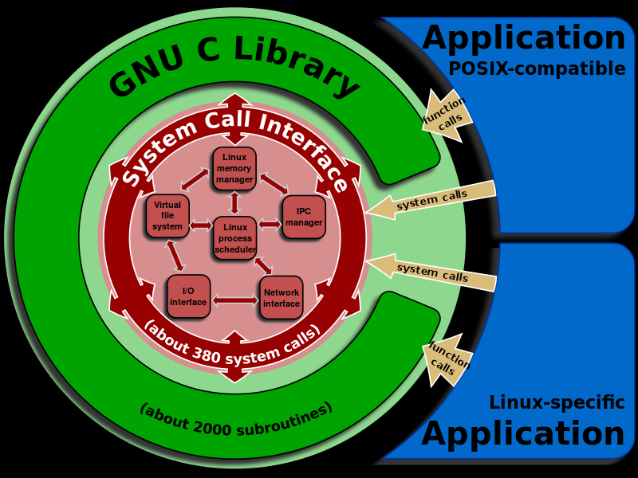
Toolchains: 3. Libraries

Slide 20
Toolchains: 3. Libraries
GNU C Library (glibC)
Source - https://www.gnu.org/software/libc/
Current Stable Version: 2.24
Portable, Extensive, High Performance
Supports ISO C99, POSIX 1.c, 1.j and 1.d, UNIX 98
Good for Host Systems, but falls short in Embedded Systems owing to large size. Minimum size is 2MB
Optimized for performance and not memory…
uCLibC
Small C Standard Library for Linux Kernel based Embedded Systems
Free and Open Source, complying to LGPL library
Light Weight supporting MMU-Less Linux
Supports number of hardware platforms
Source - https://uclibc.org/
Current Stable Version: 0.9.33.2

Slide 21
Toolchains: Headers
Required to compile the Library and User Applications for specific kernels
Sanitized Headers
Post 2.6 version of kernel, a sanitized version of the headers is generated for tool chain and application usage. This differs from the kernel headers, which contain inline assembly code, compromising the kernel, if used in application code

Slide 22

Debugger – Target-in-line
Open OCD running GDB Server with support for ARM
USB
Debug Adapter
Serial
Ethernet
Eclipse Based IDE
JTAG Signals
GDB Client + Insight
GDB Console
CPU Core
JTAG Core
USB/Serial
Host Device
Target ARM Board

Slide 23
Debugger – External
Target-in-line Debugging
Source level debugging of Linux Kernel & Bootloader
Support for debugging of dynamic modules
Integrates gdb with OpenOCD on the host, allowing the user to debug a remote target through a JTAG adapter
OpenOCD is supported by ARM architectures
Configuration scripts for CPU core and board should be developed for Open OCD to be used
Debug support for peripherals on the core and peripherals on the board may be architected as part of the design

Slide 24
Debugger – Internal
Application Debugging
User space application may be debugged using the gdb client server model, running on the target board
Native debugger (gdb) for the ARM architecture is required to perform the debug
Added into the Root File System of the target platform

Slide 25
Debugger – Linux Trace Toolkit
Host System
Eclipse Based IDE
Trace Analysis Software
Target Board
Trace Daemon
USB/Serial
Linux Kernel Patched with Trace Support
Trace - Kernel Module
VFS

Slide 26
Debugger
Linux Trace Toolkit
Includes kernel components and user-level tools required to view traces
Linux Kernel patched with trace support
Linux Kernel module which collects trace events
Trace Daemon that receives the trace events from the linux kernel and stores it into the Filesystem
Trace analysis tool that can be run on a remote system (host) for analysis
Trace support should be integrated with the kernel as part of project

Slide 27
The Board Support Package

Slide 28
Board Support Package Development
Boot loader
Uboot, Redboot, GRUB
Linux Kernel
Port Code Development & Porting to target platform
Device Tree Sources for Core and Board
Peripheral Drivers
Peripherals internal and external to the core
Multicore support
Interrupt Management
Networking Stacks
Boot Architecture - BIOS -> Level 1 Bootloader -> Level 2 Bootloader
Peripheral Driver support for booting
Root File System
Creating and populating the RFS
uCLibc/glibc
Utilities for development (Busybox) & Init Process for user space

Slide 29

Building the Sources
Bootloader
Toolchain Environment
Compile
Prepare the environment for booting the kernel
Transfer control to the kernel
Compile
Kernel
Populate
Boot the system and Load the Root Filesystem
Root File System
boot
bin
lib
home

Slide 30
The Bootloader
NO
Host Communication Start?
YES
Receive New Application from Host. Overwrite Existing
Load Application
HALT
NO
YES
YES
YES
NO
NO
Bootloader valid in flash?
YES
Application valid in Flash
YES
Wait for new app from host
YES
Wait Indefinitely?
NO
Host Communication Start?
NO
Timeout
RESET
START
NO

Slide 31
The Bootloader - GNU Grand Unified Bootloader (GRUB)
Developed by Free Software Foundation
Provides Multi-boot facility to load multiple operating systems
Highly configurable through bash-like command line interface
Supports almost all filesystem types
Two Stage Loading
Ref: https://www.gnu.org/software/grub/
Supports Ethernet, USB and SATA based loading of the kernel

Slide 32
The Bootloader - uboot
Multi-platform, open-source, universal boot-loader with comprehensive support for loading and managing boot images, such as the Linux kernel
Features
Network download: TFTP, BOOTP, DHCP, NFS
Serial download: s-record, binary (via Kermit)
Flash management: copy, erase, protect, cramfs, jffs2
Flash Types: CFI NOR-Flash, NAND-Flash
Memory utilities: copy, dump. crc, check, mtest
Mass Storage Devices: IDE, SATA, USB
Boot from disk: raw block, ext2, fat, reiserfs
Interactive shell: choice of simple or "busybox" shell with many scripting features
Powerful Commandline Interface via Serial Port
Ref: https://sourceforge.net/projects/uboot/

Slide 33
The Linux Kernel…
Contains the Operating System code and low level drivers/modules to interact with hardware and provide services to the user….
Latest Stable Version is 5.9.6
Ref: www.kernel.org

Slide 34
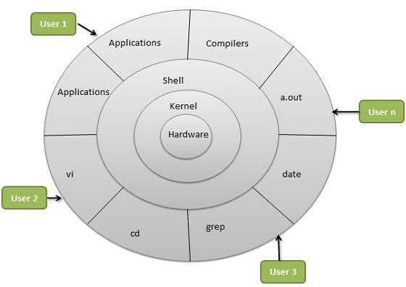
The Linux Operating System Architecture

Slide 35
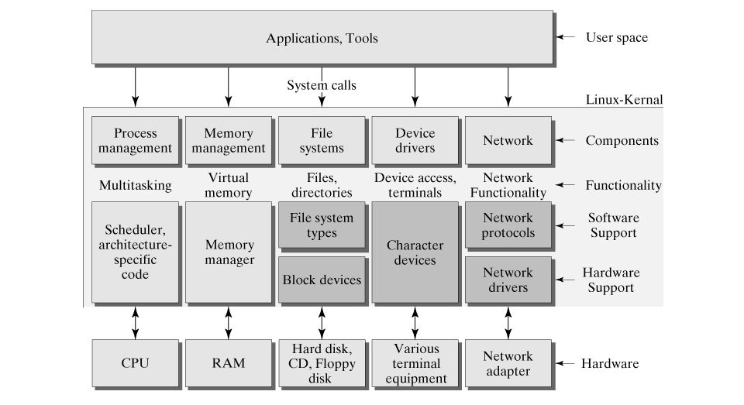
The Linux Kernel Architecture

Slide 36
The Rootfilesystems
Contains the applications, services, libraries and other executables that a user may require to run his applications.
Created with a specific filesystem type – ext2,3,4, fat32, squash, flashfs, etc
Loaded by the kernel for user applications to proceed
All libraries and native tools for further build are stored in the rootfilesystem

Slide 37
Embedded Systems – Board Development Environment
Build System
One on which the toolchain is built
Host Device
Any device capable of performing cross platform development
Linux Workstation, Unix System and Windows
Build the programs and create the object file, which will be executed on the target device
Target Device
The device onto which developed software has to be flashed and executed
X86, ARM, PowerPC, MIPS processor etc
Development Configurations
Linked Setup
Removable Storage Setup
Standalone Setup

Slide 38
Pre-requisites to get an embedded board running Linux
Tool Chain – Set of software tools needed to build computer software
Compiler
Native– Compiled on one architecture and runs on the same architecture (gcc for x86)
Cross Toolchain– Compiled on one architecture, runs on that architecture and builds code for another architecture (arm-linux-gcc)
Cross Native Toolchain – Compiled on one architecture, runs on a target architecture and builds code for the target architecture
Library: Glibc, uClibc, newlibC
Headers: For Prototype declarations and resolving
Bin-utils: Linker, Assembler, Object File Interpreters (objcopy, objdump), etc…
Debugger: gdb
Bootloader
Grub, uboot, redboot,
Kernel
Requires platform specific port code and configurations
Sometimes, Board to platform bindings are also required
Root Filesystem

Slide 39
Thanks

Slide 40
The Raspberry Pi4

Slide 41
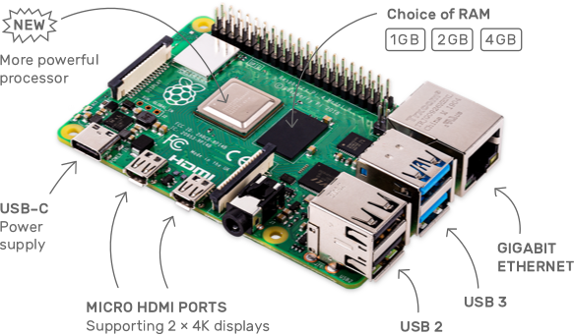
Raspberry Pi4
Tech Specs
Broadcom BCM2711, Quad core Cortex-A72 (ARM v8) 64-bit SoC @ 1.5GHz
2GB LPDDR4-3200 SDRAM
2.4 GHz and 5.0 GHz IEEE 802.11ac wireless, Bluetooth 5.0, BLE
Gigabit Ethernet
2 USB 3.0 ports; 2 USB 2.0 ports.
Raspberry Pi standard 40 pin GPIO header (fully backwards compatible with previous boards)
2 × micro-HDMI ports (up to 4kp60 supported)
OpenGL ES 3.0 graphics
Micro-SD card slot for loading operating system and data storage
5V DC via USB-C connector /GPIO header (minimum 3A*)
Power over Ethernet (PoE) enabled

Slide 42
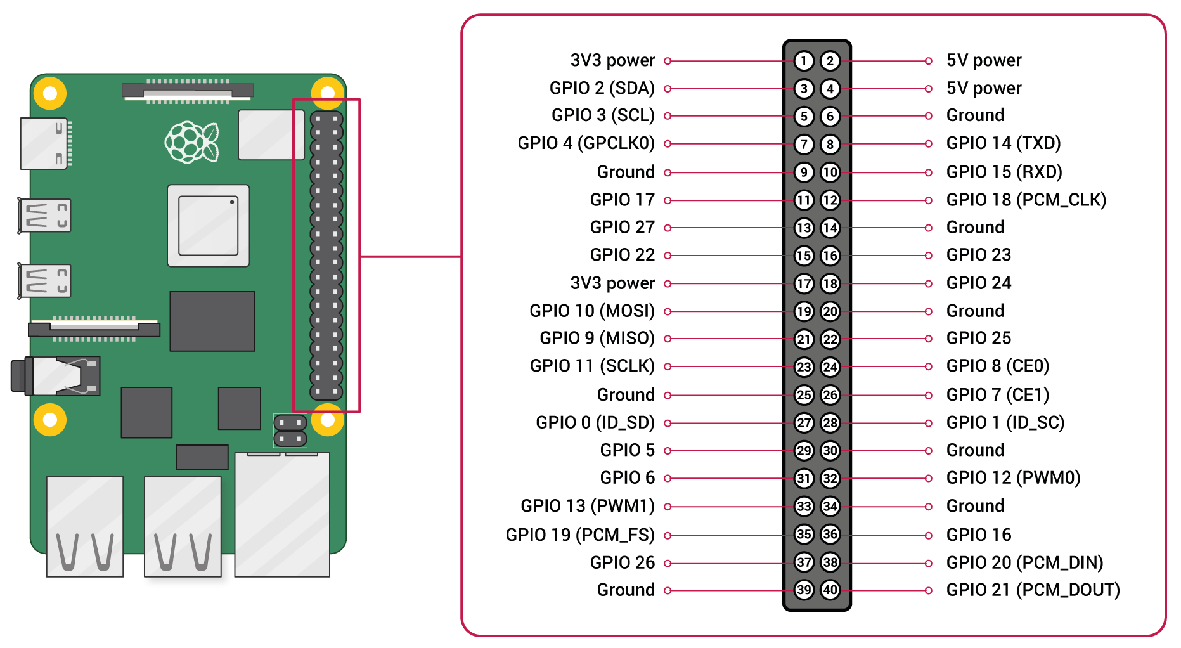
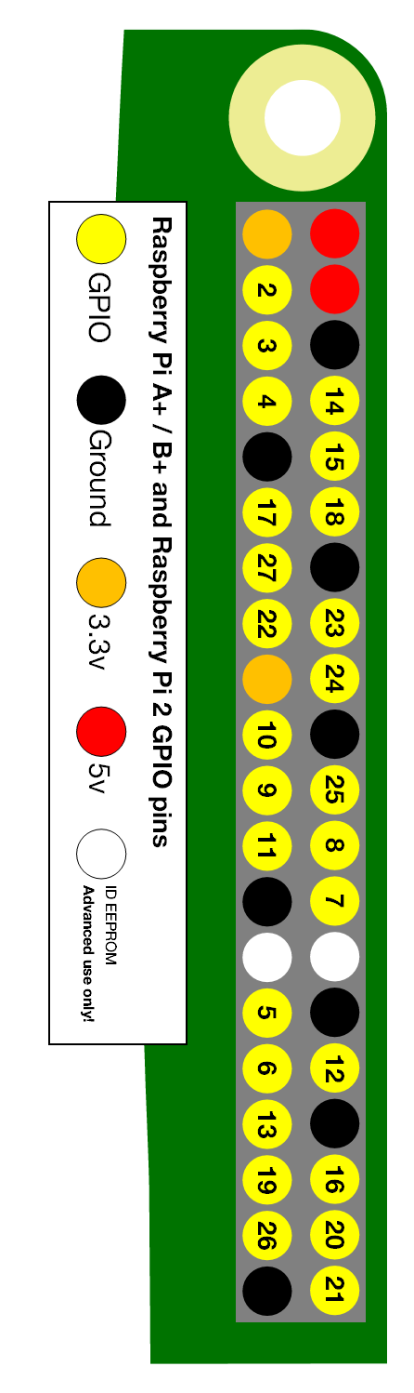
GPIO Available

Slide 43
OFF TO DEVELOPMENT
Create the SD Card Image for the Raspberry Pi4 Board
Download the SD Card image from your FTP – It is stored by the name Rpi.img
This image has to be flashed onto the SD Card before booting the Pi
Insert the SD card into the SD card Reader
Unmout the SD Card Reader: sudo umount /media/<check the name of the card>
Transfer the image to the SD card: dd if=Rpi.img of=/dev/sdb bs=4M. This will take about 40 mins.
Once completed, insert the SD card into the board. Follow the notes mentioned here and start programming
Creating the Cross Development Environment
Download the folder DeviceDrivers.zip from FTP
Unzip the folder into your home directory – unzip DeviceDrivers.zip
Change Directory to DeviceDrivers
Follow instructions in the install-Rpi.txt to install the Cross Development Environment
NOTES
Default IP on the Raspberry Pi4 is set to: 192.168.0.10
Set your PC to 192.168.0.2 using the following command: sudo ip addr add 192.168.0.2/24 dev <iface name>
Connect to the Board by executing the following on the terminal: ssh –X pi@192.168.0.10 . Password is cdac@123
Start Your Programs in DD-Progs Folder.

Slide 45
Toolchain References
Linux From Scratch project (http://trac.cross-lfs.org)

Slide 46
Debug Options
Serial Interface
UART/USB
Network Interface
Ethernet Protocols
Debugging Hardware
JTAG

Slide 47
Buildroot

Slide 48
Open Embedded and Yocto Project

Slide 49
Device Tree Sources…

