Slide 1




Linux Kernel Programming
Santosh Sam Koshy
JD, C-DAC Hyderabad
santoshk@cdac.in

Slide 2
Agenda
Kernel Classifications
The Linux Kernel
Module Programming
References

Slide 3
Kernels & Classifications

Slide 4

What is the KERNEL?
Central component of most computer operating systems
Primary Purpose is to
Manage Resources - Allow multiple process to use the resources
Provide services to various processes
Resources consist of:
Central processing unit (CPU)
Computer's memory
Input / Output devices
KERNEL

Slide 5
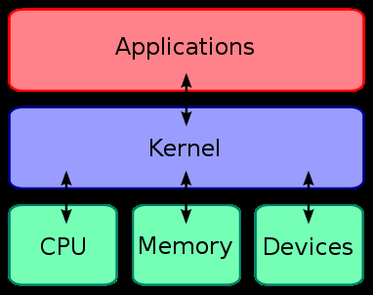
Kernel Layout
USER
Implementation
detail
Abstraction
*reference: wikipedia

Slide 6
Kernel Services
The whole kernel entity can be split into following different units according to their roles:
Process management
Memory management
File systems
Device control
Networking
Seperate Entities, working together.....

Slide 7
Kernel Explanation
System library
Kernel
System Call
R1
USER
Application
R2
R3
R4
R1, R2, R3 and R4 are 4 different resources

Slide 8
Kernel Explanation contd..
System library
Kernel
System Call
R1
USER
Application
R2
Request
made by user
R3
R4
R1, R2, R3 and R4 are 4 different resources

Slide 9
Kernel Explanation contd..
System library
Kernel
System Call
R1
USER
Application
R2
R3
App. forwards
the request to
sys lib
R4
R1, R2, R3 and R4 are 4 different resources

Slide 10
Kernel Explanation contd..
System library
Kernel
System Call
R1
USER
Application
R2
R3
Lib makes sys call
R4
R1, R2, R3 and R4 are 4 different resources

Slide 11
Kernel Explanation contd..
System library
Kernel
System Call
R1
USER
Application
R2
Sys call
interface
traps
request and
passes to kernel
R3
R4
R1, R2, R3 and R4 are 4 different resources

Slide 12
Kernel Explanation contd..
System library
Kernel
System Call
R1
USER
Application
R2
R3
Kernel access
the resources
required for
the request
R4
R1, R2, R3 and R4 are 4 different resources

Slide 13
Kernel Explanation contd..
System library
Kernel
System Call
R1
USER
Application
R2
R3
Kernel completes
the request
by accsssing
and managing
required resources
R4
R1, R2, R3 and R4 are 4 different resources

Slide 14
Kernel Explanation contd..
System library
Kernel
System Call
R1
USER
Application
R2
Returns
the result
to corres-
ponding
syscall
R3
R4
R1, R2, R3 and R4 are 4 different resources

Slide 15
Kernel Explanation contd..
System library
Kernel
System Call
R1
USER
Application
R2
R3
Syscall returns the
Result to correspnding
Calling function
R4
R1, R2, R3 and R4 are 4 different resources

Slide 16
Kernel Explanation contd..
System library
Kernel
System Call
R1
USER
Application
R2
Library func
returning result
to applicaton
R3
R4
R1, R2, R3 and R4 are 4 different resources

Slide 17
Kernel Explanation contd..
System library
Kernel
System Call
R1
USER
Application
R2
Application completes
the request and
returns the result to
user
R3
R4
R1, R2, R3 and R4 are 4 different resources

Slide 18
Kernel Classifications
Kernels
Monolithic Kernels
Micro Kernels

Slide 19
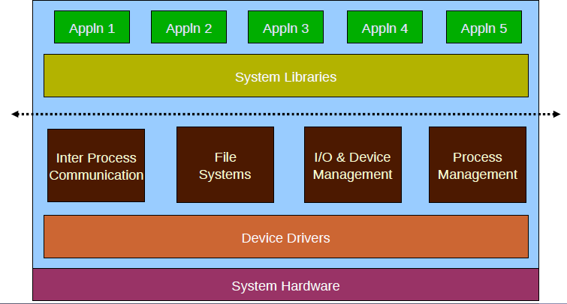
Monolithic Kernels

Slide 20
Monolithic Kernels
All the parts of a kernel like the Scheduler, File System, Memory Management, Networking Stacks, Device Drivers, etc., are maintained in one unit within the kernel
Advantages
Faster processing
Disadvantages
Prone to crash
Porting Inflexibility
Kernel Size explosion
Examples
MS-DOS, Unix, Linux, etc...

Slide 21
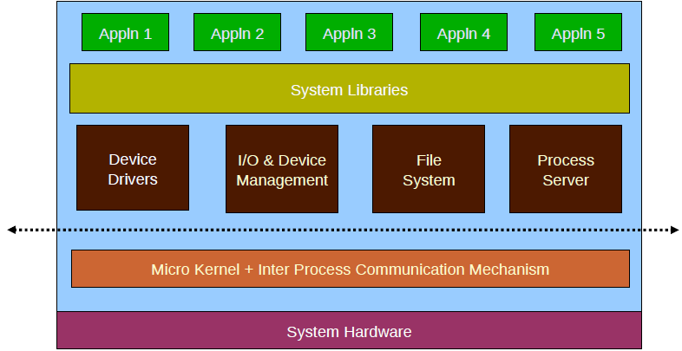
µ-Kernels

Slide 22
µ-Kernels
Only the very important parts like IPC, basic scheduler, basic memory handling, basic I/O primitives etc., are put into the kernel. Others are maintained as server processes in User Space
Advantages
Crash Resistant, Portable, Smaller Size
Disadvantages
Slower Processing due to additional Message Passing
Examples
QNX, Minix 3, EROS, KeyKOS, Windows NT

Slide 23
The Linux Operating System

Slide 24
Linux Overview
Applications/Processes
Linux Shell
Linux
kernel
Linux Distribution

Slide 25

Linux Distributions
In addition to the Linux kernel, it includes:
Extra system-installation utilities
Pre-compiled and ready to use packages of many tools
Like Web browsers, games, editors, music players etc.
Notes:
Today Linux installation is quite a easy task. But in Linux's early days, it was a bit difficult to complete this operation. Just to ease this work, many individuals and groups provided so many different pre-compiled sets of packages, utilities that is kept along with Linux system. This whole set along with Linux system is known as Linux distribution. Few examples of distribution are Red Hat, Ubuntu, SUSE etc. Even you can see the slide to see some other distributions along with their icons.

Slide 26
The Linux Kernel
Started off in 1991 by Linus Torvalds as a simple terminal driver
Distributed under the GNU General Public License as a Free and Open Source Kernel
The latest stable version of the kernel is 5.9+
The kernel can be freely downloaded in source code from www.kernel.org

Slide 27
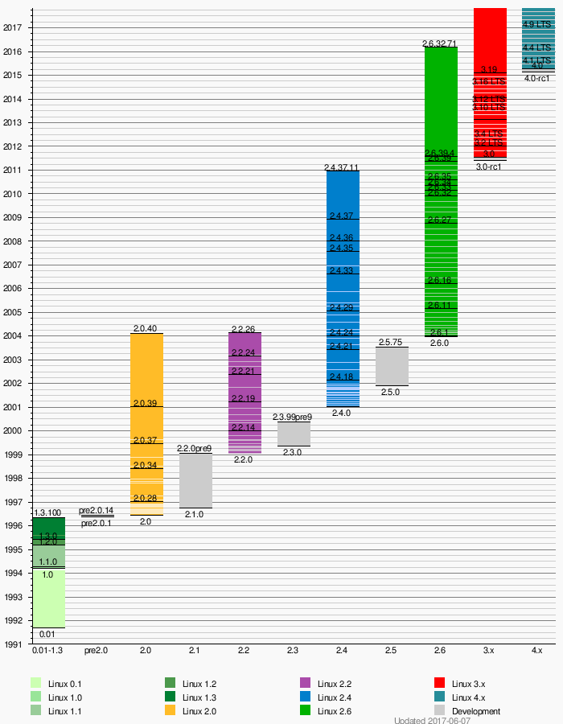
Kernel Versioning
* reference : wikipedia
Notes:
In the above diagram, you can see the different version of Linux that are released. At the time of writing this tutorial 2.6.31 version of kernel is released. Now, lets know the meaning of version number. The version is composed as A.B.C
A = kernel version
B = major revision of kernel
C = minor revision of the kernel
Odd major number means the kernel is under-development and it's unstable while even major number means a stable Linux kernel.
Now one thing that you can mark here is after release of new major version, the old version graph is simultaneously going through. For instance you can see, after release of 2.6 version still 2.4 graph is rising. This tells that still development in that version is continued and support to that version is available. Major version change is done only when some really major changes takes place in Linux kernel. So, for example, in 2.6 pre-emptive scheduler is implemented which was not there in 2.4. So, developers are having two different types of kernel, That's why, work is going into both the kernels one with pre-emptive kernel and other with non pre-emptive kernel.

Slide 28
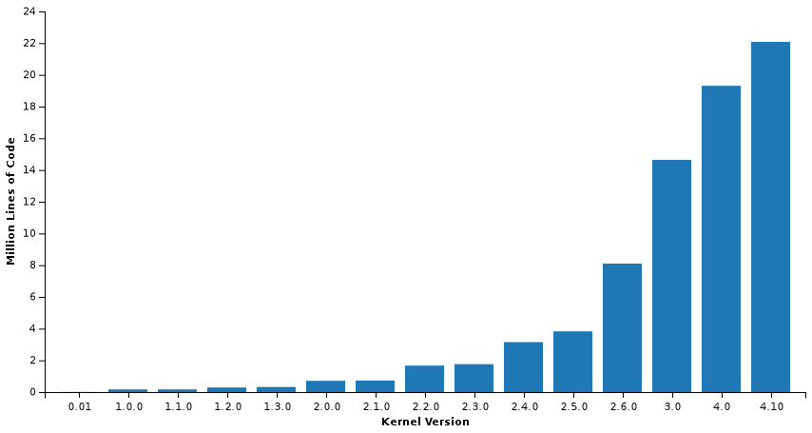
Kernel Development

Slide 29
Module Programming

Slide 30
The Linux Kernel & Modules
Every piece of code in the kernel is written as a module
2 Types of Modules
Static Modules
These are loaded with the kernel at boot time as a homogenous image in the kernel
Dynamic Modules
These are loaded dynamically into the kernel at anytime (Boot time & Run Time)
When these are loaded into the kernel, they form a homogenous part with the kernel
They can be removed when not in use/required

Slide 31
Supports Dynamic Module Loading
Dynamic Module #1
Kernel Core with static modules compiled in
Scheduler
Interrupt Management
Process management
File systems
Memory Management
Few Device Drivers
Dynamic Module #4
Dynamic Module #2
Dynamic Module #5
Dynamic Module #3
Dynamic Module #6

Slide 32
Supports Dynamic Module Loading
Kernel Core with static modules compiled in
Scheduler
Interrupt Management
Process management
File systems
Memory Management
Few Device Drivers
Dynamic Module #1
Dynamic Module #4
Dynamic Module #2
Dynamic Module #5
Dynamic Module #3
Dynamic Module #6

Slide 33
What are Modules???
Simple pieces of C Code.....
Loaded at Runtime within the kernel ... No Reboot required...
No main( ) function like normal C programs
Provides Initialization and Cleanup Functions as entry & exit points to the Module

Slide 34
Applications vs Modules
Event Driven Execution
Libraries
Floating Point Operations
Segmentation Faults
Debugging
Stack Limitations
Infinite Looping

Slide 35
What composes a module program?
Module Initialization
Module De-Initialization
Compilation & Loading a Module
Utilities to view/manage/remove a module
Insmod, lsmod, rmmod, dmesg
The Makefile to compile a kernel module
Module Parameters – Passing command line arguments
Sharing data between modules – The Kernel Symbol Table

Slide 36
Programming Template of Modules
Module Initialization
Mechanism of registering with the kernel
A module always begin the function you define with module_init()
This the entry point for the module
It tells the kernel what functionality module provides
Once it's done, init function returns and module remain in kernel waiting to be called
Calls are executed by user space application or system hardware

Slide 37
Module Initialization
#include <linux/init.h>
#include <linux/module.h>
static int hello_init(void)‏
{
printk(“\nHello, World\n”);
return 0;
}
module_init (hello_init);

Slide 38
Programming Template of Modules
Module Cleanup
A module ends by calling module_exit() function.
Exit point for the module
It undoes whatever initialization function performed
It unregisters the module from the kernel

Slide 39
Module Cleanup
#include <linux/init.h>
#include <linux/module.h>
static void hello_exit(void)‏
{
printk(“\nGoodye, World\n”);
}
module_exit (hello_exit);

Slide 40
Important MACROs
module_init (Any Name for your init function)
module_exit (A suitable name for your exit function)
What ever name is passed to the above macros should be defined as the name of the init and exit functions
Additional Macros - Declared anywhere within the module
MODULE_LICENSE(“GPL”): It's not necessary
Without this kernel gives warning message of kernel tainted
Few licenses that it understands is GPL, GPL v2 etc
MODULE_AUTHOR(“AUTHOR_NAME”): author name
MODULE_DESCRIPTION(“DESCRIPTION ABOUT MODULE”):
MODULE_ALIAS(“ALIAS NAME FOR MODULE”)
Notes:
First thing which are compulsory for each module is module initialisation and then module exit. Module initialisaton function can be any name but that should be intiamted to kernel that this function is going to work for module initialisation. For that module_init() macro is there. The return value of this macro is zero for success and non-zero for some error. Similarly, to initiamte for exit function module_exit() is there.
Besides these compulsory macros few macros can be used as a optional macros which can tell some basic information about your module. Some example are given in the above slide.

Slide 41
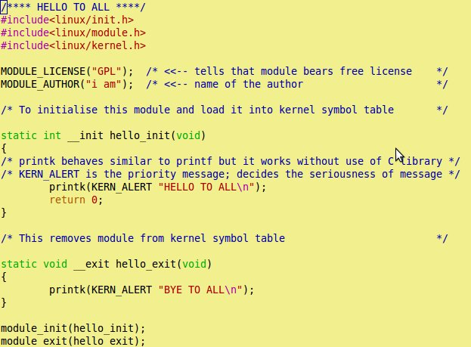
So, How does the program look??
Your first C program
without main
Hello.c
To make it to local to this
module only
It says that the given
function is used only
at initialisation time
This unloads all
the resources
loaded by
__init function
It's like printf. Prints
value into kernel log
message
Notes:
Here you can see our “Hello To World” C program. One thing that you will notice here that there is no any main to start your program instead there is one init function and one exit function. Init function initialises your module and registers the module in kernel. Exit function unloads the module from the kernel. module_init() and module_exit(), are two macros which declare your hello_init and hello_exit, which are user defined, as the init and exit function respectively. Kernel module programming does not include any standard C library because C library is inaccessible in kernel space. To provide the similar functionality within kernel a symbol table is maintained which consists of required functions like printk needed by kernel modules. At the time of loading of kernel modules into the kernel, dependency check is done and required modules are loaded into kernel. Module loading we will discuss in later sections. There you will become more clear about the dependency and symbol table.
You must be able to see that functions are declared as static. Declaring it as static, keeps this function local to this module only. It is quite required to do so because this small module when inserted into the kernel can cause function name clash. There could be some other functions in kernel with same name, so it's necessary to make your function or variable as static to keep its scope local to the module only.

Slide 42
The Kernel Makefile
obj-m := hello.o
//For Native Compilation Platform
KERNELDIR = /lib/modules/$(shell uname -r)/build
//For Cross Compilation Platform
KERNELDIR = /lib/modules/<YourKernelModulesInstallPath>/build
PWD :=$(shell pwd)‏
default:
$(MAKE) -C $(KERNELDIR) M=$(PWD) modules

Slide 43
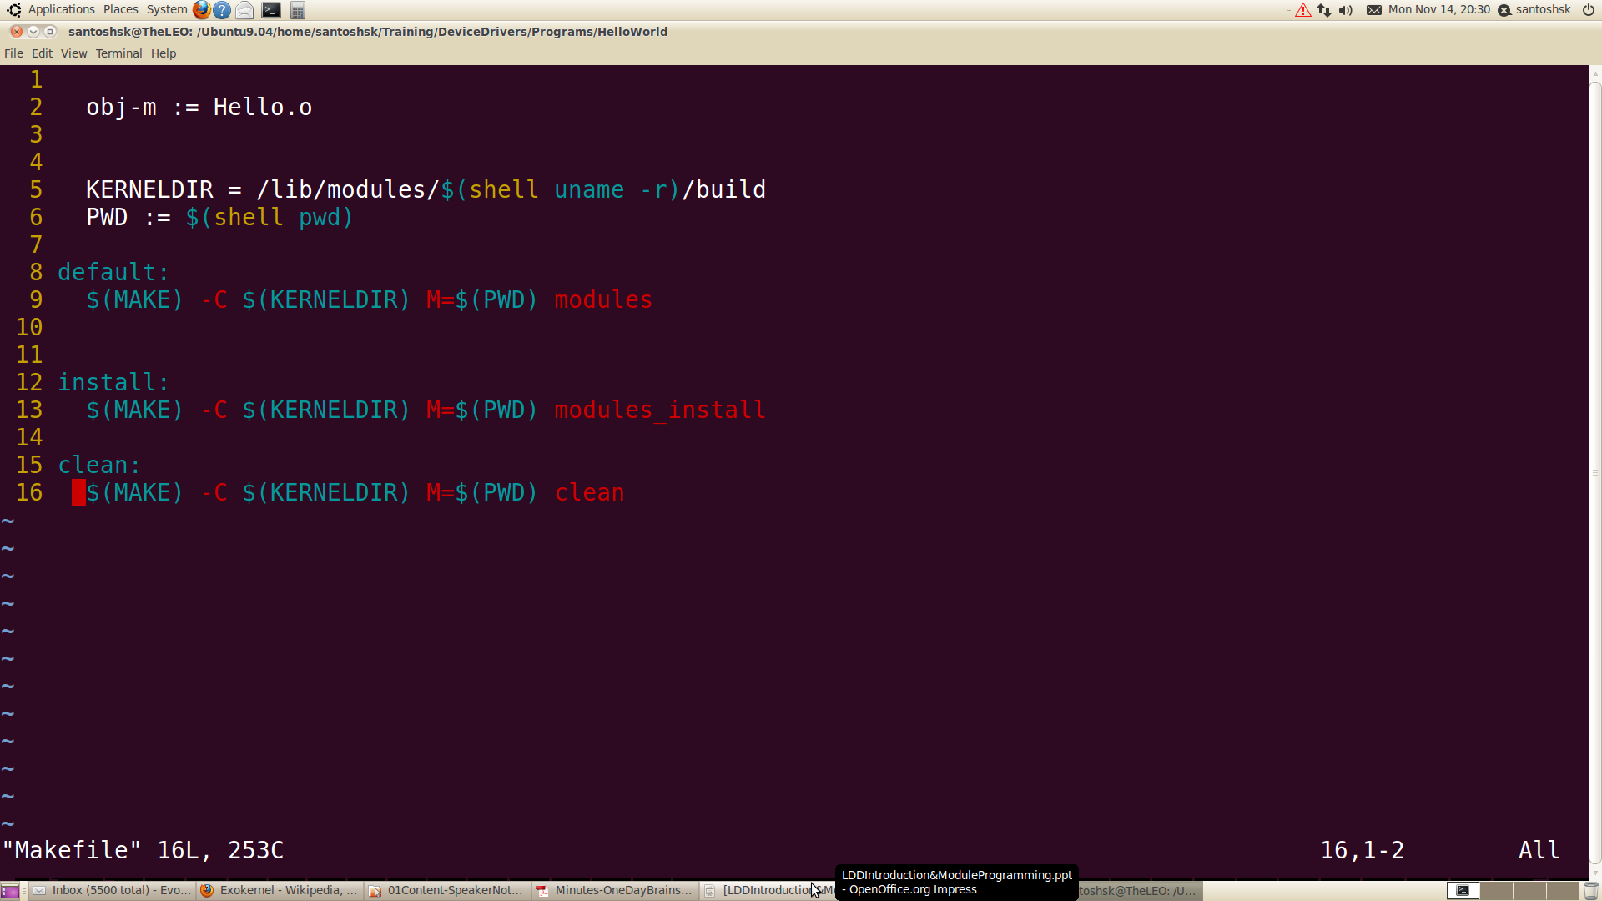
Makefile
This name should be
similar to source file.
Extension should be .o
These variables store the
path of main Makefile and
present working dir path
Notes:
Now when we are done with our kernel module, we need to compile it to create the kernel object file(.ko) which will be loaded into the kernel. But for compilation we make a Makefile that will do the cumbersome process of compilation for us. Above is the code you can see for the Makefile. The name of the file should be “Makefile”.

Slide 44
Compiling & Loading the Module
linux:~ $ make
linux:~ $ su
linux:~ # insmod ./hello.ko
linux:~ # dmesg
linux:~ # lsmod
linux:~ # rmmod hello

Slide 45
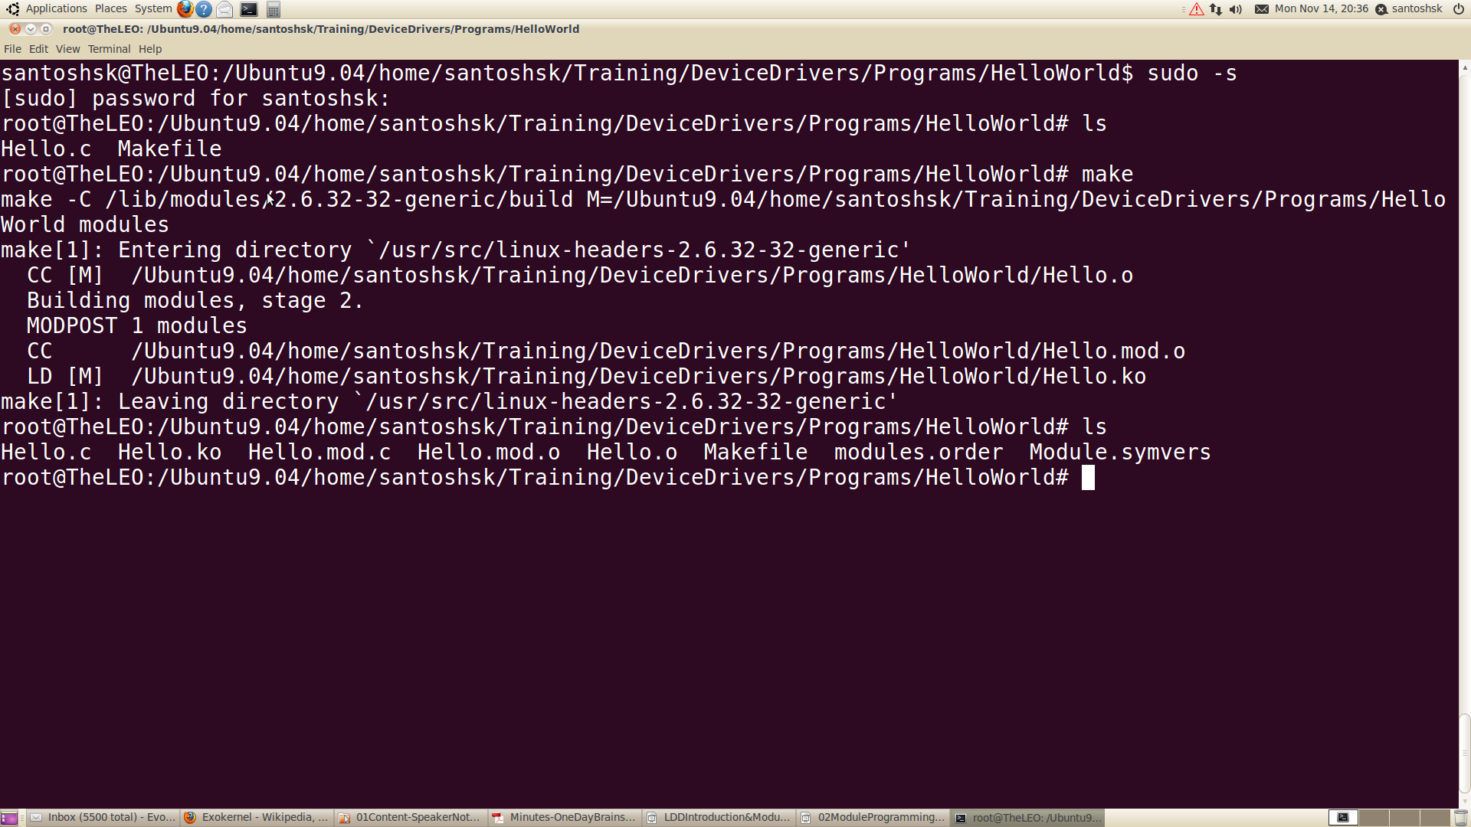
Compilation
Notes:
Our module nake is kern_mod.c. You can see the listing of files using ls command. Here we have two files one is the source code and other is Makefile. To compile your code using Makefile, use make command. This compiles your code and if everything is proper it creates .ko file along with some other files. Try to open and see those files. Explanations of these files are left as a assignment for you.
kern_mod.ko is our kernel object file which we will load into the kernel in next slide.

Slide 46
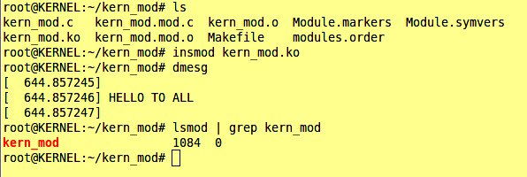
Inserting our “Hello To All” module
To insert modules commands are : insmod and modprobe
dmesg -c is for clearing
the kernel log messages
insmod is used to insert
our kernel module (.ko) into kernel space
Output can be seen from
kernel log messages which can be seen using dmesg command
lsmod: To see our module is inserted in kernel
Output message printed
by our module
Notes:
After compiling, we are ready for loading our module into the kernel. There are two tools that can do this for you: insmod and modprobe. Here we discuss insmod, modprobe will be discussed later. In the slide you can see how to insert our module into kernel. To load and unload, root permission is required. When that is done type dmesg command to see the output printed by our “Hello To All” module. Now when we inserted our module, hello_init function, which is our init function, gets executed and it prints the message.
Even we can see that our module is there in kernel or not. For that the command is lsmod. As you can see in the slide the output of lsmod shows our kern_mod.

Slide 47
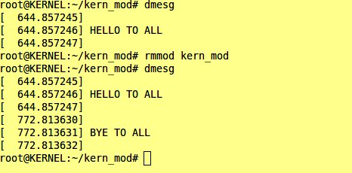
Module unloading
To remove kernel module : rmmod
Root permission is
required
rmmod and the name of your module, removes the module
In dmesg, we can see the output printed by our exit function
Now when you will do lsmod, our module will be missing from there.
Notes:
To unload the module rmmod command is used. As you can see the slide, after doing rmmod we got the hello_exit() function's output. But if your module is used by some other modules also and if you try to remove your module it will not be unloaded. Modules can be unloaded only when no other modules are using it.

Slide 48
Module Parameters
Parameters/Command Line Arguments may be passed to the modules during module insertion
The macro “module_param (name, type, perm)” is used to initialize the parameter at runtime.
It takes 3 arguments which are the parameter name, parameter type and the permissions associated with the parameter
This macro may be defined anywhere in the module

Slide 49
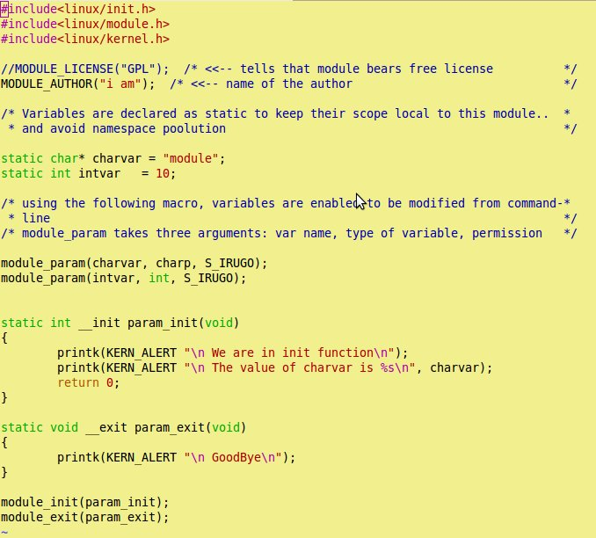
Parameter Passing
This Macro is used
to mention that these
variables can be
initialised from
command line
charp = character
pointer
bool = boolean
invbool = inverted
Boolean
Rest are same data
types
Notes:
Parameter passing to a module is similar to passing command line argument to the normal C program. Difference is only in the declaration portion. Here, there is no any concept of *argv or argc. To take any value for any variable from the command line, we have to declare that using a macro maodule_param() this takes three arguments: 1. variable name- which we want to pass value from command line; 2. data type of the variable; 3. permissions- who can enter the data for this variable.
In the above program you can see that we are using two variables charvar and intvar of data type charp and int respectively. If we are not passing any values from command line, variables are going to take default value with which we initailised it. But if we are passing any data to our variable through command line, default value will be overwritten.

Slide 50
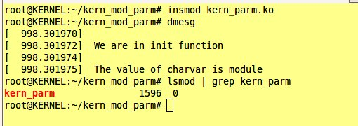
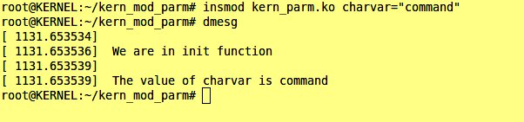
Parameter Passing ...
No parameter
Printed local value
Passing command line
parameters
charvar is a charp
variable we defined in
module
Printed command line value
Notes:
Here you can see that for the first case we are not passing any data to our variables. So, output printed is the default value that we have assigned to the variable at the time of initialisation. In the second case we can see how to pass values to the variable through command line. Even we can pass for multiple variables also, we just have to use variable name and the value we want to give for example, if we are passing data to intvar, it can be done in:
insmod kern_parm.ko charvar=”command” intvar=10

Slide 51
Library Support
Standard C library functions cannot be used in module programming
Functions/Variables shared between modules have to be exported as kernel symbols into a global space
To see the symbols exported into the kernel “cat /proc/kallsyms”
printk() is one such example
External symbols used in a module (printk) should be resolved at runtime
If symbol is not found, module will not be loaded to kernel and return back with an error

Slide 52
The Kernel Symbol Table
lp
Parport_pc
Parport
Kernel Functions

Slide 53
The Kernel Symbol Table
Global Kernel Space
Modules can export services to other modules through the use of kernel macros “EXPORT_SYMBOL(name)”
It takes the name of the parameter or function as argument
This exported function may be used by other modules that require similar functionality
For example
Module 1 defines a function “int Add(int a, int b)” which takes two arguments and returns an integer output
This function is exported from Module1 to the Kernel Symbol Table using the macro “EXPORT_SYMBOL(Add)”
When this Module1 is inserted in the kernel, the exported symbol Add becomes available for other modules to use
Now, Module 2 can call the function Add() in its execution, provided Module1 is already inserted
Please Note
The order of insertion and deletion of modules should always be maintained for success

Slide 54
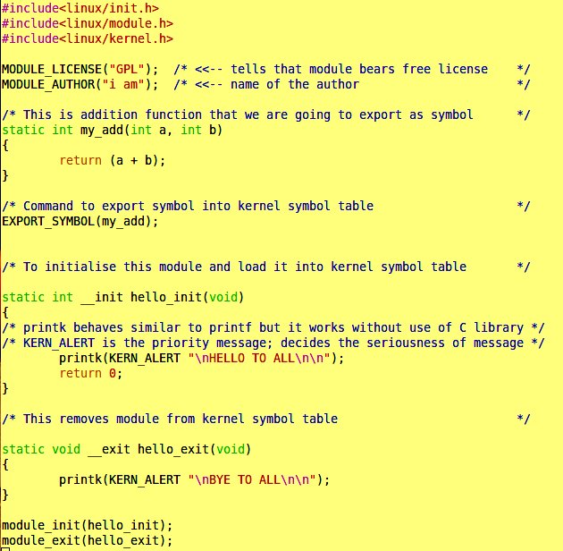

Exporting symbol – Module1
Program name kern_sym.c
This is a simple add
function declearation
that we are going to export
Command to export symbol
Header file containing
declaration of the add function
Notes:
Here, we are showing a sample program to export symbol to the kernel table. The funnction we want to export is my_add(). We defined the add function first anf then using EXPORT_SYMBOL() we exported it to kernel symbol table.

Slide 55
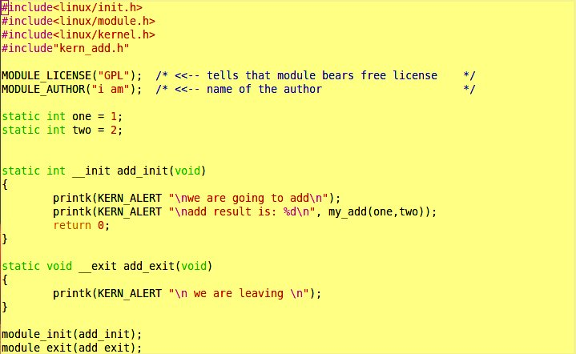
Exporting Symbol: Module2
Header containing
the declaration
of symbol
We are using the
symbol in this module
Notes:
Here, we are using the my_add function for the addition purpose.

Slide 56
Resolving Multiple Dependencies
What if, you had a module, that is dependent on 10 other modules?
Using insmod, you have to manually load each module in specific order, before you can load your module
Unloading also requires you to follow the same process
Is there no other mechanism to automate this??
Use modprobe
modprobe works in similar way as that of insmod, but it also loads any other modules that are required by the module you want to load.

Slide 57
Logically Thinking….
Questions/Doubts
How does the kernel know where these modules are?
How does the kernel know what are the symbols that are exported by each module?
Solutions
Provide a standard location from where the kernel will find the module
Provide a dependency file which resolves the modules dependencies on other modules that provide those functionalities

Slide 58
How modprobe works?
The Linux Kernel maintains a module dependency file which stores the dependencies of one module on the other.
Modprobe checks this file to resolve the dependency of modules and loads those corresponding modules
The file is called modules.dep and is located in /lib/modules/`uname -r`/
To know the dependency, modprobe looks into modules.dep file
Notes:
How modprobe knows that which module is dependent upon which module or symbol? It's a first question that must be coming to your mind. modprobe maintains one modules.dep file which contains all these information. When we do modprobe it looks into that file to see what are the dependency of the module and accordingly loads it. You can see modules.dep at /lib/modules/`uname -r`/
To update the modules.dep file depmod command is used. On the slide, you can see that how we can use depmod for updation of modules.dep file

Slide 59
How to update the modules.dep file?
This file is updated by the command ‘depmod –a’
depmod command searches standard locations where the kernel stores its required modules.
It opens the modules present in the standard location in the filesystem,
It identifies the symbols that are not resolved,
It searches for modules that export these symbols
It updates the modules.dep file to convey this information.
Alternately, to make depmod search into a user defined location on the filesystem, the absolute path of the module file should be provided to depmod
e.g depmod -a /home/user/test/kern_sym.ko /home/user/test/kern_add.ko

Slide 60
The mechanics of modprobe
modprobe can now search for the modules that export the unresolved symbols by looking into the modules.dep file and loading the corresponding modules
modprobe searches for modules in standard directories
/lib/modules/(kernel version)/
To put your modules in standard directories, use the label to execute the modules_install statement in your Makefile.
Notes:
Both insmod and modprobe ultimately loads module in the kernel but insmod does not checks for the dependency of modules over any other modules or symbol while modprobe does this thing very smoothly. With insmod we have to repeatedly do insmod for each module over which your module is dependent but with modprobe just one modprobe is enough to load all other modules over which your module is dependent. One problem with modprobe is that it searches at standard location only to search for the modules to load. If your module is at some other loaction modprobe is not going to search it there and will not load the module. In that situation modprobe is the solution but we can still use modprobe by doing one more step after compiling our kernel module. Just add these lines in your Makefle:
install:
$(MAKE) -C $(KERNELDIR) M=$(PWD) modules_install
And use make install command after doing make. This make install instruction will copy your modules .ko file at the standard loaction and then modprobe can be used from any location to load modules.

Slide 61
What should we do to use modprobe?
Modify the Makefile
Add these lines to Makefile:
install:
<next line><tab>$(MAKE) -C $(KERNELDIR) M=$(PWD) modules_install
depmod -a
Doing “make install” will create a folder named “extra” in /lib/modules/`uname -r`/ folder and copies all .ko files in the current directory into that folder
When we do modprobe, it takes .ko files from there and loads into the kernel
Notes:
We already discussed this method in previous notes. Go through it to have better unbderstanding.

Slide 62
Exporting Symbol – A few additions…
obj-y := AVG_MOD/ ADD_MOD/
KERNELDIR = /lib/modules/$(shell uname - r)/build
PWD := $(shell pwd)
default:
$(MAKE) -C $(KERNELDIR) M=$(PWD) modules
clean:
$(MAKE) -C $(KERNELDIR) M=$(PWD) clean
install:
$(MAKE) -C $(KERNELDIR) M=$(PWD) modules_install
depmod -a
EXPORT SYMBOL
ADD_MOD
.C
M
.C
AVG_MOD
M
MAKEFILE
Notes:
Only we need to add both the function module to compile.

Slide 63
References
Jonathan Corbet, Alessandro Rubini and Greg Kroah-Hartman,”Linux Device Drivers”,3rd Edition, O'Reilly Publications, March 2005
http://www.senet.com.au/~cpeacock, “Interfacing the Serial/ RS-232 port,V 5.0”
http://www.kernel.org
http://en.wikipedia.org/wiki/Linux_kernel
http://lists.ucc.gu.uwa.edu.au/pipermail/ucc/2003-June/009997.html

Slide 64
Thank You

