Slide 1

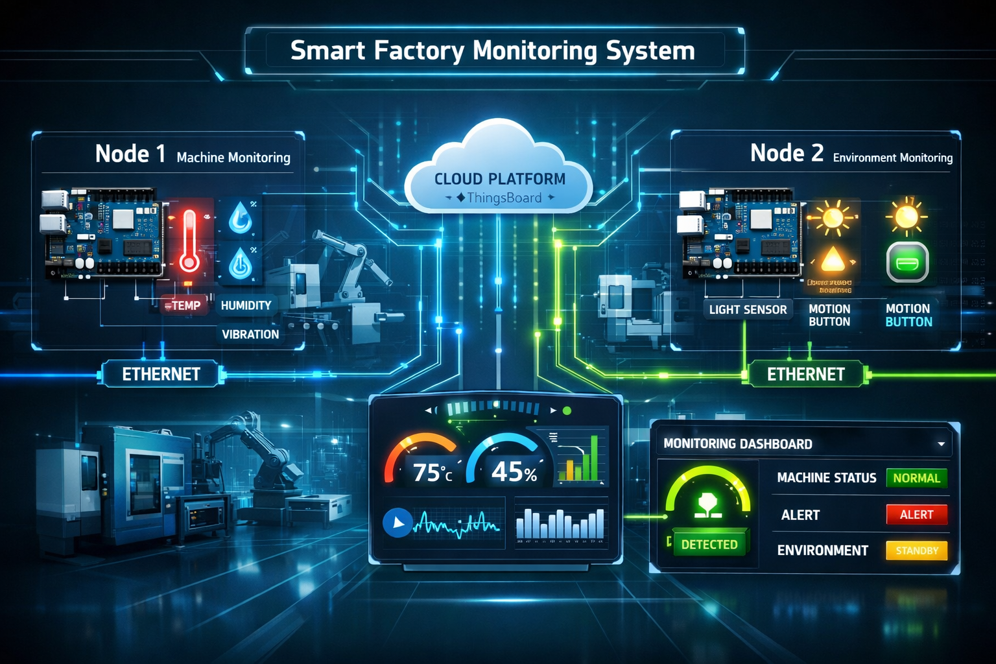
IOT Internship
Smart
Factory
Monitoring
System
By:-
Tejaswhi K Y
Toshita L
Nisarga Hosamani

Slide 2
INTRODUCTION
Internet of Things (IoT) is a network of physical devices connected to the internet that can collect and exchange data.
These devices include sensors, appliances, vehicles, and machines embedded with software and connectivity.
IoT enables devices to communicate with each other without human intervention.
It helps in real-time monitoring, control, and automation of systems.
IoT is widely used in smart homes, healthcare, agriculture, and industries.
Overall, it improves efficiency, accuracy, and convenience in daily life.

Slide 3
APPLICATIONS:
1. Smart Homes: IoT is used in smart lights, fans, thermostats, and security systems.
2. Healthcare: Used in wearable devices to monitor heart rate, temperature, and health conditions in real time.
3. Agriculture: IoT helps in smart farming by monitoring soil moisture, weather, and crop health.
4. Smart Cities: Used for traffic management, smart street lighting, waste management, and pollution control.
5. Industrial IoT: Used in factories for machine monitoring, predictive maintenance, and automation.
6. Transportation: IoT is used in smart vehicles, GPS tracking, and fleet management.

Slide 4
USES OF IOT:
Remote monitoring and control: Devices can be controlled from anywhere using the internet.
Automation: Tasks like switching lights, watering plants, or running machines happen automatically.
Data collection: Sensors collect real-time data (temperature, humidity, location, etc.).
Improved efficiency: Helps save time, energy, and resources in homes and industries.
Better decision-making: Collected data is analyzed to make smart decisions.
Safety and security: Used in surveillance, alerts, and emergency systems.
Cost reduction: Reduces manual work and maintenance costs.

Slide 5
OVERVIEW OF PROJECT Title :-Smart Factory Monitoring System
A Smart IoT Factory uses connected sensors, devices, and platforms (like ThingsBoard CE) to monitor, control, and optimize industrial operations in real time. Communication is enabled using protocols such as MQTT.
Environment Monitoring: Sensors continuously track temperature, humidity, and air quality across factory zones.This ensures proper working conditions, protects equipment, and maintains product quality.
Predictive Maintenance: Sensors (vibration, current) detect early signs of machine faults.This helps in preventing breakdowns, reducing downtime, and saving maintenance costs.
Safety & Emergency Response: IoT systems trigger automatic alerts and shutdowns during emergencies (like gas leaks or overheating).This improves worker safety and prevents major accidents.
Production Visibility: Real-time dashboards show OEE (Overall Equipment Effectiveness), machine performance, and bottlenecks.Managers can make faster and better decisions.
Remote Control: Engineers can control machines remotely (relays, conveyors, HVAC) through web or mobile dashboards.This increases flexibility and reduces manual effort.
Trend Analysis: Stored historical data is analyzed to identify patterns, energy usage, and inefficiencies.This helps in cost reduction, optimization, and meeting regulatory standards.

Slide 6
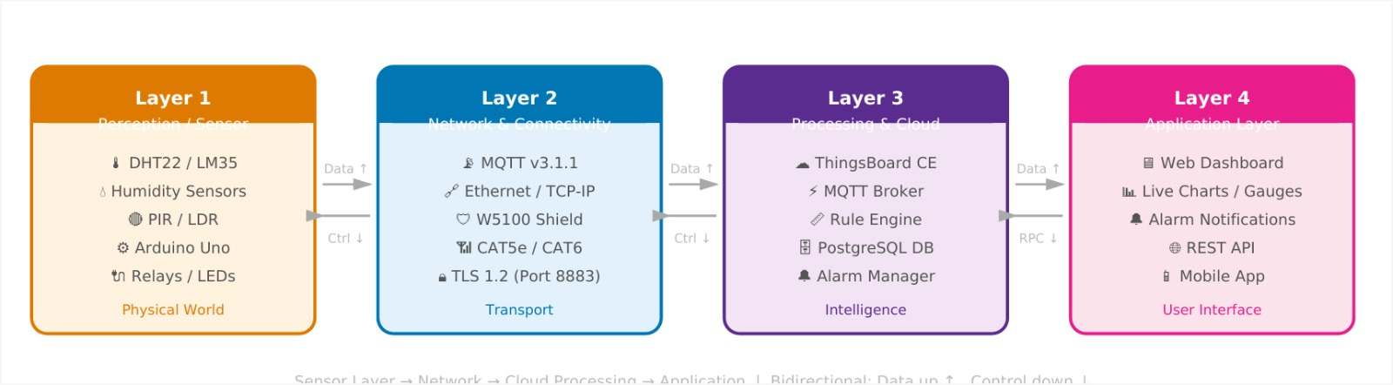
ARCHITECTURE OF IOT
This diagram represents a 4-layer IoT architecture.
The Perception Layer collects real-world data using sensors and devices like Arduino Uno.
The Network Layer transfers this data through protocols like MQTT and TCP/IP.
The Processing/Cloud Layer (e.g., ThingsBoard CE) processes, stores, and analyzes the data.
The Application Layer provides dashboards, alerts, and mobile access for users.
Overall, data flows from sensors to users, and control commands can be sent back to devices.

Slide 7
ARDUINO UNO
Open-source microcontroller board based on ATmega328P.
Widely used for prototyping and embedded system projects.
Easily programmed using the Arduino IDE.
Provides digital and analog I/O pins for interfacing components.
Operates on 5V power supply (USB or external adapter).
Beginner-friendly with simple hardware and coding.
Used in applications like robotics, IoT, and home automation.

Slide 8
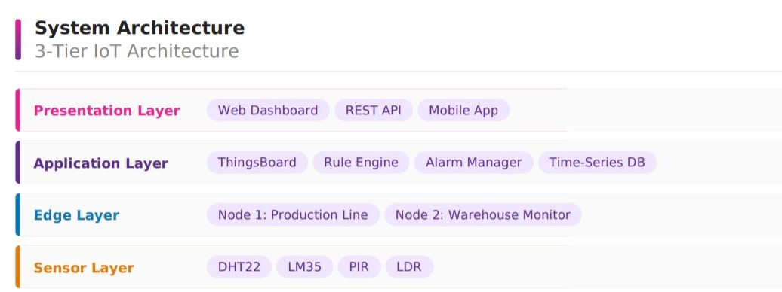
SYSTEM ARCHITECTURE

Slide 9
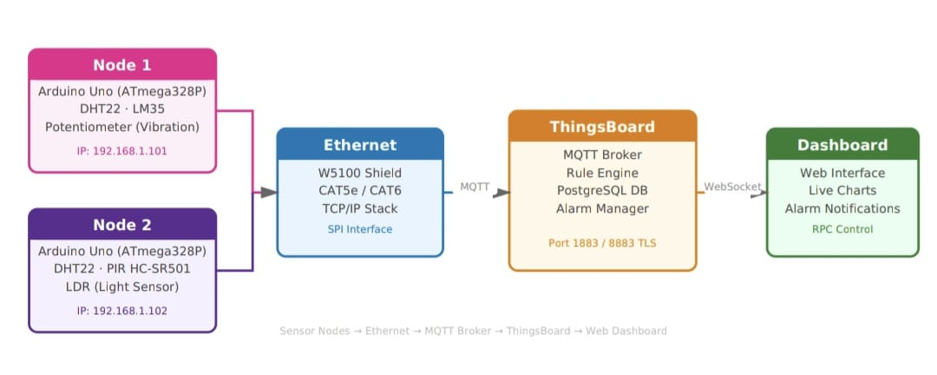
BLOCK DIAGRAM
This diagram shows an IoT system with two sensor nodes using Arduino Uno.
Sensors collect data and send it via Ethernet using MQTT.
The data is processed in ThingsBoard CE.
Finally, it is displayed on a web dashboard with charts and alerts, and users can control devices remotely.

Slide 10
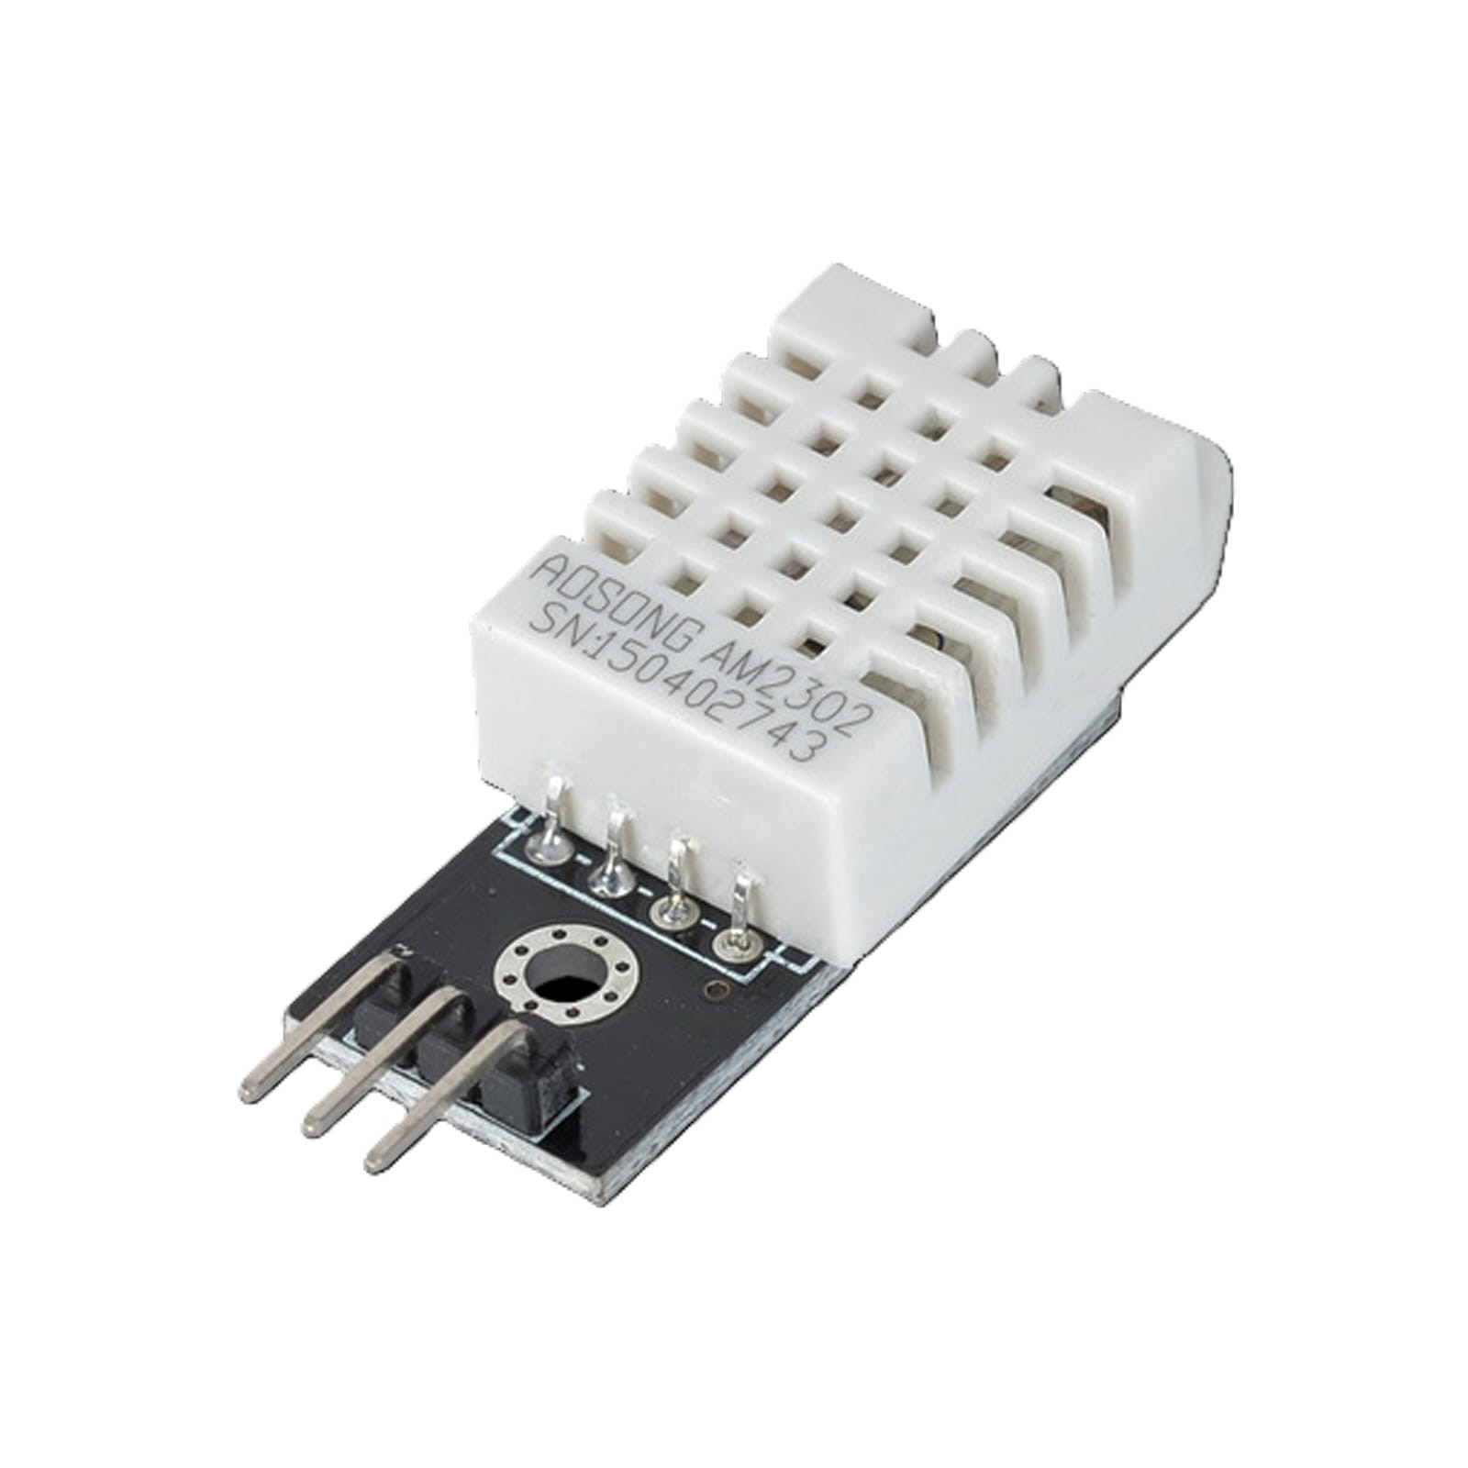
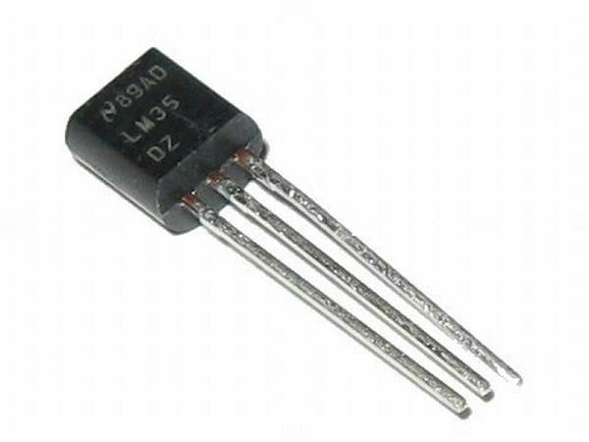
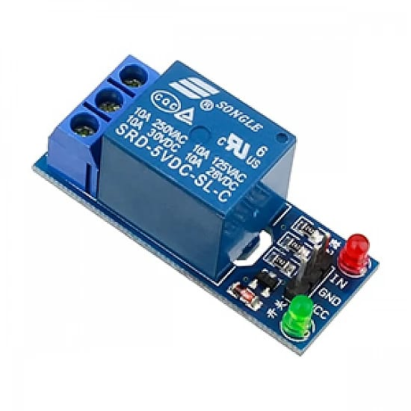
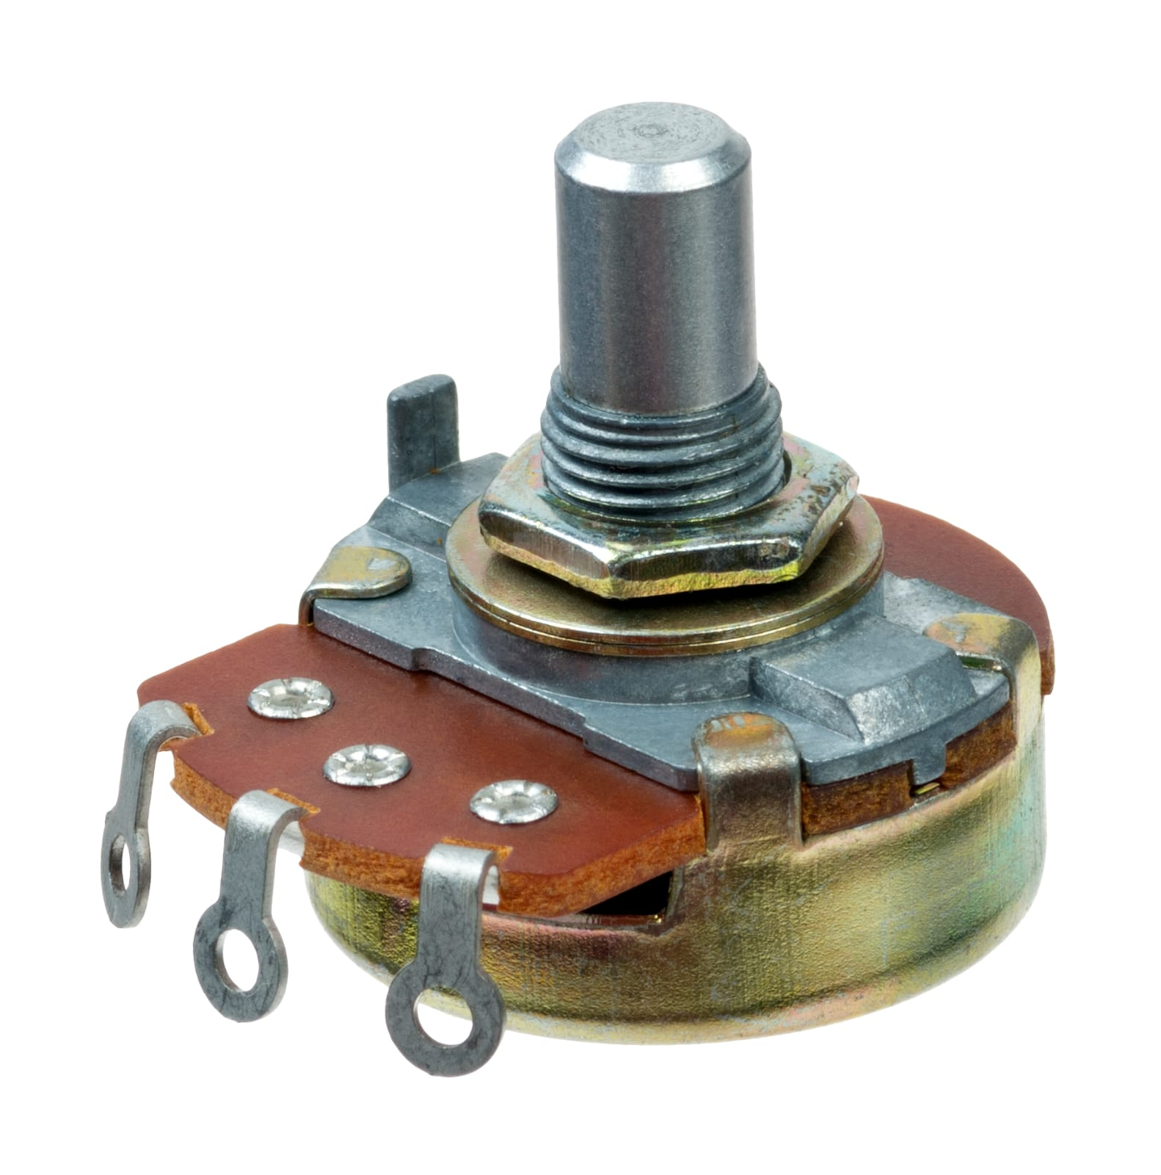
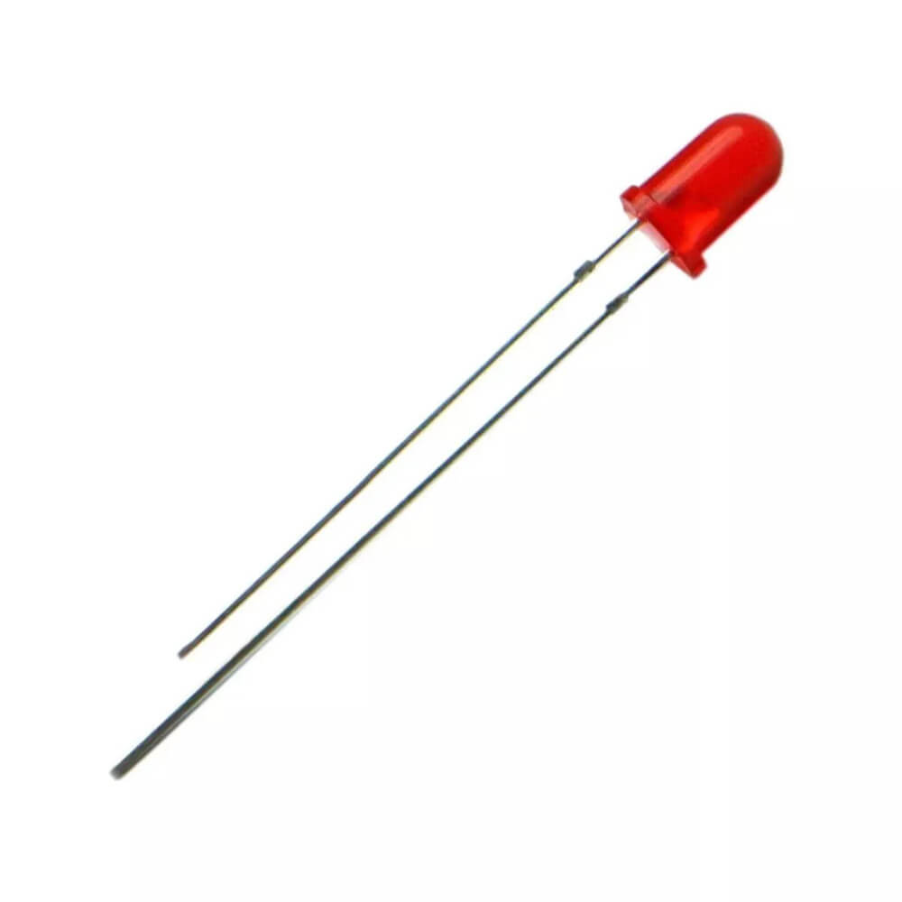
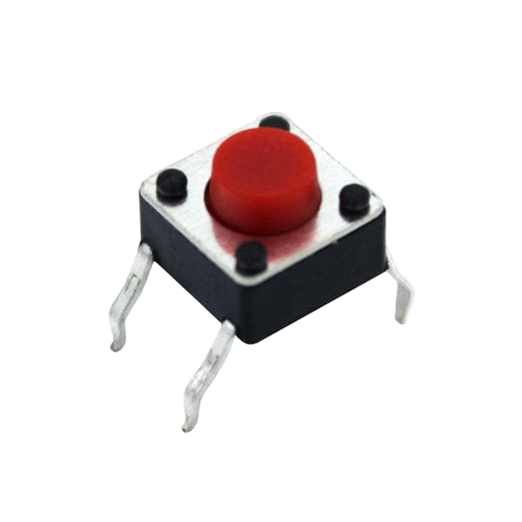
NODE 1
It consists of:
DHT22: The DHT22 sensor is a digital sensor that measures and outputs accurate
temperature and humidity data.
LM35: The LM35 is a precision sensor that measures temperature and gives output
as a voltage proportional to the temperature.
Potentiometer: The Potentiometer is a variable resistor used to adjust voltage or
control current in a circuit.
Relay: The Relay is an electrically operated switch that uses a small current to
control a larger current circuit.
Green/Yellow/Red LED: The LED is a semiconductor device that emits light
when electric current flows through it.
Push button: The Push button is a simple switch that completes a circuit only
when it is pressed.

Slide 11
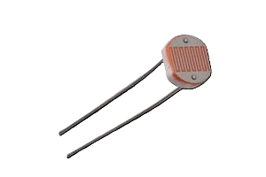
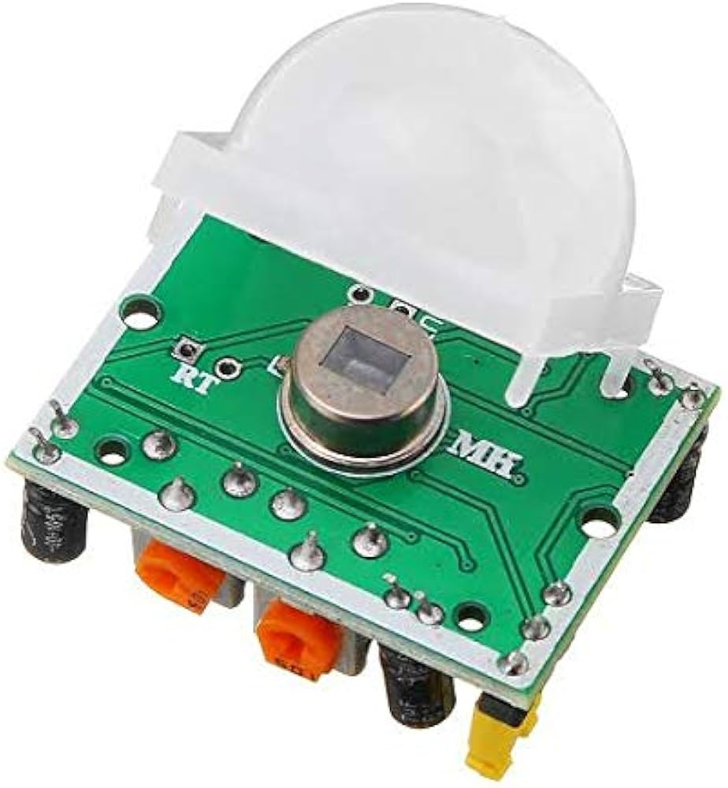
NODE 2
DHT22: The DHT22 sensor is a digital sensor that measures and outputs
accurate temperature and humidity data.
LDR: The LDR is a sensor whose resistance changes based on the intensity
of light falling on it.
PIR HC-SR501: The PIR HC-SR501 is a sensor that detects human motion
by sensing infrared radiation from moving objects.

Slide 12
PROJECT REQUIREMENTS ARE :
Functional Requirements
Non Functional Requirements
Simulatory Requirements
1. Functional Requirements :
Real-time sensor data collection every 5 seconds.
Automated threshold-based alerting (temperature, vibration, humidity).
Remote relay / actuator control via ThingsBoard dashboard.
Historical trend analysis and data reporting.
Multi-node coordination for emergency scenarios.
MQTT telemetry publishing with JSON payload format.

Slide 13
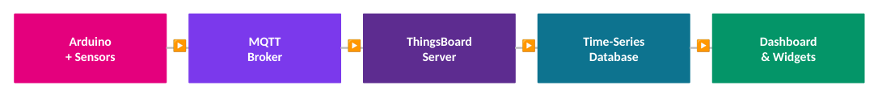
ThingsBoard dashboard
ThingsBoard is an open-source IoT platform used to manage devices, collect and process data, and visualize it in real time, supporting protocols like MQTT, HTTP, and CoAP.It supports communication protocols like MQTT, HTTP, and CoAP for device connectivity.It provides a complete system to manage, analyze, and visualize IoT data efficiently.
Platform Architecture

Slide 14
HOW ThingsBoard Dashboard WORKS ??
ThingsBoard Dasboard works in three main parts :
Device Management: It allows you to register, monitor, and control IoT devices from a single dashboard.
Real-time Data: It collects telemetry data from sensors and shows it instantly using graphs and charts.
Rule Engine & Alerts: Incoming data is processed using rules to trigger actions like alarms or notifications.

Slide 15
MQTT and JSON
MQTT (Message Queuing Telemetry Transport) is a lightweight messaging protocol used for communication between IoT devices over the internet. It works on a publish–subscribe model using a broker.
Devices publish data to topics, and other devices subscribe to receive it. It is designed for low bandwidth, low power, and unreliable networks. Widely used in IoT platforms like ThingsBoard for real-time data transfer.
JSON (JavaScript Object Notation) is a lightweight data format used to store and exchange data between systems.It uses key–value pairs to represent data (like name: value).Easy for both humans and machines to read and write.
Widely used in web and IoT applications.
Example: { "temperature": 28, "humidity": 60 }Commonly used with protocols like MQTT to send sensor data.

Slide 16
MQTT and JSON
MQTT (Message Queuing Telemetry Transport) is a lightweight messaging protocol used for communication between IoT devices over the internet. It works on a publish–subscribe model using a broker.
Devices publish data to topics, and other devices subscribe to receive it. It is designed for low bandwidth, low power, and unreliable networks. Widely used in IoT platforms like ThingsBoard for real-time data transfer.
JSON (JavaScript Object Notation) is a lightweight data format used to store and exchange data between systems.It uses key–value pairs to represent data (like name: value).Easy for both humans and machines to read and write.
Widely used in web and IoT applications.
Example: { "temperature": 28, "humidity": 60 }Commonly used with protocols like MQTT to send sensor data.

Slide 17
2. Non Functional Requirements :
End-to-end latency < 5 seconds.
System uptime > 99% .
Scalable to 100+ nodes.
MQTT message size ≤ 256 bytes.
Dashboard load time < 3 seconds.
3. Simulatory Requirements :
PICSimLab for Arduino Uno simulation
Virtual sensors: DHT22, LM35, PIR, LDR.
Simulated Ethernet (W5100) connectivity.
No physical hardware required.
Supports full firmware testing & MQTT.

Slide 18
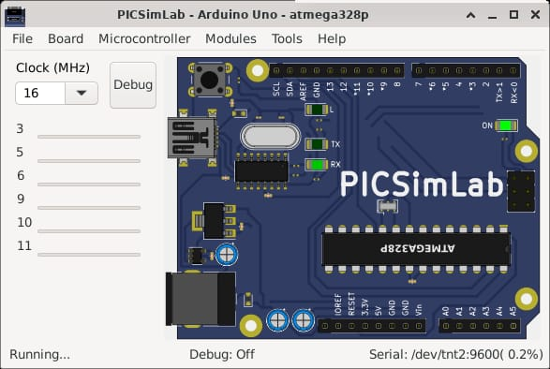
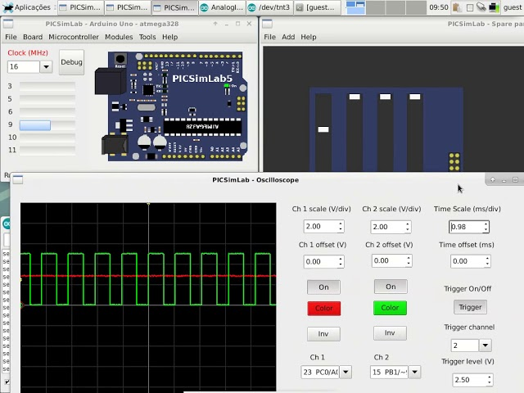
PICSiM Lab :
PICSimLab is a simulation tool used to design and test microcontroller-based circuits virtually.
It allows you to simulate boards like PIC, Arduino, and ESP without real hardware.
You can connect sensors, LEDs, and other components in a virtual environment.
Helps in testing code and circuit behavior before real implementation.
Widely used for learning embedded systems and IoT projects.

Slide 19
COMMUNICATION DESIGN
Communication Design Requirements Are :
Protocol: MQTT v3.1.1 over TCP/IP (Ethernet)
Broker - ThingsBoard (1883 / 8883 TLS)
QoS Level - 1 — At Least Once Delivery
Keep-Alive - 60 seconds
Payload Format - JSON (~150 bytes/msg)
Publish Rate - Every 5 seconds/node
Total Throughput - 60 bytes/sec (2 nodes)
Reconnect Strategy - Exp. backoff (5s → 60s)
Authentication - 256-bit device tokens

Slide 20
MQTT PROTOCOL IMPLEMENTATION INVOLVES :
Device Setup: Each machine is connected to a controller (like Aurdino) that collects sensor data (temperature, vibration, etc.).
MQTT Connection: Devices connect to the ThingsBoard broker using MQTT over TCP/IP (Ethernet).
Data Publishing: Sensor data is formatted as JSON payload and sent to a telemetry topic at regular intervals (every 5 seconds).
Reliability: QoS level 1 ensures data is delivered at least once, even if network issues occur.
Session Management: Keep-alive (60 sec) and automatic reconnect maintain continuous communication.
Security: Each device uses a unique access token for authentication.
Processing & Alerts: ThingsBoard processes incoming data, updates dashboards, and triggers alerts based on predefined rules.

Slide 21
RESULT : Automated Alert Rules
Automated alert rules in a smart factory monitoring system using ThingsBoard:
If temperature > 35°C, a critical alert is created, email/Telegram notifications are sent, and a red LED turns ON.
If vibration > 700 (ADC), a warning alert is triggered, yellow LED glows, and the event is logged.
If humidity > 80%, a warning alert is generated and notifications are sent.
The rule engine continuously checks incoming sensor data and automatically triggers actions.

Slide 22
FUTURE SCOPE AND ENHANCMENTS
AI-based Predictive Maintenance: Use machine learning to predict failures before they happen, reducing downtime.
Edge Computing: Process data locally on devices (ESP32, gateways) to reduce latency and improve speed.
Advanced Analytics Dashboard: Add real-time analytics, trends, and performance insights for better decision-making.
Mobile App Integration: Monitor and control factory systems remotely through smartphones.
Scalability: Expand to multiple factories with centralized cloud monitoring.

Slide 23
THANK YOU

