Slide 1
Introduction
Association rule learning is a rule-based machine learning method for discovering interesting relations between variables in large databases.
Eg : {onions, potatoes} => {Burger_meat}
This information can be used for promotional pricing, product placements etc.

Slide 2
Problem statement
The given data set consist of various attributes all regarding online retail of a super market. Objective is to generate association rules, that helps organisation predict which all products are bought together, based on the given data. Application of apriori algorithm and fp growth algorithm is expected.

Slide 3
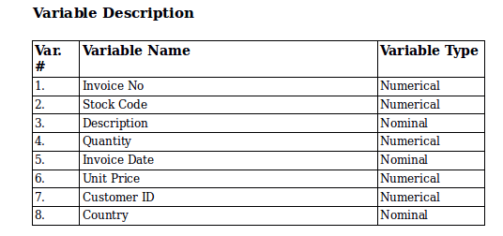
Understanding Data

Slide 4
Apriori Algorithm
It proceeds by identifying the frequent individual items in the database and extending them to larger and larger item sets as long as those item sets appear sufficiently often in the database.
supp(X)= no. of transactions which contain the itemset X / total no. of transactions
Confidence(X) = no.of transactions containing both A and B / no.of transactions containing A
Lift(X) = (Rule Support) /(Support(Antecedent) * Support(Consequent))

Slide 5
FP Growth Algorithm
FP Growth Apriori to a big extend
2 steps are required
- Build a compact data structure called the FP tree

Slide 6
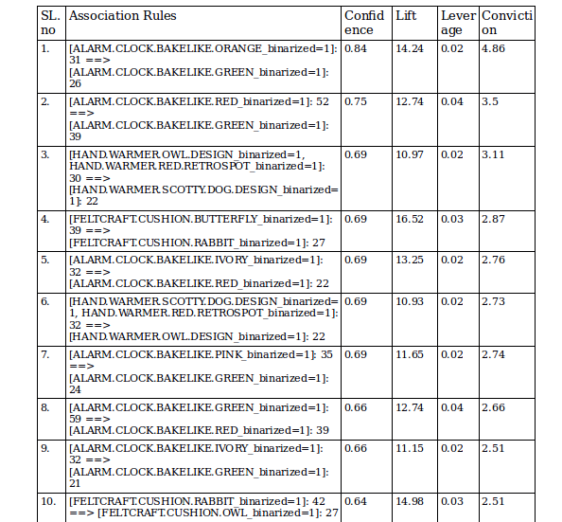

Results

Slide 7
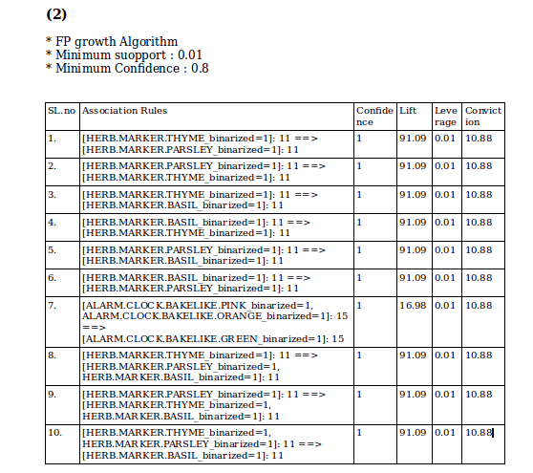

Slide 8
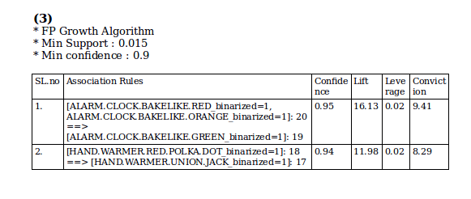

Slide 9
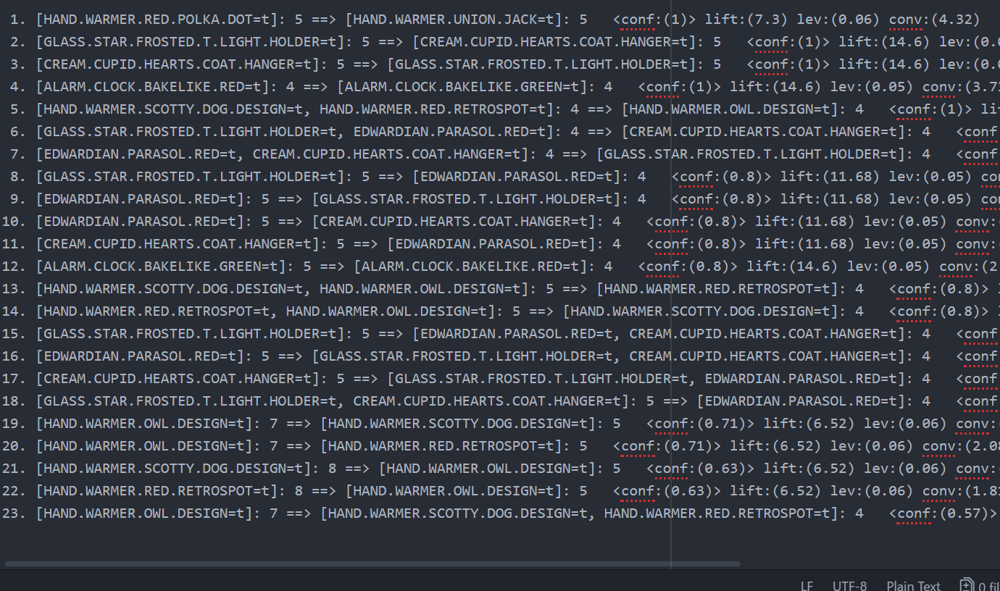
FP Growth Algorithm
Min Support : 0.05
Min Confidence : 0.5

Slide 10
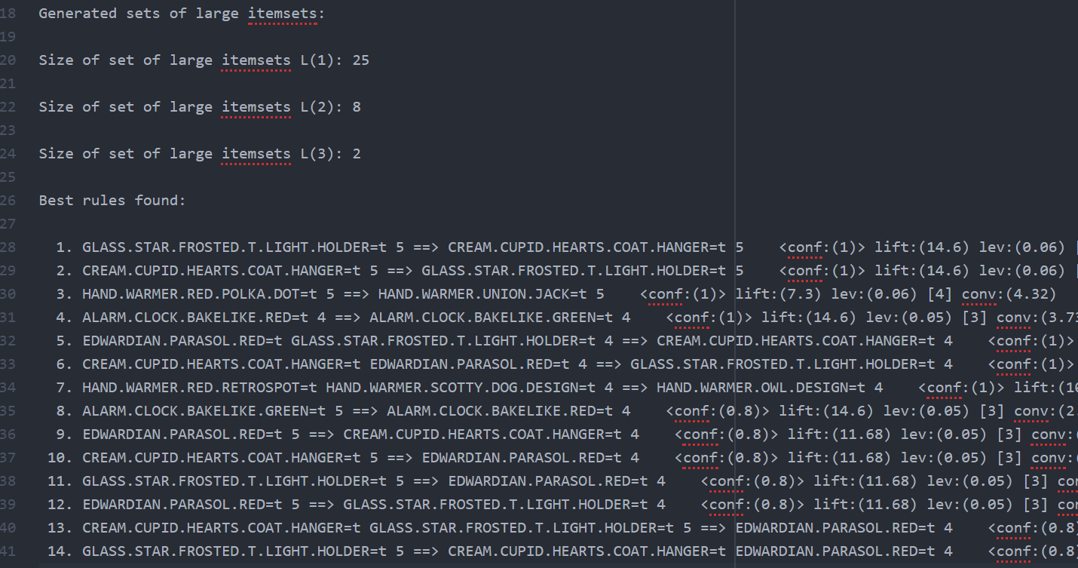
Apriori Algorithm
Min Support : 0.05
Min Confidence : 0.5

Slide 11
Conclusion

