Slide 1
DIE FOR FUN
Laxmi Alekhya Nagubandi
Mohith Chandra Narra
Tejaswi Pinnaka
Notes:
hello everyone. We have completed this project as a part of web programming course using HTML,CSS,PHP. We are a team of 3 and our team comprises of Tejaswi which is myself and my friends Mohith and Alekhya.

Slide 2
DESCRIPTION
Die for Fun game involves pure luck.
It is played between two players on a gameboard having numbered
gridded squares. A number of random “danger zones” are pictured on
the board, each connecting two specific board squares. The objective of
the game is to navigate from the start (bottom square) to the finish (top
square) with the help of die rolls and the resulted number helps or hinder
by crossing the Danger zones, of one’s game piece.
Notes:
Our game is called Die for fun. It is played by two users in which each player would roll the dice and depending on what they get on the dice, they can move forward within the game
The game starts at the bottom of the board and the player who reaches the top of the board fastest would be declared the winner.
To make the game a little interesting we have added some danger zones which would lead to loss of points for the player.

Slide 3
UML DIAGRAM
User 1
Based on the number rolled, player moves forward. If on danger zone points get deduced.
Every user gets a turn to Roll Dice
First to reach will win.
User 2
Notes:
This shows the UML diagram of the project. As discussed earlier, there would be 2 players, where each user would get an alternative chance to roll dice. Based on the number obtained on the dice, the player would be either moving forward or backward. The backward scenario only happens when the player lands in a danger zone. The first person to reach 100th block and is declared as winner.

Slide 4
Pages Implemented
Signup.php
Signup-submit.php
Signin.php
index.php
game.php
about.php
summary.html
contact.html
player_gui.php
CSS - 2
Text file
TnC.html
Notes:
Here are the pages created as a part of the project. We created few html, php and css files. We also have a text file to store the values of the users signing up for the game.

Slide 5

index.php
Notes:
index.php file is the landing page of our project, which also acts as home page.

Slide 6
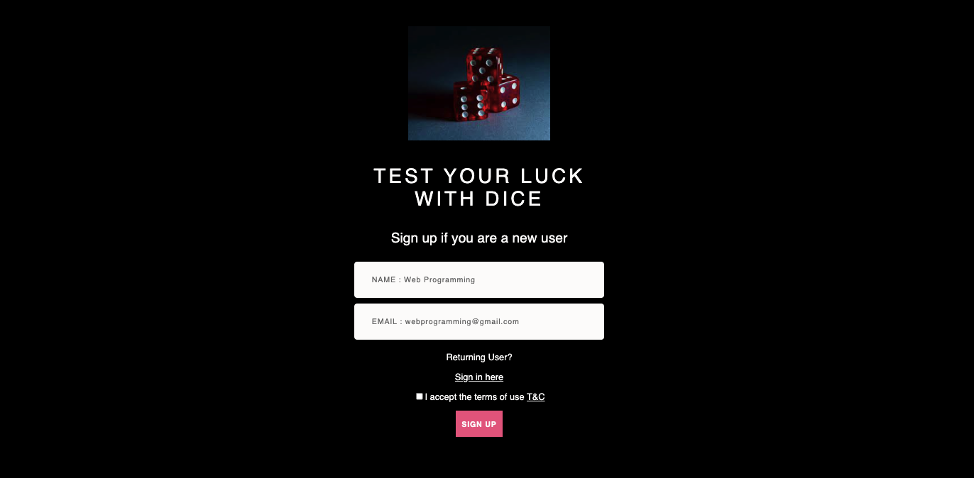
signup.php
Notes:
This is the signup page where users have to give a user name and email address before logging in to the game. They would also have to accept the terms and condisitons of the game to be able to sign up. There is also a providence to go to the sign in page without signing up redundantly for returning users. we validate returning user info using a text file.
Validations as part of this page:
User name should start with capital letter
Basic email id validations as in combination of alphanumeric, @, ending with .com.

Slide 7
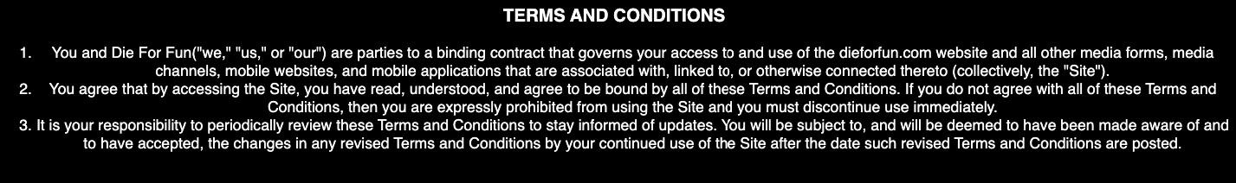
TnC.html
Notes:
Terms and conditions are the rules, specifications, and requirements of a contract. Terms and conditions are the rules and guidelines for using a website or app.

Slide 8
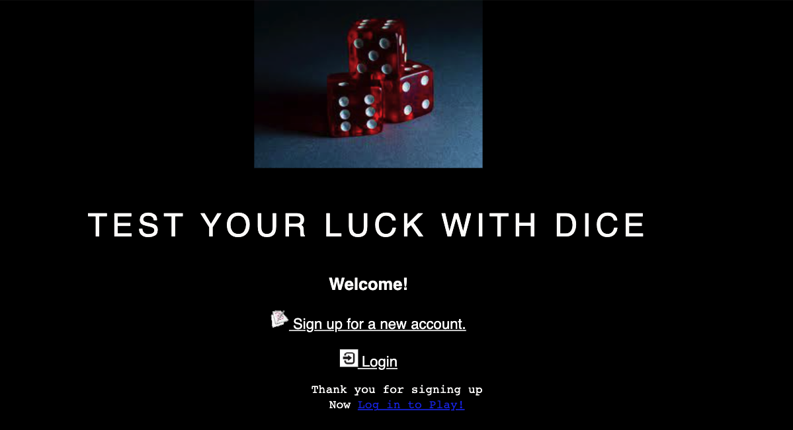
signup-submit.php
Notes:
This screen comes up after signing up where a newly signed up user should have to login after successfully signing up.

Slide 9
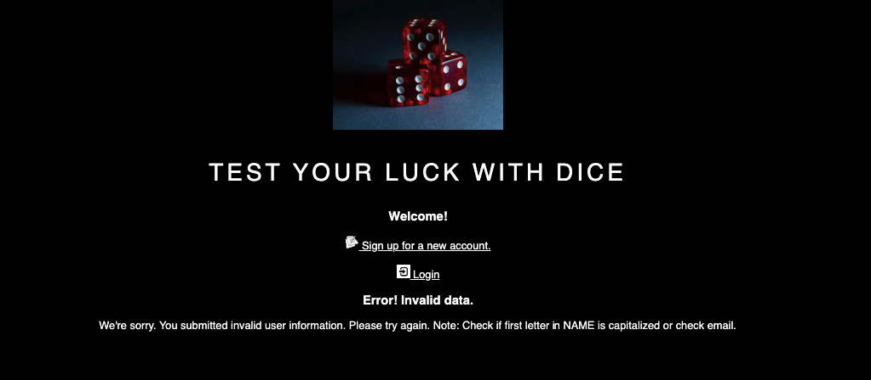
contd..
Notes:
As discussed above, if any validation goes for a toss we display error message on UI as..

Slide 10
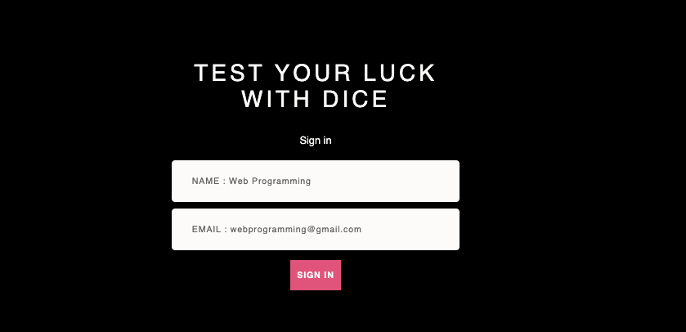
Signin.php
Notes:
sign in page looks like this where the user can sign in to enter the game by using the credentials he used for signing up

Slide 11
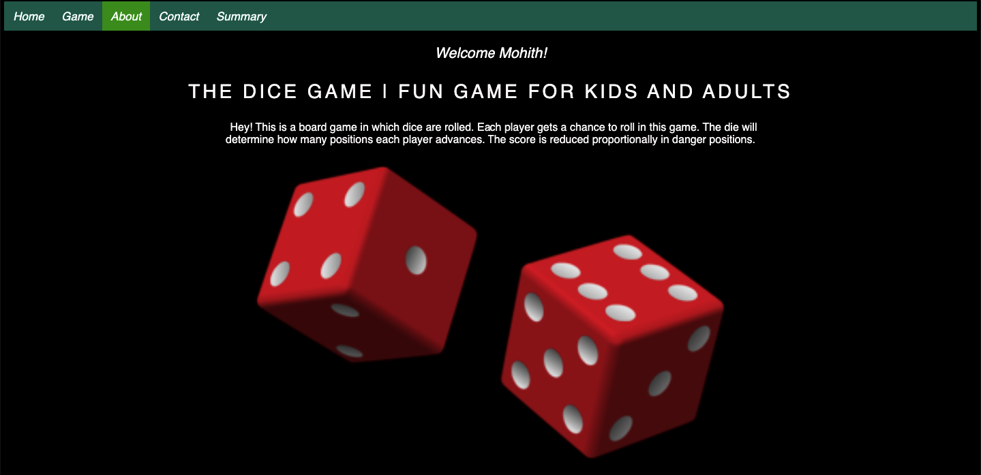
about.php
Notes:
This is the page on which a user would land after successfully signing in . This is the main idea behind our dice game ‘DIE for FUN’

Slide 12
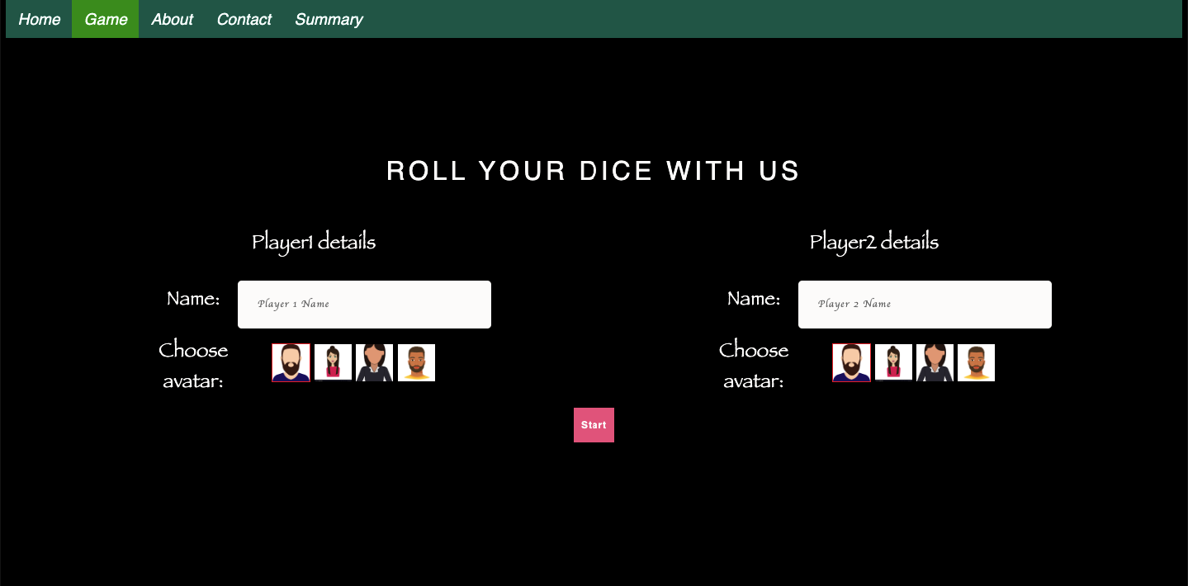
game.php
Notes:
This is where our game begins. There would be two players, and the two players would have to register their names, which would appear on the score cards while the game was being played. They would also have to choose avatars that would move across the board as they rolled the dice.

Slide 13
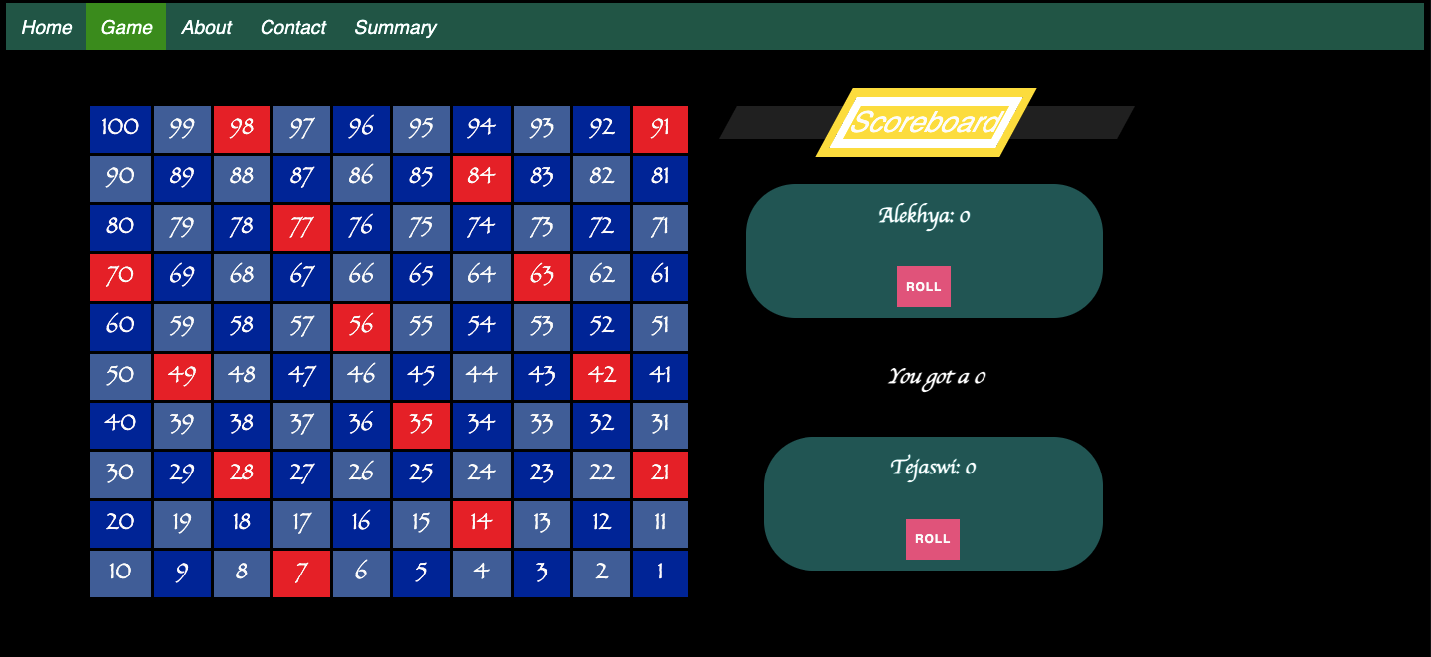
Contd..
Notes:
Whenever a user clicks on the Roll button he would see a number between 1 to 6 being displayed and for this particular purpose we have used a PHP function called rand. rand is a pre-built or predefined method which will generate a random number and here it took two parameters one and six as we wanted our dice to only have numbers from one to six. so we wanted to generate one random number within that range for that purpose
we have placed danger zones on every multiple of 7.
Another code we implemented is if a user lands in any danger zone we would calculate what his current score is and then we would deduce five points from their respective scores.

Slide 14
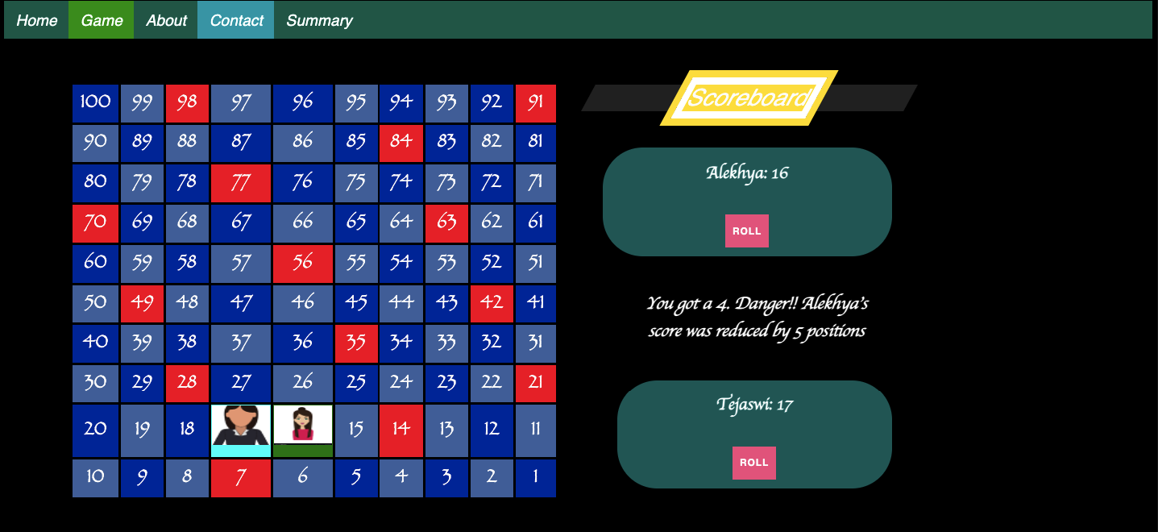
Contd..
Notes:
We can also see avatars here on the board. and if a player falls on danger zone we see this UI

Slide 15
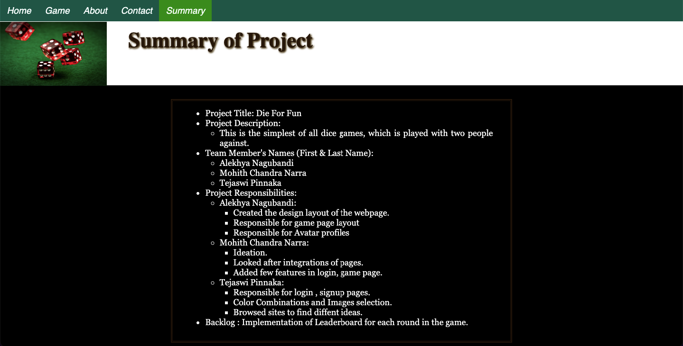
summary.html
Notes:
This page contains information about how tasks are distributed among team members during each sprint, as well as information about backlog items.

Slide 16
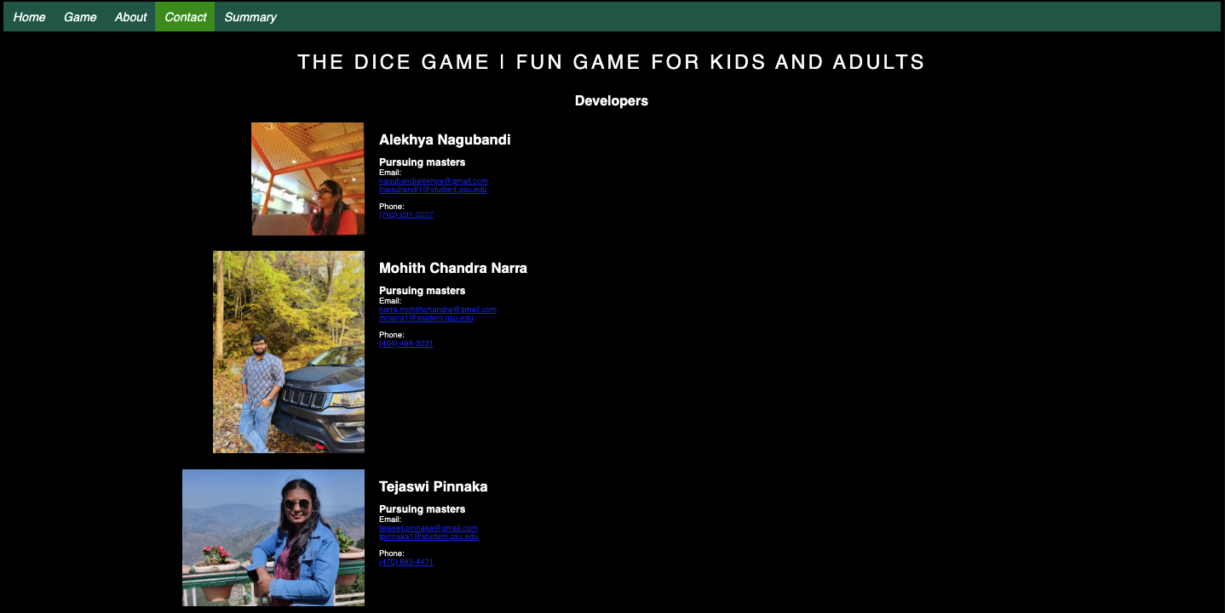
contact.html
Notes:
This is a static page with the team's contact information (email and other details). You can contact us with any questions or suggestions.

Slide 17
player_gui.php
This file aids in setting up the scoreboard layout for the players.
It also keeps track of the player rolls and disable each player alternatively.
Notes:
This file has the score board logic, the player information GUI that was created for two players; the score of the corresponding player is updated on every roll until either of the player reaches the 100th block or the max score is 100.

Slide 18
Testing and Validations
Signin
Sessions
Signup
Notes:
Step1 :A user must first sign up.
Step2: Once the user has registered or if the user is existing, then he can directly login to initiate the game.
Here we use sessions to store user login info i.e, username,email.. and carry this info to other pages game.php,about.php pages.
We also used session for saving the game scores for every roll and player avatars.
We are also retaining each page state info on every tab switch like switching from home to about page, T&C to about page and vice-versa.

Slide 19
CSS and Text File
We have implemented 2 Css pages, 1 for the entire project except summary page and other for only summary page.
We have used a text file in order to store the values that are generated during signup to avoid duplication of users.

Slide 20
Scrum Framework
It helps people, teams and organizations generate value through adaptive solutions for complex problems.
Notes:
We followed weekly scrum. In the initial 2 scrums we spent time in discussing project requirements, refining requirements and came up with a proper plan with requirements and estimates. We also assigned tasks to equally distribute the workload. After which our scrums were scheduled periodically once a week where we would discuss the progress of the tasks and redistribute the tasks for workload management.

Slide 21
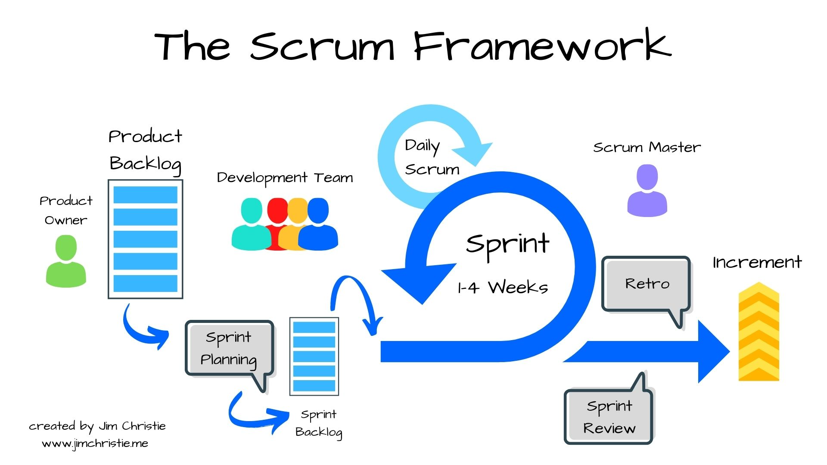
Contd..
Notes:
We followed agile methodology, where we have weekly stand up for about 10 mins and discussed on impediments and what went well.

Slide 22
Demo
Let’s go through the UI
Notes:
Here is the demo of our application,

Slide 23


