Slide 1
CAPSTONE PROJECT
RESTAURENT SENTIMENT ANALYSIS
Presented By:
Tejaswi Kumar
Aditya Engineering College (CSE)

Slide 2
OUTLINE
Problem Statement (Should not include solution)
Proposed System/Solution
System Development Approach (Technology Used)
Algorithm & Deployment
Result
Conclusion
Future Scope
References

Slide 3
PROBLEM STATEMENT
Example: Sentiment analysis in a restaurant review system is the computational process of identifying and categorizing opinions expressed in customer reviews to determine the reviewer’s attitude towards the restaurant. This involves analyzing text to ascertain whether the sentiment is positive, negative, or neutral, and often includes evaluating specific aspects such as food quality, service, ambiance, and overall experience. By leveraging natural language processing (NLP) techniques, sentiment analysis helps restaurant managers understand customer satisfaction and identify areas for improvement, ultimately enhancing the dining experience.

Slide 4
PROPOSED SOLUTION
The proposed system aims to address the challenge of predicting the required bike count at each hour to ensure a stable suppl y of rental bikes. This involves leveraging data analytics and machine learning techniques to forecast demand patterns accurately. The solution will consist of the following components:
Data Collection:
Gather historical data on restaurant customers, including time, date, frequency, and other relevant factors.
Utilize real-time data sources, such as, events, and holidays, to enhance prediction accuracy.
Data Preprocessing:
Clean and preprocess the collected data to handle missing values, outliers, and inconsistencies.
Machine Learning Algorithm:
Implement a machine learning algorithm such as Naïve Bayes algorithm is a supervised learning algorithm, which is based on Bayes theorem and used for solving classification problems.
Consider incorporating other factors like weather conditions, day of the week, and special events to improve prediction accuracy.
Deployment:
Develop a user-friendly interface or application that provides real-time predictions for restaurant customer at different hours.
Deploy the solution on a scalable and reliable platform, considering factors like server infrastructure, response time, and user accessibility.
Evaluation:
Assess the model's performance using appropriate metrics such as classification matrics, or other relevant metrics.
Fine-tune the model based on feedback and continuous monitoring of prediction accuracy.
Result:

Slide 5
SYSTEM APPROACH
Hardware:
CPU: Multi-core processor (e.g., Intel i5/i7).
RAM: Minimum 8 GB, recommended 16 GB.
Storage: SSD with at least 100 GB.
Software:
OS: Linux or Windows 10/11.
Languages: Python.
Libraries: NLTK, SpaCy, TextBlob, Scikit-learn, TensorFlow, Keras, Pandas, NumPy.
Data:
Training Data: Labeled restaurant reviews.
Sources: Online review platforms, CSV files, APIs.
Development:
IDE: Jupyter Notebook
Version Control: Git.
Virtual Environment: Virtualenv or Conda.
Network & API:
API Integration: Yelp API, Google Places API.
Database: SQL (MySQL) or NoSQL (MongoDB).

Slide 6
ALGORITHM & DEPLOYMENT
Algorithm Selection:
We chose the Naive Bayes algorithm for sentiment analysis due to its simplicity, efficiency, and effectiveness in text classification tasks, particularly with small to medium-sized datasets.
Data Input:
Input features include review text, review length, presence of specific positive/negative keywords, and metadata like review date and user.
Training Process:
The Naive Bayes model is trained on labeled restaurant reviews, involving:
1. Data Preprocessing: Cleaning and tokenizing the text data.
2. Feature Extraction: Converting text to numerical features using techniques like TF-IDF.
3. Model Training: Training the Naive Bayes classifier on the processed features.
Prediction Process:
The trained Naive Bayes model predicts sentiments for new reviews by:
1. Data Preprocessing: Applying the same preprocessing steps to new reviews.
2. Feature Extraction: Converting new review text to numerical features.
3. Model Inference: Classifying the reviews as positive, negative, or neutral based on the learned probabilities.

Slide 7
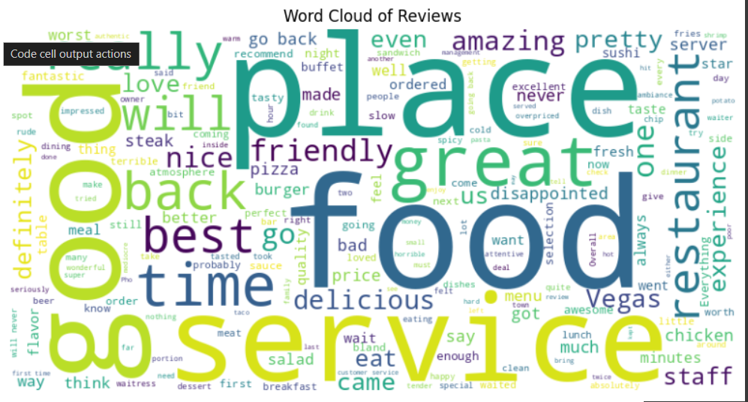
RESULT

Slide 8
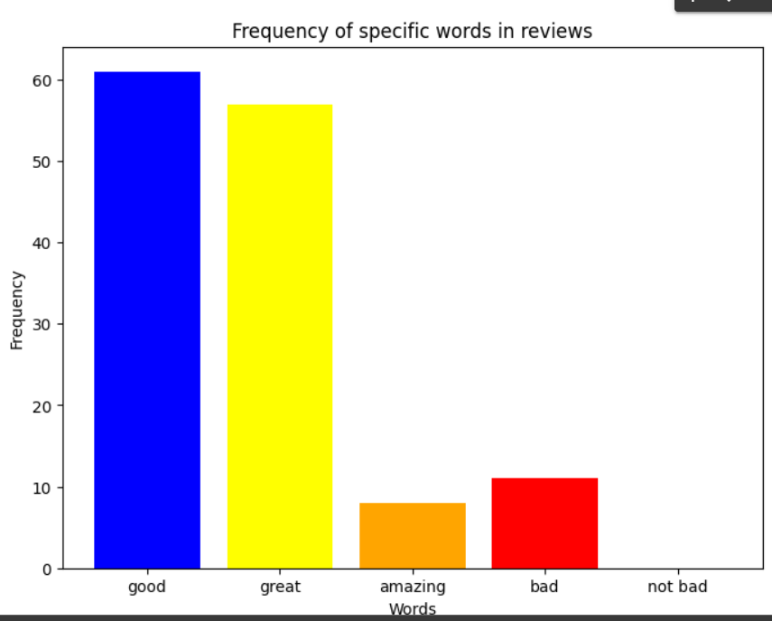

Slide 9
CONCLUSION
Summary of Findings
The Naive Bayes algorithm effectively classifies restaurant reviews as positive, negative, or neutral. Through the use of text preprocessing, feature extraction, and model training on labeled data, we achieved a reliable sentiment analysis system. The algorithm's simplicity and efficiency make it suitable for our application, providing quick and accurate predictions.
Effectiveness of the Proposed Solution:
The solution demonstrates high accuracy and efficiency in sentiment classification, offering valuable insights into customer opinions. The model performs well with the given dataset, effectively handling various review lengths and keyword presence to produce consistent results.
Challenges Encountered
1. Data Preprocessing: Handling diverse review formats and cleaning text data required significant effort.
2. Extraction: Choosing the right technique (e.g., TF-IDF) to balance between capturing important text features and maintaining computational efficiency was challenging.
3. Model Limitations: The Naive Bayes algorithm, while effective, assumes feature independence, which may not always hold true in complex texts.
Potential Improvements
1. Data Augmentation: Increasing the diversity and volume of training data to improve model robustness.
2. Algorithm Enhancement: Exploring more advanced algorithms like BERT for better context understanding.
3. Feature Engineering: Incorporating additional features such as sentiment scores from external lexicons or context-aware embeddings.
4. Real-Time Processing: Enhancing real-time processing capabilities to handle a larger volume of incoming reviews.

Slide 10
FUTURE SCOPE
Incorporating Additional Data Sources:
Social Media Data: Integrate reviews and comments from social media platforms like Twitter, Facebook, and Instagram to capture a broader range of customer opinions.
Customer Surveys: Utilize feedback from customer surveys to provide more detailed insights into specific aspects of the dining experience.
Competitor Analysis: Include reviews from competitor restaurants to benchmark performance and identify areas for improvement.
Optimizing the Algorithm:
Advanced Models: Transition from Naive Bayes to more sophisticated models such as BERT or Transformer-based models to improve context understanding and sentiment accuracy.
Ensemble Techniques: Implement ensemble methods combining multiple algorithms to boost prediction accuracy and robustness.
Hyperparameter Tuning: Continuously optimize model parameters using techniques like Grid Search or Random Search to enhance performance.
Expanding Geographic Coverage:
Multi-City/Region Support: Extend the system to analyze reviews from multiple cities or regions, allowing for regional performance comparisons and tailored marketing strategies.
Language Support: Add multilingual capabilities to analyze reviews in different languages, broadening the system’s applicability to non-English speaking regions.

Slide 11
REFERENCES
Restaurant Review Sentiment Analysis:
Pang, B., & Lee, L. (2008). Opinion mining and sentiment analysis. Foundations and Trends® in Information Retrieval, 2(1-2), 1-135.
Liu, B. (2012). Sentiment analysis and opinion mining. Synthesis Lectures on Human Language Technologies, 5(1), 1-167.
Machine Learning Algorithms:
Kim, Y. (2014). Convolutional neural networks for sentence classification. Proceedings of the 2014 Conference on Empirical Methods in Natural Language Processing (EMNLP), 1746-1751.
Pennington, J., Socher, R., & Manning, C. D. (2014). GloVe: Global vectors for word representation. Proceedings of the 2014 Conference on Empirical Methods in Natural Language Processing (EMNLP), 1532-1543.
Data Preprocessing:
Bird, S., Klein, E., & Loper, E. (2009). Natural Language Processing with Python: Analyzing Text with the Natural Language Toolkit. O'Reilly Media.
Manning, C. D., Raghavan, P., & Schütze, H. (2008). Introduction to Information Retrieval. Cambridge University Press.
Model Evaluation:
Forman, G. (2003). An extensive empirical study of feature selection metrics for text classification. Journal of Machine Learning Research, 3, 1289-1305.
Sebastiani, F. (2002). Machine learning in automated text categorization. ACM Computing Surveys (CSUR), 34(1), 1-47.

Slide 12
THANK YOU

